Slide 1

Project proposal
Biomedical Image Analysis

Slide 2
Data keine sorge nur mal ein grober überblick pink bleibt nicht…. :P
3 Datasets
N2DH- GOWT1
N2DL-HeLa
NIH3T3

Slide 3

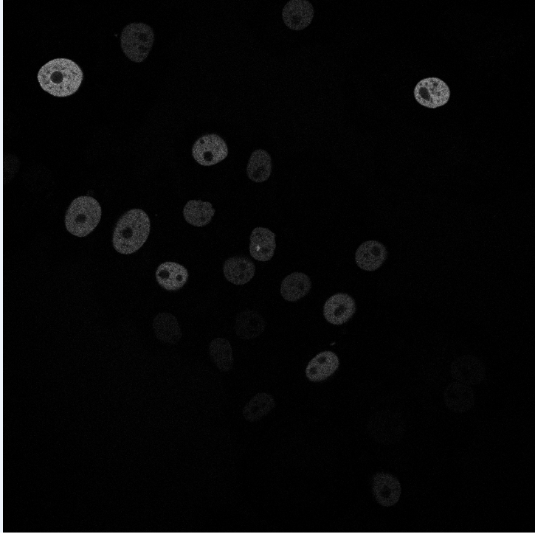
N2DH- GOWT1 Cell type: embryonic stem cells | Organism: Mouse (Mus musculus)
Stained with GFP
6 images total
1024x1024 pixels
10-20 nulei per image
Notes:
T39 bild

Slide 4
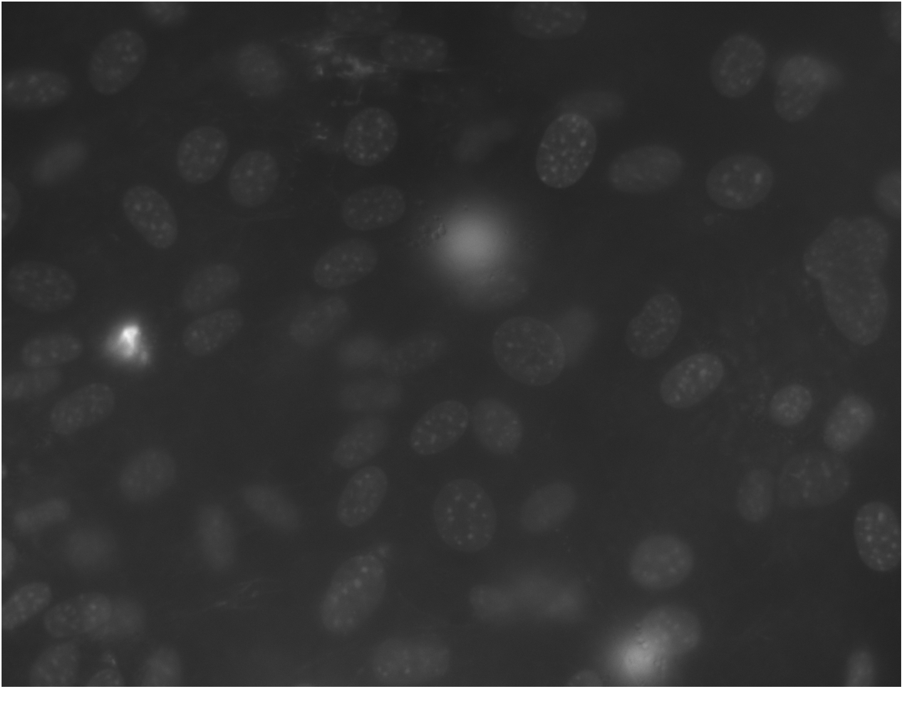
NIH3T3 Cell type: Embryonic fibroblast cells | Organism: Mouse (Mus musculus)
Stained with Hoechst
18 images total
Size: 1344x1024 pixels
about 60 nuclei per image

Slide 5

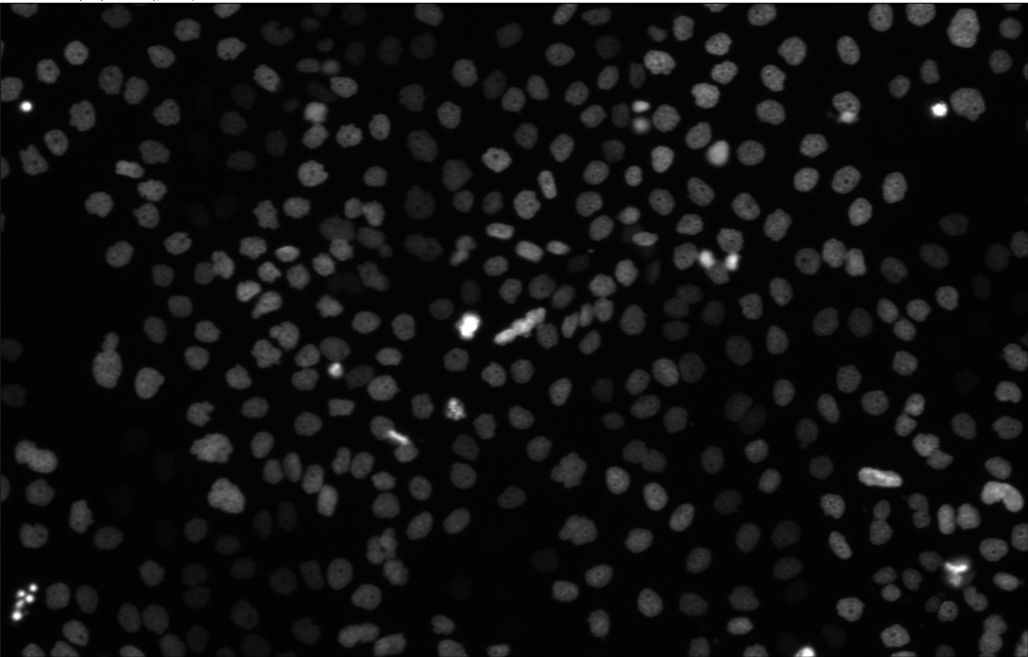
N2DL-HeLa Cell type: Cervix carcinoma cells | organism: human (Homo sapiens)
Stained with GFP
4 images total
Size: 1100x 700 pixels
30-50 nuclei per image

Slide 6
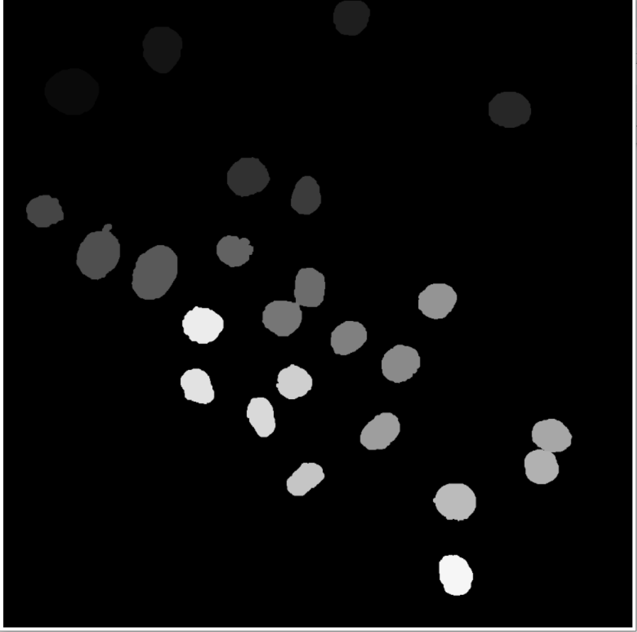
Image
Ground Truth

Slide 7
Challenges: N2DH-GOWT1
Noice
Holes

Slide 8
Challenges: NIH3T3

Slide 9
Challenges: N2DL-HeLa

Slide 10
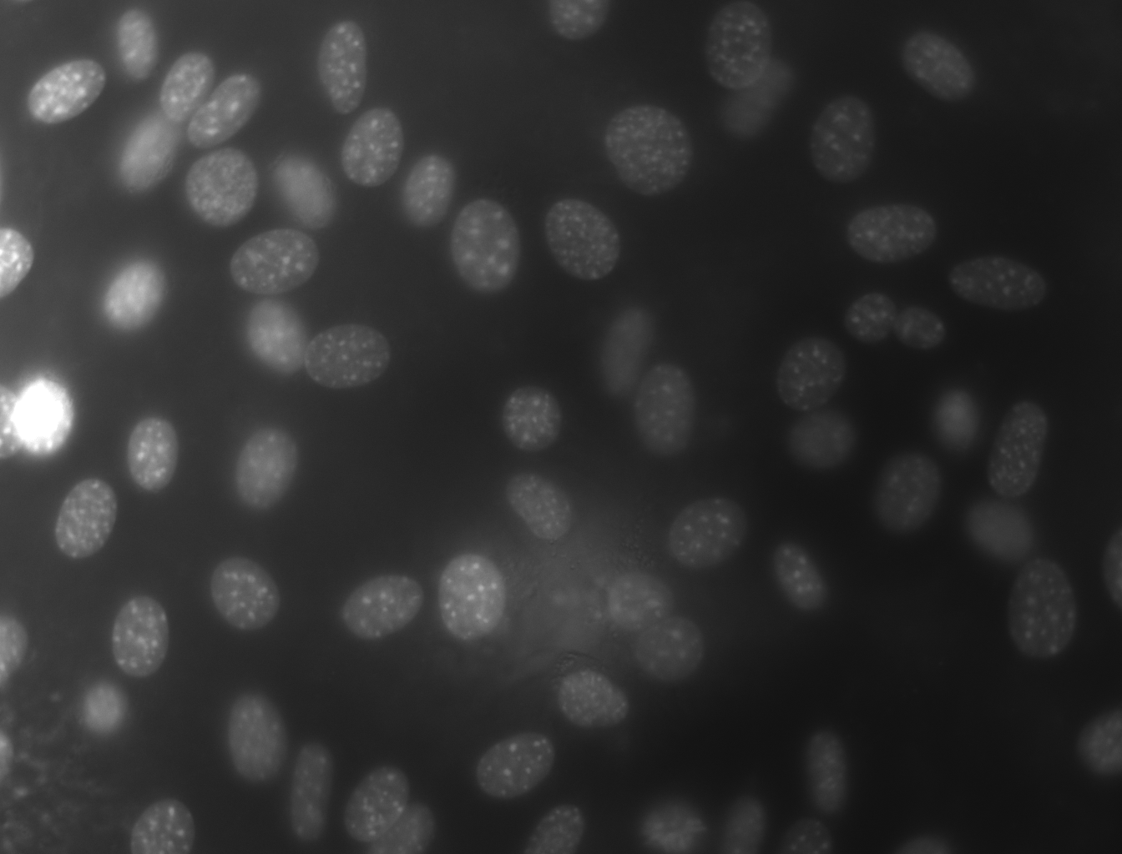
Local Thresholding - Sliding window scheme

Slide 11
Otsu Thresholding

Slide 12
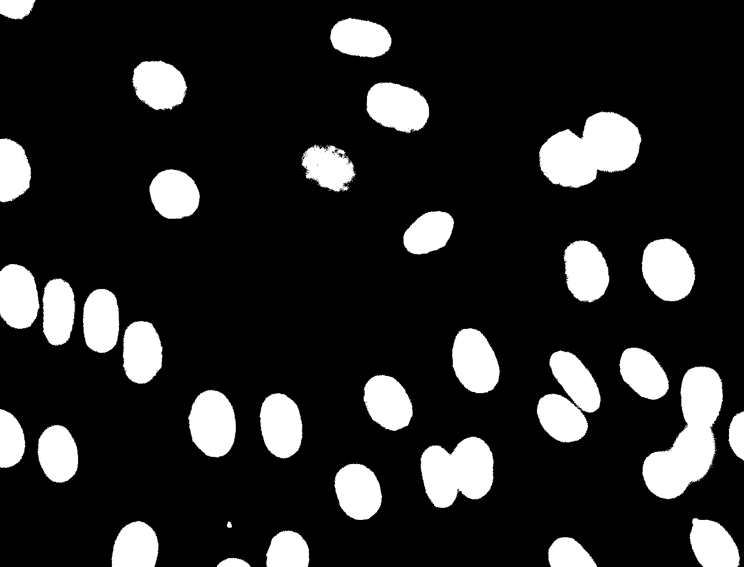
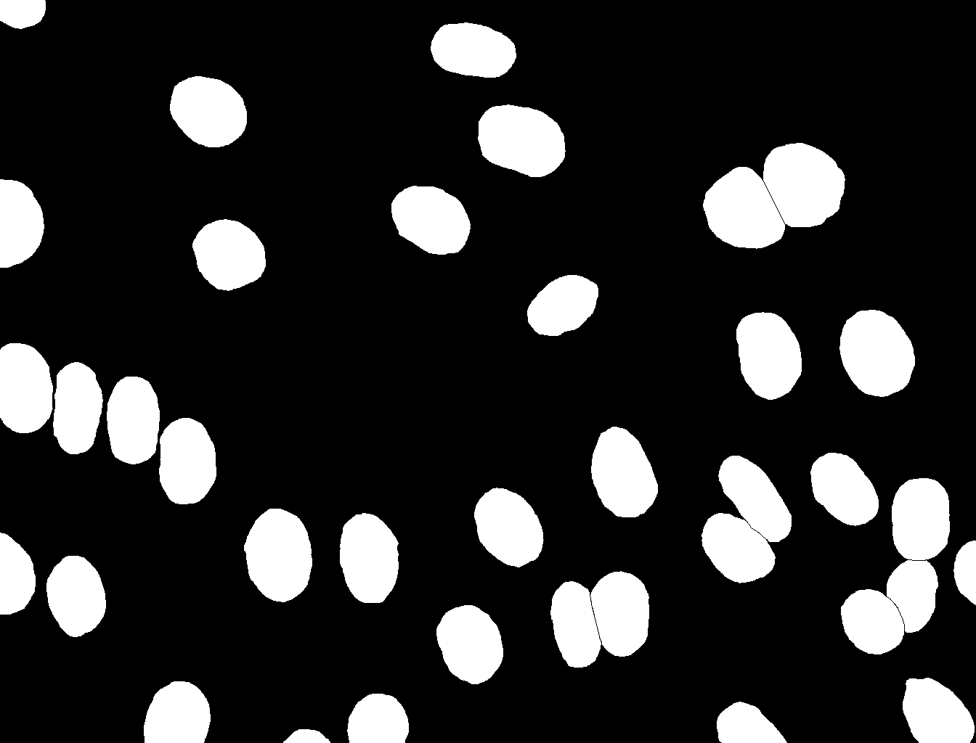
Dice Score Coefficient
Kurzerklaerung was TP, FP usw ist also
gt = ground truth; pt = post tresholding
TP : Both pixels white
FP : gt pixel black, pt pixel white
TN : both pixels black
FN : gt pixel white, pt pixel black
Tresholding using online tool
( imageonline.co)
Ground truth picture

Slide 13
Eulers rings normal version and dice score #muss noch ueberlegen wie genau ich es mache also in what order

Slide 14

wie sieht es statistisch aus (eulers rings)
$$DSC=\frac{2TP}{2TP+FP+FN}$$
TP = True positives
FP = False positives
FN = False negatives
Hier perfect scenario aka ueberlappende eulers rings
FN=0
FP=0
DSC= 2TP/2TP = 1
+ kurzerklaerung wie es zu dsc=0 kommen wurde
Realistic scenario
FN>0
FP>0
DSC=2TP/(2TP+FN+FP)

Slide 15



Timeline
First steps
Final presentation
Local threshold
Otsu and Dice
10.05.
31.05.
14.06.
Buffer and report
28.06.
21.06.
17.05.
07.06.
Cell counting
Alternative evaluation methods and further ideas
Project proposal
Preprocessing and testing

Slide 16
Milestones and Deliverables
First steps
Plan and organize team
Read resources and understand data
Propject proposal
Visualize data and understand algorithms
Main algorithms
Implement Otsu thresholding and dice score
Finish project proposal
Test it on data

Slide 17
Milestones and Deliverables
Preprocessing and testing
Implement different preprocessing features
Test pipeline on optimized images
Local threshold
Impement sliding window scheme
Organize and optimize code
Alternative evaluation methods and further ideas
Implement further evaluation methods
Implement two-level-Otsu
Cell counting
Implement cell counting algorithm
Buffer and Final presentation
Compare/collaborate with other team
Clean GitHub and write final report

Slide 18



Team
Meetings
Teamwork
GitHub
2x a week
Live and online
Use project feature
Strucuture repository
Work in pairs
Help each other

