Slide 1

Project proposal
Biomedical Image Analysis

Slide 2
Data keine sorge nur mal ein grober überblick pink bleibt nicht…. :P
Würde irgenwie ziemlich am anfang erklären warum wir jetzt otsu verwinden und was das genau bringt für unsere bilder. Evtl 2 sätze dazu quasi als einleitungssatz? Und dann sagen genaueres kommt später oder sowas meint ihr?
3 Datasets
N2DH- GOWT1
N2DL-HeLa
NIH3T3
Why Otsu thresholding?

Slide 3
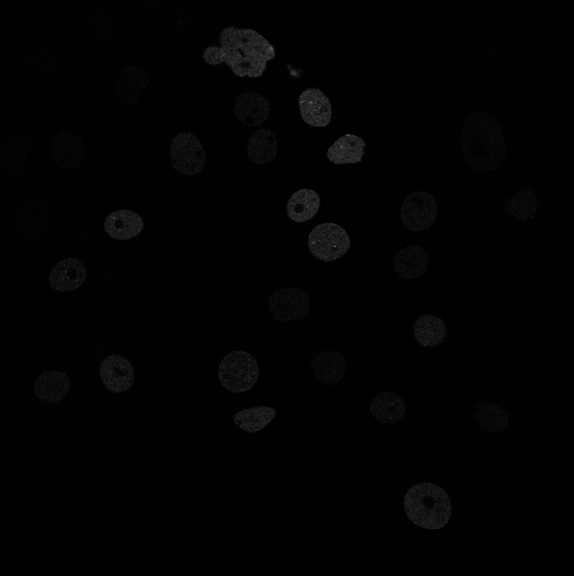
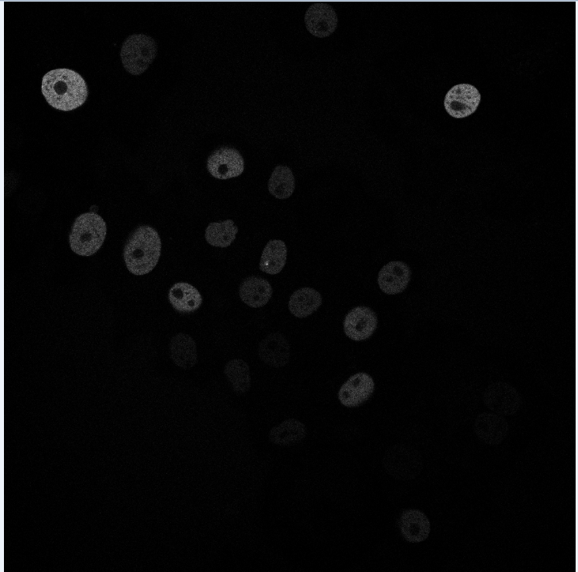
N2DH- GOWT1 GFP transfected GOWT1 mouse embryonic stem cells
6 images total
1024x1024 pixels
10-20 nulei per image
Challenge:
…..
Hier müsste ein histogramm sein..☺
(in arbeit)

Slide 4
NIH3T3 Mouse embryonic cells stained with Hoechst
18 images total
Size: 1344x1024 pixels
about 60 nuclei per image
Challenge:
…..
Bild und histogramm

Slide 5
N2DL-HeLa HeLa cells stably expressing H2b-GFP
4 images total
Size: 1100x 700 pixels
30-50 nuclei per image
Challenge:
….
Bild und histogramm

Slide 6
Global Thresholding
Local Thresholding
Adaptive Thresholding
Otsu Thresholding
Image Thresholding

Slide 7
Otsu Thresholding
Histogram einer bimodal distribution+ threshold!!!!

Slide 8
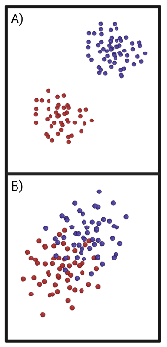
Otsu Thresholding
Histogramm von diesem Bild: t39

Slide 9


Otsu Thresholding
Determintation of the optimal threshold value by maximizing the between-class variance or equivalently minimizing the the within-class variance
Between-class variance
$σ_{b}^{2}=ω_{0}ω_{1}\left(μ_{1}−μ_{0}\right)$²
$ω_{0,1}$ = Probabilities of calss occurrence
$μ_{0,1}$ = Class mean levels
Within-class variance
$$σ_{w}^{2}=ω_{0}σ_{0}^{2}+ω_{1}σ_{1}^{2}$$
$ω_{0,1}$ = Probabilities of calss occurrence
$σ_{0,1}^{2}$= Class variances

Slide 10
Otsu Thresholding
$$g_{seg}\left(x,y\right)=\left\{\begin{aligned}0 if g\left(x,y\right)≤t \\ 255 if g\left(x,y\right)>t\end{aligned}\right.$$
𝑔_𝑠𝑒𝑔 (𝑥,𝑦)={█(0 𝑖𝑓 𝑔(𝑥,𝑦)≤𝑡@255 𝑖𝑓 𝑔(𝑥,𝑦)>𝑡)┤

Slide 11







Otsu Thresholding - Algorithm
Input image
Image histogram, P(i)
Set up initial $ω_{i}\left(0\right)$ and $μ_{i}\left(0\right)$
Set up initial 𝜔_𝑖 (0) and 𝜇_𝑖 (0)
Update values of $ω_{i}$ and $μ_{i}$
Update values of 𝜔_𝑖 and 𝜇_𝑖
Compute variances $σ_{b}^{2}$ and $σ_{w}^{2}$
Compute variances 𝜎_𝑏^2 and 𝜎_𝑤^2
Select threshold intensity t
Set pixels $≤$t to 0 and pixels > t to 255
Set pixels ≤ t to 0 and pixels > t to 255
Output image

Slide 12
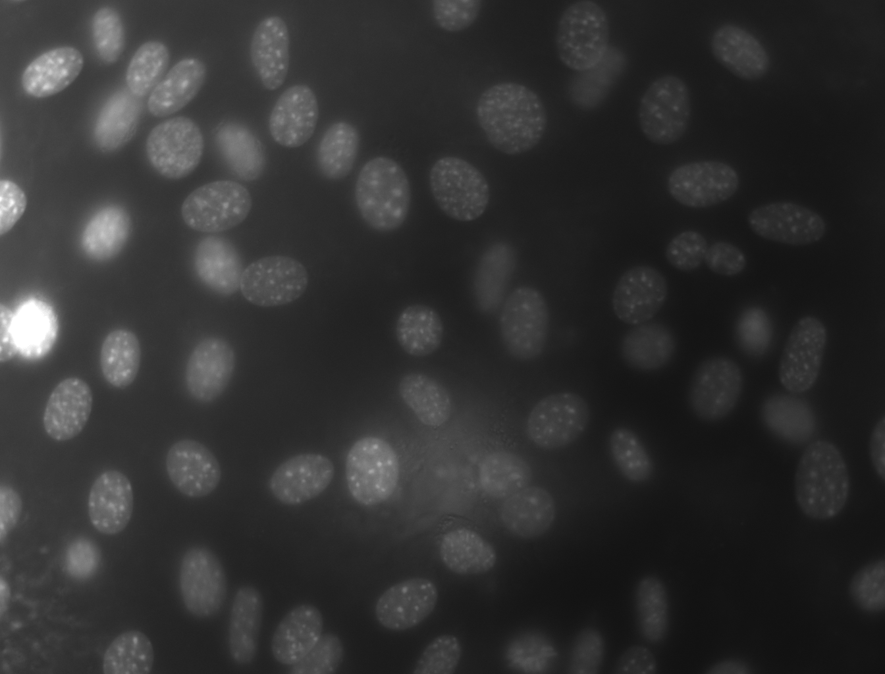
Local Thresholding - Sliding window scheme

Slide 13

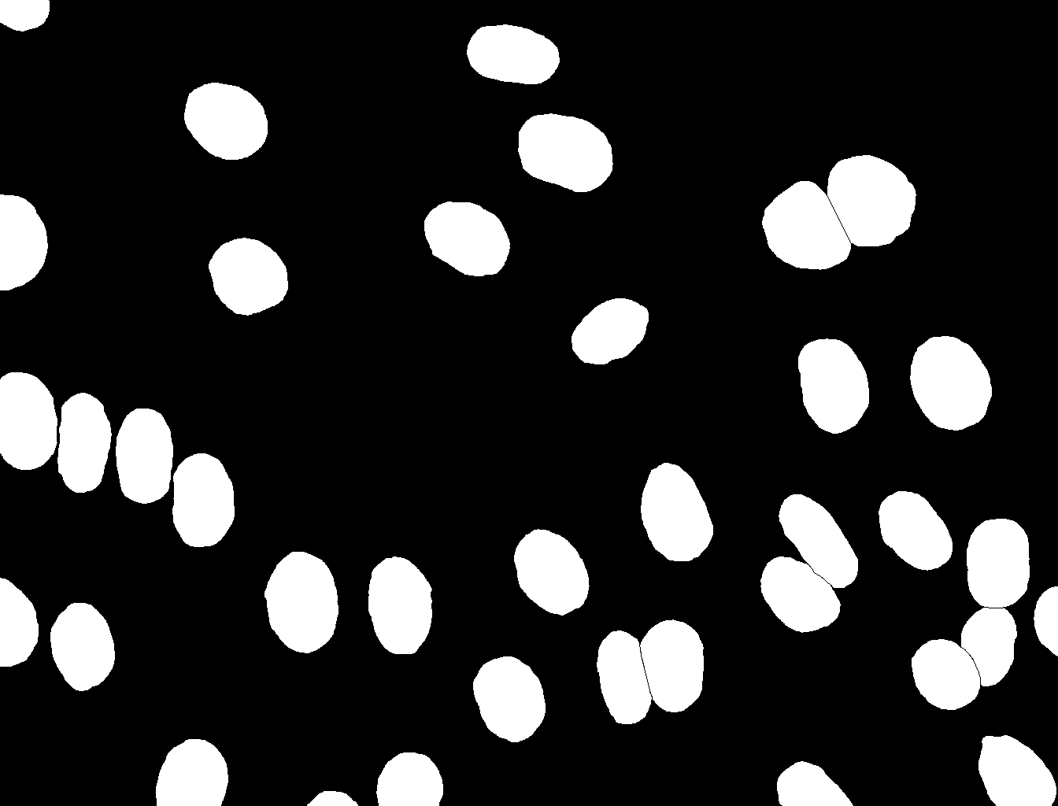
Dice Score Coefficient
Kurzerklaerung was TP, FP usw ist also
gt = ground truth; pt = post tresholding
TP : Both pixels white
FP : gt pixel black, pt pixel white
TN : both pixels black
FN : gt pixel white, pt pixel black
Tresholding using online tool
( imageonline.co)
Ground truth picture

Slide 14
Eulers rings normal version and dice score #muss noch ueberlegen wie genau ich es mache also in what order

Slide 15

wie sieht es statistisch auss (eulers rings)
$$DSC=\frac{2TP}{2TP+FP+FN}$$
TP = True positives
FP = False positives
FN = False negatives
Hier perfect scenario aka ueberlappende eulers rings
FN=0
FP=0
DSC= 2TP/2TP = 1
+ kurzerklaerung wie es zu dsc=0 kommen wurde
Realistic scenario
FN>0
FP>0
DSC=2TP/(2TP+FN+FP)

Slide 16



Timeline
First steps
Final presentation
Local threshold
Otsu and Dice
10.05.
31.05.
14.06.
Buffer and report
28.06.
21.06.
17.05.
07.06.
Cell counting
Alternative evaluation methods and further ideas
Project proposal
Preprocessing and testing

Slide 17
Milestones and Deliverables
First steps
Plan and organize team
Read resources and understand data
Propject proposal
Visualize data and understand algorithms
Main algorithms
Implement Otsu thresholding and dice score
Finish project proposal
Test it on data

Slide 18
Milestones and Deliverables
Preprocessing and testing
Implement different preprocessing features
Test pipeline on optimized images
Local threshold
Impement sliding window scheme
Organize and optimize code
Alternative evaluation methods and further ideas
Implement further evaluation methods
Implement two-level-Otsu
Cell counting
Implement cell counting algorithm
Buffer and Final presentation
Compare/collaborate with other team
Clean GitHub and write final report

Slide 19



Team
Meetings
Teamwork
GitHub
2x a week
Live and online
Use project feature
Strucuture repository
Work in pairs
Help each other

