Slide 1




Slide 2

Project proposal
Biomedical Image Analysis

Slide 3

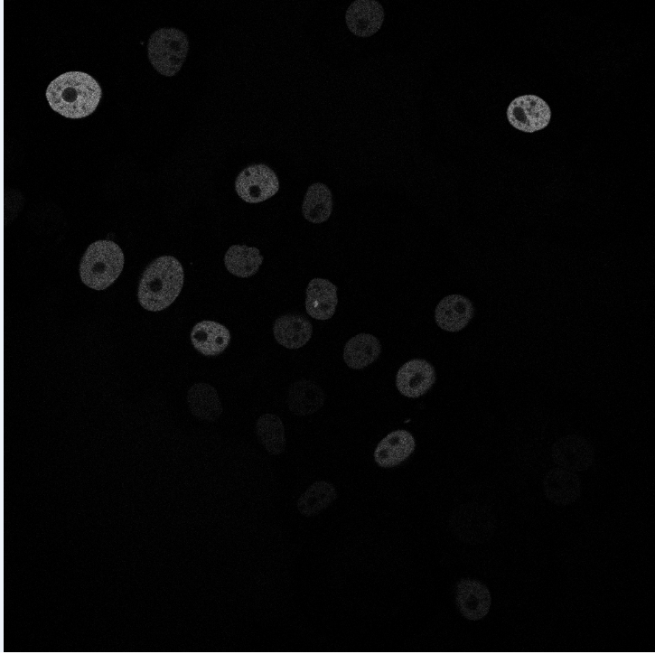
N2DH-GOWT1 Cell type: embryonic stem cells | Organism: Mouse (Mus musculus)
Stained with GFP
6 images total
1024x1024 pixels
10-20 nulei per image
GOWT1 – stem cell line

Slide 4
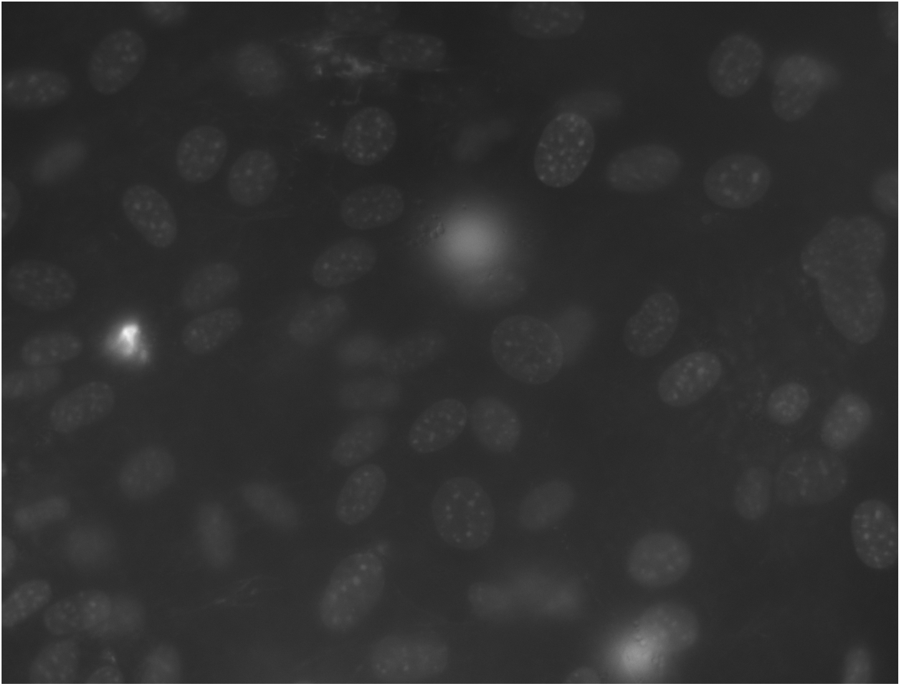
NIH3T3 Cell type: Embryonic fibroblast cells | Organism: Mouse (Mus musculus)
Stained with Hoechst
18 images total
Size: 1344x1024 pixels
about 60 nuclei per image

Slide 5

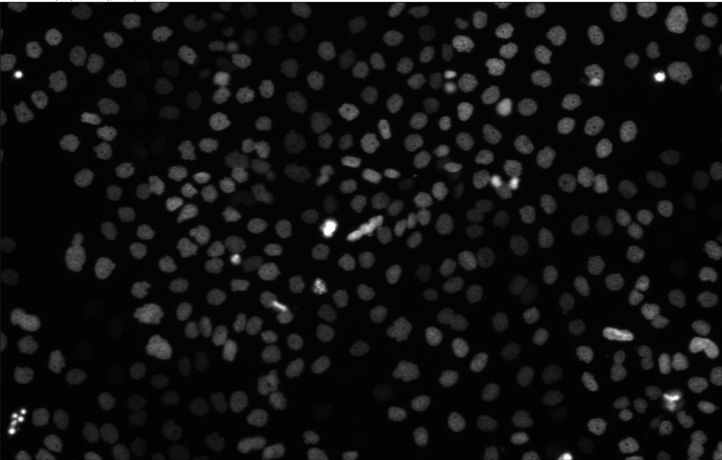
N2DL-HeLa Cell type: Cervix carcinoma cells | organism: human (Homo sapiens)
Stained with GFP
4 images total
Size: 1100x 700 pixels
30-50 nuclei per image

Slide 6
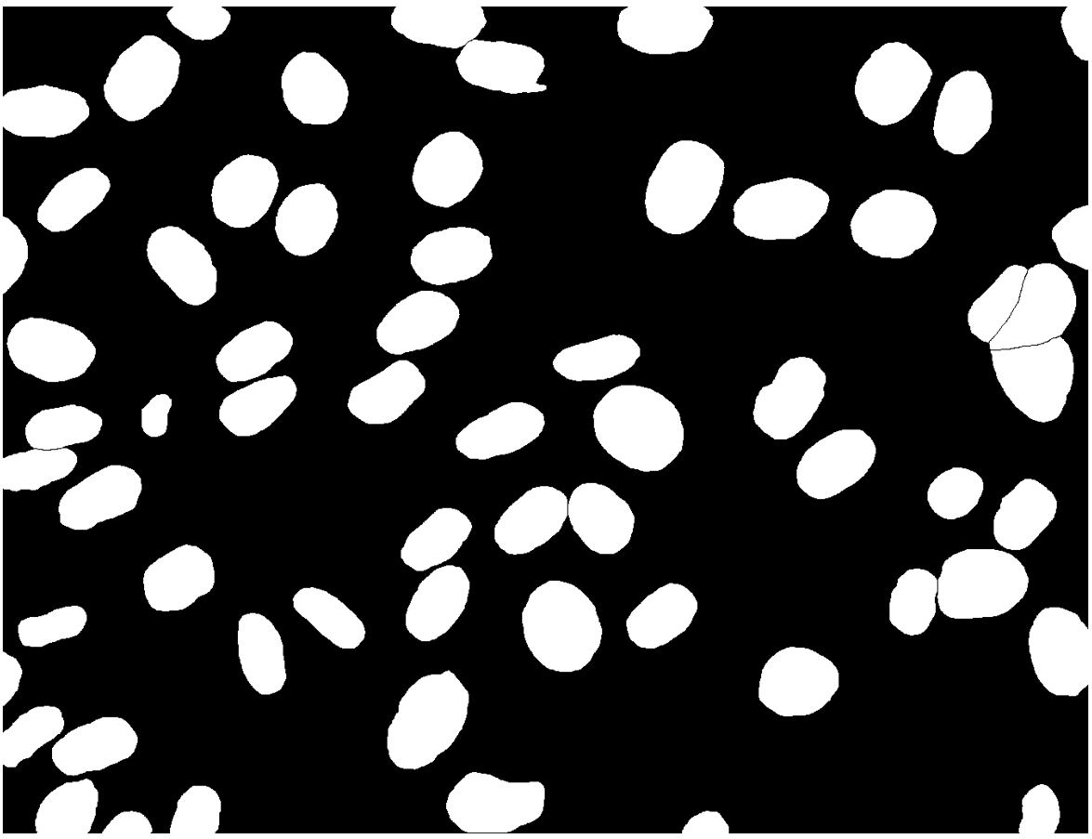
Image
Ground Truth

Slide 7
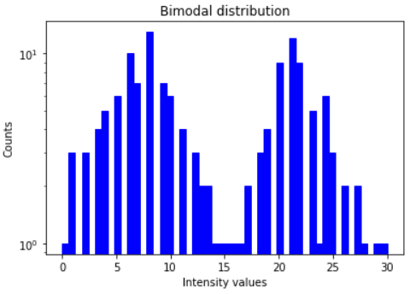
Otsu Thresholding

Slide 8
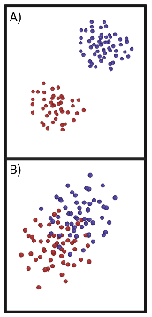
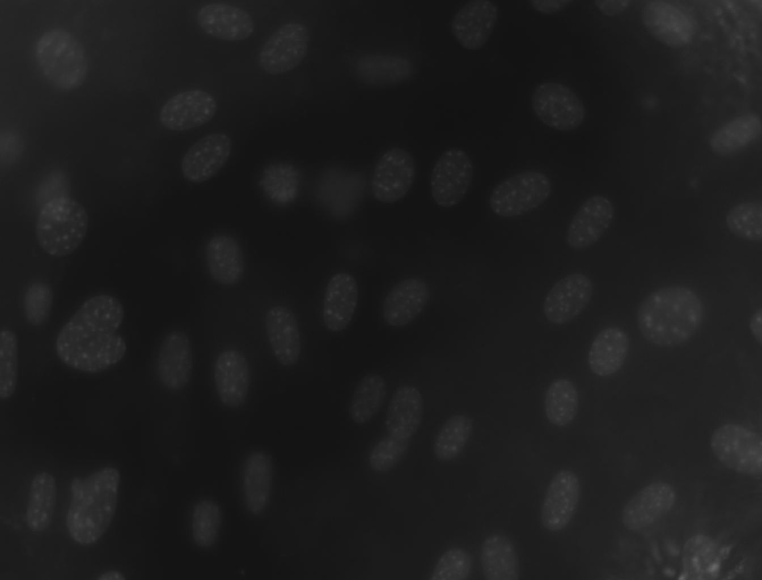
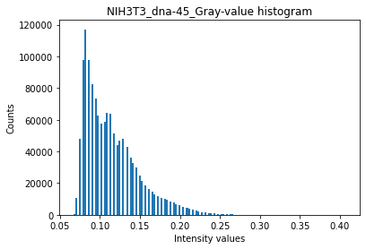
Otsu Thresholding

Slide 9


Otsu Thresholding
Determintation of the optimal threshold value by maximizing the between-class variance or equivalently minimizing the the within-class variance
Between-class variance
$σ_{b}^{2}=ω_{0}ω_{1}\left(μ_{1}−μ_{0}\right)$²
$ω_{0,1}$ = Probabilities of class occurrence
$μ_{0,1}$ = Class mean levels
Within-class variance
$$σ_{w}^{2}=ω_{0}σ_{0}^{2}+ω_{1}σ_{1}^{2}$$
$ω_{0,1}$ = Probabilities of calss occurrence
$σ_{0,1}^{2}$= Class variances

Slide 10
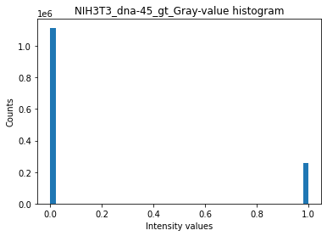
Otsu Thresholding
$$g_{seg}\left(x,y\right)=\left\{\begin{aligned}0 if g\left(x,y\right)≤t \\ 255 if g\left(x,y\right)>t\end{aligned}\right.$$
𝑔_𝑠𝑒𝑔 (𝑥,𝑦)={█(0 𝑖𝑓 𝑔(𝑥,𝑦)≤𝑡@255 𝑖𝑓 𝑔(𝑥,𝑦)>𝑡)┤

Slide 11







Otsu Thresholding - Algorithm
Input image
Image histogram, P(i)
Set up initial $ω_{i}\left(0\right)$ and $μ_{i}\left(0\right)$
Set up initial 𝜔_𝑖 (0) and 𝜇_𝑖 (0)
Update values of $ω_{i}$ and $μ_{i}$
Update values of 𝜔_𝑖 and 𝜇_𝑖
Compute variances $σ_{b}^{2}$ and $σ_{w}^{2}$
Compute variances 𝜎_𝑏^2 and 𝜎_𝑤^2
Select threshold intensity t
Image clipping
Output image

Slide 12

Optimisation algorithm – Dice score
~ 80% Accuracy

Slide 13
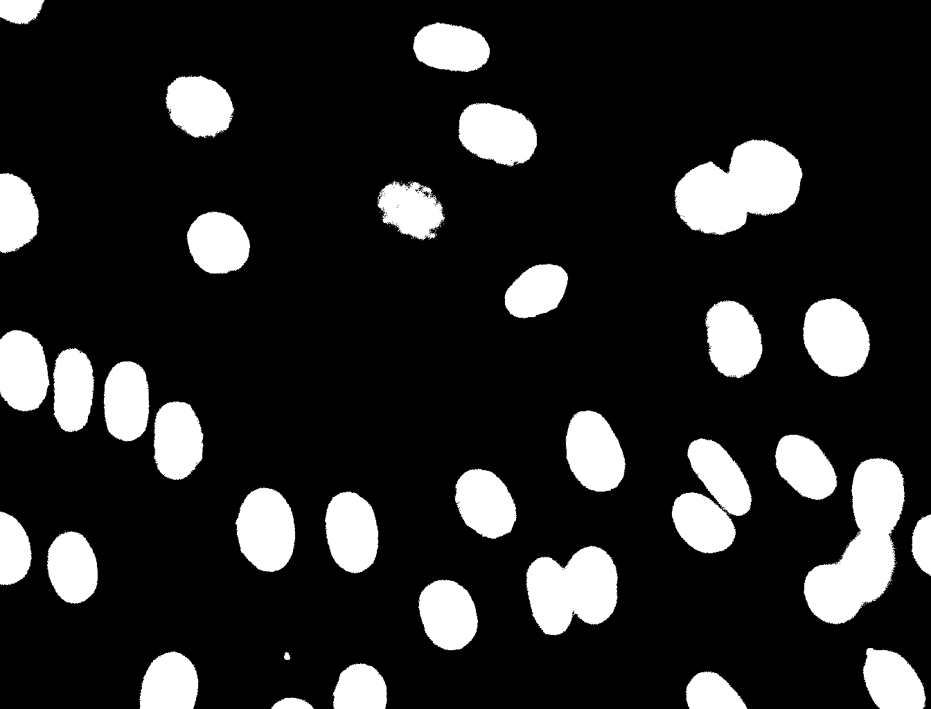
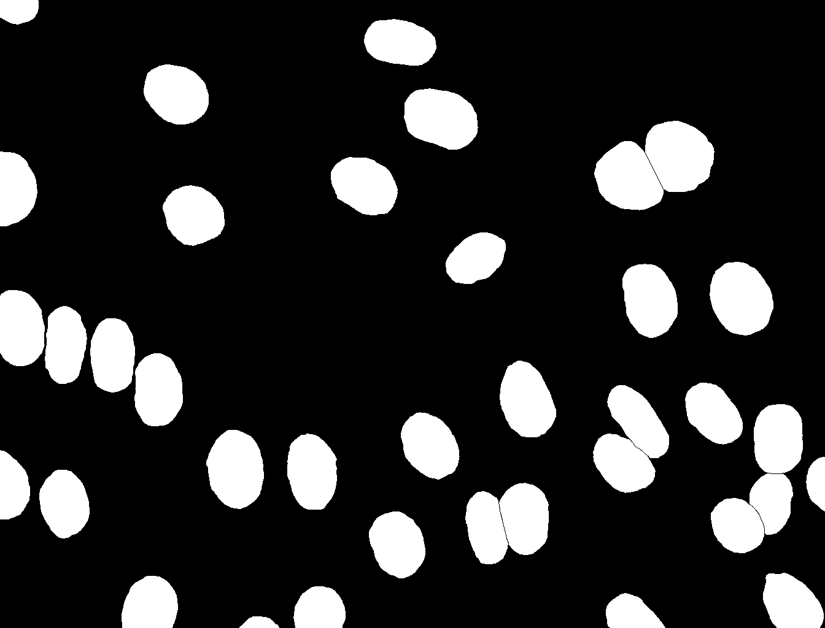
Dice Score Coefficient
Kurzerklaerung was TP, FP usw ist also
gt = ground truth; pt = post tresholding
TP : Both pixels white
FP : gt pixel black, pt pixel white
TN : both pixels black
FN : gt pixel white, pt pixel black
Tresholding using online tool
( imageonline.co)
Ground truth picture

Slide 14


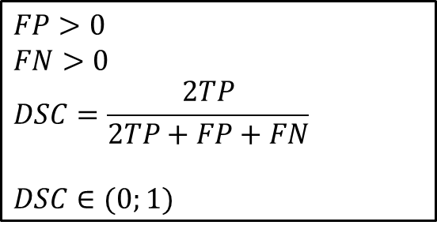


Dice Score
Post Otsu = Ground truth
$$FP=0$$
$$FN=0$$
$$DSC=\frac{2TP}{2TP}=1$$
$$DSC=\frac{2TP}{2TP+FP+FN}$$
TP = True positives
FP = False positives
FN = False negatives
TP
Ground truth
$$FP>0$$
$$FN>0$$
$$DSC=\frac{2TP}{2TP+FP+FN}$$
$$DSC∈(0;1)$$
FN
TP
FP
Post Otsu

Slide 15
Problems with dice score

Slide 16
Challenges: N2DH-GOWT1
Noise -> Gauss fi
Holes
Low contrast

Slide 17
Challenges: NIH3T3
Reflection
Hier lieber helligkeit anderes bild suchen

Slide 18
Challenges: N2DL-HeLa
Bild wo man reflections sieht…

Slide 19
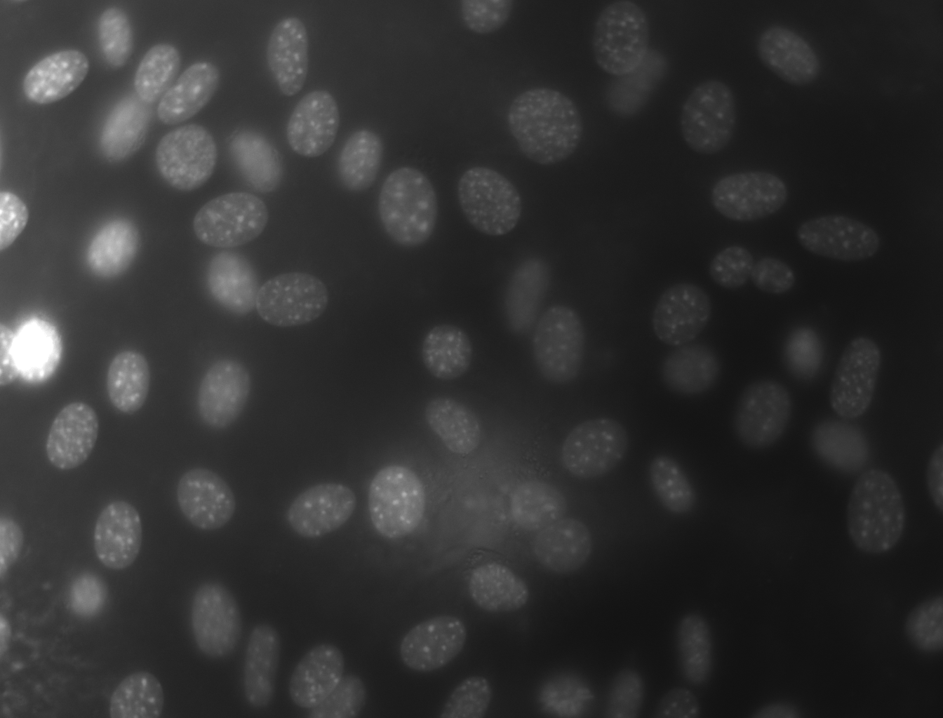
Local Thresholding - Sliding window scheme

Slide 20



Timeline
First steps
Final presentation
Local threshold
Otsu and Dice
10.05.
31.05.
14.06.
Buffer and report
28.06.
21.06.
17.05.
07.06.
Cell counting
Alternative evaluation methods and further ideas
Project proposal
Preprocessing and testing

Slide 21
Milestones and Deliverables
First steps
Plan and organize team
Read resources and understand data
Propject proposal
Visualize data and understand algorithms
Main algorithms
Implement Otsu thresholding and dice score
Finish project proposal
Test it on data

Slide 22
Milestones and Deliverables
Preprocessing and testing
Implement different preprocessing features
Test pipeline on optimized images
Local threshold
Impement sliding window scheme
Organize and optimize code
Alternative evaluation methods and further ideas
Implement further evaluation methods
Implement two-level-Otsu
Cell counting
Implement cell counting algorithm
Buffer and Final presentation
Compare/collaborate with other team
Clean GitHub and write final report

Slide 23



Team
Meetings
Teamwork
GitHub
2x a week
Live and online
Use project feature
Strucuture repository
Work in pairs
Help each other

