Slide 1
1. Preliminary steps
- Data cleaning - Normalization
- Reproducibility
2. Identification of RNA-dependent proteins
- Defining selection criteria - Applying selection criteria
3. Dimension reduction analysis
- Procedure - Results and their meaning
4. Developing a linear regression model
- Procedure - Results and their meaning
ausgrauen
Notes:
Gliederung: Schlagwörter mit kurzer Erläuterung. Was wurde gemacht

Slide 2
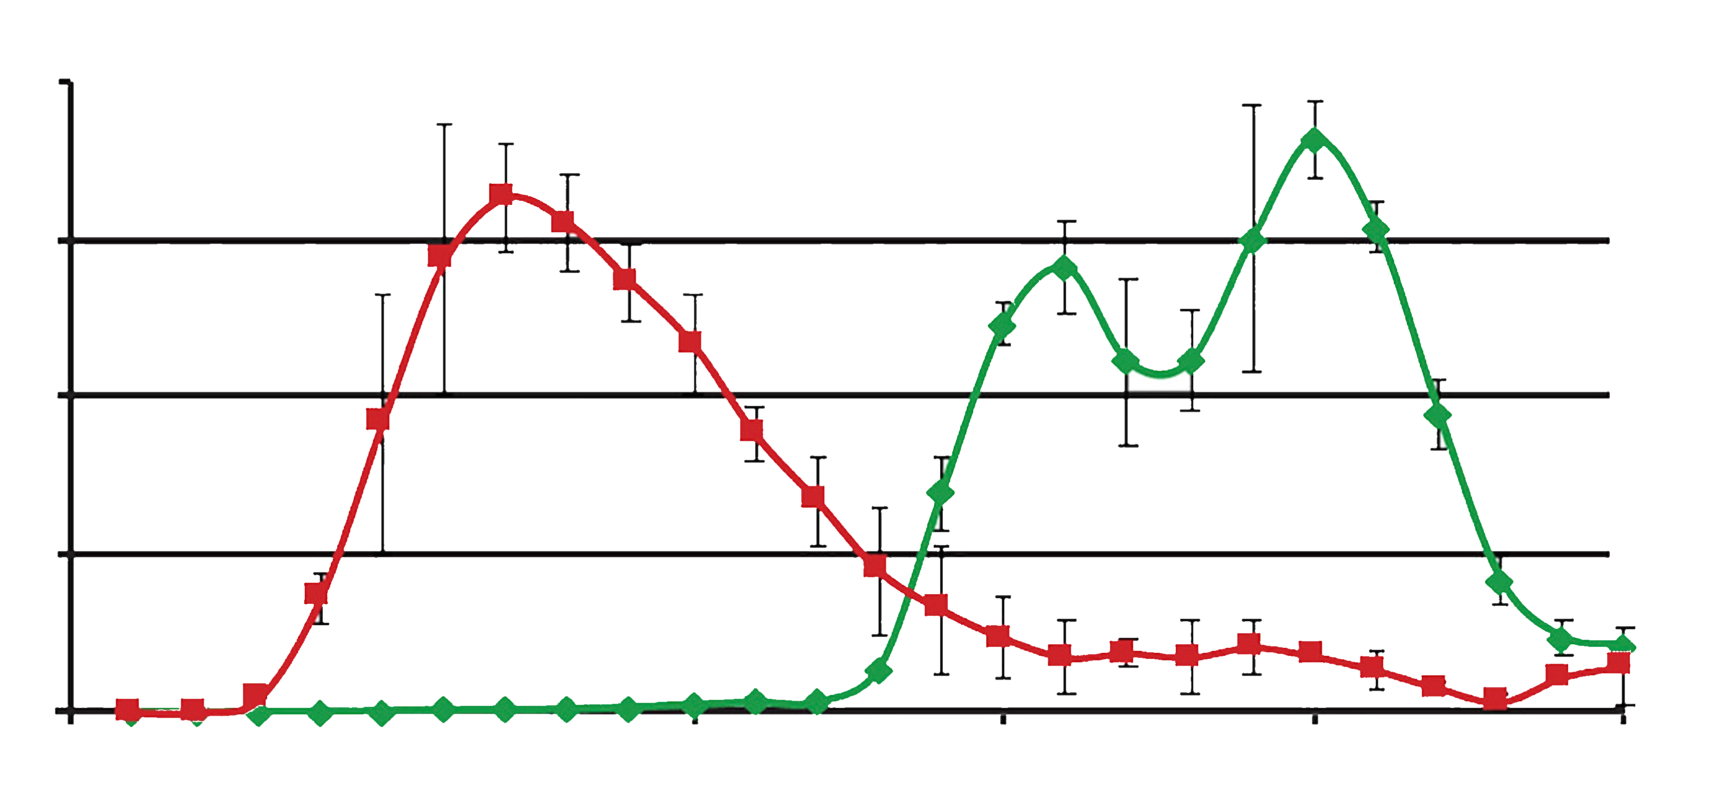
Data Analysis Project 2022
Topic 03: Proteome-wide Screen for RNA-dependent Proteins
Subproject 2: HeLa Cells Synchronized in Mitosis
Supervisor: Dr. Maïwen Caudron-Herger
Tutor: Niklas Engel
Project Presentation
Michel Tarnow, Michèle Bennek, Lennart Müller, Sebastian Rickert;
Date: 19.08.2022
Adapted from: [9]

Slide 3
Why Bother About RNA-dependent Proteins (R-DeeP)?
ATXN2, hnRNPA1, MATR3, TIA-1^{[6]}
Amyotrophic lateral sclerosis (ALS)
TTP, FUS, EWS, TAF15^{[8]}
Frontotemporal Lobar Dementia (FTLD)
TTP^{[6]}
Atherosclerosis
eIF2B^{[7]}
Leukoencephalopathy
(Selection of) RBPs Whose Malfunction Has Been Associated With Human Diseases
RBFOX2^{[6]}
Diabetic cardiomyopathy
SMN^{[8]}
Spinal Muscular Atrophy (SMA)
KHDRBS1^{[1]}, ELAV1^{[2]}, FXR1^{[3]}, UHMK1^{[4]}, PATL2, DUS1L^{[5]}
Cancer
APP^{[7]}
Alzheimer’s Disease
FMRP^{[8]}
Fragile X Syndrome
IRP1^{[7]}
Hyperferritinemia-cataract syndrome
DKC1^{[7]}
Dyskeratosis congenita

Slide 4
What are R-DeePs and how do we test them?
RNase
Proteins where the interactome depends on RNA!
Change in RNA-interactions leads to change in data.

Slide 5
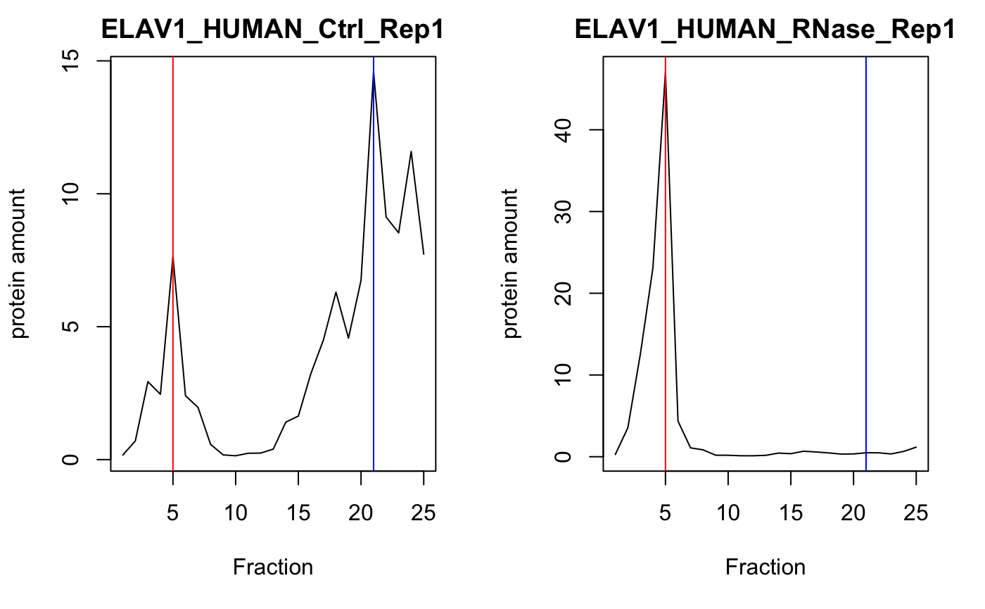
Example Protein: ELAV1
Plotted with R
Notes:
Transition via ELAV1 as an example

Slide 6
1. Preliminary steps
- Data cleaning
- Normalization
- Reproducibility
2. Identification of RNA-dependent proteins
- Defining selection criteria
- Applying selection criteria
3. Dimension reduction analysis
- Procedure
- Results
- Interpretation
4. Developing a linear regression model
- Procedure
- Results
- Interpretation
Notes:
In theory - all other things being equal - replicating the same experiment three times should produce three times the same result. This is equivalent to saying that, for a given fraction, the sum of protein amount values across all included proteins of the data set should be equal for all three replicates. However, this is not the case because in reality, experimental conditions aren’t ideal and are subject to various sources of distortion, including naturally occurring statistical fluctuations and limited measurement accuracy. Thus, in order to ensure comparability of our data, it was necessary to perform a column-wise normalization step.

Slide 7
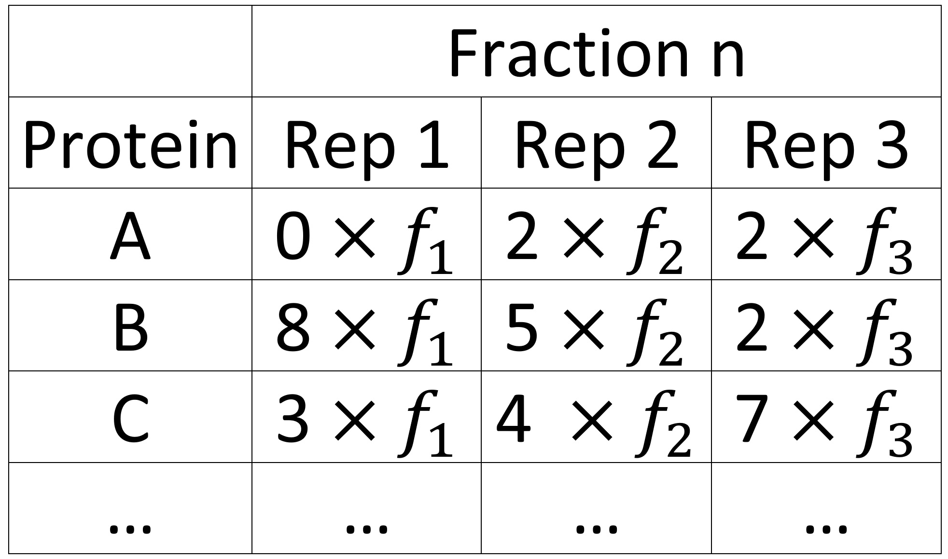
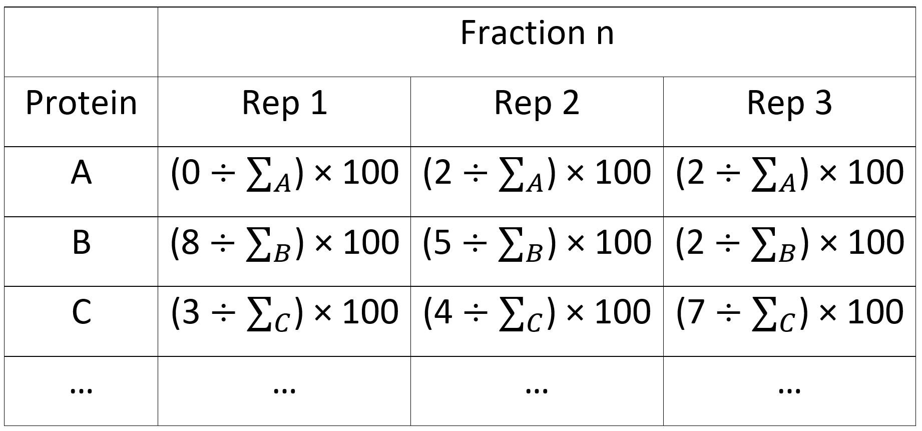
Normalization
Column-wise:
Row-wise:

Slide 8
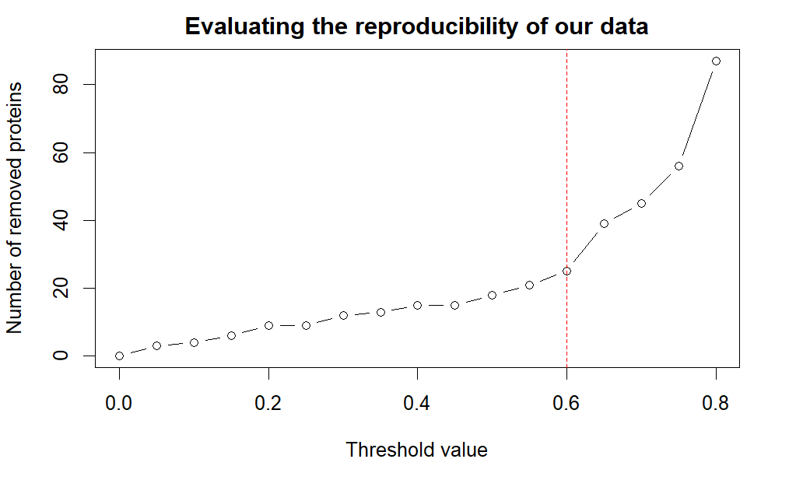
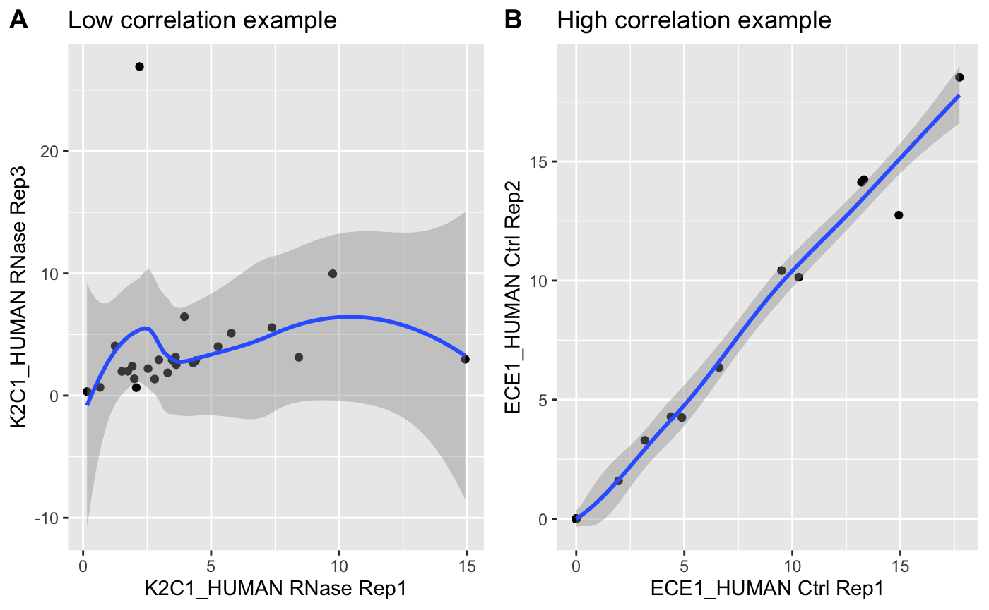
Reproducibility
→ removal of 25 proteins
Notes:
This led to the removal of another 25 proteins from our data set. Therefore, we removed a total of 32 proteins from our data set, which amounts to around 0.5% of all proteins from our native data set.

Slide 9
1. Preliminary steps
- Data cleaning
- Normalization
- Reproducibility
2. Identification of RNA-dependent proteins
- Defining selection criteria
- Applying selection criteria
3. Dimension reduction analysis
- Procedure
- Results
- Interpretation
4. Developing a linear regression model
- Procedure
- Results
- Interpretation

Slide 10
Defining selection criteria
1. selection criterion
The position of the global maximum of the protein amount across all 25 fractions shows an absolute shift between control and RNase greater 1 fraction.
2. selection criterion
A significant difference in protein amount between the position of the global maxima in control and the protein amount at the respective fractions in RNase.

Slide 11
Applying selection criteria
1 plot beispiel rdeep 1 beispiel non-rdeep
Notes:
Hier ein anderen Plot nehmen ohne lokal maximum dann kann ich daraus eine grafik machen wo shift erklärt wird
Soll ich eine grafik mit tabellen und vektoren machen um zu erklären wie wir die signifikanz berechnet haben?
Info:7127 t-tests performed. P-values were corrected for multiple testing by controlling the false-discovery rate (FDR) according to Benjamini and Hochberg (1995), using the function p.adjust. Therefore, difference in protein amount was regarded as significant if the FDR-corrected p-value p was smaller than the chosen significance level of α = 0.05.

Slide 13
1. Preliminary steps
- Data cleaning
- Normalization
- Reproducibility
2. Identification of RNA-dependent proteins
- Defining selection criteria
- Applying selection criteria
3. Dimension reduction analysis
- Procedure
- Results
- Interpretation
4. Developing a linear regression model
- Procedure
- Results
- Interpretation

Slide 14
Procedure
Create 50-dimensional mean value data set
Perform principal component analysis using prcomp
Perform Uniform Manifold Approximation and Projection analysis
Color proteins based on
a) RNA-dependance
b) shift

Slide 15
Results

Slide 16
1. Preliminary steps
- Data cleaning
- Normalization
- Reproducibility
2. Identification of RNA-dependent proteins
- Defining selection criteria
- Applying selection criteria
3. Dimension reduction analysis
- Procedure
- Results
- Interpretation
4. Developing a linear regression model
- Goal and Procedure
- Results
- Interpretation

Slide 17
Goal and Procedure
Goal: Prediction of the absolute and the real shift in position of the global maximum
Set parameters used for predictions
Correlation between mean protein amount values of control and RNase
Split data set 80/20
Perform model training with function lm
Run model with lm.predict

Slide 18
Planned Analysis Steps
Part (01)
Data cleaning
Describing the structure of the data frame using descriptive statistics
Normalize amount of each protein to 100 arb. units for every replicate
Assess importance of testing reproducibility
Prove reproducibility of the data via Q-Q plots and correlation between replicates
Combine values of replicates using mean value
Part (02)
Global maxima: highest value across all fractions
Local maxima: 1. Each value of the two neighboring pairs must be lower than the local maxima (avoid fluctuation bias)
2. Value of local maxima must be greater than 4 % of total protein amount (100) (avoid background noise)
Maxima (fraction and value) for each protein will be stored in an R object (e.g., data frame)
Criteria for maxima may change during project work
▶
▶

Slide 19
Planned Analysis Steps
Part (03)
Evaluate differences between Ctrl and RNase condition maxima via statistical tests (t-test) using the three replicates
Selection criteria to identify R-DeeP:
Part (04)
Apply selection criteria to identify R-DeeP
Group proteins with the same shifting behavior using k-means clustering (e.g., left shift, right shift, no shift)
▶
1. | Shift of maxima > 1 fraction
2. | Significant difference of protein amount at the position of the maxima between Ctrl and RNase condition
▶
Part (05)
Comparing results with R-DeeP or RBPs of data bases
Develop linear regression model to identify R-DeeP (using parameters found during analysis)
■ Coverage of the four MUSTs

Slide 20
Timeline, Milestones and Deliverables
Part (04)
R object containing potential RNA-dependent proteins
Division of R-Deep candidates into subgroups with similar shifting behavior
Part (02)
R object containing position (fraction) and magnitude of local and global maxima for each protein
Report
+ Final Presentation
Project
Proposal
22.05.
26.06.
10.07.
17.05.
12.06.
03.07.
Buffer time
19.07.
Part (01)
Statistical description of dataset
Normalized and cleaned data frame
Evaluated reproducibility
Part (03)
R object containing significance of differences between Ctrl and RNase condition maxima
Clear set of selection criteria for RNA-dependent proteins
Part (05)
Comparison with databases
Linear regression model
Weekly team meetings on Wednesdays and if necessary
Course adjustments after consultation with tutor
Simultaneous writing of the report
■ Deliverables

Slide 21
References
[1] Bielli, P., Busà, R., Paronetto, M.P., and Sette, C. (2011). The RNA-binding protein Sam68 is a multifunctional player in human cancer. Endocr Relat Cancer 18, R91-r102.
[2] Abdelmohsen, K., and Gorospe, M. (2010). Posttranscriptional regulation of cancer traits by HuR. Wiley Interdiscip Rev RNA 1, 214-229.
[3] Qian, J., Hassanein, M., Hoeksema, M.D., Harris, B.K., Zou, Y., Chen, H., Lu, P., Eisenberg, R., Wang, J., Espinosa, A., et al. (2015). The RNA binding protein FXR1 is a new driver in the 3q26-29 amplicon and predicts poor prognosis in human cancers. Proc Natl Acad Sci U S A 112, 3469-3474.
[4] Feng, X., Ma, D., Zhao, J., Song, Y., Zhu, Y., Zhou, Q., Ma, F., Liu, X., Zhong, M., Liu, Y., et al. (2020). UHMK1 promotes gastric cancer progression through reprogramming nucleotide metabolism. Embo j 39, e102541.
[5] Wang, Z.L., Li, B., Luo, Y.X., Lin, Q., Liu, S.R., Zhang, X.Q., Zhou, H., Yang, J.H., and Qu, L.H. (2018). Comprehensive Genomic Characterization of RNA-Binding Proteins across Human Cancers. Cell Rep 22, 286-298.
[6] Kelaini, S., Chan, C., Cornelius, V.A., and Margariti, A. (2021). RNA-Binding Proteins Hold Key Roles in Function, Dysfunction, and Disease. Biology (Basel) 10.
[7] Gebauer, F., Schwarzl, T., Valcárcel, J., and Hentze, M.W. (2021). RNA-binding proteins in human genetic disease. Nature Reviews Genetics 22, 185-198.
[8] Maziuk, B., Ballance, H.I., and Wolozin, B. (2017). Dysregulation of RNA Binding Protein Aggregation in Neurodegenerative Disorders. Front Mol Neurosci 10, 89.
[9] Caudron-Herger, M., Rusin, S.F., Adamo, M.E., Seiler, J., Schmid, V.K., Barreau, E., Kettenbach, A.N., and Diederichs, S. (2019). R-DeeP: Proteome-wide and Quantitative Identification of RNA-Dependent Proteins by Density Gradient Ultracentrifugation. Mol Cell 75, 184-199.e110.

Slide 22
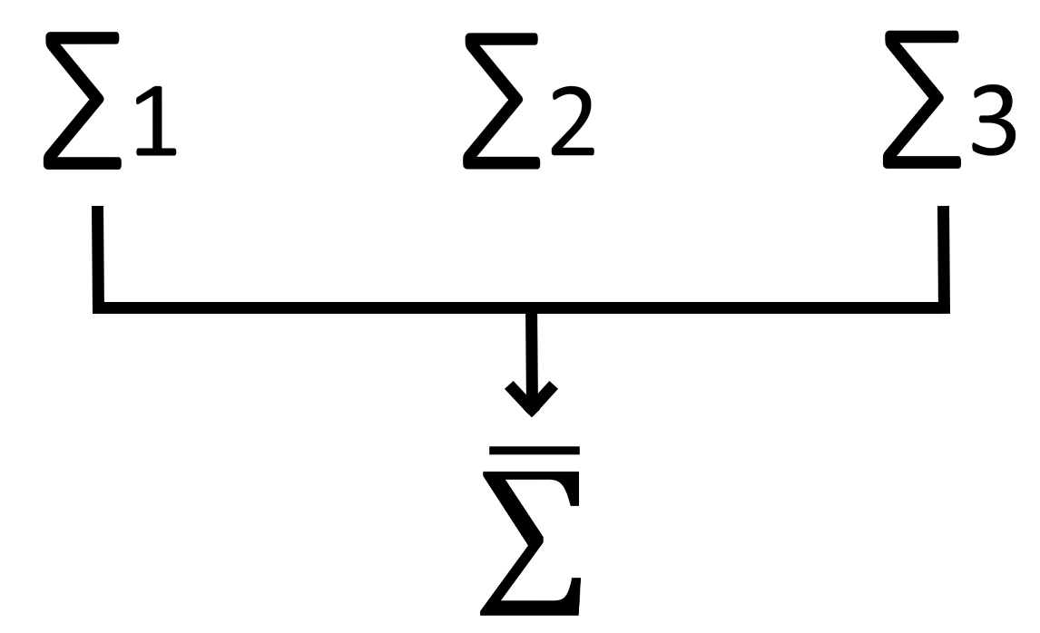
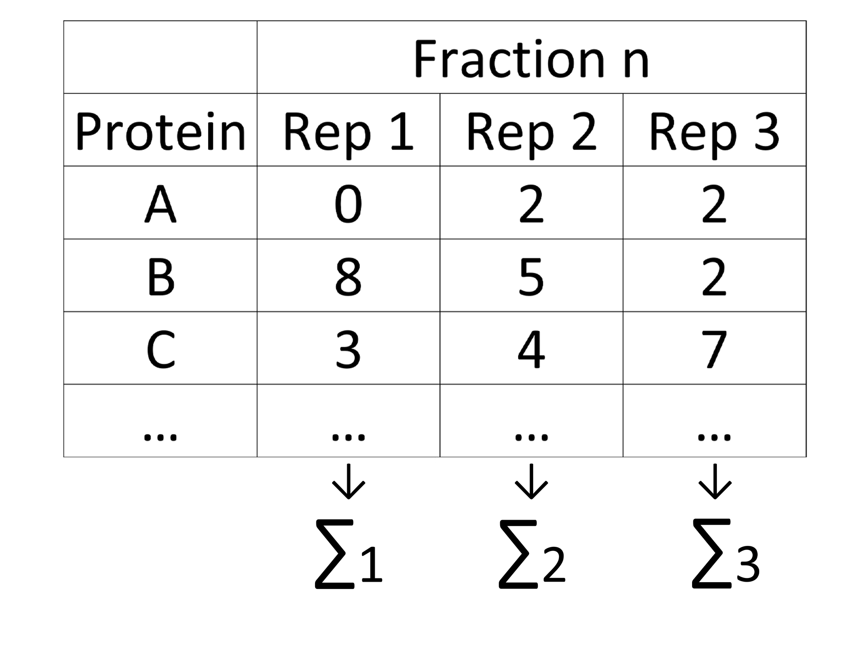
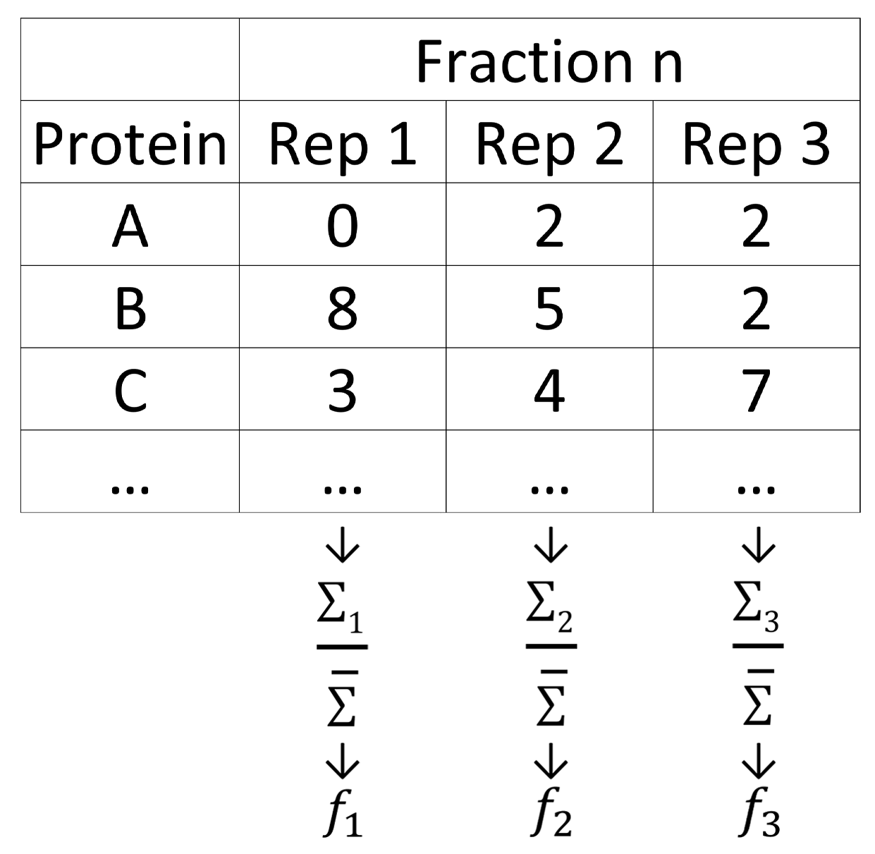
Normalization
1)
2)

Slide 23
zusatzfolien

