Slide 1
PROTEOME-WIDE SCREEN FOR RNA-DEPENDENT PROTEINS non-synchronized A549 cells datascience SS22, project 3 group 4
Greta Karathanos, Khalida Dushimova, Madleen Piegsa, Richard Langi

Slide 2
CHOSEN MILESTONES BEFORE STARTING THE PROJECT
Our aim? → automatically identify RNA-dependent proteins by analyzing our masspectometry data
Restructuring, normalization and datacleanup
Identification of peaks
Shift detection/
k-means clustering
Definition and application of selection criteria
Further analysis and report
Notes:
Fassen Sie Ihre Forschung in drei bis fünf Punkten zusammen.

Slide 3
MILESTONE 1: RESTRUCTURING THE DATA
BEFORE: RNASE + CTRL GROUP IN ONE DF
Human protein | Fraction 1 Rep.1 Ctlr | Fraction 1 Rep.1 RNase | Fraction 1 Rep.2 Ctlr | Fraction 1 Rep.2 RNase | Fraction 1 Rep.3 Ctlr | Fraction 1 Rep.3 RNase
SPB6_HUMAN | x | x | x | x | x | x
CRYAB_HUMAN | x | x | x | x | x | x
VIGLN_HUMAN | x | x | x | x | x | x

Slide 4
MILESTONE 1: RESTRUCTURING THE DATA
AFTER: RNASE DF AND CTRL DF
Fractions | SPB6_HUMAN_REP_1 | SPB6_HUMAN_REP_2 | SPB6_HUMAN_REP_3 | CRYAB_HUMAN_REP_1 | CRYAB_HUMAN_REP_2 | CRYAB_HUMAN_REP_2
Fraction_1 | x | x | x | x | x | x
Fraction_2 | x | x | x | x | x | x
Fraction_3 | x | x | x | x | x | x
Fractions | SPB6_HUMAN_REP_1 | SPB6_HUMAN_REP_2 | SPB6_HUMAN_REP_3 | CRYAB_HUMAN_REP_1 | CRYAB_HUMAN_REP_2 | CRYAB_HUMAN_REP_2
Fraction_1 | x | x | x | x | x | x
Fraction_2 | x | x | x | x | x | x
Fraction_3 | x | x | x | x | x | x

Slide 5
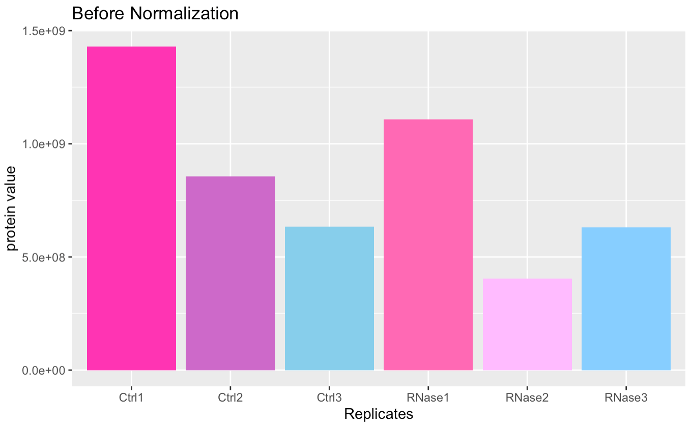
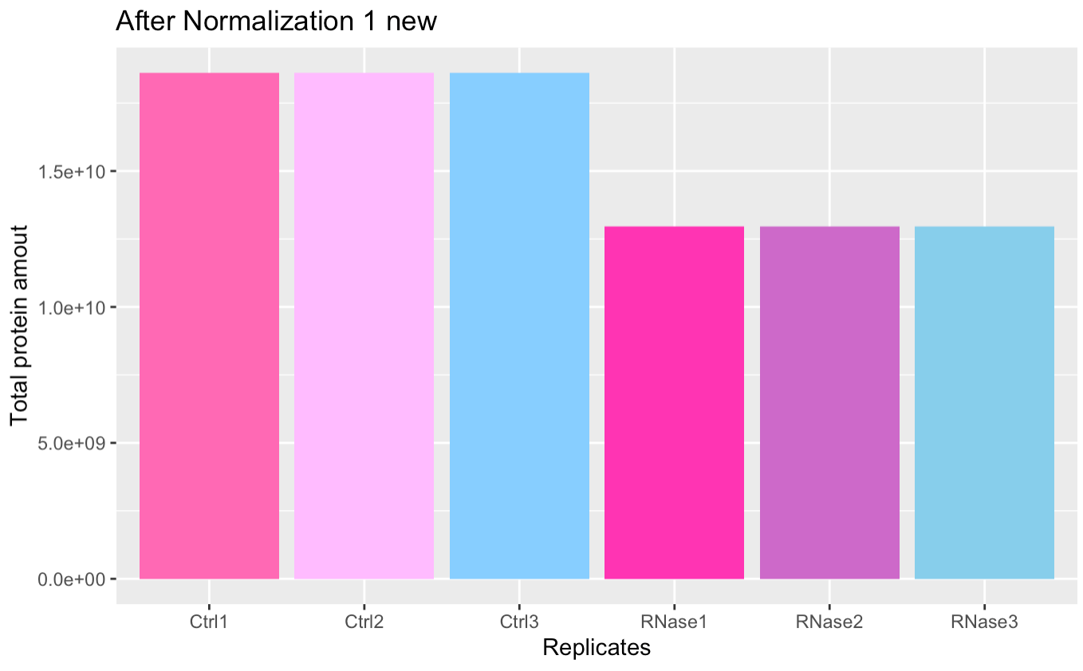
MILESTONE 2: FIRST NORMALIZATION
Objective: The values have to be comparable and therefor the total amount of protein has to be equal for all replicates
BEFORE FIRST NORMALIZATION AFTER FIRST NORMALIZATION

Slide 6
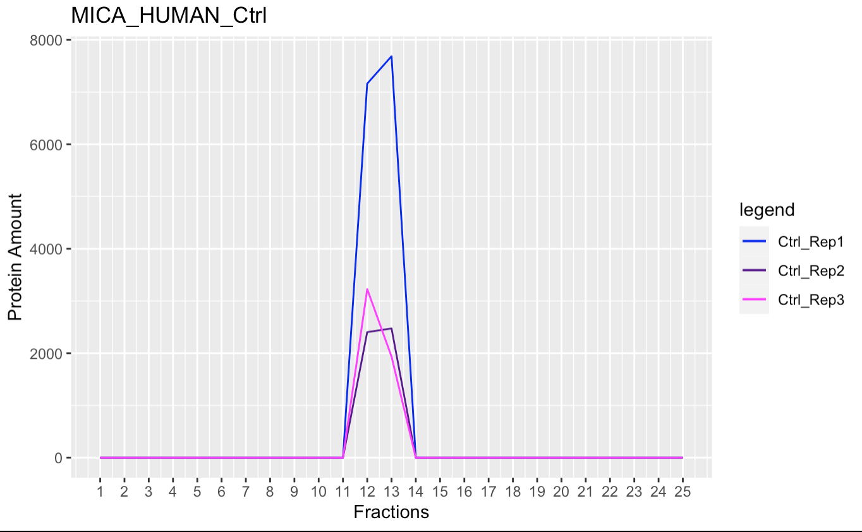
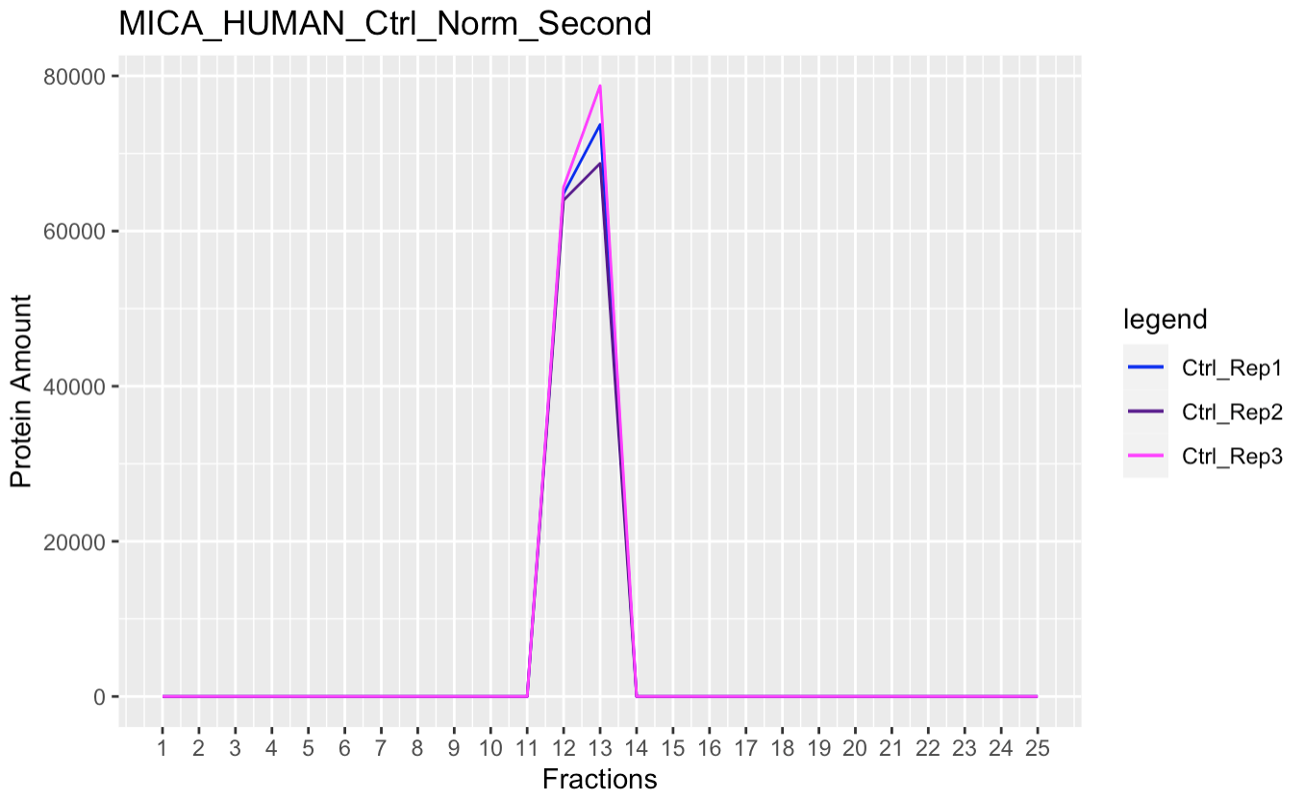
MILESTONE 2: SECOND NORMALIZATION
→ Objective: Reduce the outliers with the antioutlier function
BEFORE SECOND NORMALIZATION AFTER SECOND NORMALIZATION

Slide 7
MILESTONE 3: PEAKS IDENTIFICATION
→ Objective:
SCREENSHOT MAIWEN

Slide 8
MILESTONE 4: T-TEST
Objective:
Input:
Output:
TABELLE TRUE AND FALSE

Slide 9
MILESTONE 5: K-MEANS
Objective:
Input:
Output:
K- means cluster bild

Slide 10
MILESTONE 6: COMPARISON OF RNA DEPENDENCY OF BOTH T-TEST AND K-MEANS
Objective:
Input:
Output:
K- means cluster bild

Slide 11
MILESTONE 7: LINEAR REGRESSION
Objective:
Input:
Output:
massenspektroskopie bild malen !!!

Slide 12
Milestone 2: Identification of peaks
How to?
→ create function that detects maxima automatically
→ compare the results of the self-written function with the existing function
→ adjust self-written function → maxima precisely determinable
Outcome?
→ own maxima detection function
→ 4 df with number and location of the maxima for each protein

Slide 13
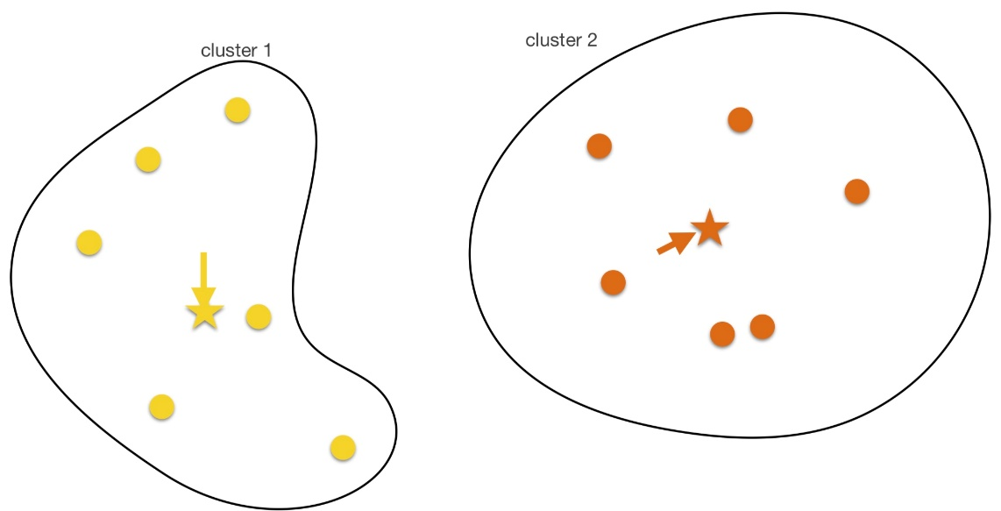
Milestone 3: Shift detection/ k-means clustering
How to?
→ figure out difference of the maxima
(Ctrl vs. Rnase)
→ K-means clustering for assigning each protein into
clusters with regard to their shift characteristics (left shift,
right shift, no shift) and assign biological meaning to it
Outcome?
→ 2 df (one df per cleaning method)
→ 2 clusters (RNA-dependent and RNA-independent cluster)
Source: Lecture Computer Science Dr. Carl Hermann

Slide 14
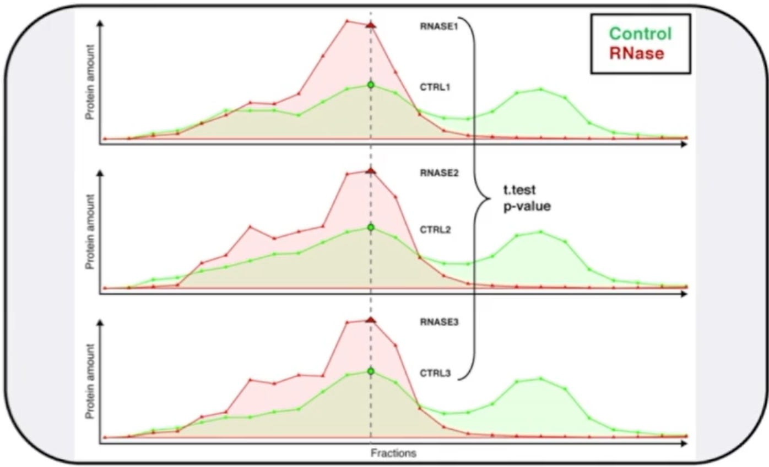
Milestone 4: Definition and application of selection criteria
How to?
→ Define selection criteria ( evaluating the relationship between shift
characteristics and RBPs)
→ apply selection criteria to our 2 df (statistical test, t-test?)
→ determine which human proteins are RBP with insights of milestone 3
→ visualize proteins
Outcome?
→ in ideal case: proteins that are RBPs
→ method to identify them automatically
Source: https://www.dropbox.com/s/ivm1q7fpf9153j3/2022_Project3_Data_Analysis.mp4?dl=0

Slide 15
Milestone 5: Further analysis and report
How to?
→ get comparable information about RBPs ( Uniprot, R-Deep, RBP2GO)
→ develop linear regression model to identify R-DeeP
→ highlight outstanding RBPs
Outcome?
→ outstanding RBPs
→ confirmed RBPs
→ RNA- independent proteins

Slide 16
WEEK
1
Data restructuring, normalization and cleanup
WEEK
2
WEEK
3
WEEK
4
WEEK
5
WEEK
6
WEEK
7
WEEK
8
Define Criteria for RNA dependent Protein
Application of criteria
Further analysis
Report Part 1
Report Part 2
Absolute and Local Maxima (Peaks)
Shift detection and clustering

