Slide 1
PROTEOME-WIDE SCREEN FOR RNA-DEPENDENT PROTEINS non-synchronized A549 cells datascience SS22, project 3 group 4
Greta Karathanos, Khalida Dushimova, Madleen Piegsa, Richard Langi

Slide 2
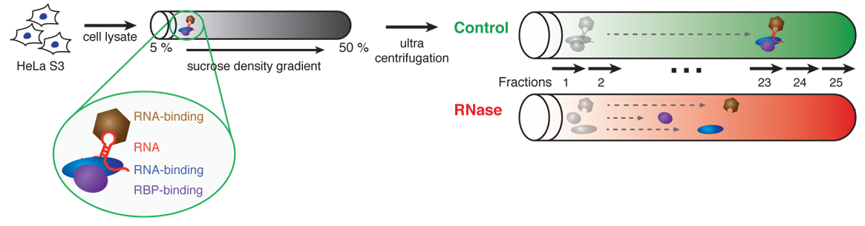
The concept of R-DeeP: Proteome-wide Screen for RNA-dependent Proteins
RNA-binding proteins (RBPs)
—> RNA processing and modification (Alternative splicing, RNA editing, polyadenylation), export, mRNA localization, translation
—> disfunction of RBPs: influence on embryonic development and cancer
Notes:
Dies ist die Frage, auf die Ihr Experiment die Antwort gibt

Slide 3
Our dataset
Mass spectrometry data from non-synchronized A549 cells
non-synchronized A549 cells? → Lung carcinoma cells (Caucasian male)
Structure of the data? → amount of each protein (3680 human proteins, one protein per row) per fraction (2 samples x 25 fractions x 3 replicates = 150 columns)
Human protein | Fraction 1 Rep.1 Ctlr | Fraction 1 Rep.1 RNase | Fraction 1 Rep.2 Ctlr | Fraction 1 Rep.2 RNase | Fraction 1 Rep.3 Ctlr | Fraction 1 Rep.3 RNase
SPB6_HUMAN | x | x | x | x | x | x
CRYAB_HUMAN | x | x | x | x | x | x
VIGLN_HUMAN | x | x | x | x | x | x

Slide 4
Project Goals/ Milestones
Restructuring, normalization and datacleanup
Our aim? → automatically identify RNA-dependent proteins by analyzing our masspectometry data
Identification of peaks
Shift detection/
k-means clustering
Definition and application of selection criteria
Further analysis and report
Notes:
Fassen Sie Ihre Forschung in drei bis fünf Punkten zusammen.

Slide 5
Milestone 1: Restructuring the data
Ctrl group
Fractions | SPB6_HUMAN_REP_1 | SPB6_HUMAN_REP_2 | SPB6_HUMAN_REP_3 | CRYAB_HUMAN_REP_1 | CRYAB_HUMAN_REP_2 | CRYAB_HUMAN_REP_2
Fraction_1 | x | x | x | x | x | x
Fraction_2 | x | x | x | x | x | x
Fraction_3 | x | x | x | x | x | x
Rnase group
Fractions | SPB6_HUMAN_REP_1 | SPB6_HUMAN_REP_2 | SPB6_HUMAN_REP_3 | CRYAB_HUMAN_REP_1 | CRYAB_HUMAN_REP_2 | CRYAB_HUMAN_REP_2
Fraction_1 | x | x | x | x | x | x
Fraction_2 | x | x | x | x | x | x
Fraction_3 | x | x | x | x | x | x

Slide 6
Milestone 1: Normalization
Why?
→ total amount (protein) of every replicate should be
similar
→ change values of numeric columns in our dataset to
a common scale

Slide 7
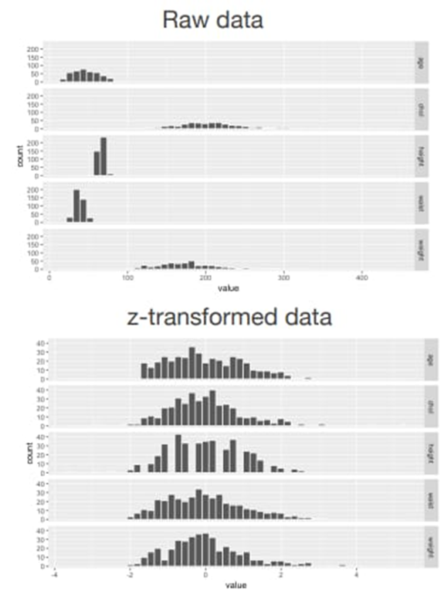
Milestone 1: Normalization
How to?
→ standarize several variables using
the scale function and Z-transformation
→ apply to control and Rnase table
→ compare both methods
Outcome?
→ 4 dataframes (df) (3*3680 x 25) 2 for the control and 2 for the RNase group
Source: Lecture Computer Science Dr. Carl Hermann

Slide 8
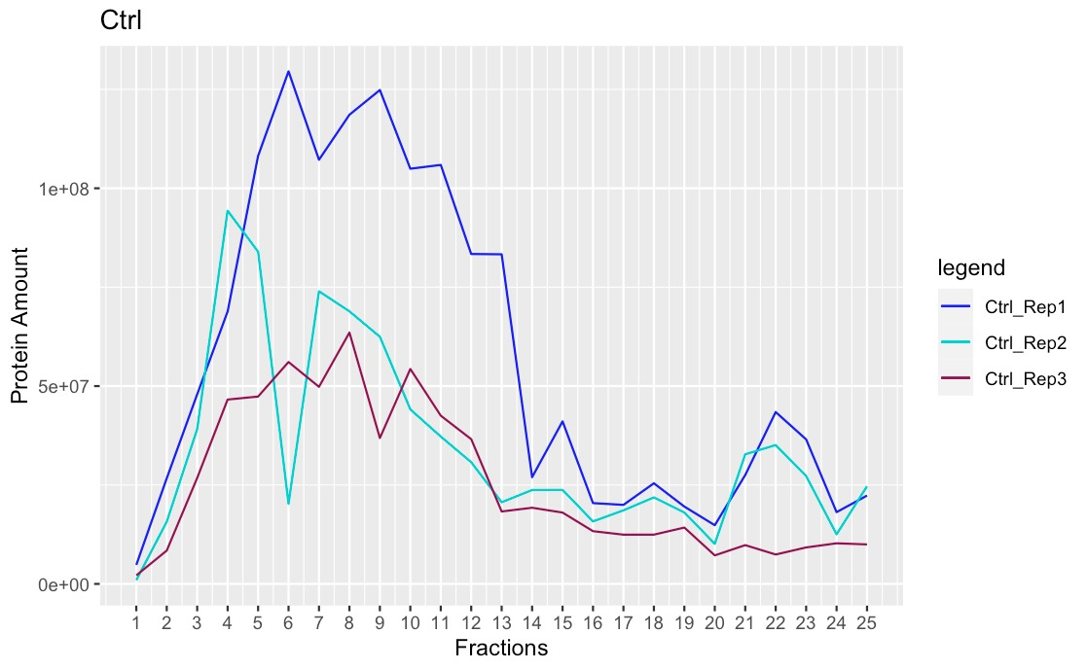
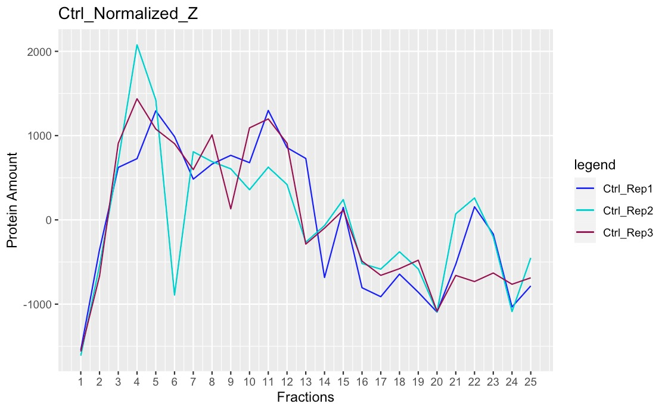
Milestone 1: Normalization (Ctrl group)
Before
After

Slide 9
Milestone 1: Datacleanup
How to?
→ use two cleanup methods (mean, median)
→ compare both methods
Outcome?
→ 4 df (3680x25) for 2 cleanup methods ( for each cleanup method 1 df for the
control group and 1 df for the Rnase group

Slide 10
Milestone 2: Identification of peaks
How to?
→ create function that detects maxima automatically
→ compare the results of the self-written function with the existing function
→ adjust self-written function → maxima precisely determinable
Outcome?
→ own maxima detection function
→ 4 df with number and location of the maxima for each protein

Slide 11
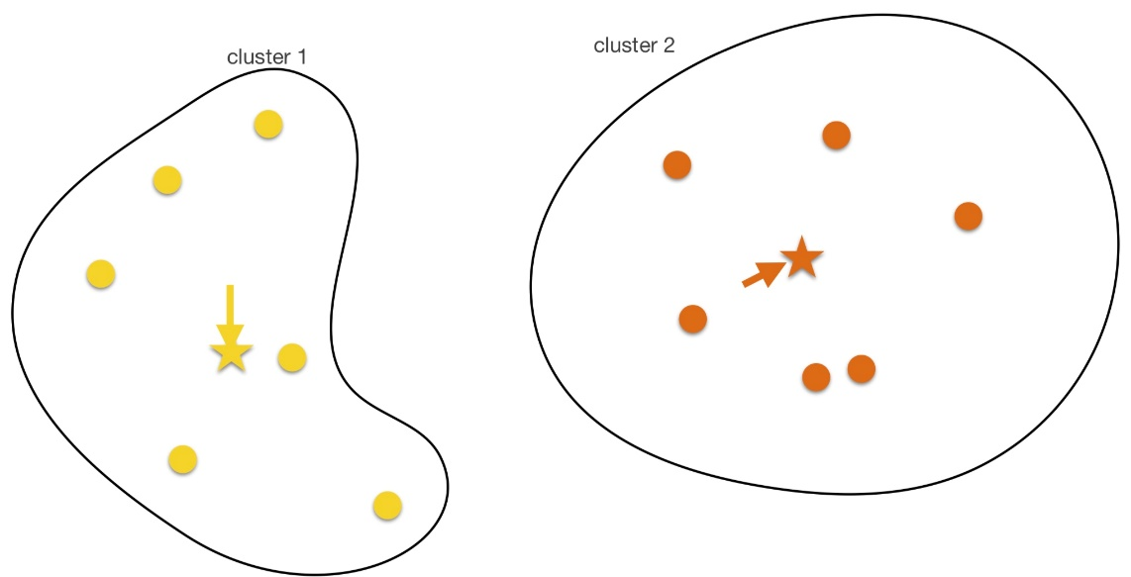
Milestone 3: Shift detection/ k-means clustering
How to?
→ figure out difference of the maxima
(Ctrl vs. Rnase)
→ K-means clustering for assigning each protein into
clusters with regard to their shift characteristics (left shift,
right shift, no shift) and assign biological meaning to it)
Outcome?
→ 2 df (one df per cleaning method)
→ 2 clusters ( RNA-dependent and RNA-independent cluster)
Source: Lecture Computer Science Dr. Carl Hermann

Slide 12
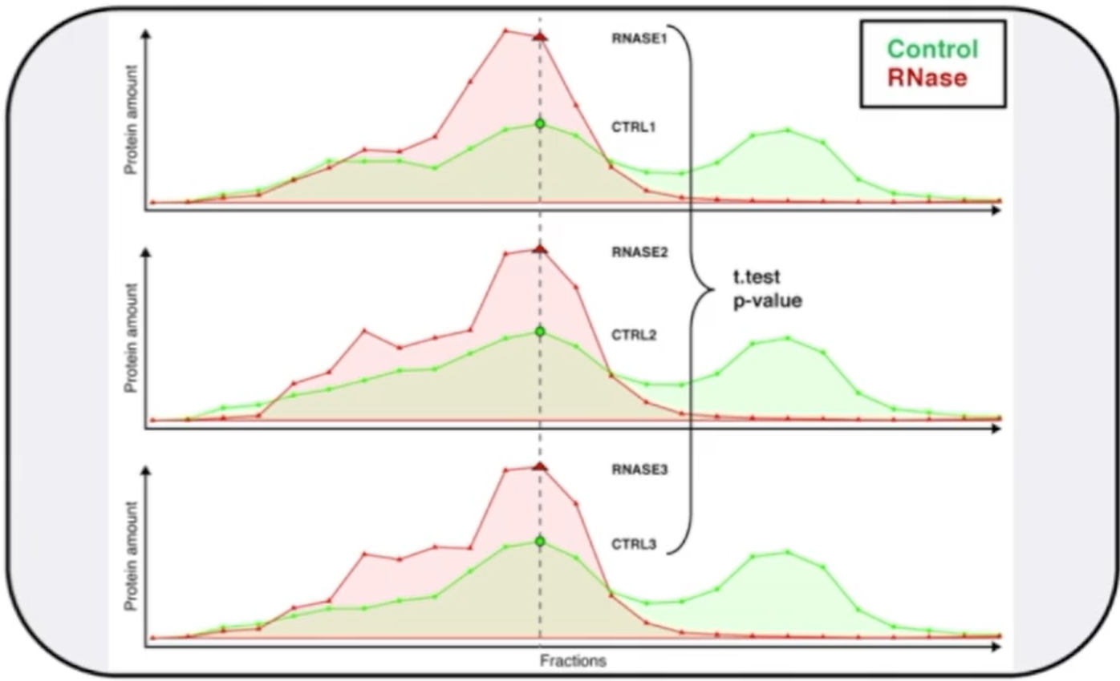
Milestone 4: Definition and application of selection criteria
How to?
→ Define selection criteria ( evaluating the relationship between shift
characteristics and RBPs)
→ apply selection criteria to our 2 df (statistical test, t-test?)
→ determine which human proteins are RBP with insights of milestone 3
→ visualize proteins
Outcome?
→ in ideal case: proteins that are RBPs
→ method to identify them automatically
Source: https://www.dropbox.com/s/ivm1q7fpf9153j3/2022_Project3_Data_Analysis.mp4?dl=0

Slide 13
Milestone 5: Further analysis and report
How to?
→ get comparable information about RBPs ( Uniprot, R-Deep, RBP2GO)
→ develop linear regression model to identify R-DeeP
→ highlight outstanding RBPs
Outcome?
→ outstanding RBPs
→ confirmed RBPs
→ RNA- independent proteins

Slide 14
WEEK
1
Data restructuring, normalization and cleanup
WEEK
2
WEEK
3
WEEK
4
WEEK
5
WEEK
6
WEEK
7
WEEK
8
Define Criteria for RNA dependent Protein
Application of criteria
Further analysis
Report Part 1
Report Part 2
Absolute and Local Maxima (Peaks)
Shift detection and clustering

