Slide 1
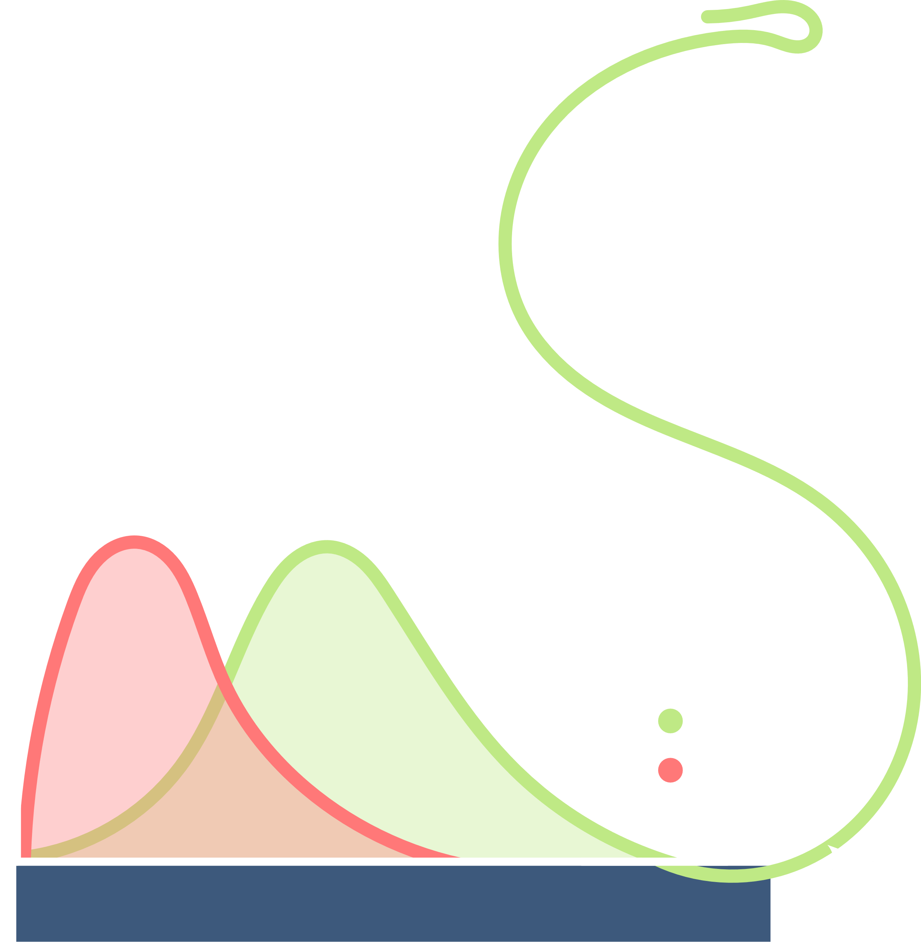
Final Presentation
Proteome-wide Screen for RNA-dependent Proteins
Team 3: HeLa Cells Synchronized in Interphase
Hannah Brehm, Johann Blakytny, Kira Hoffmann, Viktor Bonin
Data Analysis Project Summer Term 2023
Supervisor: Dr. Maïwen Caudron-Herger
Tutor: Fabio Rauscher
Wednesday, 19.07.2023

Slide 2
Biological Background • Methods • Results • Outlook
02
# Überschrift #
# Text #
# Source #
Proteome-wide Screen for RNA-dependent Proteins I Team 3: HeLa Cells Synchronized in Interphase I Summer Term 2023 I 19.07.2023 I Supervisor: Dr. Maïwen Caudron-Herger

Slide 3
Biological Background • Methods • Results • Outlook
04
# Überschrift #
# Text #
# Source #
Proteome-wide Screen for RNA-dependent Proteins I Team 3: HeLa Cells Synchronized in Interphase I Summer Term 2023 I 19.07.2023 I Supervisor: Dr. Maïwen Caudron-Herger

Slide 4
Biological Background • Methods • Results • Outlook
05
# Überschrift #
# Text #
# Source #
Proteome-wide Screen for RNA-dependent Proteins I Team 3: HeLa Cells Synchronized in Interphase I Summer Term 2023 I 19.07.2023 I Supervisor: Dr. Maïwen Caudron-Herger

Slide 5
Biological Background • Methods • Results • Outlook
15
# Überschrift #
# Text #
# Source #
Proteome-wide Screen for RNA-dependent Proteins I Team 3: HeLa Cells Synchronized in Interphase I Summer Term 2023 I 19.07.2023 I Supervisor: Dr. Maïwen Caudron-Herger

Slide 6
Backup

Slide 7
Biological Background • Methods • Results • Outlook
16
# Überschrift #
# Text #
# Source #
Proteome-wide Screen for RNA-dependent Proteins I Team 3: HeLa Cells Synchronized in Interphase I Summer Term 2023 I 19.07.2023 I Supervisor: Dr. Maïwen Caudron-Herger

