Slide 1
Impact of Relative Humidity on Dengue cases in Thailand
Project
Proposal
By Noemi Tigrato, Lea Mrowiec, Manon Mandernach, Paula Mostert
Notes:
Hello and Welcome
Group one
Focus on relative humidity and its impact on dengue fever cases in Thailand
To start off we need to discuss dengue fever and have a quick overview over the seasons in Thailand because that’s where our reseachr question is at the intersection

Slide 2
Dengue fever
Viral Vector:
Aedes aegypti; Aedes albopictus
Four serotypes (DENV 1-4) of ssRNA virus of the genus Flavivirus
Symptoms:
High fever, severe headaches, nausea, skin rash, joint pain etc.
Notes:
mosquito-transmitted virus and the leading cause of arthropod-borne viral disease in the world
primary vectors of the disease are female mosquitoes of the species Aedes aegypti and Aedes albopictus
aegypti → associated with most infections
four serotypes (DENV 1-4) of ssRNA virus of the genus Flavivirus → infection of one serotype results in life-long immunity
The infectious cirle includes: mosquitos and non-human primate
mosquitos and humans → depends if human to mosquitos (viral load)
Very limited treatment options
Apparent in tropical and sub-tropical regions: high hospitalizations and many deaths especially in children

Slide 3
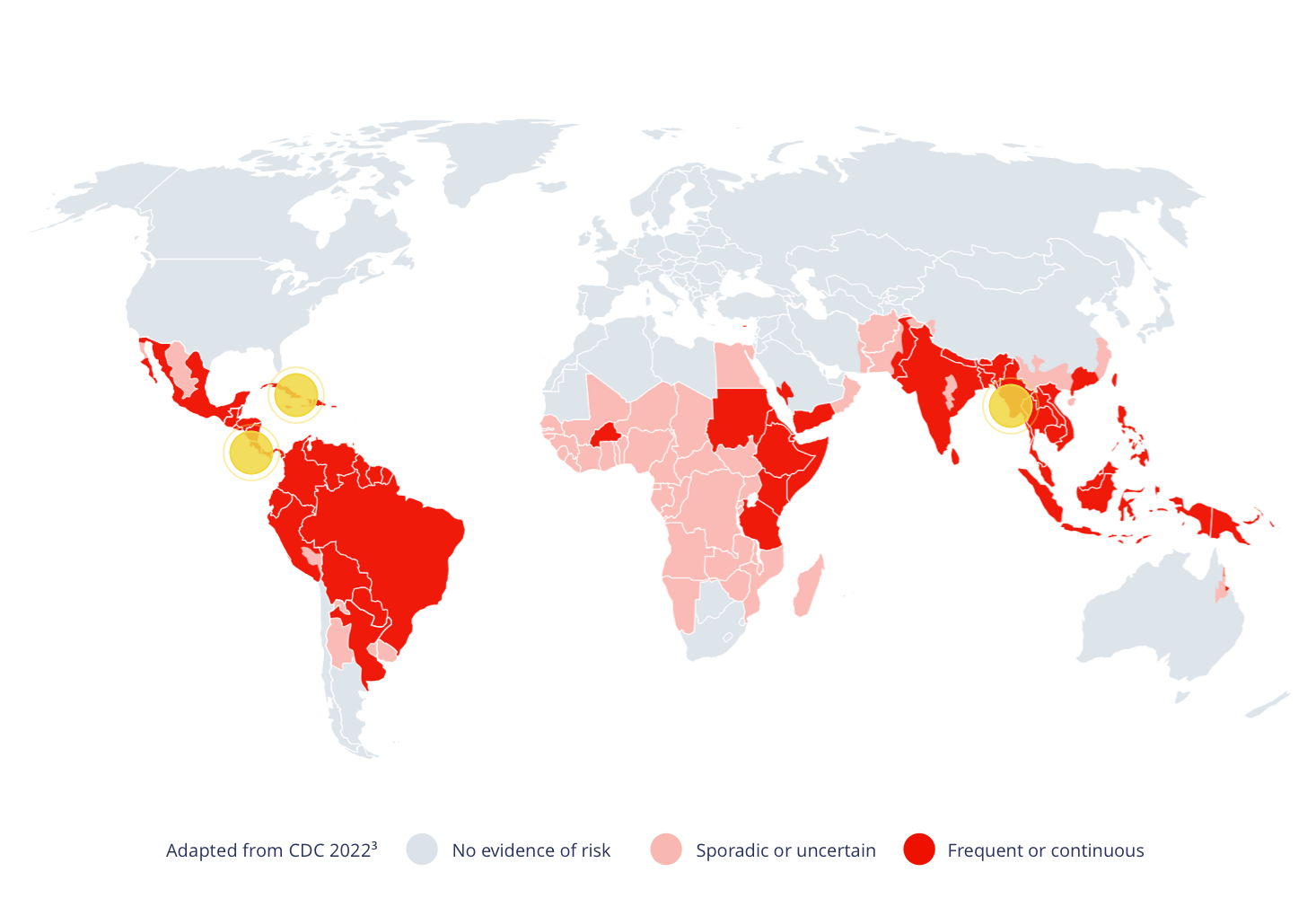
Dengue Fever Prevalence
Notes:
Approximately 3.9 billion people living in endemic areas - half of the world's population — are at risk of dengue every day.
The number of cases reportetd from the WHO increased over 10-fold in the last 2 decades from 505 430 in 2000 to over 2.4 million in 2010 and 5.2 mil in 2019
Thailand is in the heart of Southeast Asia.
Apparent in tropical and sub-tropical regions: high hospitalizations and many deaths especially in children

Slide 4
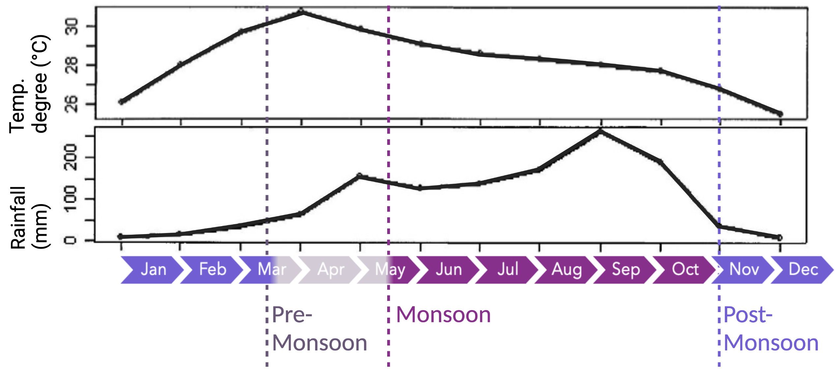
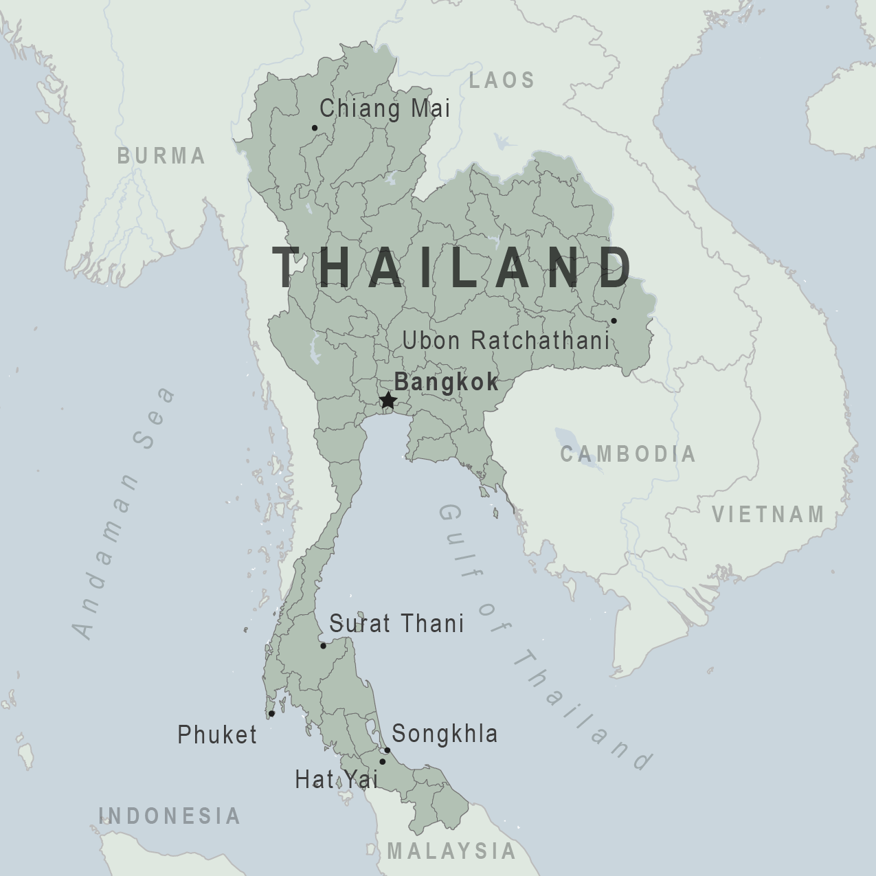
Climate in Thailand
Notes:
Monsoon is main driver of seasonal weather changes
Hospitalization rises during monsoon period , decreases months later
During the monsoon seasons: rise in rainfall
Pre-monsoon seasons: higher temperature
Singhrattna, N., B. Rajagopalan, K. K. Kumar, and M. Clark, 2005: Interannual and Interdecadal Variability of Thailand Summer Monsoon Season. J. Climate, 18, 1697–1708, https://doi.org/10.1175/JCLI3364.1.

Slide 5
South-west monsoon
North-east monsoon
Notes:
Post- monsoon : nov-mid may:
North east monsoon -> cool seasons with less peripitation and lower temperatures
Pre-monsoon: mid mar – mid may
Hot season
switch between the different monsoons
Temperatures are the highest and pericpitaion increases
Monsoon: south-west-monsoon
Wet season
Highest rainfall
-> connection to dengue fever: mosquitos and especially the larves cycle has an influence on the incidents cases

Slide 6
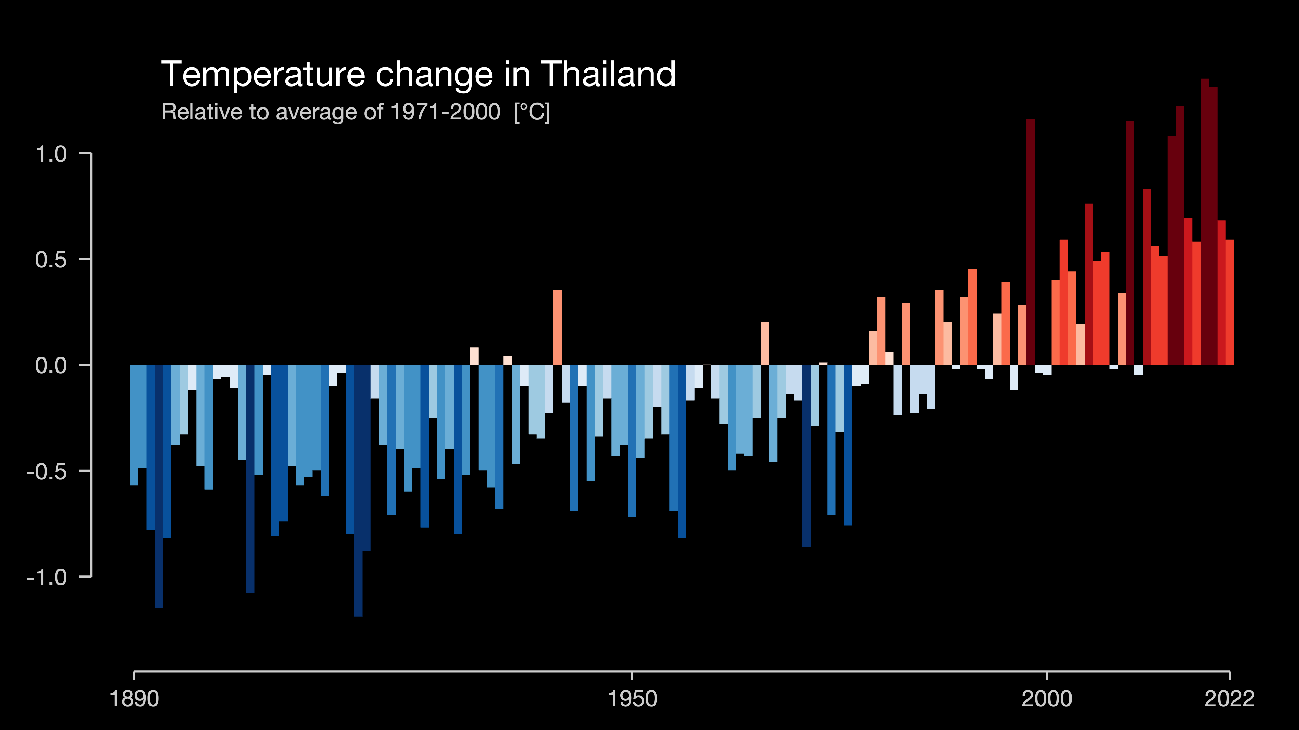
Relevance
Climate change in Thailand is creating favourable conditions for dengue transmissions:
increase of 1.0-3.8°C in mean temperature until 2099 is expected
Dengue is a high socioeconomic burden
→ Warning systems and predictions are vital to recognize outbreaks early on, to react accordingly and distribute limited resources

Slide 7
Hypothesis
Relative humidity has a positive impact on dengue fever cases in Thailand between the years 2006-2020
Can we define geographical and temporal Clusters for Dengue cases and humidity?
Can we find relations between the dengue and humidity clusters?
geographically
Yearly
Monthly (Pre-, Post- and Inter-monsoon)
What is the relationship between population density and dengue cases?
Dengue cases
humidity

Slide 8
Relation between climate and mosquito
Increased Biting Rate
More Breeding Possibilities
Decreased Incubation Rate
Temperatur Increase
Higher Precipipitation Rate
Climate Change
Geographical Shift
Destroyed Larvea by heavy Rainfall

Slide 9

Relative Humidity
= the amount of water vapor in the air at a given temperature as a percentage of the amount needed for saturation
relative humidity < 100%
100% relative humidity
relative humidity > 100%
oversaturation, rain
25%
50%
75%
125%
temperature
relative humidity
absolute humidity
Inspired by: https://ibidi.com/content/371-humidity-and-evaporation
Notes:
Definition: how much water vapor is in the air meassured as a percentage of the maximum amount of water vapor that can be present in the air
Max amount of water air van contain dependent on temperature
The higher the temperature the higher the maximum amount of water vapor that can be contained
The same amount of absolute humidity shows different values of relative humidity at different temperatures
Oversaturation: more relative humidity than amount of vapor that can bei containes in the air at the given temperature → rain

Slide 10
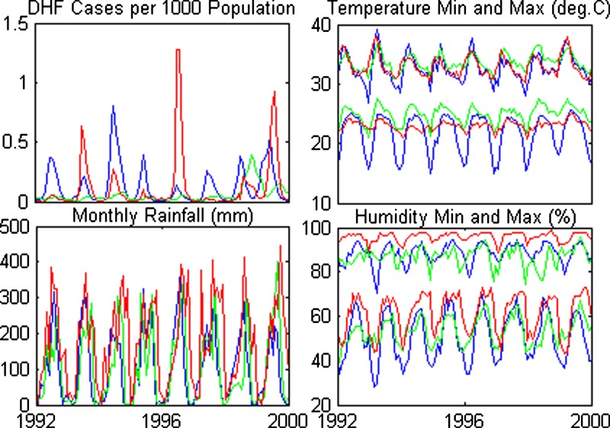
Relative Humidity
Blue: Udon Thani (northeast)
Green: Bankok (south-central)
Red: Trang (south)
Campbell KM, Lin DC, lamsirithaworn S, Scott TW. The complex relationship between weather and dengue virus transmission in Tailand. Am J Trop Med Hyg. 2013 Dec;89(6):1066-1080.doi: 10.4269/ajtmh.13-0321.Epub 2013 Aug 19. PMID: 23958906; PMCID: PMC3854883.
Notes:
Connection of relative humidity to dengue cases:
Graphs show max and min humidity between 1992 and 2000 in northeast, south-canter and south of T
Periodicity/ multiple peaks of dengue cases, humidity
Geographical differences in hights of peaks

Slide 11



Aspect of population
Challenge: different characteristics of provinces influence which analysis model is best suited
Strongly connected provinces show higher correlation of dengue cases than weaker connected provinces
Larger Populations improves breeding environemt for Aedes mosquito
Notes:
Complex relationships between different factors (not a petri dish, controlled environment)
Larger population → more blood mosquitos can feed on
Strongly connectes provinces ahow higher correlation of dengue cases than weaker connected provinces
Different characteristics and overall very difficult to analyse

Slide 12
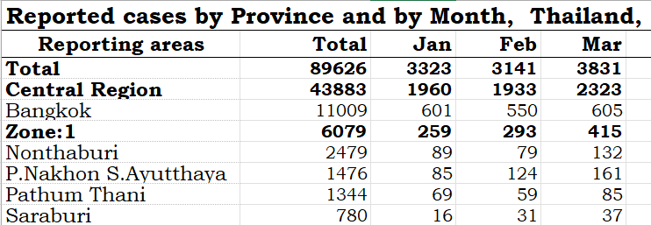
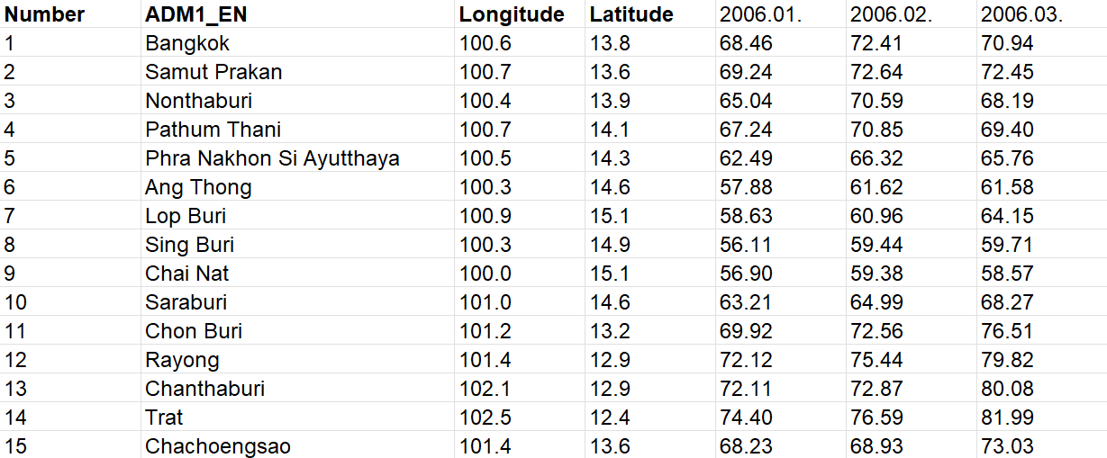
Data
Dengue cases in each province per month from 2006 to 2020,extracted from yearly reports
Monthly mean values of relative humidity, temperature and rainfall in each province 2006 to 2020 (ERA5)
Provinces
Spatial information
Monthly data from 2006-2020

Slide 13
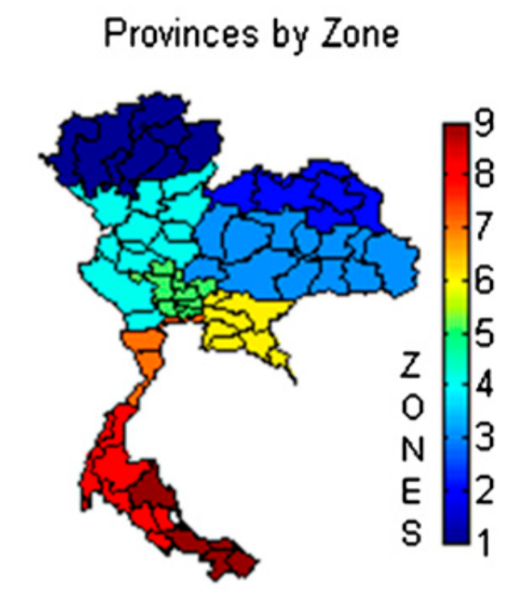
Methods
Time series analysis
spatial-temporal-analysis
Descriptive Analysis
Correlation analysis
Clustering
Poisson modelling
Regression analysis
ARIMA or GAM

Slide 14
timeline
Step 1
Step 2
Step 3
Step 4
Step 5
Research and Organization
Prepare Data
Coding
Presentation
Buffer
Week 22
Week 23
Week 24
Week 25
Week 26
Week 27
Week 28
get familiar with the Data
Prepare Data for further Coding
Code for Tasks and Subtasks
writing and designing our final presentation
brainstorming
project ideas
running
experiments and models
Project Proposal
finalizing and
Evaluating results

Slide 15
Sources
Title : Spatiotemporal Dynamics of Dengue Epidemics, Southern Vietnam; Personal Author(s) : Cuong, Hoang Quoc;Vu, Nguyen Thanh;Cazelles, Bernard;Boni, Maciej F.;Thai, Khoa T.D.;Rabaa, Maia A.;Quang, Luong Chan;Simmons, Cameron P.;Huu, Tran Ngoc;Anders, Katherine L.; Published Date : Jun 2013; Source : Emerg Infect Dis. 19(6):945-953.URL : https://stacks.cdc.gov/view/cdc/18983
Do, T.T.T., Martens, P., Luu, N.H. et al. Climatic-driven seasonality of emerging dengue fever in Hanoi, Vietnam. BMC Public Health 14, 1078 (2014). https://doi.org/10.1186/1471-2458-14-1078
Pumijumnong, N., Eckstein, D. Reconstruction of pre-monsoon weather conditions in northwestern Thailand from the tree-ring widths of Pinus merkusii and Pinus kesiya . Trees25, 125–132 (2011). https://doi.org/10.1007/s00468-010-0528-4
https://science.howstuffworks.com/nature/climate-weather/atmospheric/question651.htm
https://www.vaisala.com/en/expert-article/relative-humidity-how-is-it-defined-and-calculated
Campbell KM, Lin CD, Iamsirithaworn S, Scott TW. The complex relationship between weather and dengue virus transmission in Thailand. Am J Trop Med Hyg. 2013 Dec;89(6):1066-1080. doi: 10.4269/ajtmh.13-0321. Epub 2013 Aug 19. PMID: 23958906; PMCID: PMC3854883.
Campbell KM, Lin CD, Iamsirithaworn S, Scott TW. The complex relationship between weather and dengue virus transmission in Thailand. Am J Trop Med Hyg. 2013 Dec;89(6):1066-1080. doi: 10.4269/ajtmh.13-0321. Epub 2013 Aug 19. PMID: 23958906; PMCID: PMC3854883.
Climatic Factors Affecting Dengue Haemorrhagic Fever Incidence in Southern Thailand S. Promprou, M. Jaroensutasinee! and K. Jaroensutasinee Institute of Science, Walailak University, 222 Thaiburi, Thasala District, Nakhonsrithammarat 80160, Thailand
https://www.thaizer.com/the-effects-of-the-monsoon-on-thailands-weather/
https://education.nationalgeographic.org/resource/monsoon/
https://scijinks.gov/what-is-a-monsoon/#:~:text=A%20monsoon%20is%20caused%20by,blow%20from%20cold%20to%20warm
https://www.thaizer.com/the-effects-of-the-monsoon-on-thailands-weather/
Schaefer TJ, Panda PK, Wolford RW. Dengue Fever. [Updated 2022 Nov 14]. In: StatPearls [Internet]. Treasure Island (FL): StatPearls Publishing; 2023 Jan-. Available from: https://www.ncbi.nlm.nih.gov/books/NBK430732/
Dengue Fever | NIH: National Institute of Allergy and Infectious Diseases
https://www.leicestermercury.co.uk/news/uk-world-news/symptoms-dengue-fever-watch-amid-8351403

