Slide 1
The role of tissue-specific antigens in different cancer entities
Analysis of Csn Genes
Supervisor: Dr. Maria Dinkelacker
Tutor: Nils Mechtel
Subject: Data Science SoSe 2021
Date of Presentation: 04.06.2021
Participents: Anastassia Fink, Andreas Breuß, Yuan Sun, Leon Hornich

Slide 2
Biological Background

Slide 3
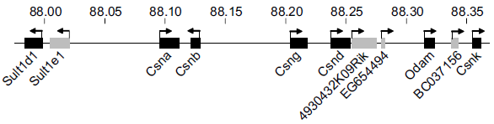
Casein Genes (CSN)
Casein genes: Csna, Csnb, Csng, Csnd, Csnk
Temporarily regulated during late pregnancy and postpartum lactation period (-> horome dependent)
TRA restricted to mammary gland epithelial cells (MEC)
Located in the casein gene region on chromosome 5
Derbinski et al. 2008, Promiscuous gene expression patterns in single medullary thymic epithelial cells argue for a stochastic mechanism, Proc Natl Acad Sci U S A. 2008 Jan 15;105(2):657-62.

Slide 4
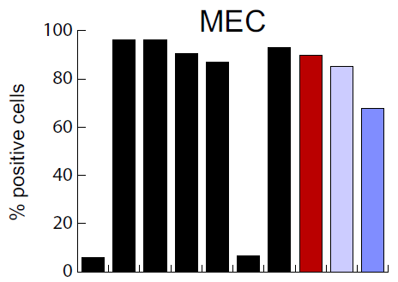

Correlation with other genes
Csna, Csnb, Csng, Csnd, Csnk
-> Coexpressed in MEC
Functionally related genes: lactalbumin-α (Lalba), whey acidic protein (WAP) and Elf5
-> These genes show correlated expression
with Csn in MEC
Colocalized genes: Sult1d1 and Odam
-> These genes show no correlated expression
with Csn in MEC
Derbinski et al. 2008, Promiscuous gene expression patterns in single medullary thymic epithelial cells argue for a stochastic mechanism, Proc Natl Acad Sci U S A. 2008 Jan 15;105(2):657-62.

Slide 5
Data Exploration

Slide 6
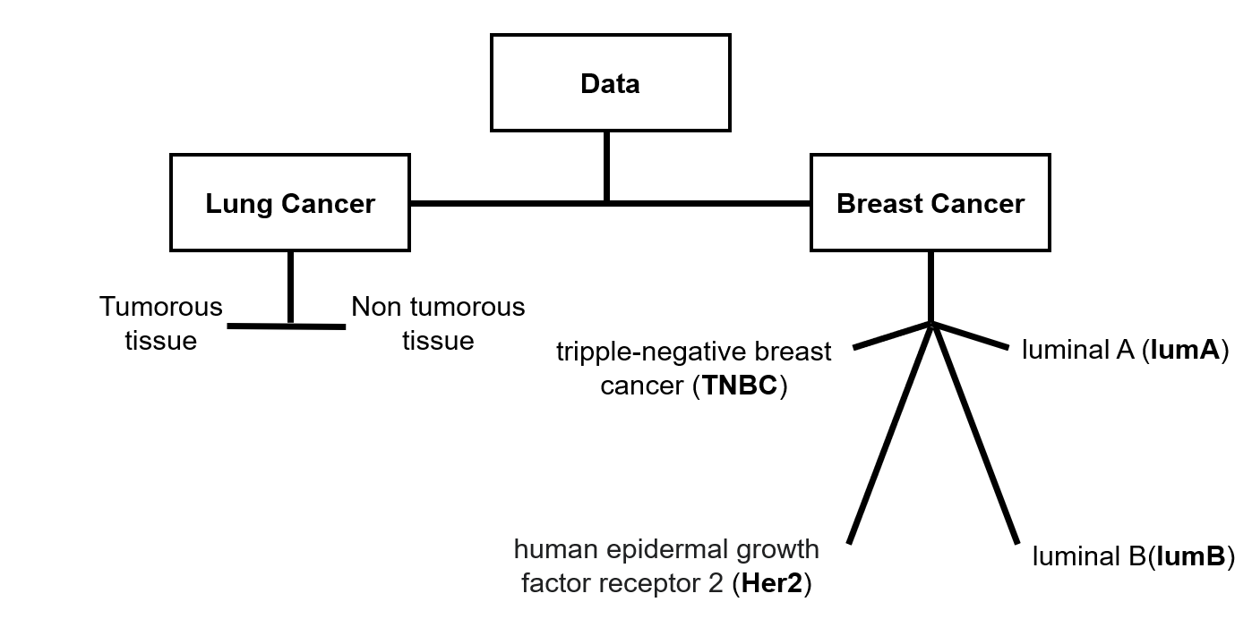
Datasets

Slide 7
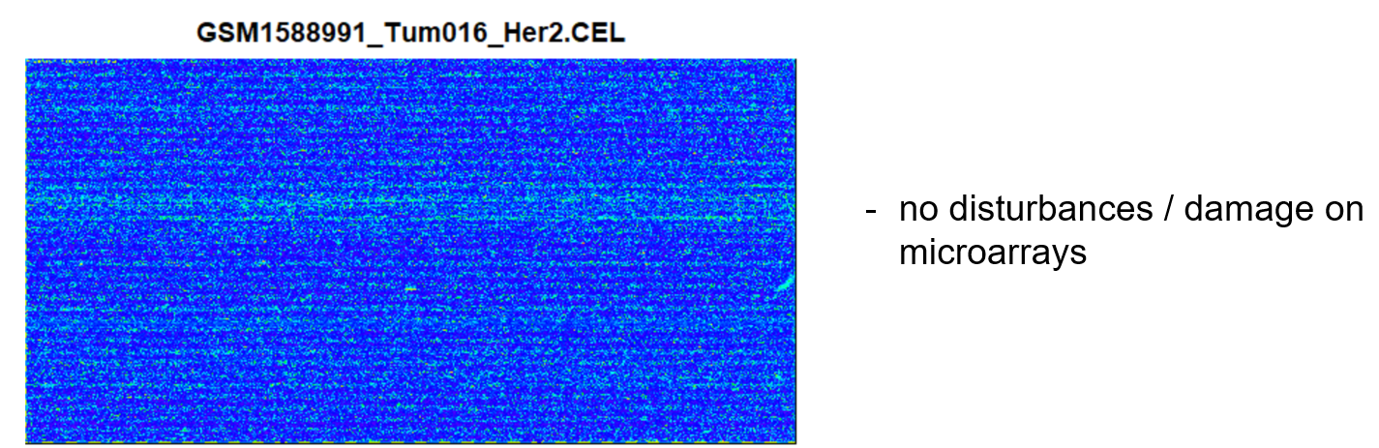
Microarray´s
no disturbances / damage on microarrays

Slide 8
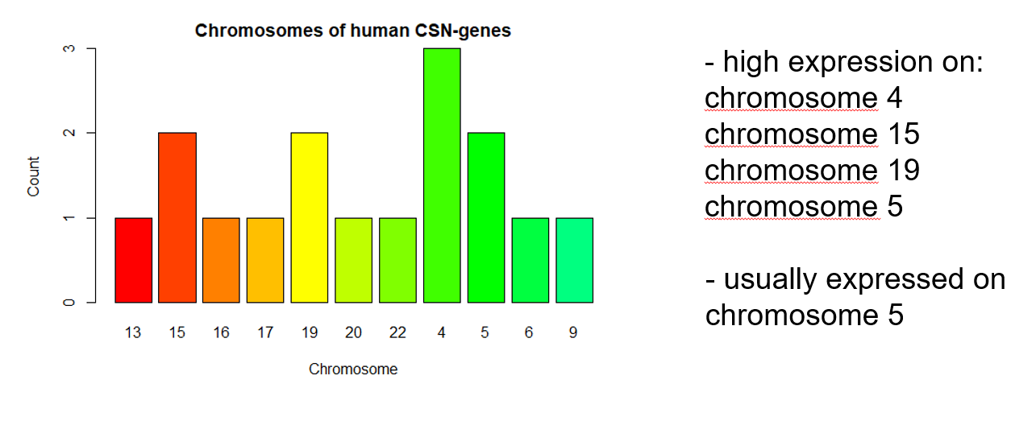
Distribution over chromosomes
16 csn transcripts

Slide 9
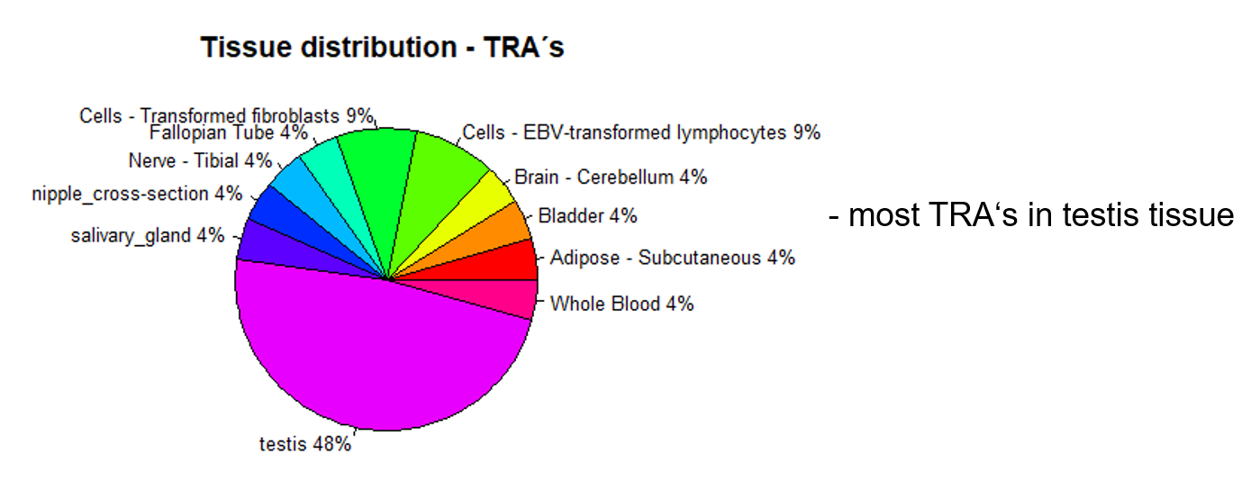
Tissue distribution - TRA´s

Slide 10
Quality control

Slide 11
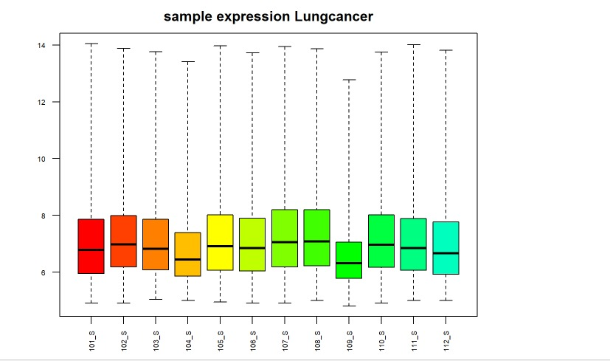
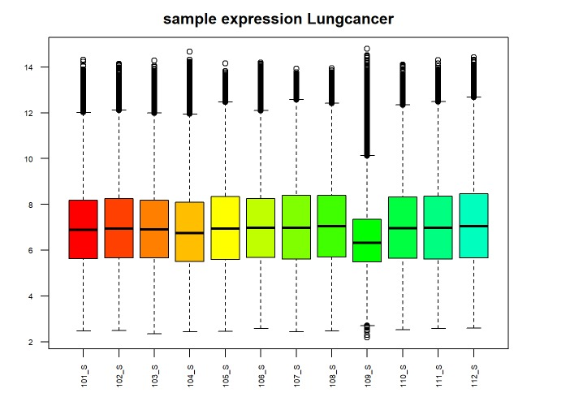
Normalization of Microarrays
before the normalization
after the normalization
low level of expression
origin of the sample (really from tumor cell)?
11

Slide 12
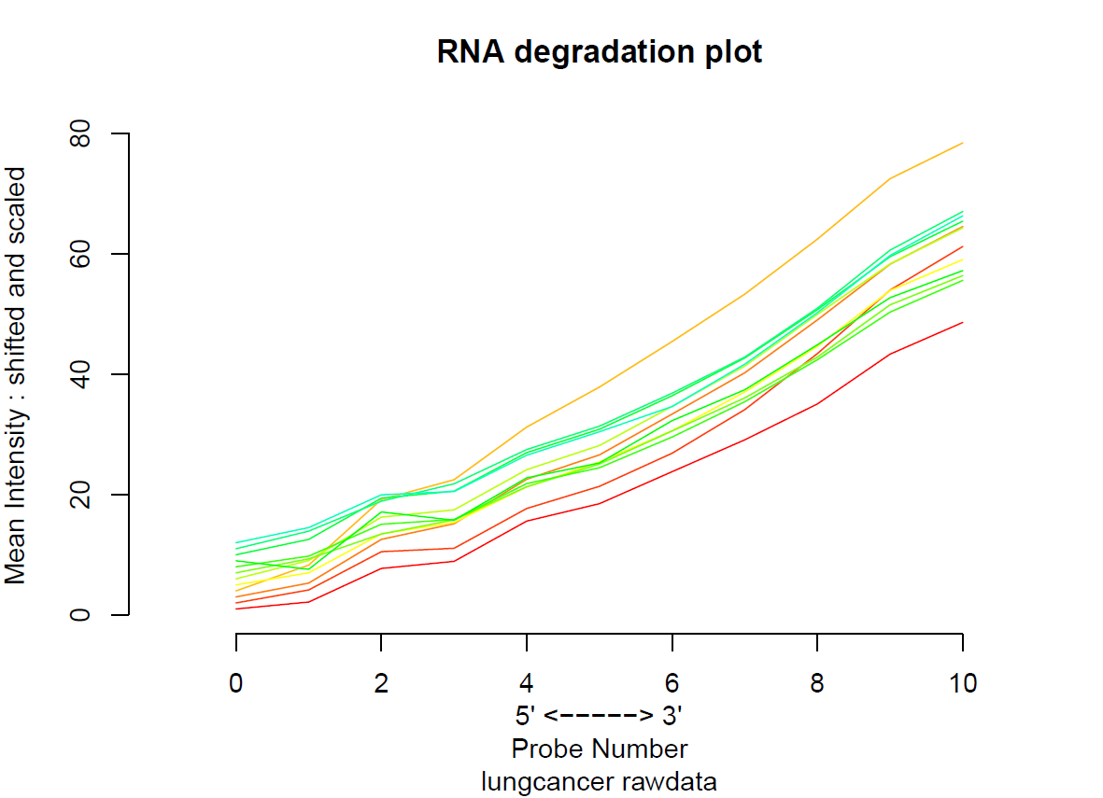
Rna degradation
Overlap because of abnormal chips?

Slide 13
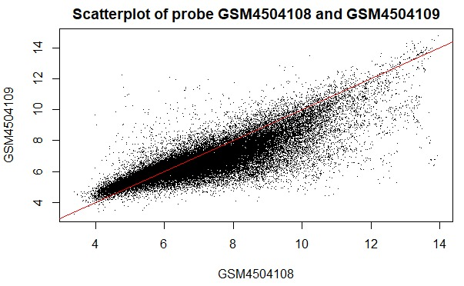
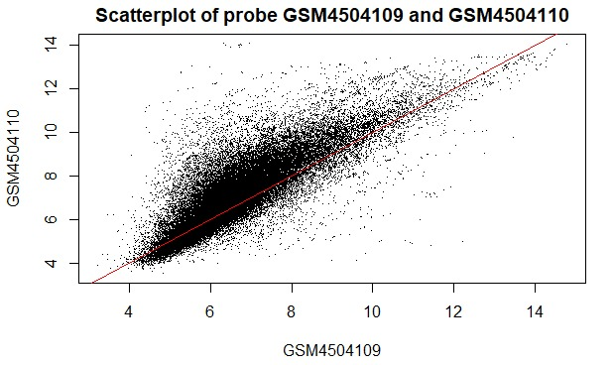

Scatterplot

Slide 14
Goals

Slide 15
Questions
We want to determine weather Casein genes are up-regulated in breast or lung cancer - potentially good target for cancer immunotherapy
Furthermore, we want to evaluate if overexpression is limited to a specific loci in cancer cells

Slide 16
Are genes of interest overexpressed in cancer in comparison to healthy samples?
Is there a possible conclusion from one gene to another?
Visualize our data.
Which gene store´s the most information?
Are there significant patterns in context to our goals?
Heatmap
T-test
PCA
Regression

Slide 17
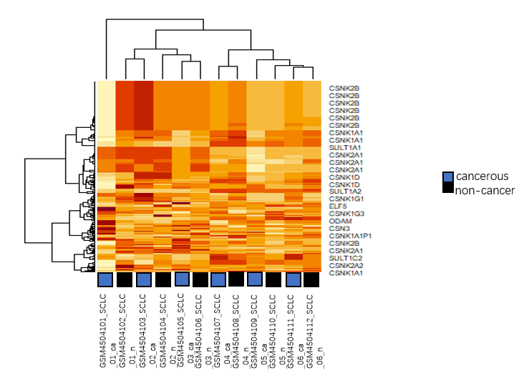
Heatmap lungcancer
26 gene transcripts listed

Slide 18
Heatmap
PCA
F-test
09.06
23.06.
02.06
09.06
06.07.
One-sided upper t-test
Regression model
Data clean-up

