Slide 1
The role of tissue-specific antigens in different cancer entities
Analysis of CSN Genes
Supervisor: Dr. Maria Dinkelacker
Tutor: Nils Mechtel
Subject: Data Science SoSe 2021
Date of Presentation: 21.07.2021
Participents: Anastassia Fink, Andreas Breuß, Yuan Sun

Slide 2
Biological Background

Slide 3
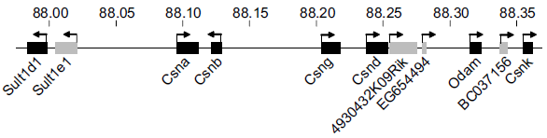
Recap: Casein Genes (CSN)
Casein genes: Csna, Csnb, Csng, Csnd, Csnk
Temporarily regulated during late pregnancy and postpartum lactation period (-> horome dependent)
TRA restricted to mammary gland epithelial cells (MEC)
Location: casein gene region on chromosome 4 in humans (5 in mice)
Derbinski et al. 2008, Promiscuous gene expression patterns in single medullary thymic epithelial cells argue for a stochastic mechanism, Proc Natl Acad Sci U S A. 2008 Jan 15;105(2):657-62.

Slide 4
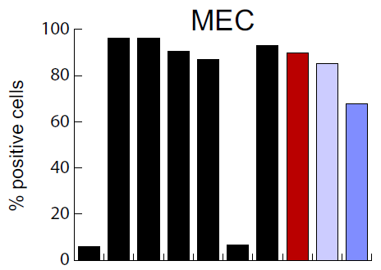

Recap: Correlation with other genes
Csna, Csnb, Csng, Csnd, Csnk
-> Coexpressed in MEC
Functionally related genes: lactalbumin-α (Lalba), whey acidic protein (WAP) and Elf5
-> These genes show correlated expression
with Csn in MEC
Colocalized genes: Sult1d1 and Odam
-> These genes show no correlated expression
with Csn in MEC
Derbinski et al. 2008, Promiscuous gene expression patterns in single medullary thymic epithelial cells argue for a stochastic mechanism, Proc Natl Acad Sci U S A. 2008 Jan 15;105(2):657-62.

Slide 5
Lung cancer dataset
-> Small cell lung cancer (SCLC)
- high-grade neuroendocrine tumor
- very bad prognosis, no targeted therapy is available
- initiating mutations: TP53 and RB1

Slide 6
Breast cancer dataset
-> HER2 positive breast cancer
- overexpression of human epidermal growth factor receptor-2 (HER2)
-> Luminal A (LumA) and luminal B (LumB) breast cancer
- estrogen & progesterone receptors are expressed, additionally other hormone receptor-related genes
-> Triple negative breast cancer (TNBC)
- no expression of estrogen & progesterone receptors and no overexpression of HER2
- poor prognosis: high proliferation rate and genetic instability

Slide 7
Project Goals

Slide 8
Project goals
1. Investigation of the expression of CSN genes in cancer cells
Are any CSN genes up-regulated in cancer?
2. Investigation of the correlation of CSN with other genes
Are functionally related, but not colocalized genes like Lalba, WAP and Elf5 coexpressed with CSN?
Could they be potentially good targets for targeted therapy of cancer?
Are functionally unrelated, but colocalized genes like Sult1d1 and Odam coexpressed with CSN?

Slide 9
Heatmap

Slide 10
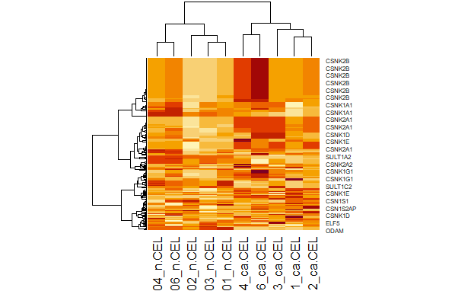
Heatmap from lung cancer data
CSNK2B and CSNK2A1 similar higher expression value in cancerous group than non-cancerous group
Using t-test to prove it

Slide 11
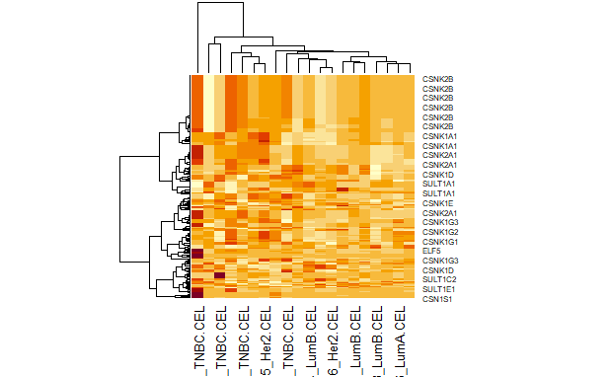
Heatmap from breast cancer data
Find out whether breast cancer TNBC are highly expressed in all CSN genes
Using t-test to prove it

Slide 12
Principal Component Analysis

Slide 13
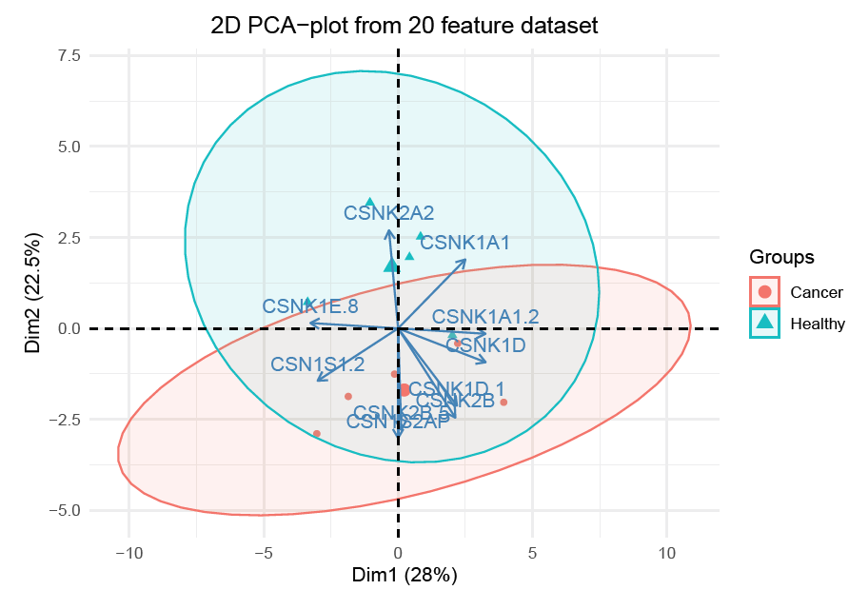
PCA: Lung cancer
before the PCA: all transcripts with a correlation over 0,8 are filtered out
→ from 181 transcripts 20 remain
→ the groups of cancerous and healthy cells are overlapping, a separating trend is visible
→ possible differentiation of cancerous and healthy cells in a bigger dataset

Slide 14
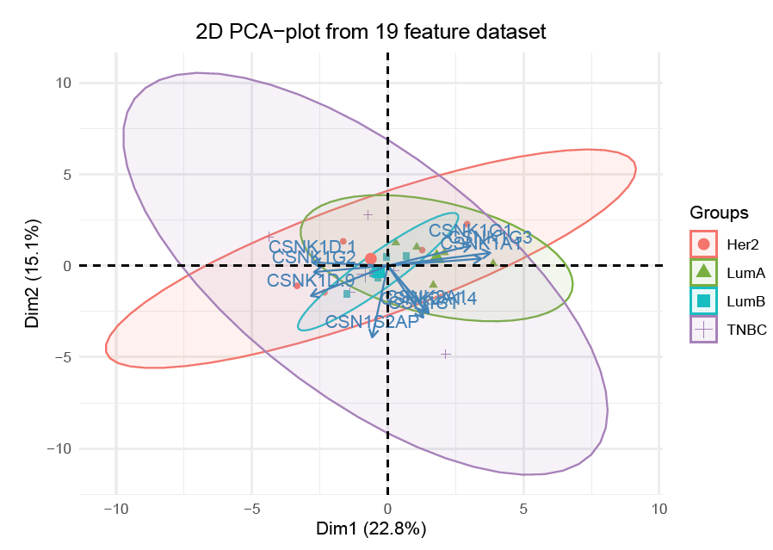
PCA: Breast cancer
before the PCA: All transcripts with a correlation over 0,8 are filtered out
→ from 181 transcripts 19 remain
→ the groups are mostly overlapping, which means that all samples have similar characteristics
→ Interesting: LumA and LumB have less variation in the distribution their samples than TNBC or Her2

Slide 15
T-test

Slide 16
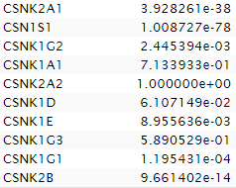
Results of t-test from lung cancer
Gene of interest
P-value from t-test
6 genes out of 10 genes have higher expression value in cancerous group

Slide 17
Results of one way anova test from breast cancer
Gene of interest | P-value from one way anova test
CSNK2A1 | 0.18140659
CSN1S1 | 0.51918957
CSNK1G2 | 0.20523146
CSNK2B | 0.08206299
CSNK1A1 | 0.68839922
CSNK2A2 | 0.10440108
CSNK1G1 | 0.05561539
CSNK1E | 0.56146738
CSNK1D | 0.25862612
CSNK1G3 | 0.24774170
All genes have higher p-value that 0.05 -> no significant difference under the four breast cancer type

Slide 18
Linear regression

Slide 19
Linear regression
Correlations between the casein genes and the genes Sult1A1, ODAM, ELF5 and ODAM
Every CSN transcript was compared with one of the mentioned genes
F-test was used to determine if the H0 thesis is valid or not / p-value

Slide 20
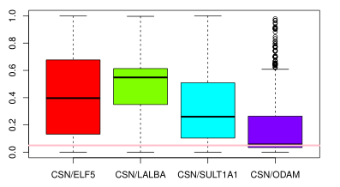
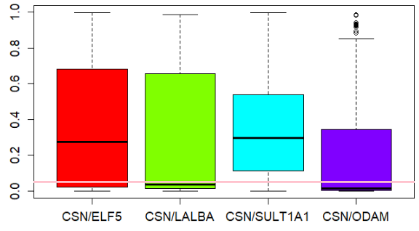
Linear regression
Lung cancer
Breast cancer

Slide 21
Discussion

Slide 22
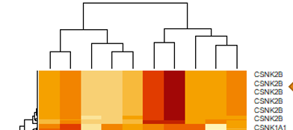
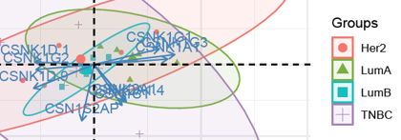
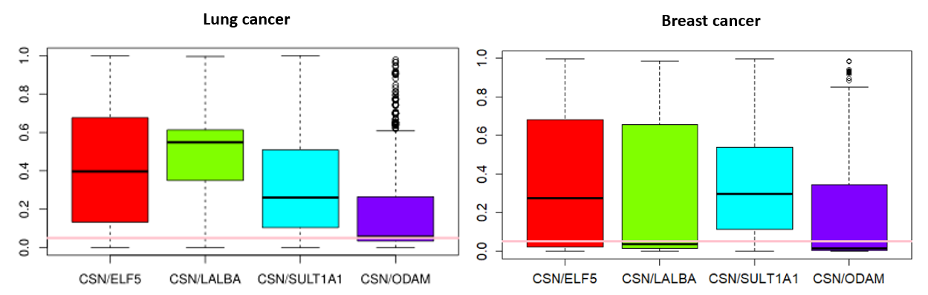
Discussion
Possible Obstacles to keep in mind
Note quiet what we thought
Cluster behaviour
Expression values
Correlations and localization

