Slide 1
TRA expression in pancreatic cells
Can TRA genes be identified that are highly expressed in PDAC tissue but not in ß cells?
Can we identify the fate of pancreatic cells using TRA expression?
by Anna Boot, Bianca Greul, Carolyn Blümcke & Selina Ernst
supervised by Dr. Dinkelacker

Slide 2




epidemiology of pancreatic cancer
J. He et al.(2014)
A.Carrato et al.(2015)
RR. L. Siegel, K. D Miller, A. Jemal (2015)
L. Rahib et al.(2014)
adapted from pancreaticcancereurope.eu
nnew diagnostic and treatment options needed

Slide 3
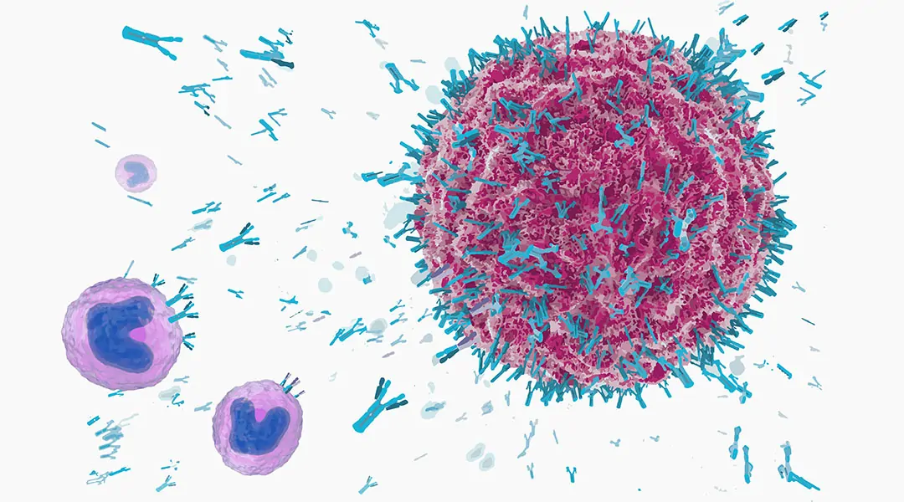
TRAs only highly expressed in specific tissues
biological function
Central tolerance of immune system
Negative selection of T-cells¹
Defect -> diabetes type 1²
application in cancer
Tumor marker³
Immunotherapy⁴
Targeted classic therapy⁵
https://www.advancedsciencenews.com/antibody-and-antibody-derivatives-as-cancer-therapeutics/

Slide 4
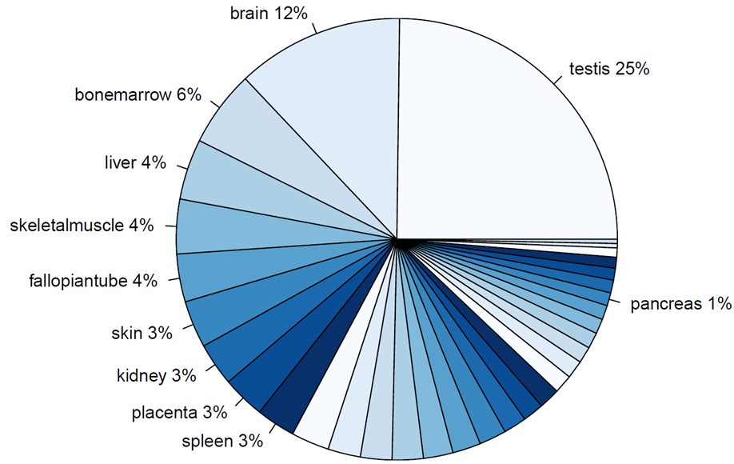
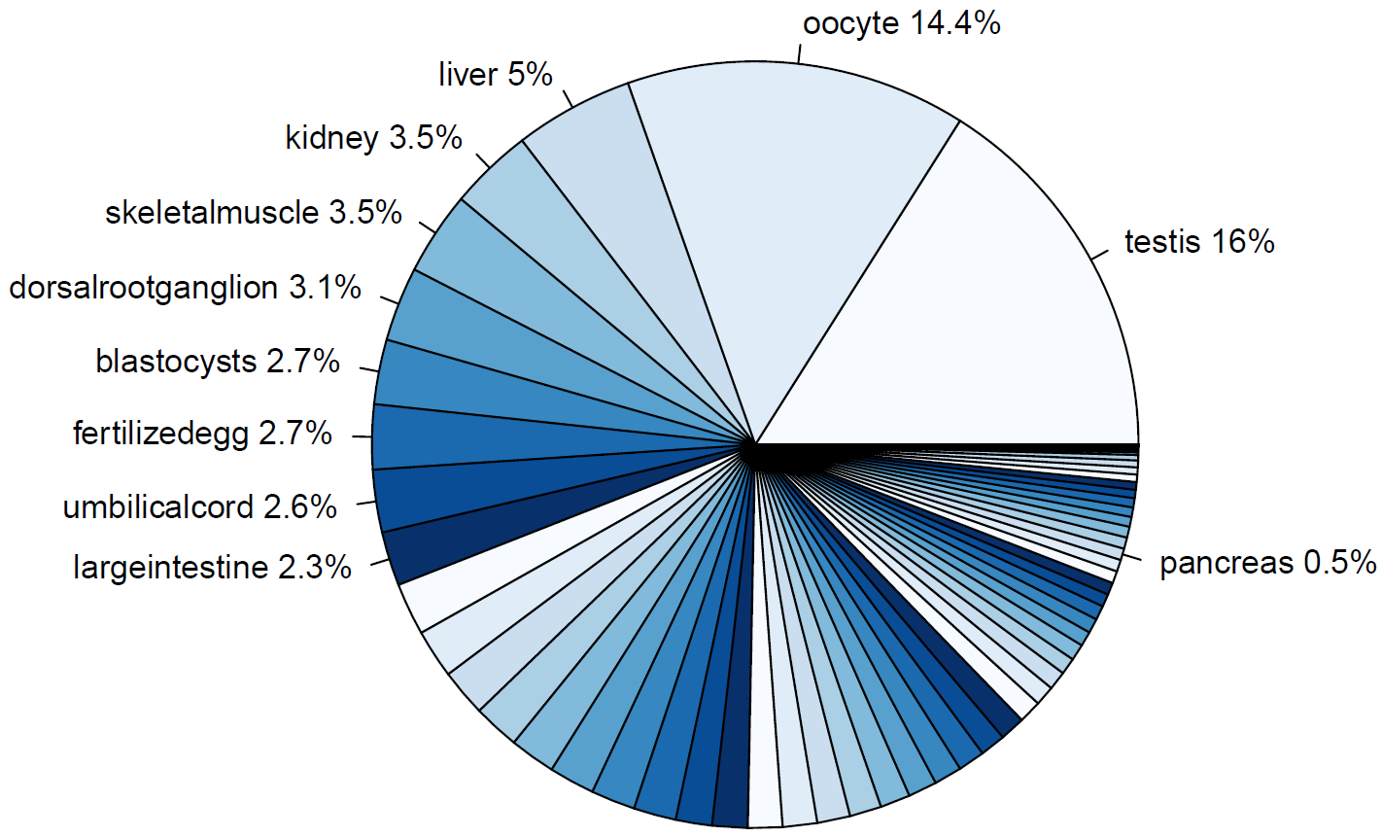
TRAs data set
Human TRA gene expression
Mouse TRA gene expression

Slide 5
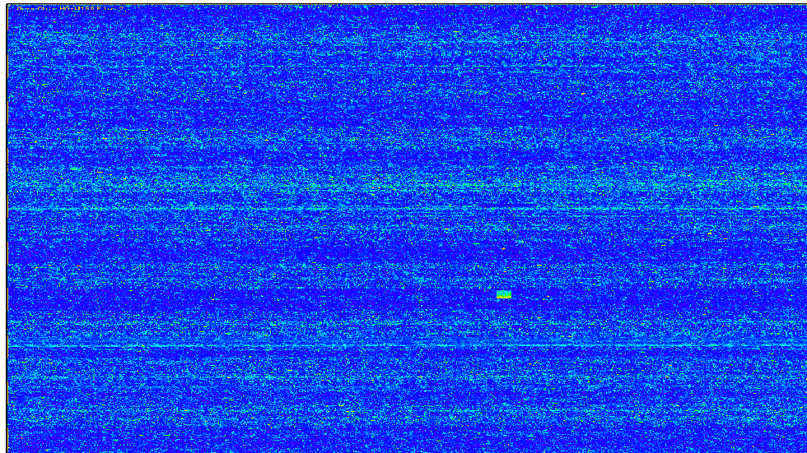
Microarrays

Slide 6
Microarray data sets
β-cells
Control group
No special treatment
Different time points
Cytokine group (diabetes)
Treated with cytokines (IL-1β & IFN-γ)
Different time point
PDAC cells
Control group
Treated with unspecified siRNA (NC)
Knockout group
Treated with siRNA against TBL1X

Slide 7
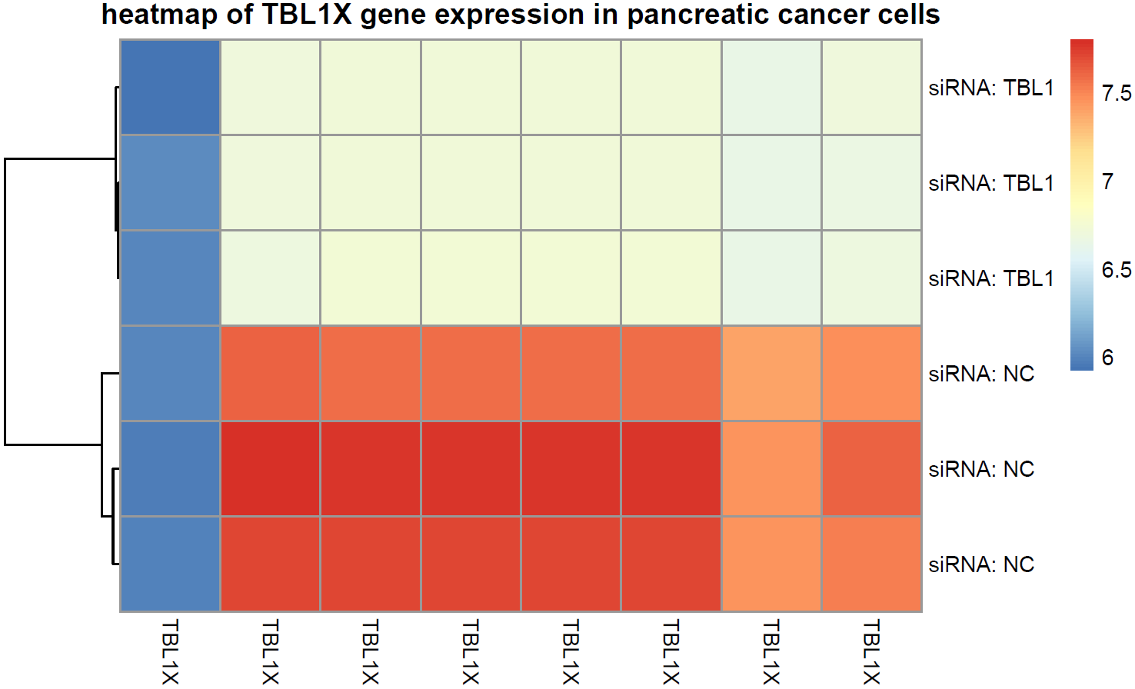
Microarray data sets
β-cells
Control group
No special treatment
Different time points
Cytokine group (diabetes)
Treated with cytokines (IL-1β & IFN-γ)
Different time point
PDAC cells
Control group
Treated with unspecified siRNA (NC)
Knockout group
Treated with siRNA against TBL1X
Stoy C, Sticht C, Muciek M, Strobel O, Herzig S; GSE59761 (2015)

Slide 8
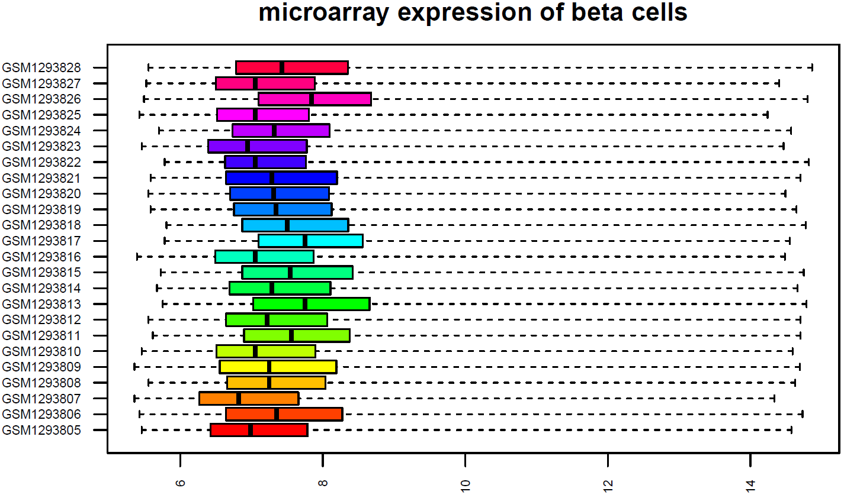
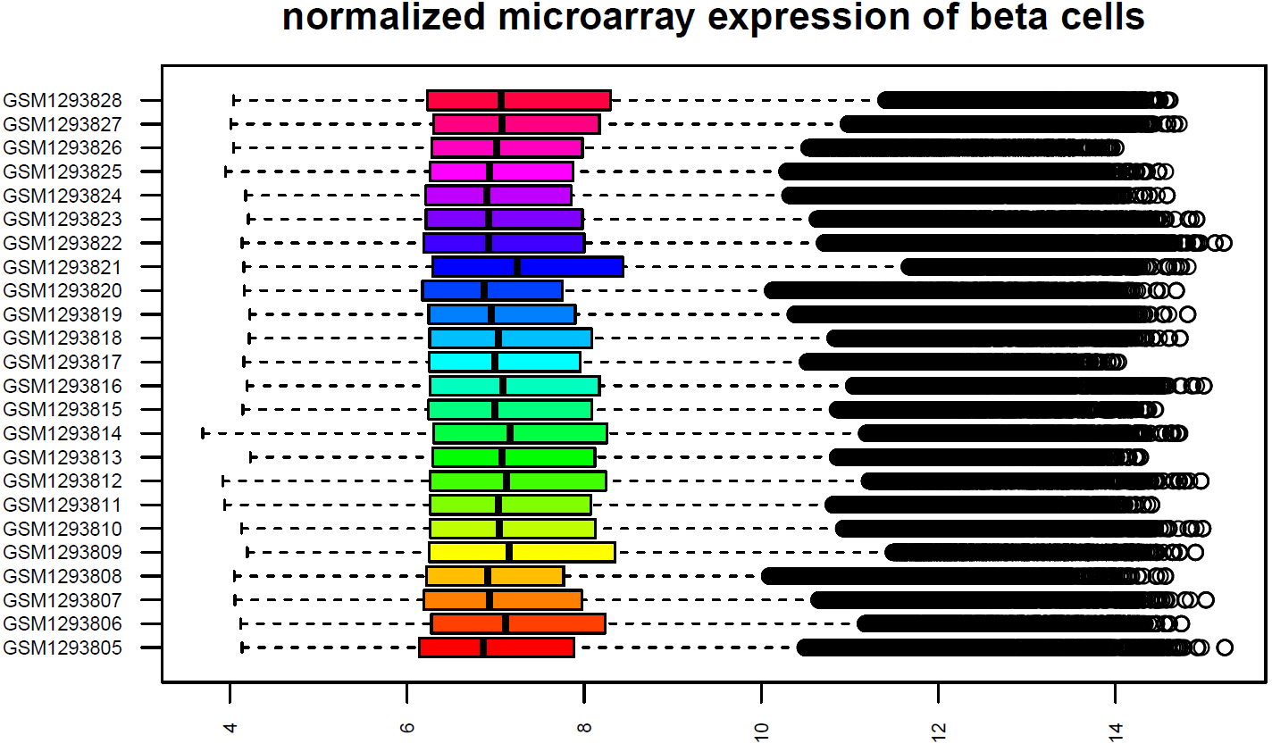
Normalization
Kutlu B, Lopes M ; GSE53454 (2013)

Slide 9
Normalization
Kutlu B, Lopes M; GSE53454 (2013)

Slide 10
Milestones
TRA Expression in Pancreatic Cells
12.05.
19.05.
26.05.
02.06.
09.06.
16.06.
23.06.
30.06.
07.07.
Project Proposal
Project finished
8 weeks
Buffer

Slide 11
Milestones
Can TRA genes be identified that are highly expressed in PDAC tissue but not in ß cells?
12.05.
19.05.
26.05.
02.06.
09.06.
16.06.
23.06.
30.06.
07.07.
1st Milestone: Data Clean Up and Overview Data
Correct gene symbol assignment
Descriptive statistics
2nd Milestone: Differential TRA Expression
Identify high TRA gene expression
Identify differential TRA gene expression
Compare + Literature

Slide 12
Differential TRA gene expression
Highly expressed genes PDAC
Can TRA genes be identified that are highly expressed in PDAC tissue but not in ß cells?
Lowly expressed genes Diabetes
TRA Expression

Slide 13
Milestones
Can we identify the fate of pancreatic cells using TRA expression?
12.05.
19.05.
26.05.
02.06.
09.06.
16.06.
23.06.
30.06.
07.07.
3rd Milestone: Proliferation vs. Cell death
Changes TRAs during cytokine treatment in diabetes set
Comparison to pancreatic cancer
Linear regression model: diabetes treatment
4th Milestone: Complete project
R Markdown file
Select meaningful graphics
Answering main questions
Buffer

Slide 14
references
Slide 1:
A. Carrato et al., A Systematic Review of the Burden of Pancreatic Cancer in Europe: Real-World Impact on Survival, Quality of Life and Costs, J Gastrointest Cancer. 2015; 46(3): 201–211
He, J. et al. 2564 resected periampullary adenocarcinomas at a single institution: trends over three decades. HPB (Oxford) 16, 83–90 (2014)
Siegel, R. L., Miller, K. D. & Jemal, A. Cancer statistics, 2015. CA Cancer J. Clin. 65, 5–29 (2015)
Rahib, L. et al. Projecting cancer incidence and deaths to 2030: the unexpected burden of thyroid, liver, and pancreas cancers in the United States. Cancer Res. 74, 2913–2921 (2014)
Slide 2:
¹ B. Kyewski & L. Klein, A central role for central tolerance, Annu. Rev. Immunol. 2006. 24:571-606
² Atkinson MA, Eisenbarth GS, Michels AW. Type 1 diabetes. Lancet. 2014;383(9911):69-82
³ Hong SK. Kallikreins as biomarkers for prostate cancer. Biomed Res Int. 2014;2014:526341
⁴ Mahmoud AM. Cancer testis antigens as immunogenic and oncogenic targets in breast cancer. Immunotherapy. 2018;10(9):769-778
⁵ Koppe MJ, Postema EJ, Aarts F, Oyen WJ, Bleichrodt RP, Boerman OC. Antibody-guided radiation therapy of cancer. Cancer Metastasis Rev. 2005 Dec;24(4):539-67
⁵ Kahl B. Chemotherapy combinations with monoclonal antibodies in non-Hodgkin's lymphoma. Semin Hematol. 2008 Apr;45(2):90-4
Original data:
Stoy C, Sundaram A, Rios Garcia M, Wang X et al. Transcriptional co-factor Transducin beta-like (TBL) 1 acts as a checkpoint in pancreatic cancer malignancy. EMBO Mol Med 2015 Aug;7(8):1048-62
Lopes M, Kutlu B, Miani M, Bang-Berthelsen CH et al. Temporal profiling of cytokine-induced genes in pancreatic β-cells by meta-analysis and network inference. Genomics 2014 Apr;103(4):264-75

