Slide 1




epidemiology of pancreatic cancer
adapted from pancreaticcancereurope.eu
nNew diagnostic and treatment options needed

Slide 2
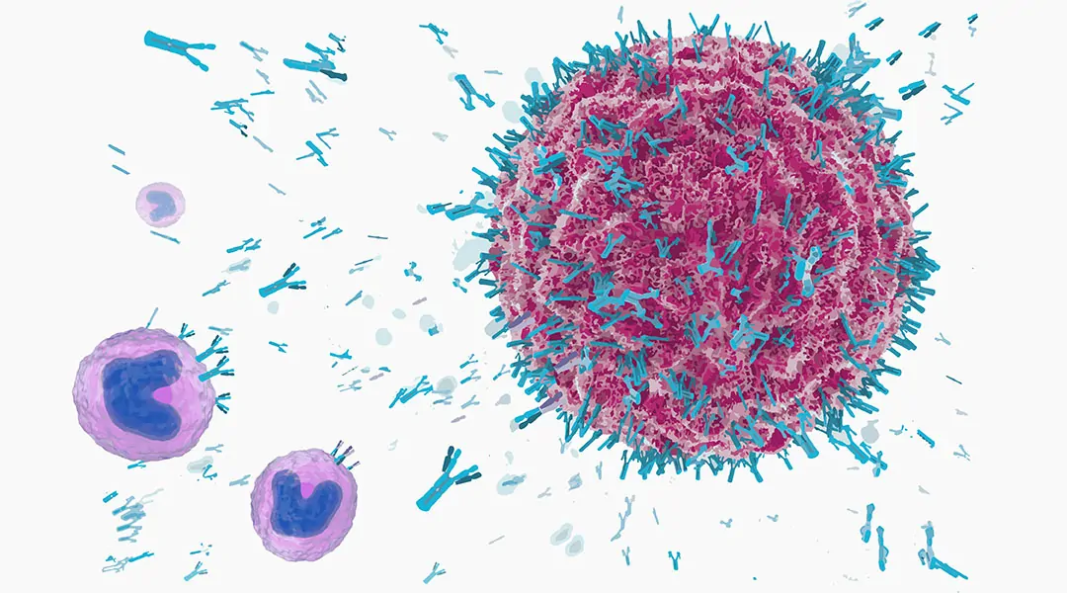
TRAs applications in cancer
Tumor marker
Immunotherapy
Classic Therapy
https://www.advancedsciencenews.com/antibody-and-antibody-derivatives-as-cancer-therapeutics/

Slide 3
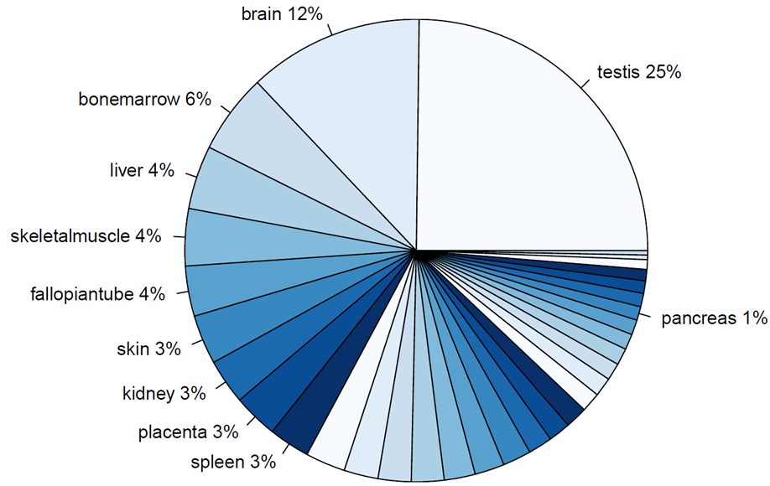
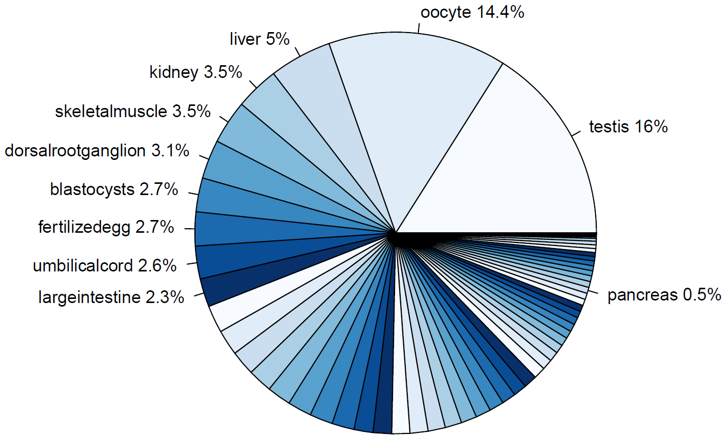
TRAs highly expressed in a few tissues
Distribution of TRAs over specific tissues
Human TRA gene expression
Mouse TRA gene expression

Slide 4
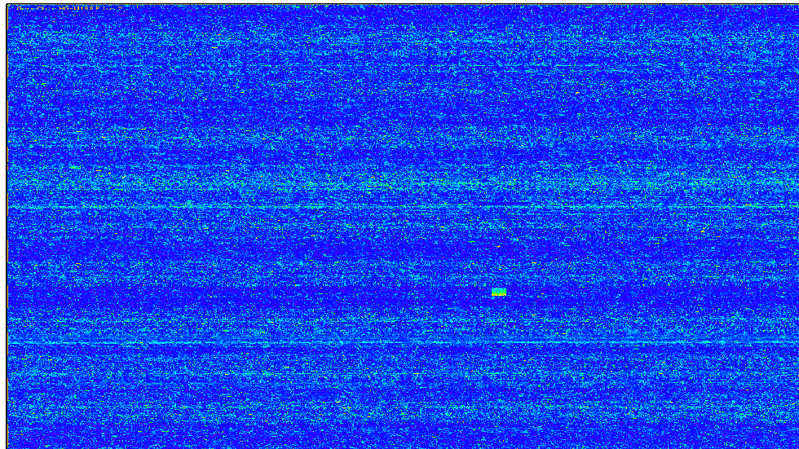
Microarrays

Slide 5
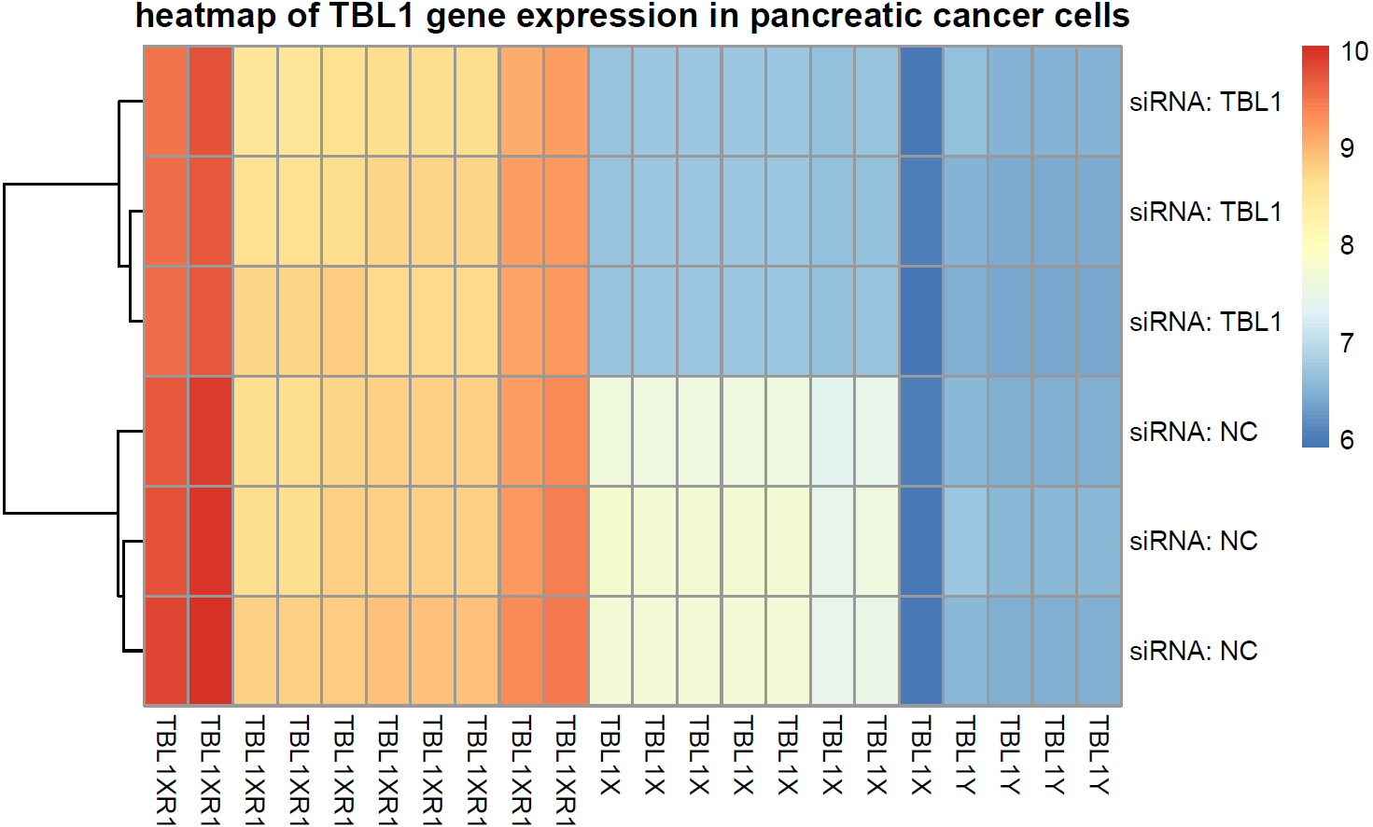
Microarray data sets
β-cells
Control
No special treatment
different time points
Cytokine group
treated with cytokines (IL-1β & IFN-γ)
different time point
Pancreatic cancer cells
Control group
Treated with unspecified siRNA (NC)
Knockout group
Treated with siRNA against TBL1X

Slide 6
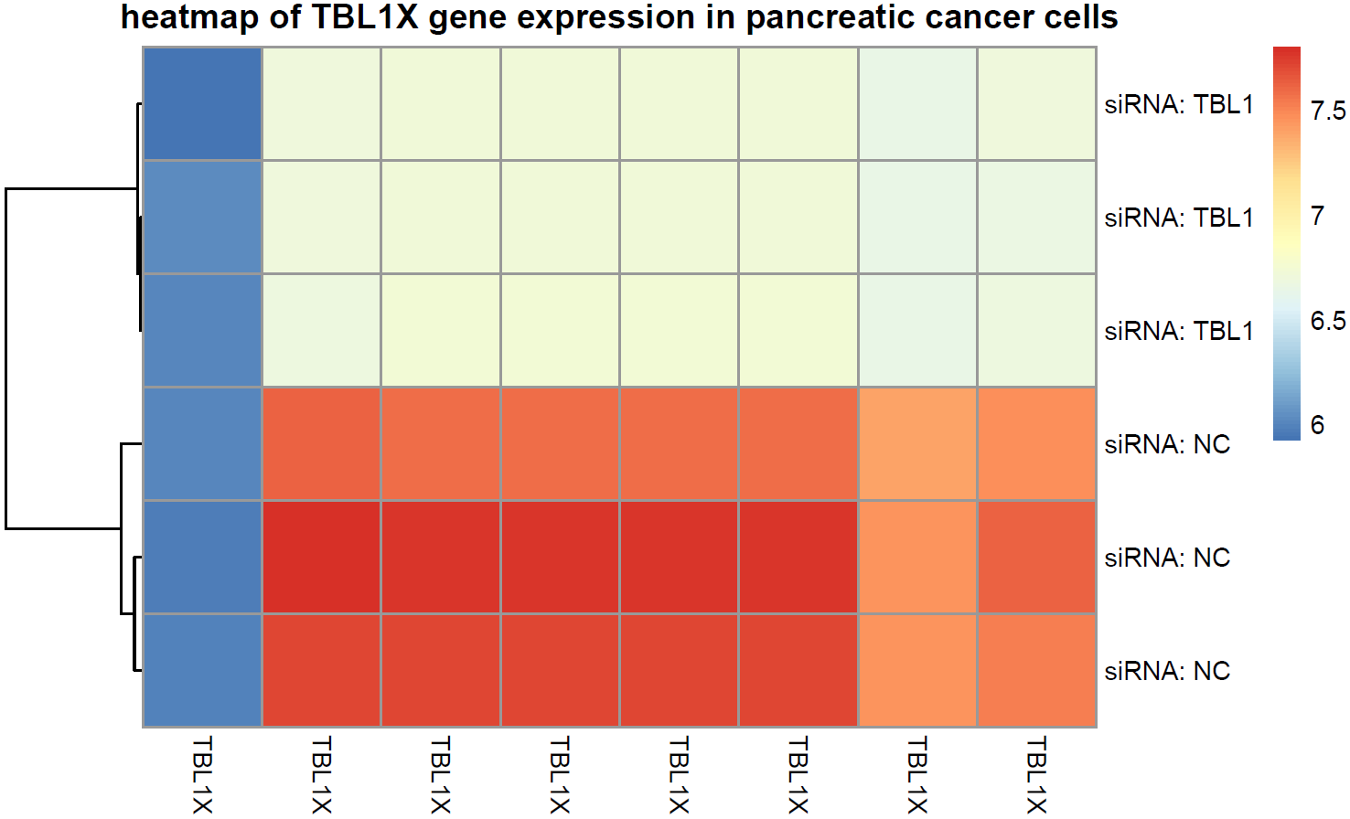
Microarray data sets
β-cells
Control
No special treatment
different time points
Cytokine group
treated with cytokines (IL-1β & IFN-γ)
different time point
Pancreatic cancer cells
Control group
Treated with unspecified siRNA (NC)
Knockout group
Treated with siRNA against TBL1X

Slide 7
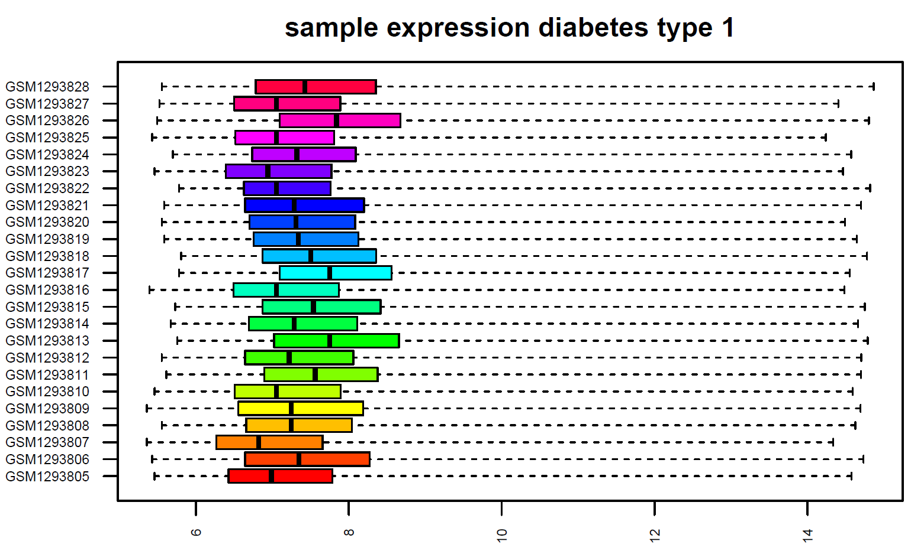
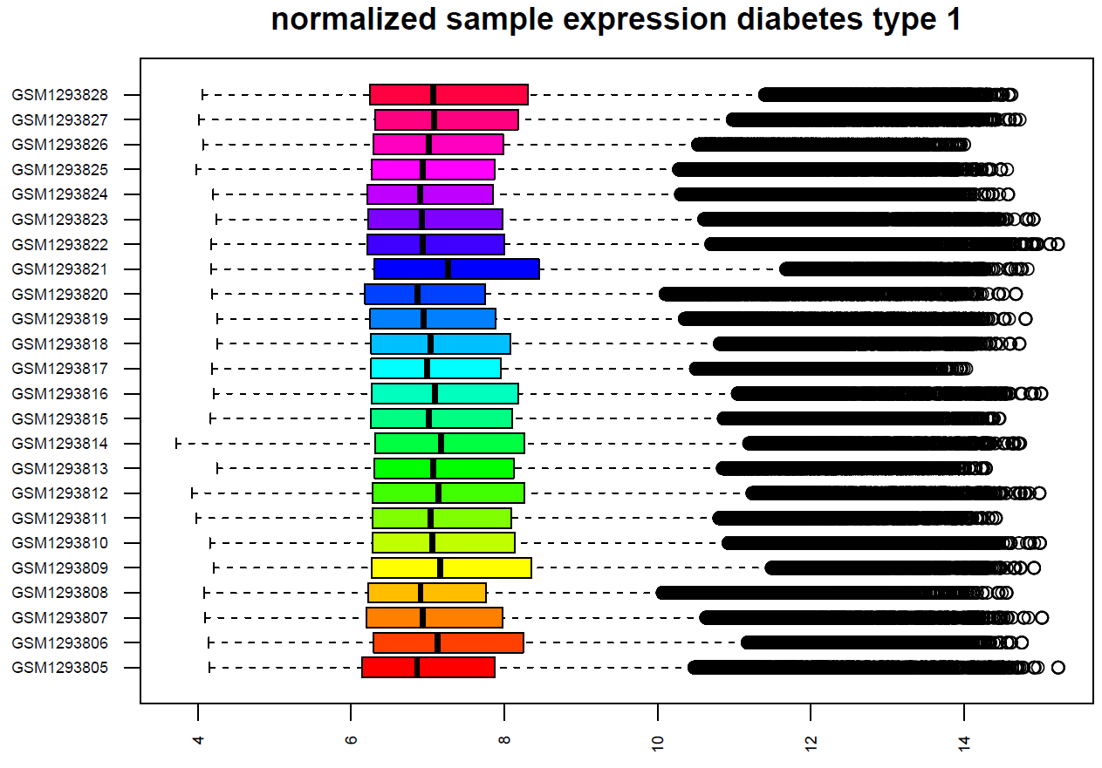
Normalization

Slide 8
Quellen
Folie 1:
A. Carrato et al., A Systematic Review of the Burden of Pancreatic Cancer in Europe: Real-World Impact on Survival, Quality of Life and Costs, J Gastrointest Cancer. 2015; 46(3): 201–211
Rahib, L. et al. Projecting cancer incidence and deaths to 2030: the unexpected burden of thyroid, liver, and pancreas cancers in the United States. Cancer Res. 74, 2913–2921 (2014).
Siegel, R. L., Miller, K. D. & Jemal, A. Cancer statistics, 2015. CA Cancer J. Clin. 65, 5–29 (2015).
He, J. et al. 2564 resected periampullary adenocarcinomas at a single institution: trends over three decades. HPB (Oxford) 16, 83–90 (2014).
Folie 2:
Hong SK. Kallikreins as biomarkers for prostate cancer. Biomed Res Int. 2014;2014:526341Mahmoud AM. Cancer testis antigens as immunogenic and oncogenic targets in breast cancer. Immunotherapy. 2018;10(9):769-778.
Koppe MJ, Postema EJ, Aarts F, Oyen WJ, Bleichrodt RP, Boerman OC. Antibody-guided radiation therapy of cancer. Cancer Metastasis Rev. 2005 Dec;24(4):539-67.
Kahl B. Chemotherapy combinations with monoclonal antibodies in non-Hodgkin's lymphoma. Semin Hematol. 2008 Apr;45(2):90-4

