Slide 1
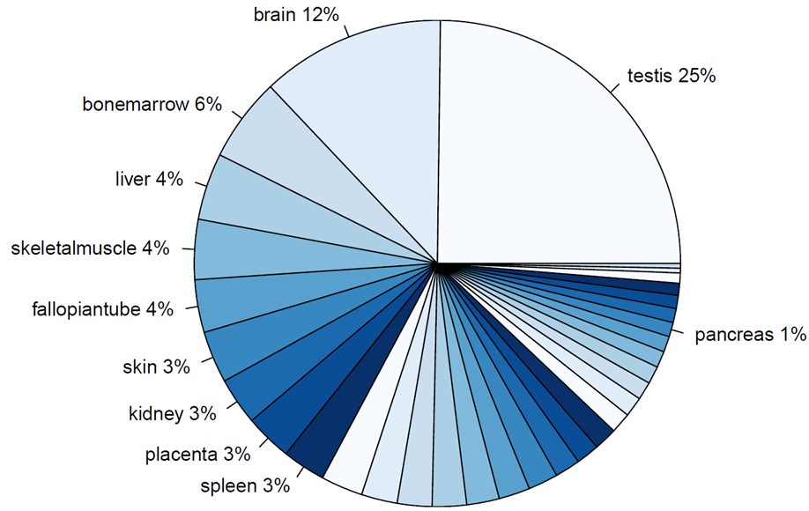
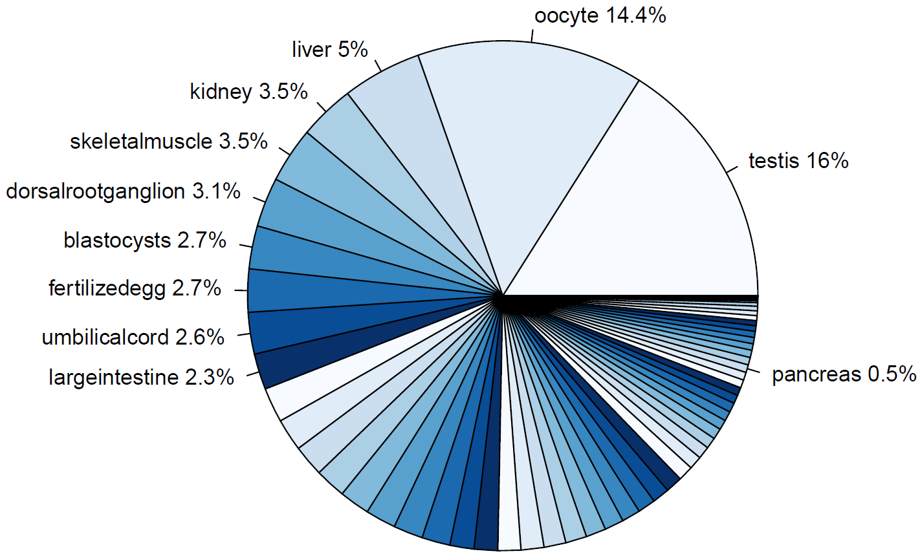
TRAs
Distribution of TRAs over specific tissues
Human TRA gene expression
Mouse TRA gene expression

Slide 2
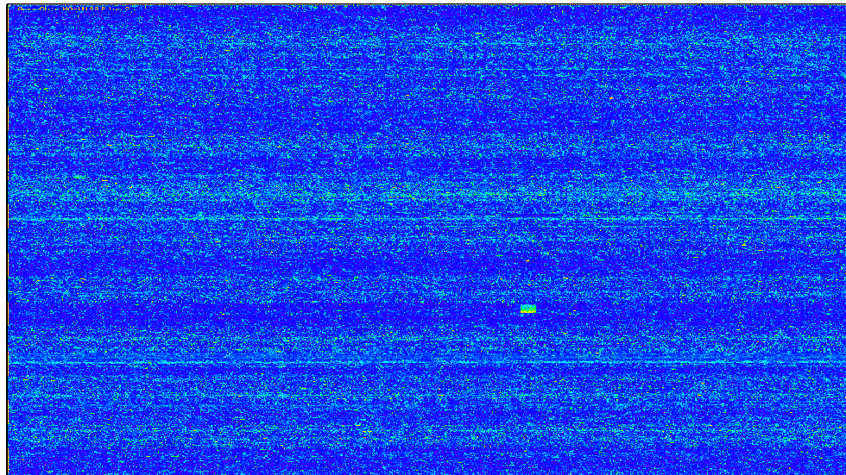
Microarrays

Slide 3
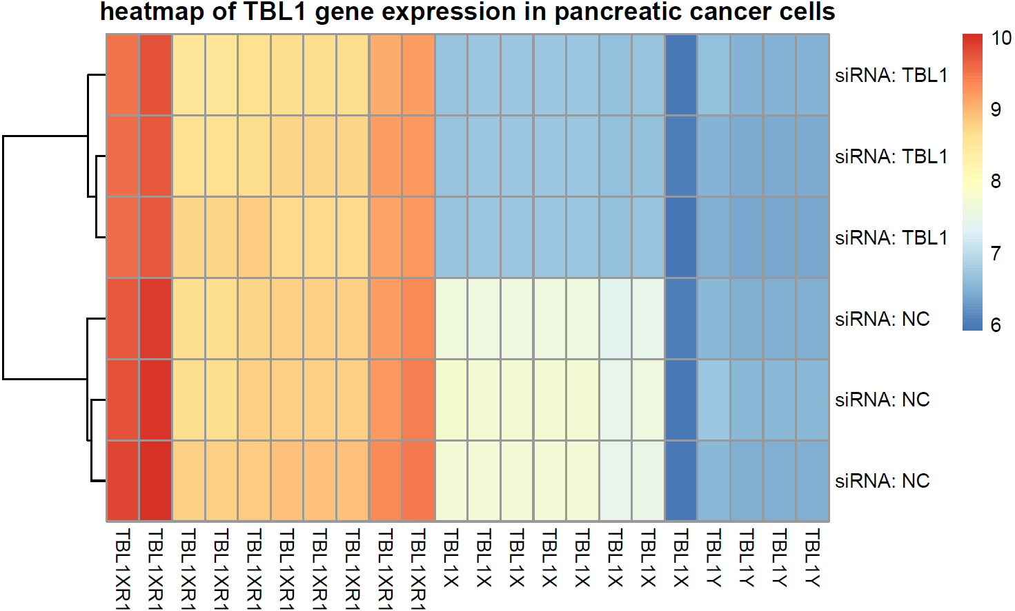
Microarray data sets
β-cells
Control
No special treatment
different time points
Cytokine group
treated with cytokines (IL-1β & IFN-γ)
different time point
Pancreatic cancer cells
Control group
Treated with unspecified siRNA (NC)
Knockout group
Treated with siRNA against TBL1X

Slide 4
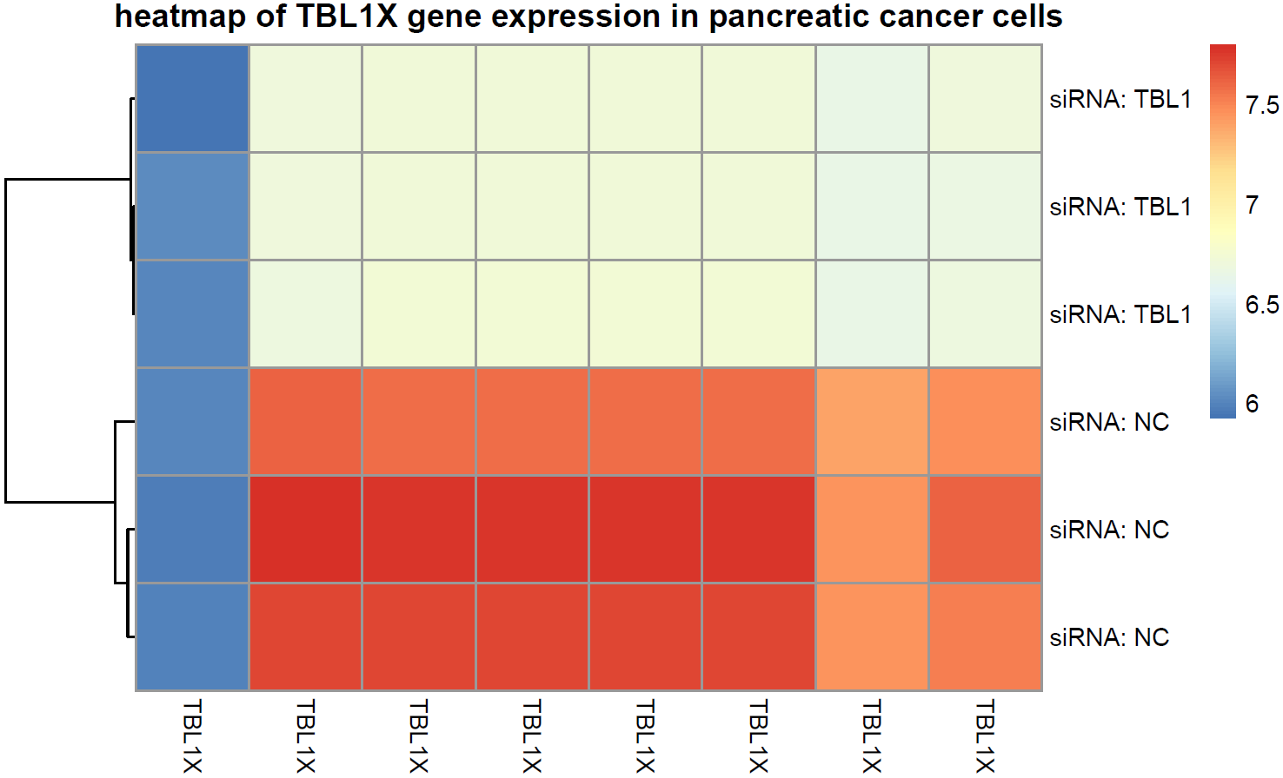
Microarray data sets
β-cells
Control
No special treatment
different time points
Cytokine group
treated with cytokines (IL-1β & IFN-γ)
different time point
Pancreatic cancer cells
Control group
Treated with unspecified siRNA (NC)
Knockout group
Treated with siRNA against TBL1X

Slide 5
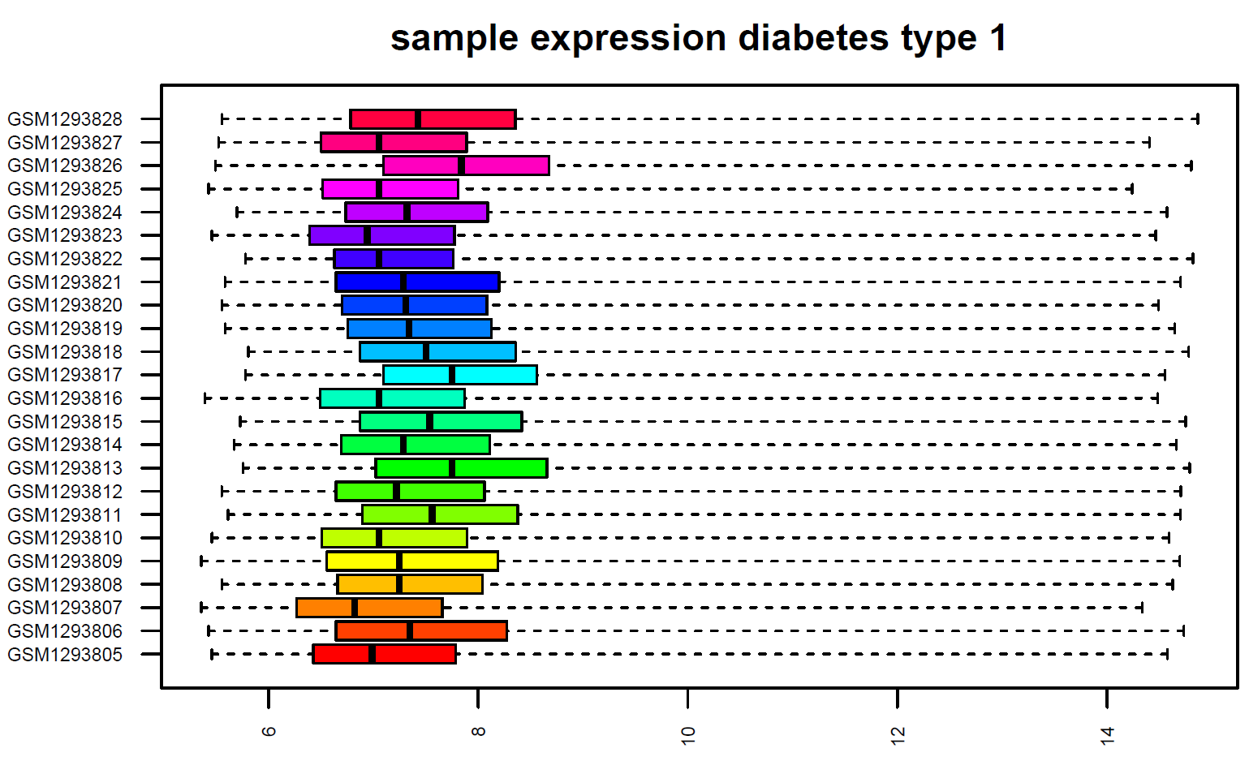
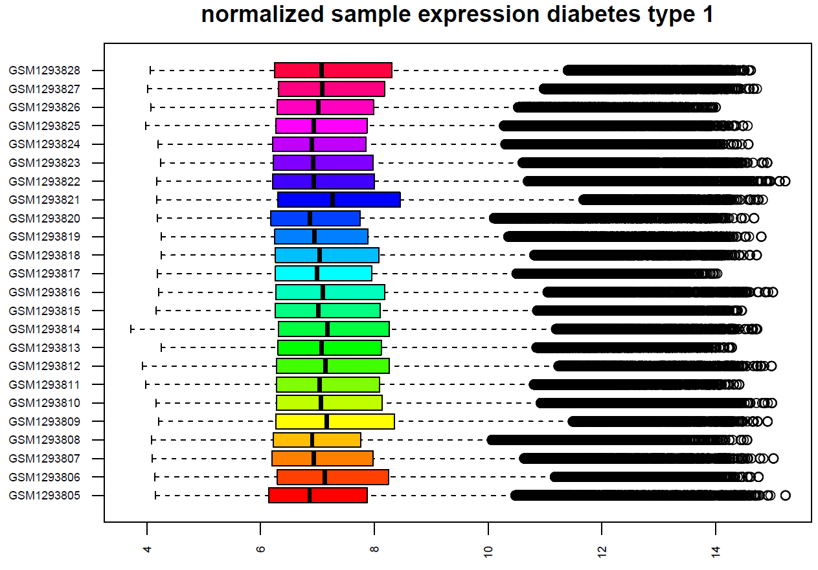
Normalization

