Slide 1
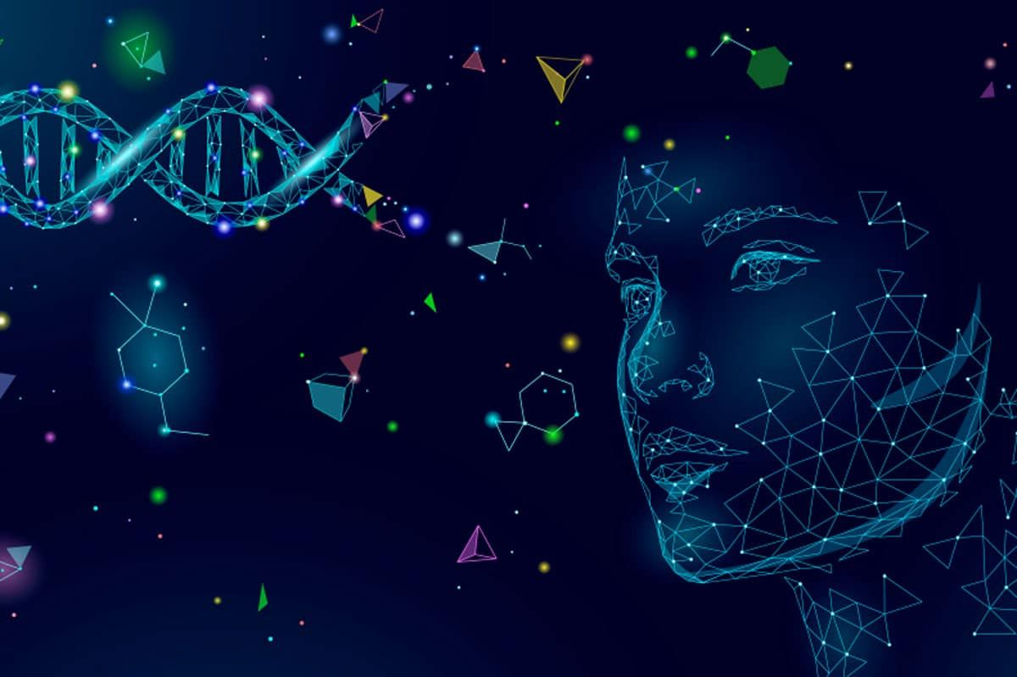
KNN ALGORITHM FOR HUMAN FACE RECOGNITION
Students: Maria Chiritescu, Gabriela Marinova, Georgi Georgiev, Deniz Akinbosoye
Tutor: Nicolas Peschke
Course: Data Analysis
Semester: 4. Semester

Slide 2
PROJECT
AIM
Creating a tool which recognizes faces in different lighting conditions

Slide 3
Taking Facial Recognition Step by Step…
Image processing
Facial recognition
Facial Detection
Image Clasiffication
Image Acquisition
Evaluating results

Slide 4
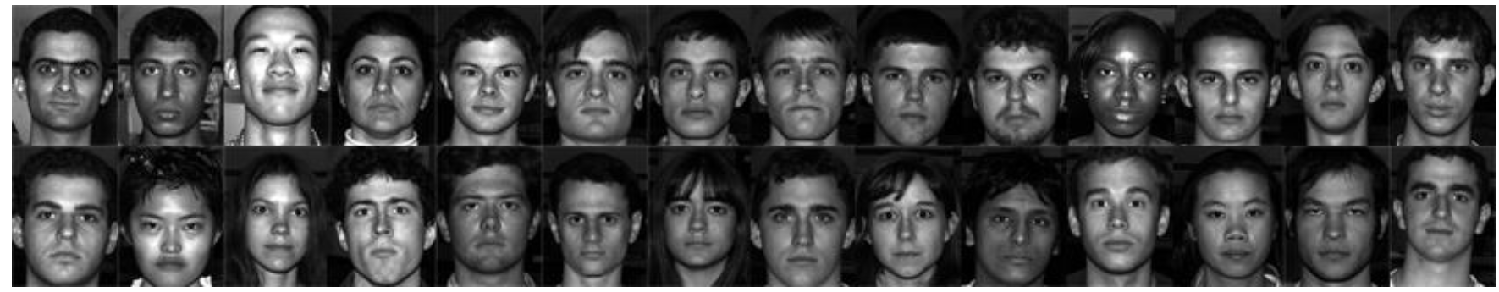
Dividing the Dataset
Set of 2535 images of 39 subjects -> 65 images per person
All greyscale (pgm) images under different light conditions
Size: 168 x 192 pixel
65 images per person
50 images for training
15 images for testing

Slide 5
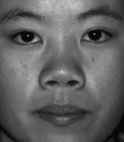
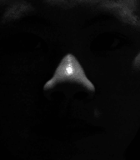
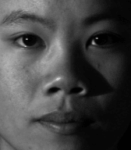
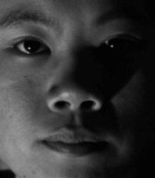
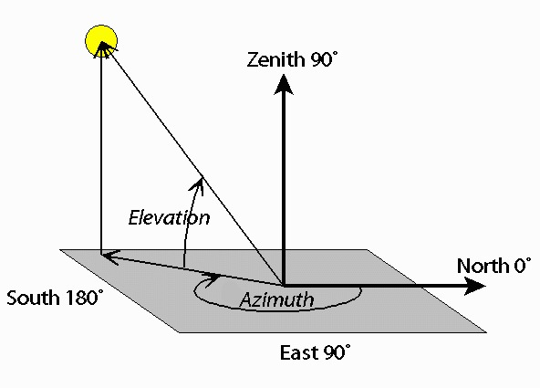
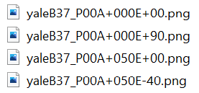
Image Acquisition: Our Dataset
~ Extended Yale Face Database B ~

Slide 6
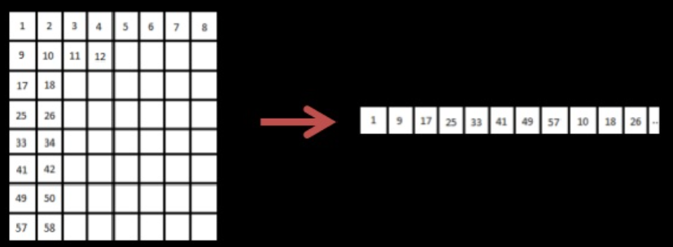
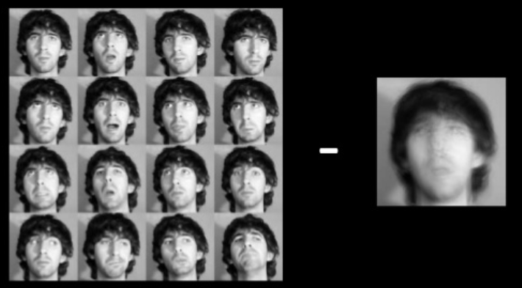
Image Processing
IMAGE SEGMENTATION:
Flattening the image into a vector
Making an array using the vectors
MEAN FACE EXTRACTION:
Image centering
Data normalization
Reducing the effect variant illumination

Slide 7
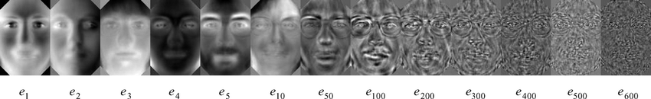
Feature Extraction Using PCA
PCA (Principal Component Analysis)
Providing a lower dimensional picture
Calculates eigenvectors (vi) of the covariance matrix (S)
Extracts the features of a face (eyes, nose, etc)
Making a template out of them
Reducing noise
Creating eigenfaces which look like shadows of the original picture
Svi = TT^{t} vi = λivi

Slide 8
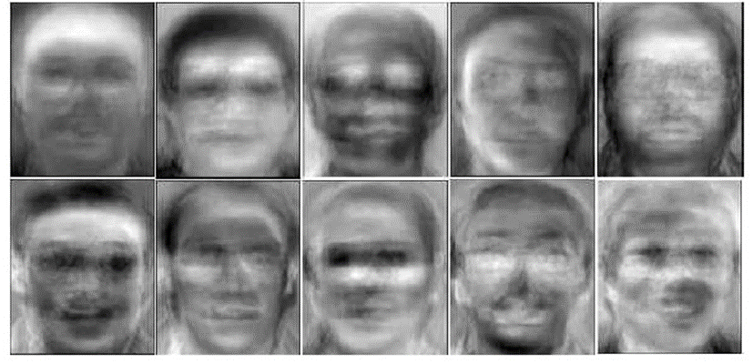
Feature Extraction Using PCA
The images of the training dataset are converted into the PCA space by subtracting the mean image from each of them and multiplying the result by the eigenfaces matrix.
Input image from the testing dataset is converted into the PCA space by subtracting the mean image from multiplying the result by the eigenfaces matrix.

Slide 9
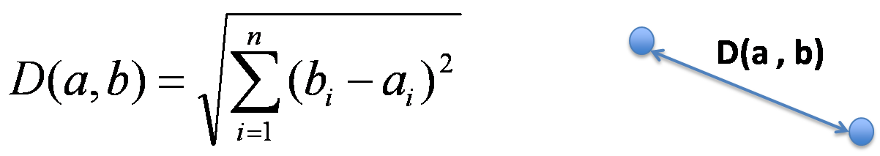
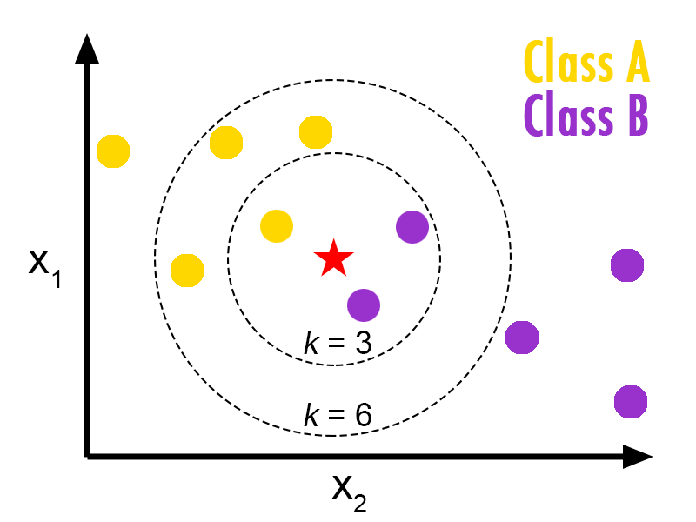
Validation Using KNN (K-Nearest Neighbors)
Comparing the input image with the ones in the dataset
Measuring the Euclidian distance between the pixels of different pictures
Creating a distance matrix
Assigning the new objects to the category of their most similar K nearest neighbors.
Input image
Output image

Slide 10



Evaluating results (accuracy formula)
The performance of the system is measured in terms of accuracy:
$$Accuracy=\frac{Correctly Detected Test Images}{Total Number of Test Images}$$

Slide 11

Milestones and Deliverables
Segmenting the images into vectors and presenting them into a matrix
Result : matrix of all the training set of images with all 39 participants
Extraction of a mean face
Result: visual representation of the mean face
Calculating the covariance matrix and its eigenvalues and eigenvectors (the PCA)
Result: Eigenfaces matrix

Slide 12
Milestones and Deliverables
Projecting training data and testing data onto the PCA subspace
Result: transformed dataset matrix
Calculate Euclidian distance
Result: Distance array
Grouping input image to images from training set using KNN
Result: output image from training set

Slide 13
Further applications of KNN
Taking the input image from a video or from a webcam
Heart disease prediction
Object recognition
Detecting patterns in credit card usage
Analyzing register data and detecting suspicious activity

Slide 14
Timeline
June 20 ~ July 15
Finish code
Bug fixing
Presentation preparation
May 26~ June 20
- Task division and development:
Georgi: Data processing
Maria: PCA
Gabriela: KNN
Deniz: Further applications
May 12 ~May 25
- Collecting ideas for the code and presentation
Time

Slide 15
Thank you for your attention!

Slide 16
Sources
Belhumeur, P.N., Hespanha, J.P. and Kriegman, D. "Eigenfaces vs. Fisherfaces: Recognition Using Class Specific Linear Projection." IEEE Transactions on Pattern Analysis and Machine Intelligence (1997), vol. 19, pp 711-720.
Gerbrands, J.J. "On the relationships between SVD, KLT and PCA." Pattern Recognition (1981), vol. 14, issues 1-6, pp 375-381
Gareth, J. et al. "An introduction to statistical learning." Springer New York (2013), Chapter 4.4
Sasankar, P. and Kosarkar, U. “A study for Face Recognition Using Techniques PCA and KNN“ Research Review Journals (2021)
Wirdiani, N. et al. “Face Identification Based on K-Nearest Neighbor” Scientific Journal of Informatics (2019)

