Slide 1

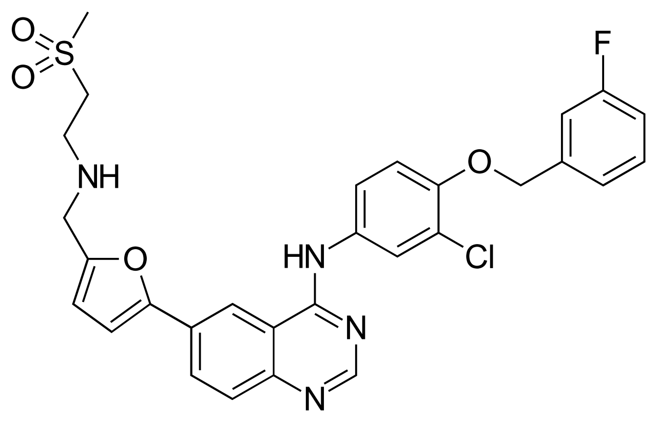
Lapatinib
Cellular response to drug pertubations
Project proposal – Summerterm 2019 – 15.05.2019
Supervisors:
Nicolàs Palacio-Escat & Javier Perales-Patón
Katharina Weinberger | Eva Schentarra | Tobias Krumpf | Laura Keppler

Slide 2




Broad Analysis
Milestones
Specific Analysis
Main Questions
Presentation

Slide 3
Timeline
Broad Analysis
Main Questions (4 Weeks)
(1 Week)
Final Presentation (24.07.2019)
Specific Analysis (2 Weeks)
Presentation (1 Week)

Slide 4
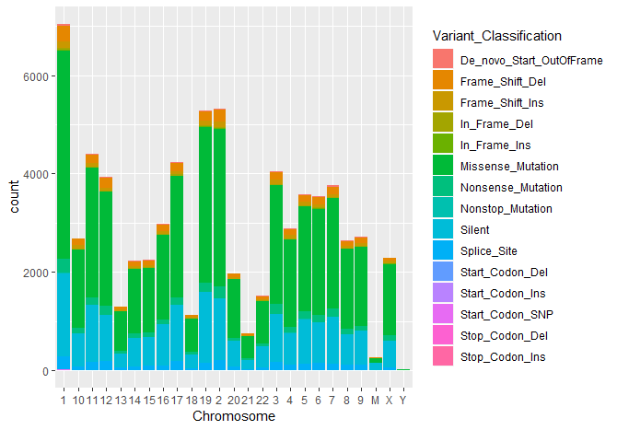
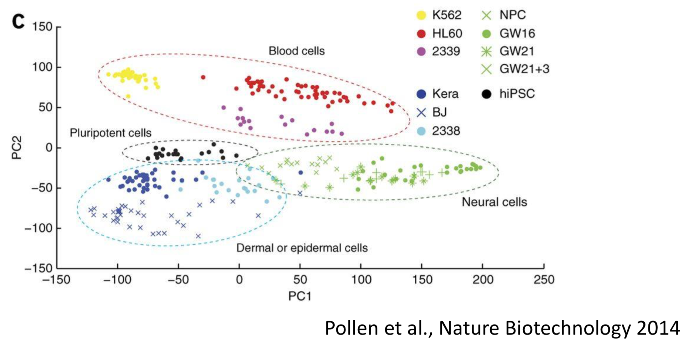
Broad Analysis
DATA:
NCI_TPW_gep_treated/ NCI_TPW_gep_untreated
Untreated
Treated
Boxplot
Are the data normalized?
Batch correction
PCA

Slide 5
Broad Analysis
Cell lines
Tissue
Drug
Relation
Pollen et all (2014). Low-coverage single-cell mRNA sequencing reveals cellular heterogeneity and activated signaling pathways in developing cerebral cortex. Nature Biotechnology volume 32, pages 1053–1058

Slide 6
Broad Analysis
Gene expression:
Untreated
Treated
Boxplot
Cell lines
Tissue
Drug
Are the data normalized?
Relation
Batch correction
PCA
Dimensionality reduction
Log2(FC)
Notes:
@Tobi, wenn wir treated durch untreated teilen kriegen wir die Expressionsrate, das sollten wir auch machenn:)
@evai know I am not that stupid but thanks :*

Slide 7
Distribution of mutations sorted by chromosomes

Slide 8
Timeline
Broad Analysis
Main Questions (4 Weeks)
Familiarize with the Data
General plots
Data reduction
(1 Week)
Final Presentation (24.07.2019)
Specific Analysis (2 Weeks)
Presentation (1 Week)

Slide 9

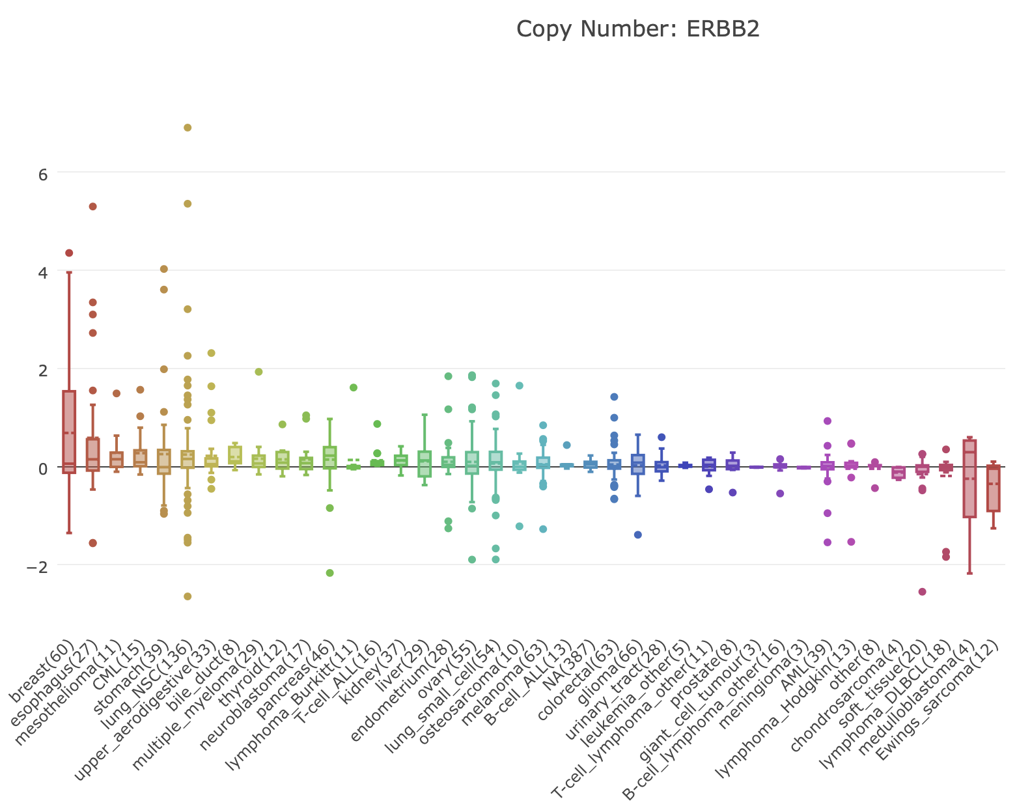
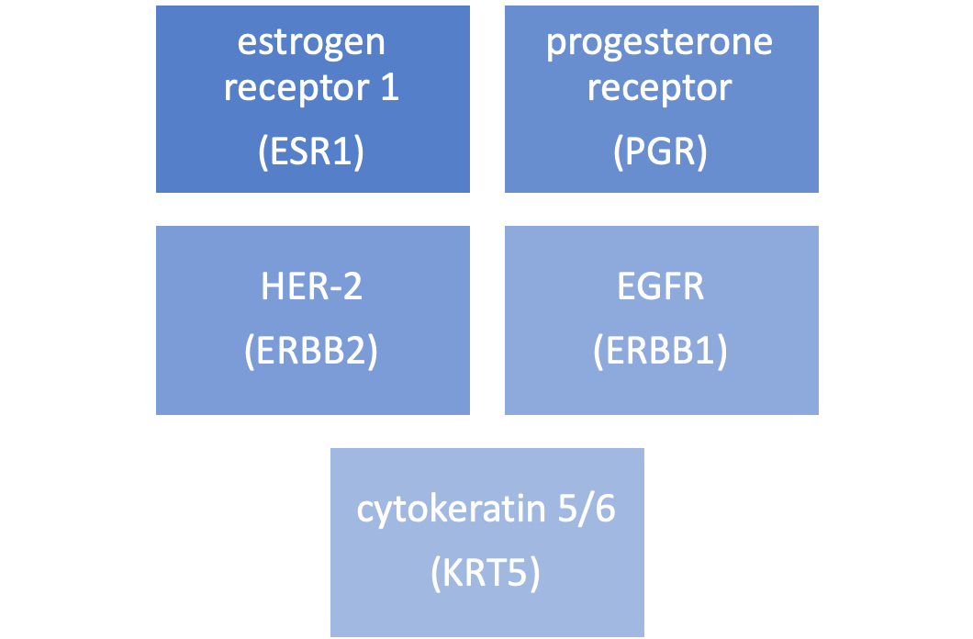
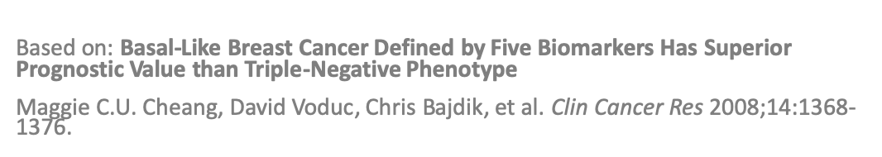
Selection of biomarkers
DATA:
CCLE_basalexpression.rds

Slide 10

Paired t-test to test for significant differences between Lapatinib treated and untreated cells per gene
DATA:
NCI_TPW_gep_treated.rds
DATA:
NCI_TPW_gep_untreated.rds
On which genes does Lapatinib have the greatest influence?
Does Lapatinib significantly reduce the expression of biomarkers?
For which types of cancer does Lapatinib have the greatest effect?

Slide 11

Using a PCA to display cells with similar expression profiles (pattern finding)
DATA:
NCI_TPW_gep_treated.rds
NCI_TPW_gep_untreated.rds
Cellline_Annotation$Microsatellite_instability_status
Lapatinib-Biomarker
Log 2 fold change
Principal Component Analysis (PCA)
specific sample staining and labeling for microsatellite instability/stability and cancer types
Pollen et all (2014). Low-coverage single-cell mRNA sequencing reveals cellular heterogeneity and activated signaling pathways in developing cerebral cortex. Nature Biotechnology volume 32, pages 1053–1058
Notes:
This PCA diagram shows clusters of cell types.
The expression of about 10,000 genes per sample was measured.
Each point represents a sample and its transcription profile.
The general idea is that cells should cluster with similar expression profiles.

Slide 12


k-means clustering to group cell lines with similar drug sensitivities
DATA:
NegLogGI50.rds
Which cell lines are the most sensitive to Lapatinib?
Notes:
https://towardsdatascience.com/k-means-clustering-identifying-f-r-i-e-n-d-s-in-the-world-of-strangers-695537505d

Slide 13

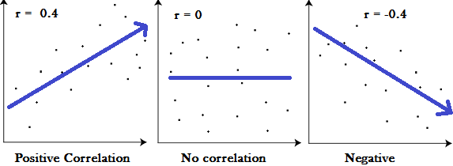
Modeling of a linear relationship between cell doubling time and inoculation density by Pearson correlation
DATA:
Cellline_Annotation$Inoculation_Density
DATA:
Cellline_Annotation$Doubling_Time
https://www.statisticshowto.datasciencecentral.com/probability-and-statistics/correlation-coefficient-formula/

Slide 14
Timeline
Broad Analysis
Main Questions (4 Weeks)
Familiarize with the Data
General plots
Data reduction
(1 Week)
Final Presentation (24.07.2019)
Specific Analysis (2 Weeks)
Presentation (1 Week)
Selection of biomarkers​
Paired t-test​
PCA​
k-means clustering​
linear relationship

Slide 15
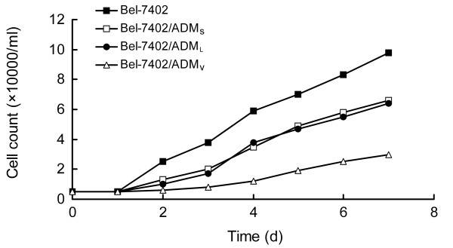
Does the cell doubling time correlate with reduced drug sensitivity?
Based on: Zhong, X., Xiong, M., Meng, X., and Gong, R. (2010). Comparison of the multi-drug resistant human hepatocellular carcinoma cell line Bel-7402/ADM model established by three methods. Journal of experimental & clinical cancer research : CR 29, 115-115.
Notes:
https://www.ncbi.nlm.nih.gov/pmc/articles/PMC2933613/

Slide 16
Does the cell doubling time correlate with reduced drug sensitivity?
Based on: Zhong, X., Xiong, M., Meng, X., and Gong, R. (2010). Comparison of the multi-drug resistant human hepatocellular carcinoma cell line Bel-7402/ADM model established by three methods. Journal of experimental & clinical cancer research : CR 29, 115-115.
DATA:NegLogGI50
Linear regression
Linear regression
Multiple Regression
DATA:
Cellline_Annotation$Doubling_Time
DATA:
Fold_change (mean/median)
Training
Testing
Predict
Principle:
Notes:
https://www.ncbi.nlm.nih.gov/pmc/articles/PMC2933613/

Slide 17
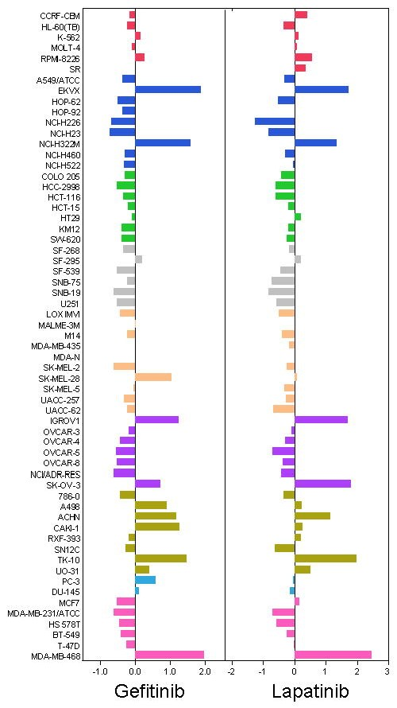

Antitumor and antiangiogenic effect of the dual EGFR and HER-2 tyrosine kinase inhibitor lapatinib in a lung cancer model.
(Diaz et al., 2010)
Holbeck, Susan L et al. “Analysis of Food and Drug Administration-approved anticancer agents in the NCI60 panel of human tumor cell lines.” Molecular cancer therapeutics vol. 9,5 (2010): 1451-60. doi:10.1158/1535-7163.MCT-10-0106
Erlotinib
Notes:
evidence that activation of (EGFRs) leads to tumor growth, progression, invasion and metastasis.
Erlotinib and gefitinib, two EGFR-targeted agents, relevant drugs for lung cancer treatment.
lapatinib, a dual tyrosine kinase inhibitor of EGFR and HER-2 receptors investigate the activity of lapatinib against (NSCLC).
The graph is color-coded by tissue of origin: Red for leukemia, blue for lung cancer, green for colon cancer, grey for CNS cancer, coral for melanoma, purple for ovarian cancer, gold for renal cancer, turquoise for prostate cancer and pink for breast cancer cell lines.

Slide 18

Does Lapatinib have a similar effect on lung cancer as Erlotinib?
Question
H0=Mean values do not differ
Two sample unpaired t-test
Create Matrix of both drugs
Bar plot like Gefitinib
Pearson correlation
H1=Mean values differ
DATA:
NegLogGI50
DATA:
NCI_TPW_gep_treated.rds

Slide 19
Does Lapatinib have a similar effect on brain metastases as it does on breast cancer?
Selection of Lapatinib response genes
Visualization of expression profiles
Investigation of CNS and breast cancer correlation
The efficacy of Lapatinib and capecitabine in HER-2 positive breast cancer with brain metastases.
(Bachelot et al., 2013)
Creating matrix with CNS and breats cancer cell lines Volcano plot of each cell line Setting thresholds and selecting signature genes
Heat map of expression pattern of the signature genes among selected cell lines
Identifying correlation structure Calculating statistical significance
Notes:
https://www.ncbi.nlm.nih.gov/pmc/articles/PMC2933613/

Slide 20
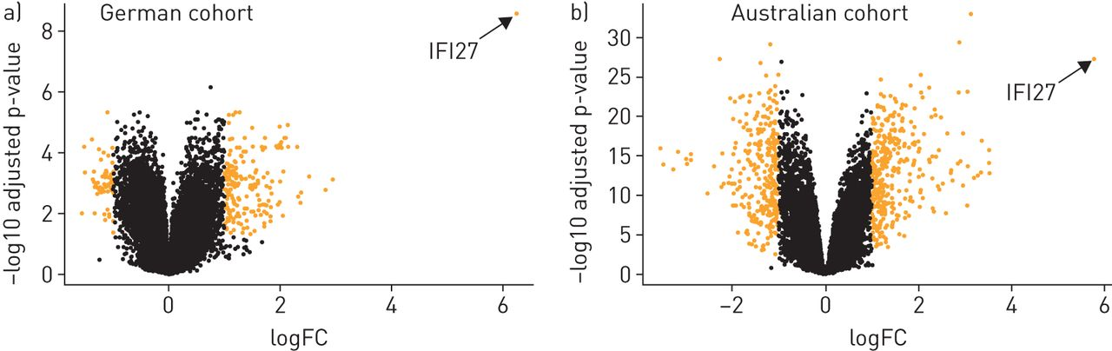
Volcano plot?
Necessary calculations:
log fold change of gene expression data
Paired t-test comparing gene expression levels
DATA:
NCI_TPW_gep_treated.rds
NCI_TPW_gep_untreated.rds
CNS and breast cancer cell lines
Tang, et al. (2017). A novel immune biomarker IFI27 discriminates between influenza and bacteria in patients with suspected respiratory infection. European Respiratory Journal 49, 1602098.

Slide 21
Timeline
Broad Analysis
Main Questions (4 Weeks)
Drug sensitivity correlation
Comparison with Erlotinib
Effect of Lapatinib on CNS cancer
Familiarize with the Data
General plots
Data reduction
(1 Week)
Final Presentation (24.07.2019)
Specific Analysis (2 Weeks)
Presentation (1 Week)
Selection of biomarkers​
Paired t-test​
PCA​
k-means clustering​
linear relationship

Slide 23
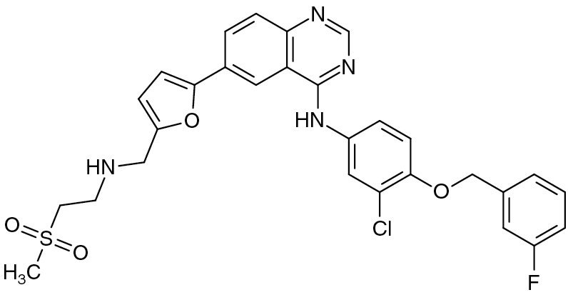
Mode of action of lapatinib
25% of breast cancers overexpress ErbB2 / HER
Leads to a more aggressive phenotype
Lapatinib blocks tyrosine kinases that belong to the HER2 receptor, which is increasingly found on the cell surface of cancer cells
HER2 is a receptor for the growth factor epidermal growth factor (EGF), which stimulates the cell division of cancer cells
By blocking these HER2 receptors, the unregulated growth of cancer cells can be controlled again

Slide 24
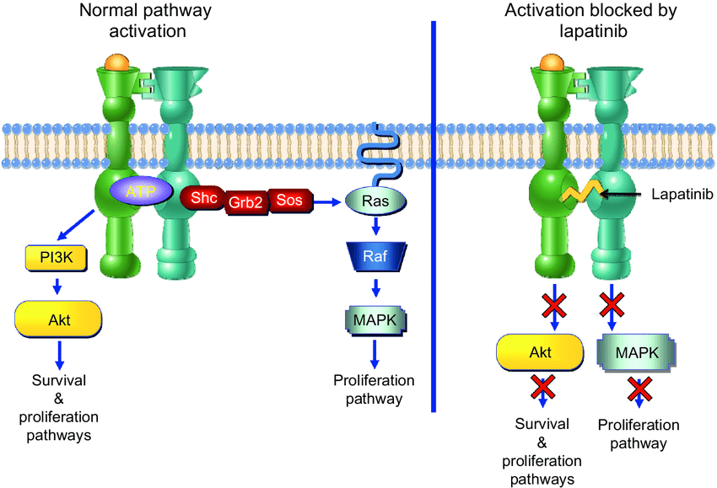
Mode of action of lapatinib
Lapatinib binds the ATP-binding site of the receptor's intracellular domain
Inhibits the survival and proliferation pathways of the tumor cell

