Slide 1
Image Analysis
Digit Recognition

Slide 2
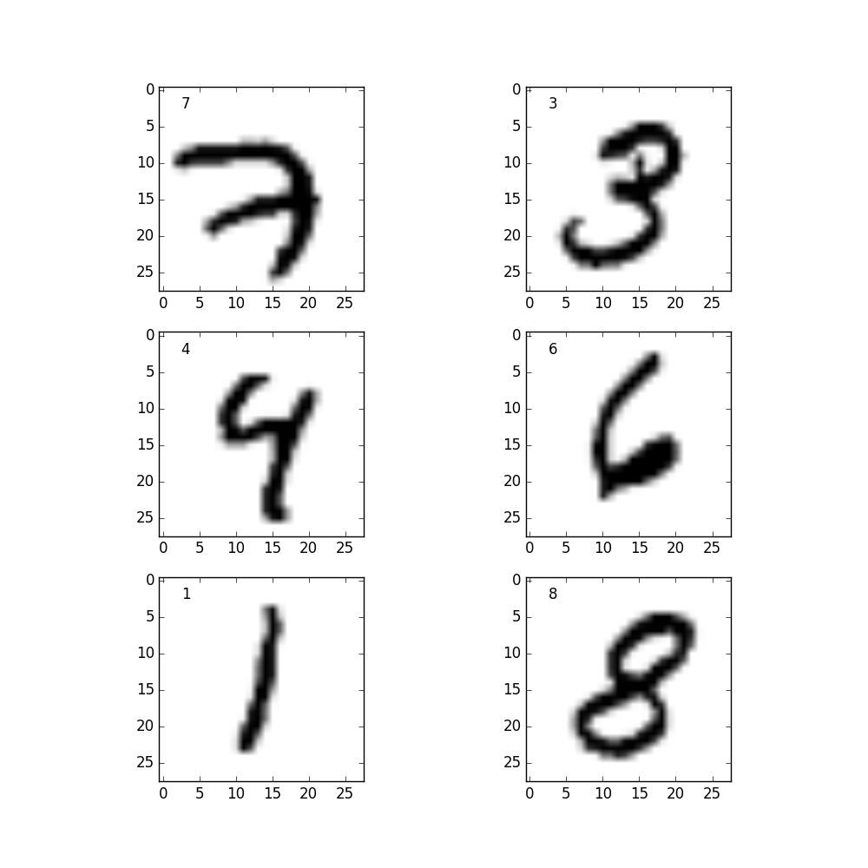
MNIST-Dataset
Goal:
The computer recognizes which digit is portrayed on the test-image
by comparing it to the training-images.
Input:
Images of handwritten digits: centralized and grayscaled
Training set: 60 000 Images
Test set: 10 000 Images
Output:
Prediction of the written number.

Slide 3
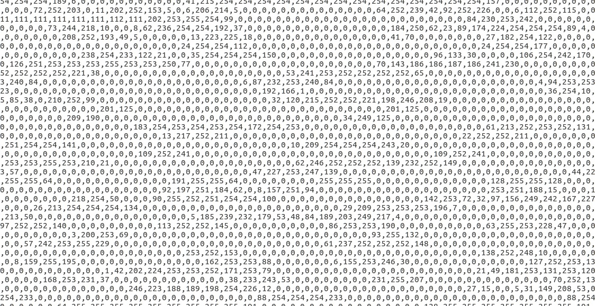
MNIST-Dataset
 | Pixel1 | Pixel2 | Pixel3 | Pixel… | Pixel784
Image1 | 0 | 0 | 0 | 0 | 0
Image2 | 0 | 3 | 74 | 0 | 64
Image3 | 0 | 15 | 87 | 33 | 14
Image4 | 0 | 0 | 95 | 0 | 0
Image5 | 0 | 0 | 36 | 24 | 0
Image… | 9 | 0 | 0 | 0 | 8
Image x | 0 | 0 | 11 | 0 | 57
We see our image-data in this form

Slide 4
K Nearest Neighbour (KNN)
Which K trainings-vectors are the nearest to our test-vector (euclidian distance)
-> Which K trainings-images are the most similar to our test-image.
In this example with 2 dimensions
(our case has 784 dimensions)

Slide 5
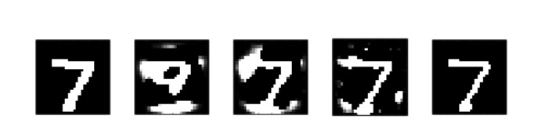
Principal Component Analysis (PCA)
The image -> a 784 dimensional vector (too many dimensions)
Solution: PCA Reduces dimensionality by eliminating redundancy and emphazising variances.
May increase the accuracy of the KNN algorithm.
Vectorspace with 784, 2, 20, 100 and 700 dimensions
Source: PCA of handwritten digits, Tyler McDonnell

Slide 6
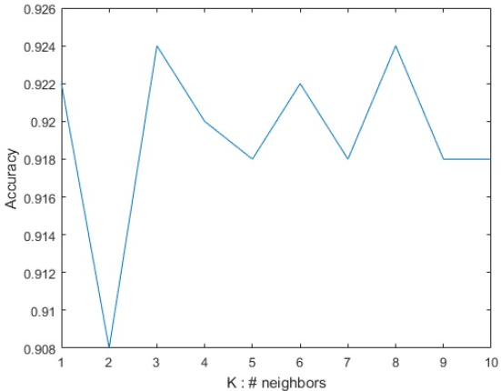
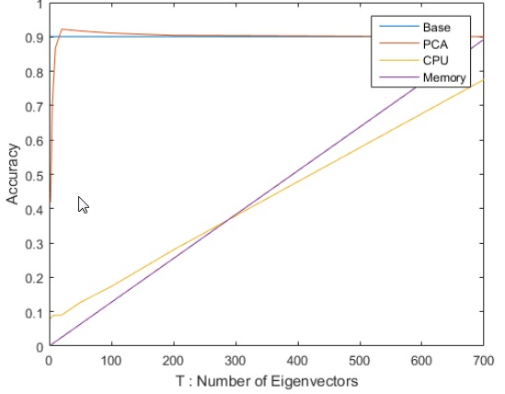
Optimizing parameters for the KNN/PCA
Needs a function to record accuracy rate of correctly recognized digits.
We use KNN and PCA to find out the best values for K and T (dimensions) with the highest accuracy.
Source: PCA of handwritten digits, Tyler McDonnell

Slide 7
Visualization
Our imagedata only consists of numbers, so we reverse-transform it to jpg.
 | Pixel1 | Pixel… | Pixel784
Image1 | 0 | 0 | 0
Image2 | 0 | 0 | 64
Image3 | 0 | 24 | 0
Image… | 9 | 0 | 8
Image x | 0 | 0 | 57
For Example:
View images of falsely recognized digits
Source: Digit Recognition Using Keras, Mukul Agrawal

Slide 8
Overview
Things to try out:
Our handwriting
Analog system for letters
Neural network
(maybe)
Parser: CSV input to matrix
PCA
Optimize parameters
KNN
Visualization

