Slide 1
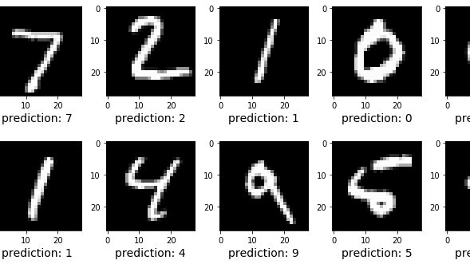
Image Analysis
Digit Recognition

Slide 2
Milestones of digit recognition
Must-have Project
Main Algorithm – KNN: self-written
Scikit-learn function
Further optimization of KNN via PCA, best parameters for PCA (n-number of PCs used) and KNN (k-neighbors)
Meta-digits: mean, median, best neighbored
Analysis of falsely recognized digits
Drawing environment
Centering
Evaluation
Drawing canvas

Slide 3
K-Nearest Neighbours (KNN)
Which K training vectors are the nearest to our test-vector (euclidian distance)
-> Which k training images are the most similar to our test image.
In this example with 2 dimensions
(our case has 784 dimensions)

Slide 4
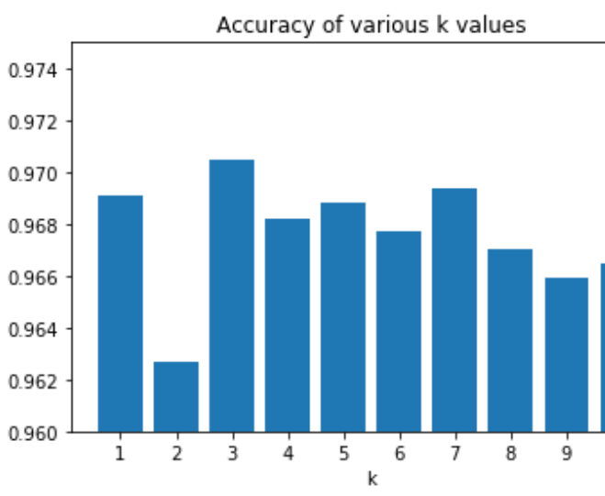
KNN accuracy analysis
Best number of nearest neighbors: n=3
Around 97% accuracy
Conflict with even values for k
Algorithm choses randomly
If k is too big, distances that are too far are included

Slide 5
Principal Component Analysis (PCA)
The image is a 784 dimensional vector. 60000 train images, 10000 test images -> KNN takes too long
Solution: PCA
Reduces dimensionality by eliminating redundancy and emphazising variances.
We used scikit-learn function
Not only accelerated calculations, but also increased accuracy by noice reduction

Slide 6
Variance explained by PCA
First PCs explain the most variance due to the way the PCA works
Idea at the beginning: to visualize the data points in 2D space and may be find some interesting tendencies
Not possible, first two PCs explain too little variance

Slide 7
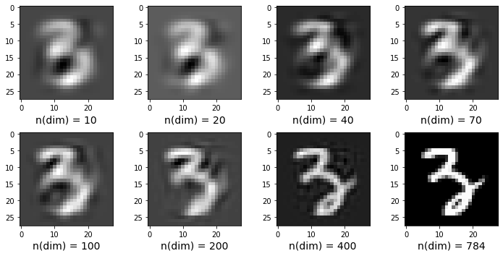
Recovered images

Slide 8
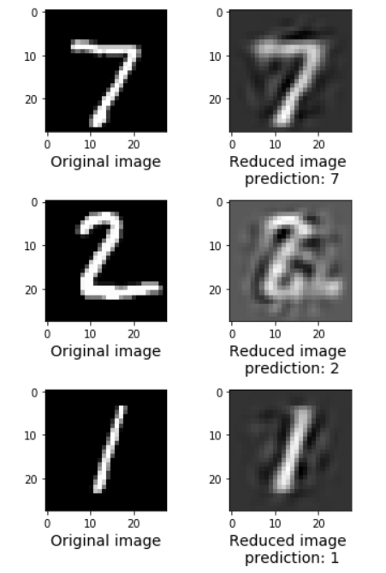
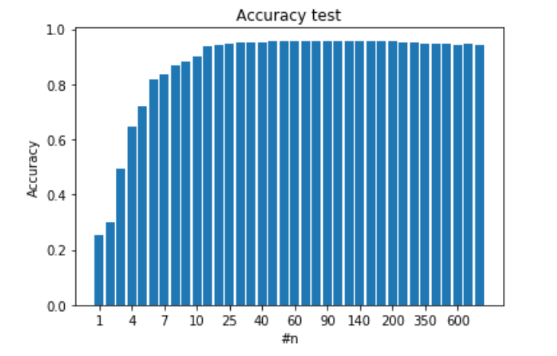
Interesting tendencies and the best parameter
Highest accuracy with 78 dimensions
Noise reduction
2 dimensions: less than 5% variance, but more than 30% accuracy
3 dimensions: 5% variance, the highest increase in accuracy (to 50%)

Slide 9
Interesting tendencies
2 dimensions: less than 5% variance, but more than 30% accuracy
3 dimensions: 5% variance, the highest increase in accuracy (to 50%)
Are these 30% from 2 dimensions in 50% in 3 dimensions?
1) More generally, are there digits which were recognized in n dimensions, but mixed up in n+1?
Solution: 784 diagrams with 10 categories and accuracy of recognition for every category.
2) (Hypothesis) 30% and 50% of accuracy are not evenly spread among all digits. There are some, which can recognized even with 2 dimension and some, which are unrecognizable even in 10. (should be seen from the 1. diagram) With which digits are they often mixed up by different dimensions? -> Relationship tree
3) There is the maximum of accuracy by 78 dimensions due to noise reduction. But what digits are better recognized by 78 than by 784.
-> most “noisy” digits

Slide 10
Finding meta digits
Objective: Something what describes digits with the same label.
Reason:
To see a cause for a wrong recognition by KNN by comparing of falsely predicted with Meta
We need a reference point for drawing canvas to evaluate our own hand-written digits

Slide 11
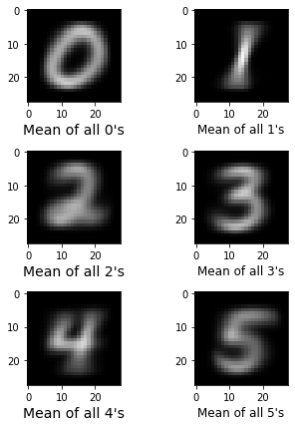
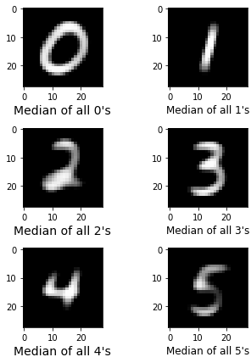
Two easiest solutions: mean and median meta digits

Slide 12
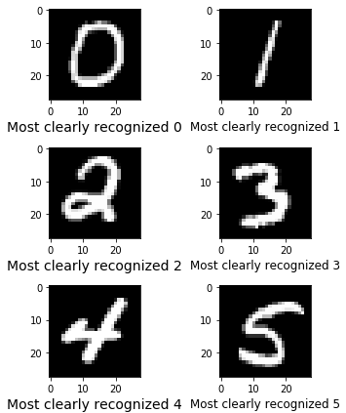
Best recognizable digit
Image that is surrounded by the highest number of images with the same label.
We decided to take it as meta digit.
Reason: only this meta digit type represents the real existing data-point (image)

Slide 13
Why are there mispredictions?

Slide 14
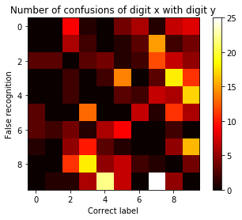
Heatmap with confused digits

Slide 15
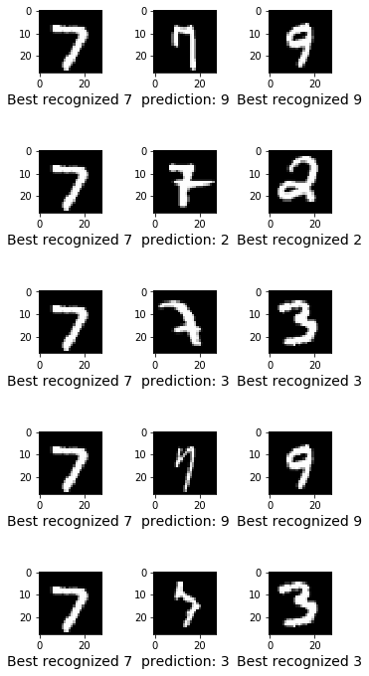

Wrong predicted digits

Slide 16
Exciting things to be investigated
Digits tree and cumulativity in prediction accuracy for a certain digit or even data-point
Which digits have higher average noise component (recognized better by 78 than by 784)
Other metrics for the distance calculation and their effect on the accuracy of recognition
Other types of dimensionality reduction methods (f.i. kernel PCA) -> a hypothetical further increase in accuracy of recognition and noise elimination.
??????????????????????????????

Slide 17
DRAWING CANVAS

