Slide 1
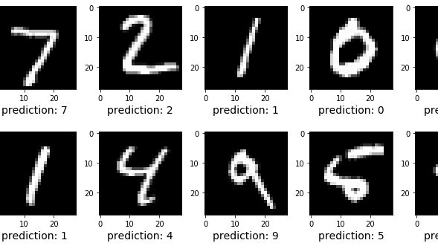
Image Analysis
Digit Recognition

Slide 2
Milestones of digit recognisition
Must-have Project
Main Algorithm – KNN: self-written
Scikit-learn function
Further optimization of KNN via PCA, best parameters for PCA (n-number of PCs used) and KNN (k-neighbors)
Meta-digits: mean, median, best neighbored
Analysis of falsely recognized digits
Drawing enviroment
Centering
Evaluation
Drawing canvas

Slide 3
K-Nearest Neighbours (KNN)
Which K training vectors are the nearest to our test-vector (euclidian distance)
-> Which k training images are the most similar to our test image.
In this example with 2 dimensions
(our case has 784 dimensions)

Slide 4
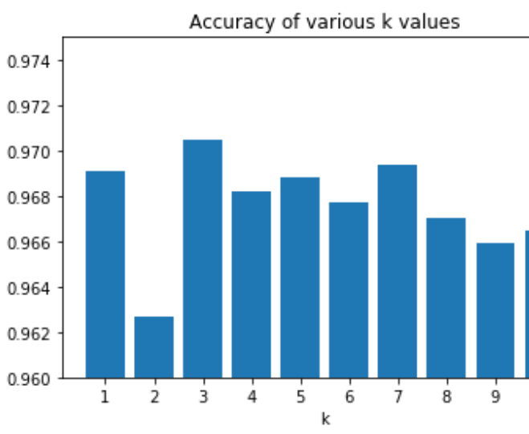
KNN accuracy analysis
Best number of nearest neighbors: n=3
Around 97% accuracy
Conflict with even values for k
Algorithm choses randomly
If k is to big too far distances are included

Slide 5
Principal Component Analysis (PCA)
The image is a 784 dimensional vector. 60000 train images, 10000 test images -> KNN takes too long
Solution: PCA
Reduces dimensionality by eliminating redundancy and emphazising variances.
We used scikit-learn function
Not only accelerated calculations, but also increased accuracy by noice reduction

Slide 6
Variance explained by PCA
First PCs explain the most variance due to the way the PCA works
Idea at the beginning: to visulalize the data points in 2D space and may be find some interesting tendencies
Not possible, first two PCs explain too little variance

Slide 7
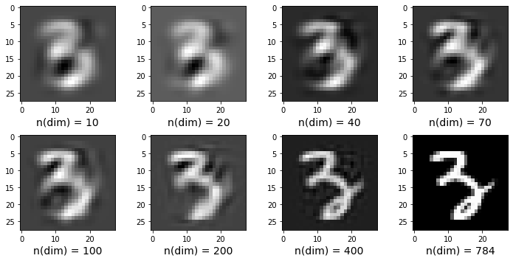
Recovered images

Slide 8
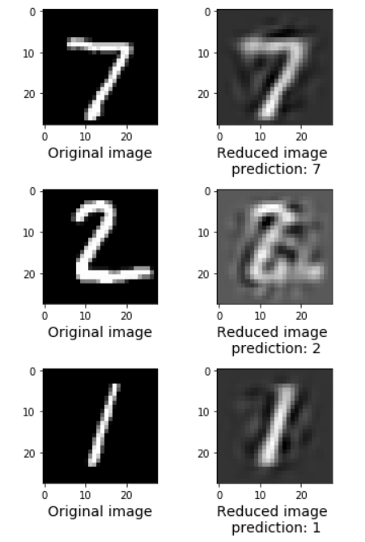
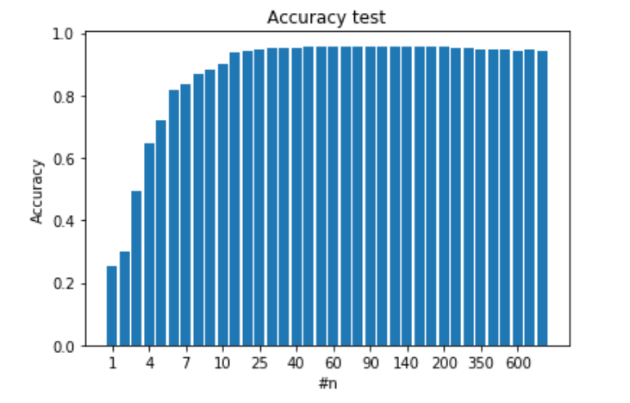
Interesting tendencies and the best parameter
Highest accuracy with 78 dimensions
Noise reduction
2 dimensions: less than 5% variance, but more than 30% accuracy
3 dimensions: 5% variance, the highest increase in accuracy (to 50%)

Slide 9
Finding meta digits
Objective: Find best recognizable image for each digit.
allows us to: evaluate digits
analyze wrong recognized images
3 different methods

Slide 10
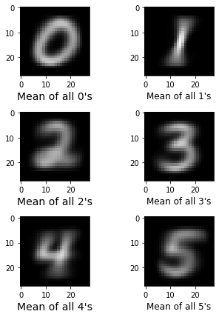
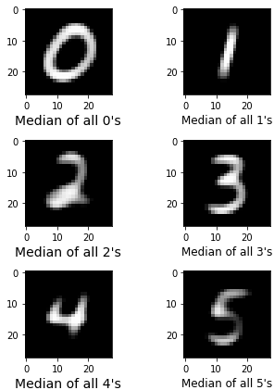
Two easiest solutions: mean and median meta digits

Slide 11
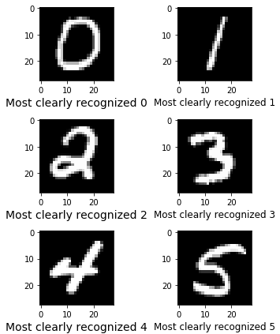
Best recognizable digit
Image that is surrounded by the highest number of images with the same label.

Slide 12
Why are there mispredictions?

Slide 13
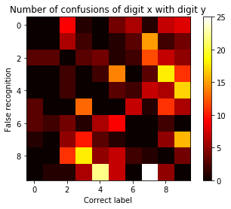
Hetmap with confused digits

Slide 14
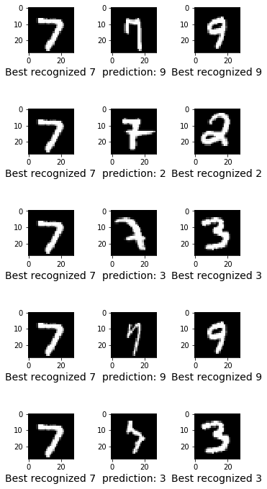

Wrong predicted digits

Slide 15
DRAWING CANVAS

