Slide 1
Image Analysis
Digit Recognition

Slide 2
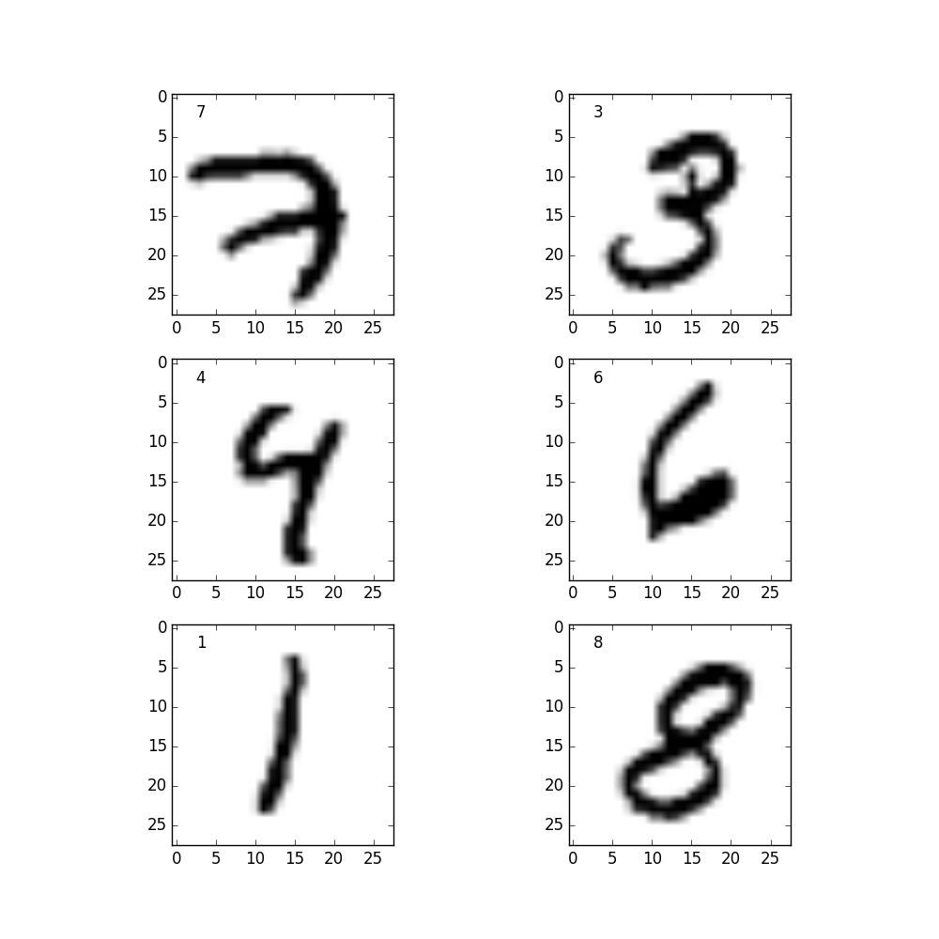
MNIST-Dataset
Goal:
The computer recognizes which digit is portrayed on the test-image
by comparing it to the training-images.
Input:
Images (28x28=784 pixels) of handwritten digits: centralized and grayscaled
Training set: 60 000 Images
Test set: 10 000 Images
Output:
Prediction of the written number.

Slide 3
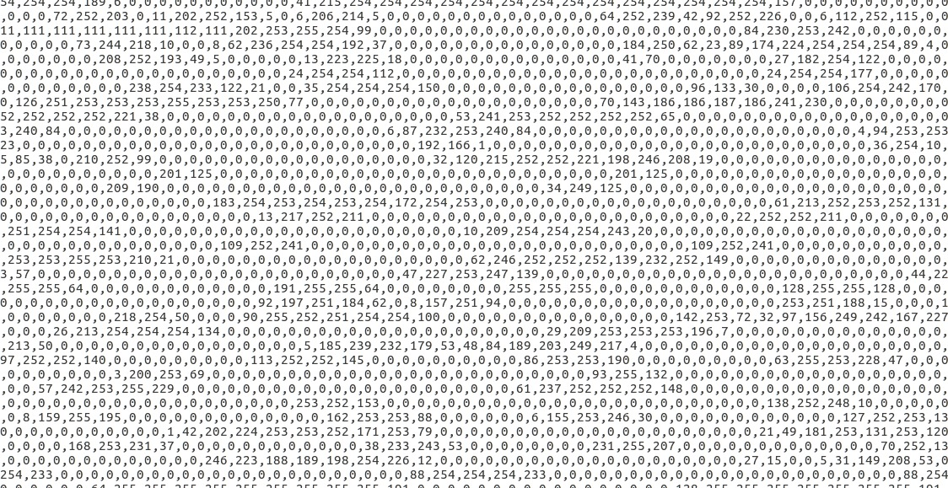
MNIST-Dataset
 | Pixel1 | Pixel2 | Pixel3 | Pixel… | Pixel784
Image1 | 0 | 0 | 0 | 0 | 0
Image2 | 0 | 3 | 74 | 0 | 64
Image3 | 0 | 15 | 87 | 33 | 14
Image4 | 0 | 0 | 95 | 0 | 0
Image5 | 0 | 0 | 36 | 24 | 0
Image… | 9 | 0 | 0 | 0 | 8
Image x | 0 | 0 | 11 | 0 | 57
We see our image-data in this form

Slide 4
K-Nearest Neighbours (KNN)
Which K training vectors are the nearest to our test-vector (euclidian distance)
-> Which k training images are the most similar to our test image.
In this example with 2 dimensions
(our case has 784 dimensions)

Slide 5

Principal Component Analysis (PCA)
The image is a 784 dimensional vector (too many dimensions)
Solution: PCA Reduces dimensionality by eliminating redundancy and emphazising variances.
May increase the accuracy of the KNN algorithm.
Vectorspace with 784, 2, 20, 100 and 700 dimensions
Source: PCA of handwritten digits, Tyler McDonnell

Slide 6
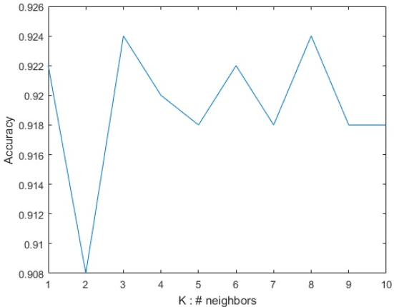
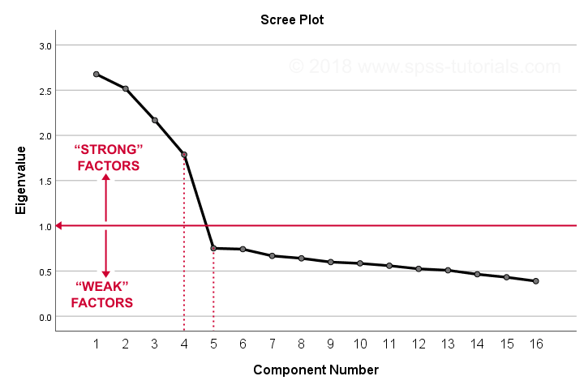
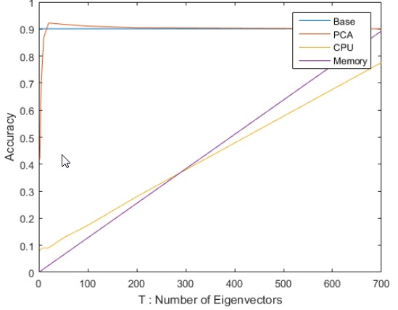
Optimizing parameters for the KNN/PCA
Needed a function to record accuracy rate of correctly recognized digits
The maxima of the accuracy are interpreted as the optimal numbers for k neighbours and t dimensions in PCA space.
For optimal t finding scree plot and “elbow” scree test could also be used
Source: PCA of handwritten digits, Tyler McDonnell

Slide 7

Visualization
Our imagedata consists only of numbers, so we reverse-transform it to a common image format.
 | Pixel1 | Pixel… | Pixel784
Image1 | 0 | 0 | 0
Image2 | 0 | 0 | 64
Image3 | 0 | 24 | 0
Image… | 9 | 0 | 8
Image x | 0 | 0 | 57
For Example:
View images of falsely recognized digits
Source: Digit Recognition Using Keras, Mukul Agrawal

Slide 8
Overview
Our handwriting
Comparison with a corresponding perfect digit
Evaluation
Parser: CSV input to matrix
Calculate a perfect digit via different methods
Optimize parameters
PCA
KNN
Visualization
Things to try out:

Slide 9
We have time, but we need more!
Milestones | Weeks
Project proposal + programming skill improving | 20
KNN in 784 dimensions | 21+22
optimal k number, success-rate from k plotting function | 22+23
Visualization of recognized/falsely recognized digits | 24
PCA, optimal number t of dimensions | 25+26
KNN in PCA-space, success rate from t and k plotting, optimal k for PCA | 27
Analysis of our handwriting, search for a perfect digit, comparison of perfect digits found via different methods | 28
Writing exercise: write a digit, which you see on the screen and our script will evaluate how well it is written. | 29
Preparation to final presentation | 30

