Slide 1
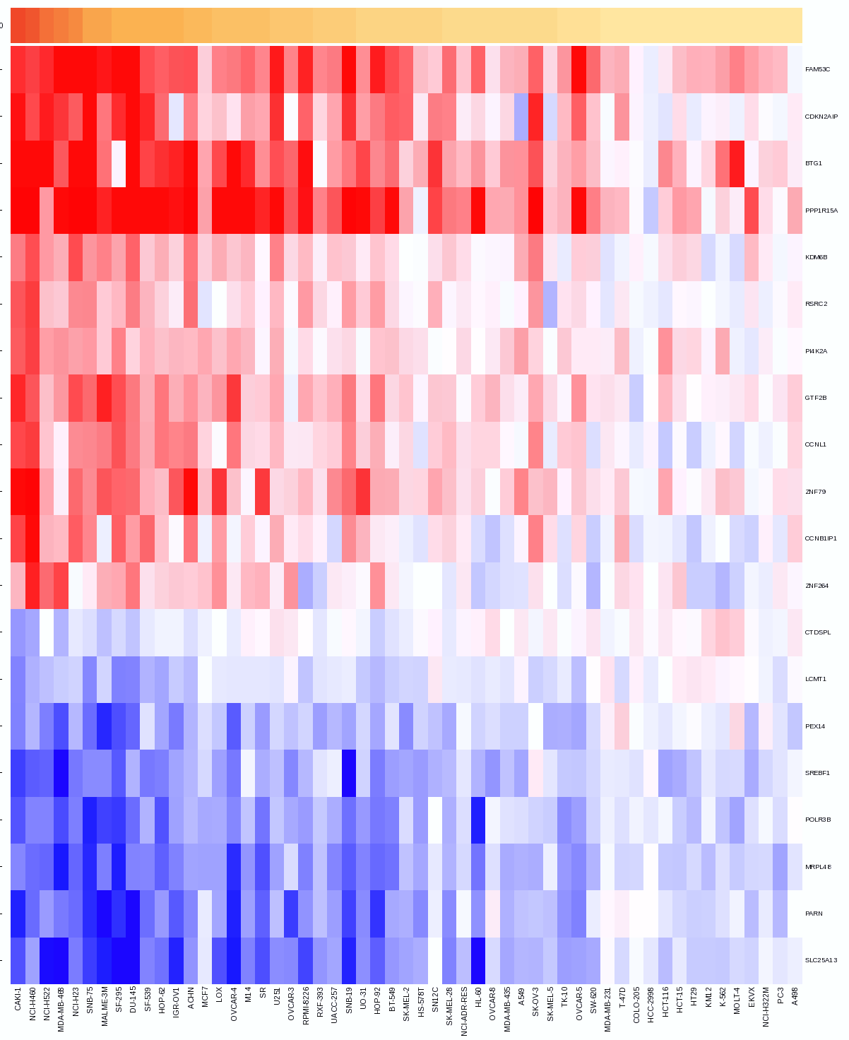
Project 2: Cellular response to drug pertubations
Group 2: Amelie Vogt, Johanna Bauer, Teresa von Linde, Dorothee Mersch

Slide 2




Data Overview
Mutation cell lines
Genes - information about mutation
Gene copy number alterations
Basal expression
Untreated
Genes - cell lines
Genes - samples
Genes - cell lines
Drug sensitivity
Initial cell line metadata
Drugs - cell lines
Treated
Drug annotation
Genes - samples
Metadata drugs

Slide 3
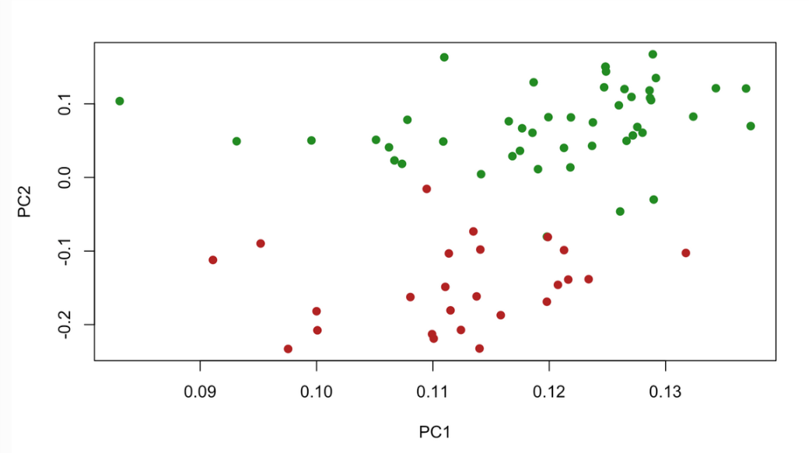
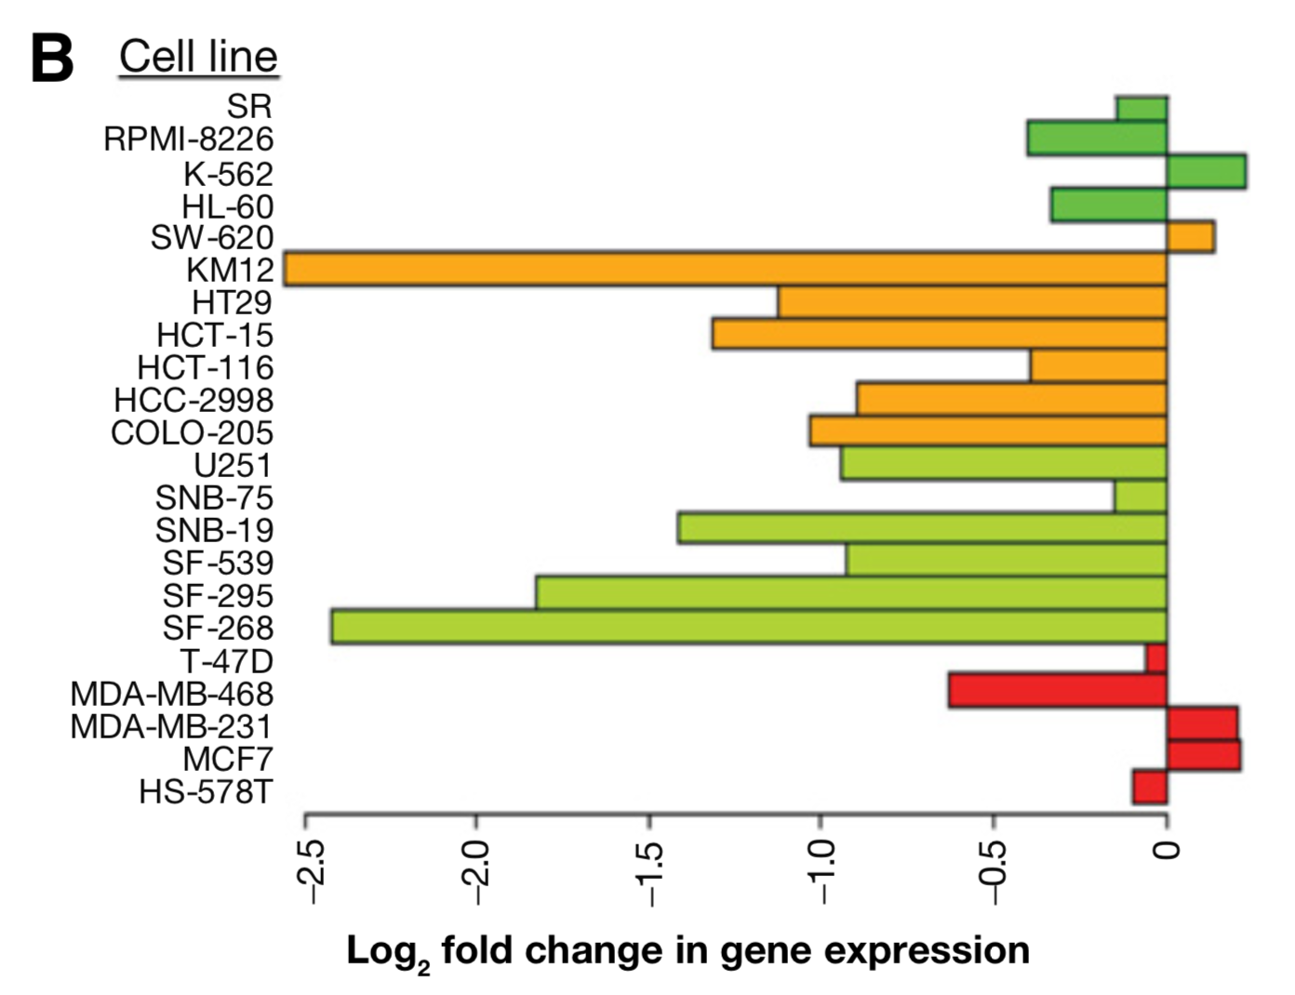
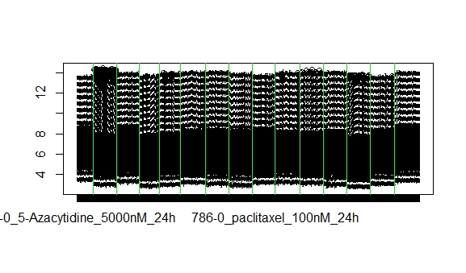
General analysis
expression
treated cell lines
http://bioinfo.ipmb.uni-heidelberg.de/crg/datascience3fs/practicals/2_UnsupervisedLearning.html
Chen B et al. Reversal of cancer gene expression correlates with drug efficacy and reveals therapeutic targets. Nat Commun. 2017 Jul 12;8:16022.v
Notes:
We want to ask 3 questions:
Is there a general difference between the distribution if we highlight the different drugs? Yes but it disappiered when we normalized the data
Which genes change their expression the most when cancer is induced and then treated? -> most extreme FC values – the same genes?
To explore the change from untreated to treated more we want to do a PCA for the FC data -> compare chemotherapy agents with targeted drugs and hope for 2 clear groups

Slide 4
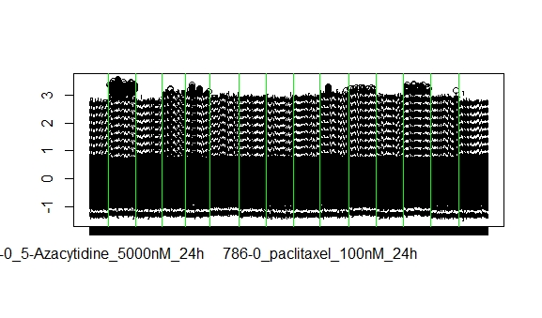
General analysis
Are there obvious differences in the transcriptomes between drugs?
expression
treated cell lines
http://bioinfo.ipmb.uni-heidelberg.de/crg/datascience3fs/practicals/2_UnsupervisedLearning.html
Chen B et al. Reversal of cancer gene expression correlates with drug efficacy and reveals therapeutic targets. Nat Commun. 2017 Jul 12;8:16022.v
Notes:
We want to ask 3 questions:
Is there a general difference between the distribution if we highlight the different drugs? Yes but it disappiered when we normalized the data
Which genes change their expression the most when cancer is induced and then treated? -> most extreme FC values – the same genes?
To explore the change from untreated to treated more we want to do a PCA for the FC data -> compare chemotherapy agents with targeted drugs and hope for 2 clear groups

Slide 5
General analysis
Are there obvious differences in the transcriptomes between drugs?
Which genes change their expression profiles the most?
expression
treated cell lines
http://bioinfo.ipmb.uni-heidelberg.de/crg/datascience3fs/practicals/2_UnsupervisedLearning.html
Chen B et al. Reversal of cancer gene expression correlates with drug efficacy and reveals therapeutic targets. Nat Commun. 2017 Jul 12;8:16022.v
Notes:
We want to ask 3 questions:
Is there a general difference between the distribution if we highlight the different drugs? Yes but it disappiered when we normalized the data
Which genes change their expression the most when cancer is induced and then treated? -> most extreme FC values – the same genes?
To explore the change from untreated to treated more we want to do a PCA for the FC data -> compare chemotherapy agents with targeted drugs and hope for 2 clear groups

Slide 6
General analysis
Are there obvious differences in the transcriptomes between drugs?
Which genes change their expression profiles the most?
Is there a general difference between chemotherapy agents and targeted drugs?
expression
treated cell lines
http://bioinfo.ipmb.uni-heidelberg.de/crg/datascience3fs/practicals/2_UnsupervisedLearning.html
Chen B et al. Reversal of cancer gene expression correlates with drug efficacy and reveals therapeutic targets. Nat Commun. 2017 Jul 12;8:16022.v
Notes:
We want to ask 3 questions:
Is there a general difference between the distribution if we highlight the different drugs? Yes but it disappiered when we normalized the data
Which genes change their expression the most when cancer is induced and then treated? -> most extreme FC values – the same genes?
To explore the change from untreated to treated more we want to do a PCA for the FC data -> compare chemotherapy agents with targeted drugs and hope for 2 clear groups

Slide 7
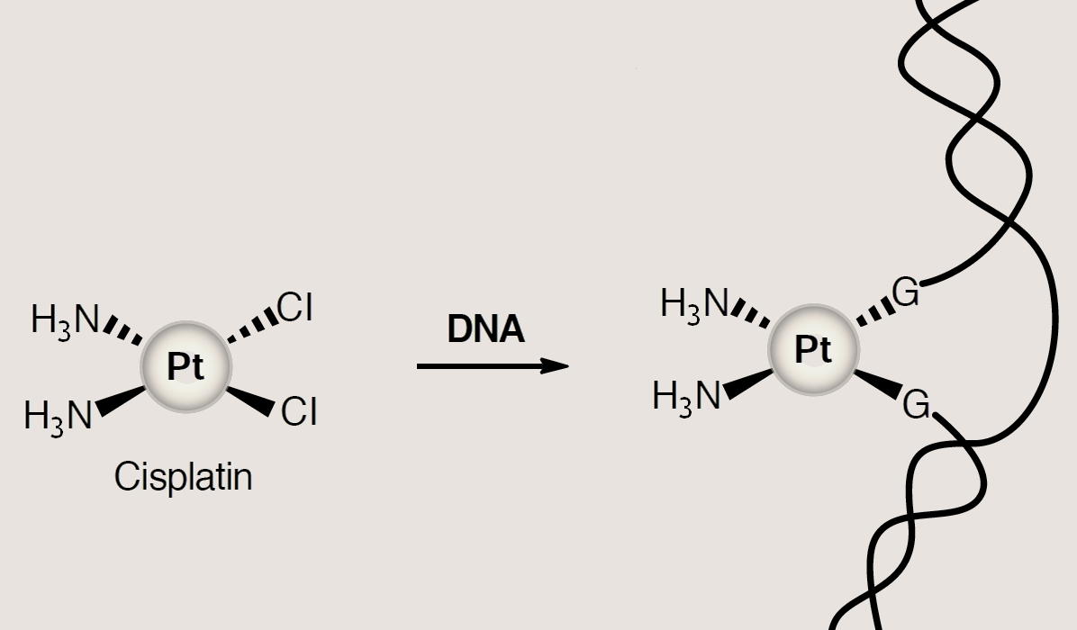
Specific analysis
Cisplatin, a chemotherapy agent

Slide 8
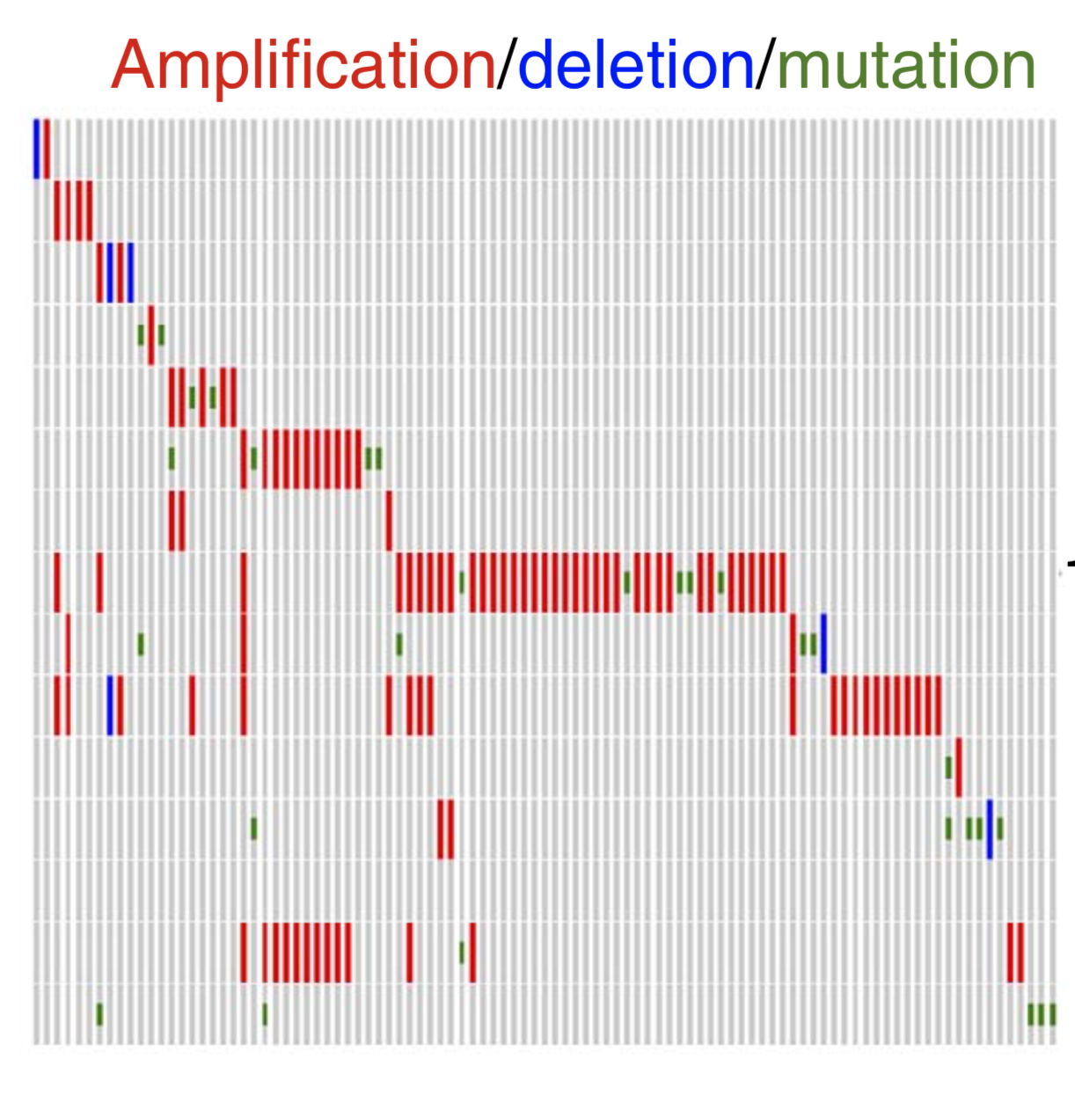
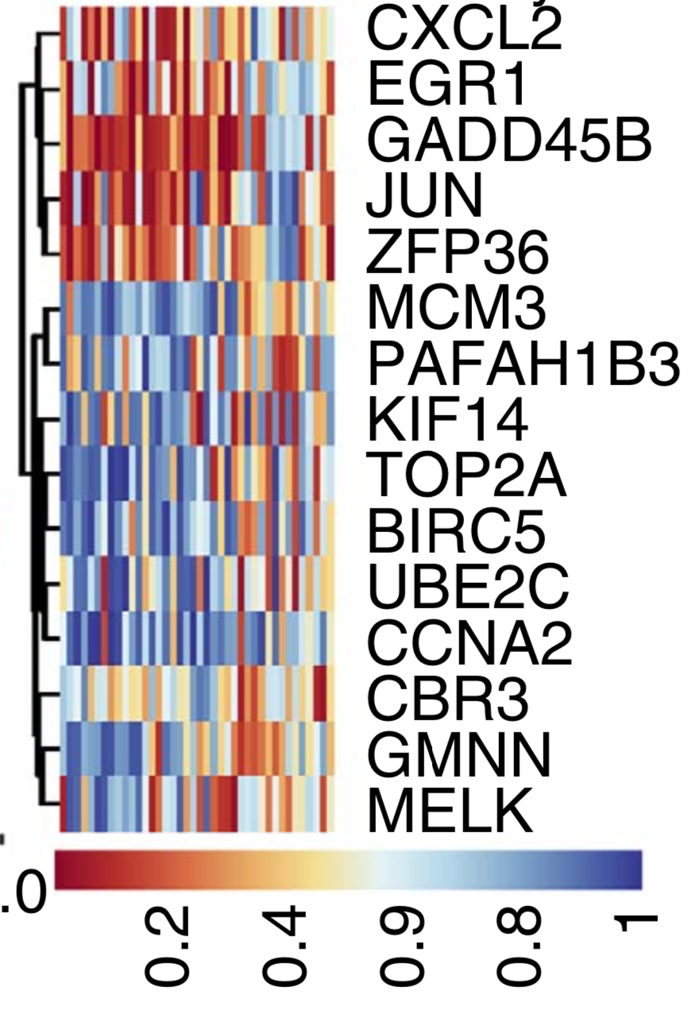
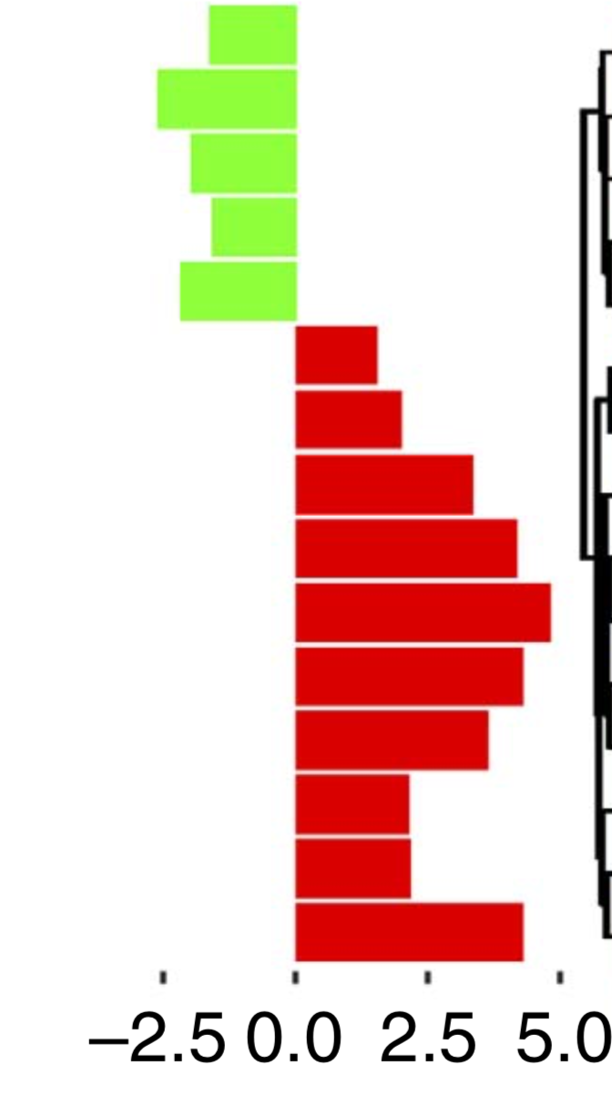
Can we identify genes as significant biomarkers?
Influence of cisplatin on the biomarkers gene expression in different cell lines?
Is there a connection between biomarkers and gene alterations?
Log2 fold change
untreated vs. treated
Cell lines Biomarker
Drugs
Genes
Genes
Genes
patient samples
Chen B et al. Reversal of cancer gene expression correlates with drug efficacy and reveals therapeutic targets. Nat Commun. 2017 Jul 12;8:16022.v

Slide 9
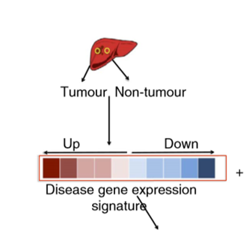
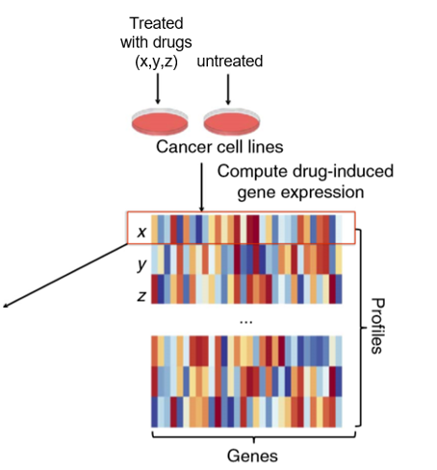
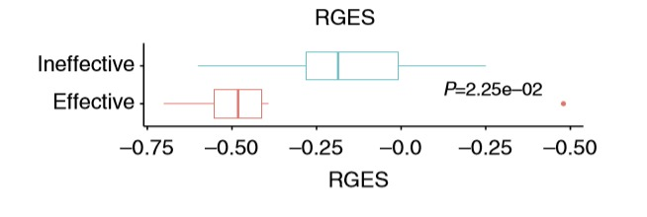
RGES =
Can cisplatin reverse the cancer induced gene expression?
Cisplatin
reverse gene expression score
Chen B et al. Reversal of cancer gene expression correlates with drug efficacy and reveals therapeutic targets. Nat Commun. 2017 Jul 12;8:16022.
Notes:
´verschiedene Gene auf x Achse, deren verschiedenen Expressionnen als Farbe und in den Reihen die Medikamente

Slide 10
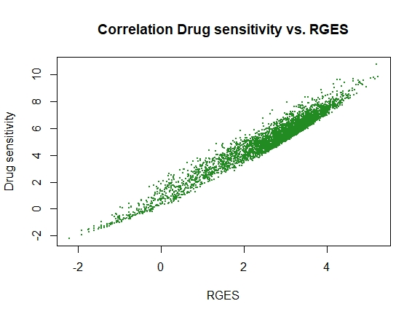
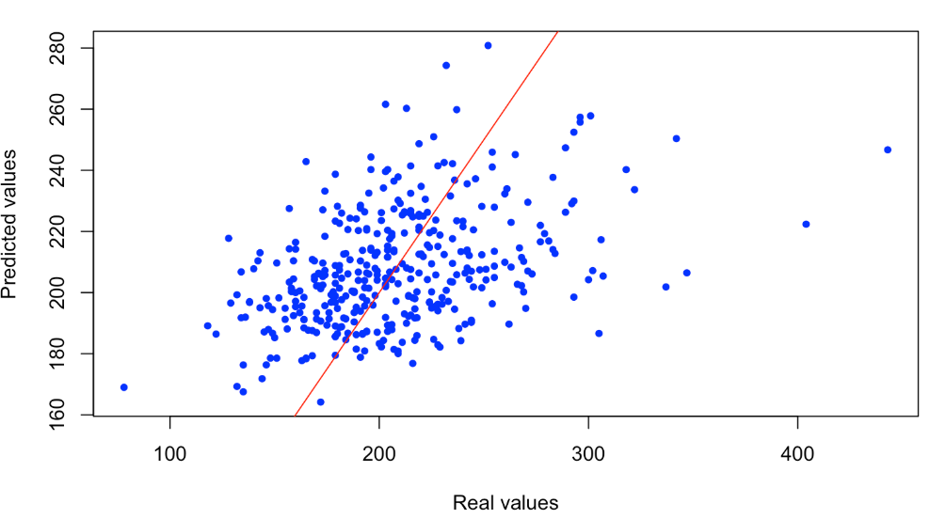

Connection to drug sensitivity?
Does our RGES correlate with drug sensitivity?
Can we predict the drug sensitivity with RGES?
Put more variables → biomarkers?
http://bioinfo.ipmb.uni-heidelberg.de/crg/datascience3fs/practicals/5_Regression.html
Notes:
Is there any connection to our drug sensitivity data?
-> RGES is a measure of the potency for every drug to reverse the gene expression in every cell line
-> drug sensitivity measures the growth inhibition, it shows how well the drug takes effect
From our paper we know, that there is a positive correlation between RGES and drug sensitivity
-> is it possible to predict the drug sensitivity through RGES?
-> can we learn a model on our RGES data and predict the drug sensitivity data?
-> we want to know if the efficacy of drugs for each cell line can be predicted
(müssen wir da noch andere Daten nehmen oder können wir das mit unseren machen??)
-> linear regression model
Is it possible to perform a multiple regression model by including more variables
-> possible added variable could be the previously found biomarkers (these genes which change their gene expression between treated and untreated the most)
-> does the inclusion of more variables enhance the model?

Slide 11




Timeline
PCA
Log2 FC
Biomarker Analysis
Regression Analysis
6th May
15th May
22nd May
27th May
19th June
3rd July
Exploring Data
Find Biomarkers
RGES
General analysis
Specific analysis
Advanced analysis

