Slide 1
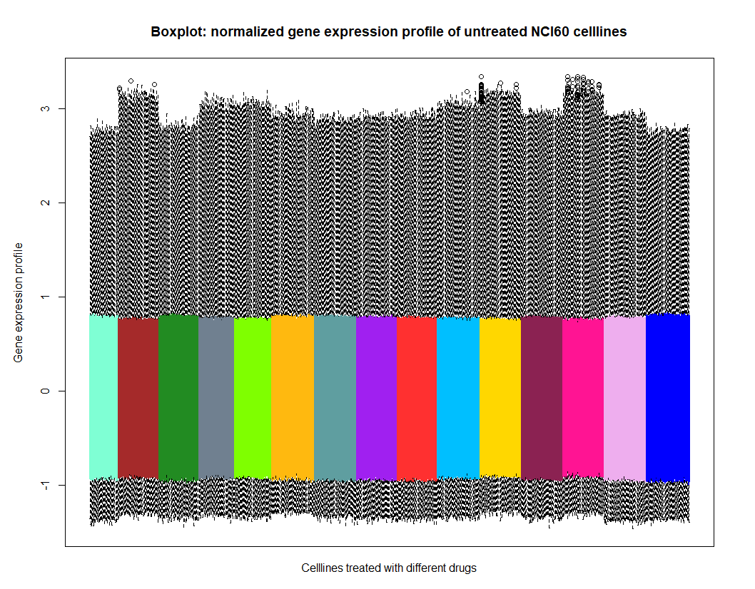
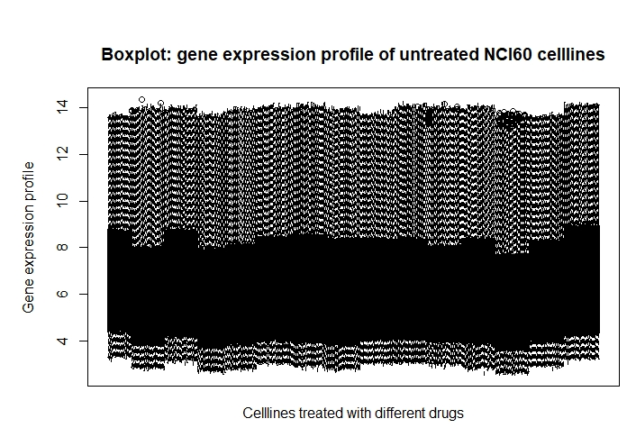

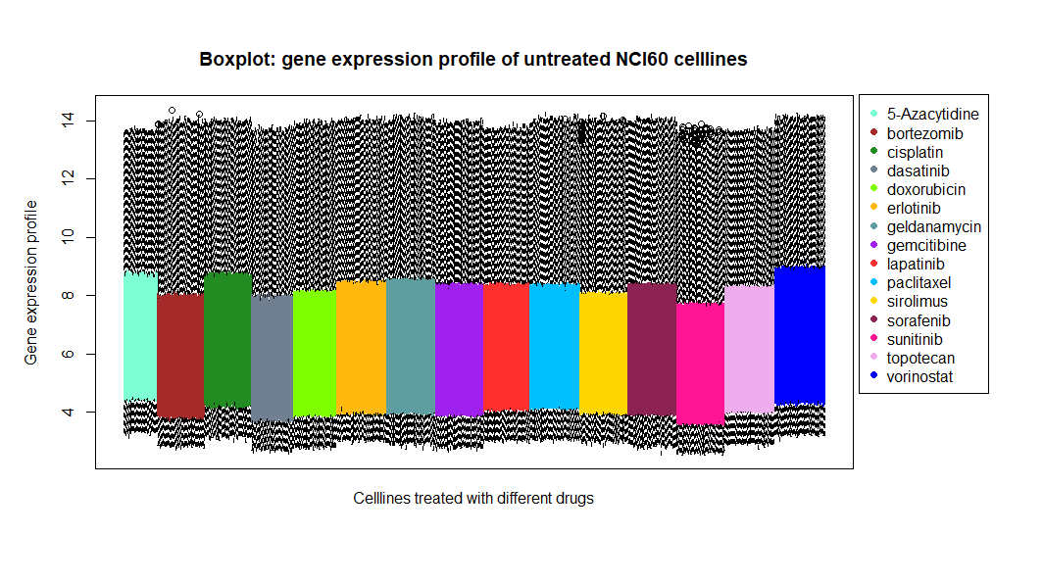
1. Milestone - Broad analysis
Expression profiles:
Coloring according to drug
Normalization
Boxplot

Slide 2
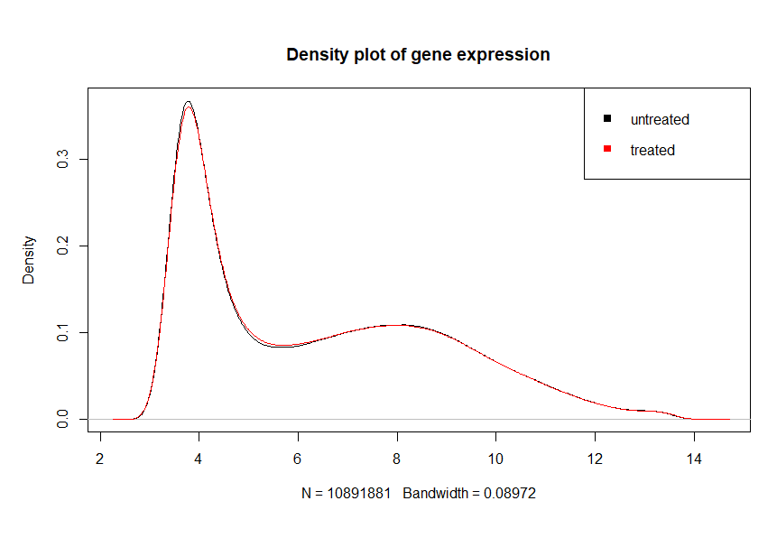
1. Milestone - Broad analysis
Expression profiles:
Density plot

Slide 3
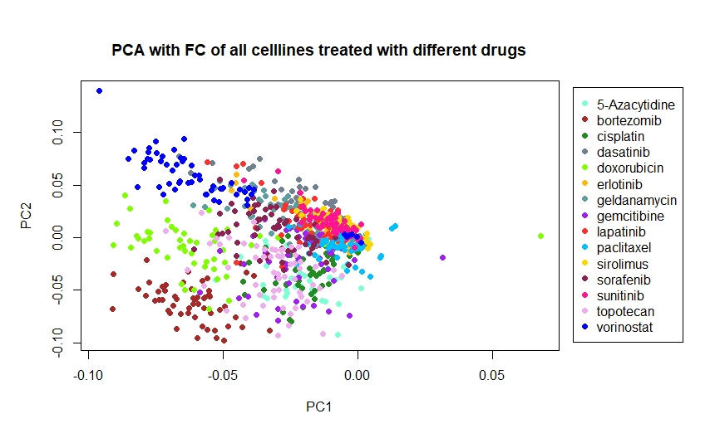
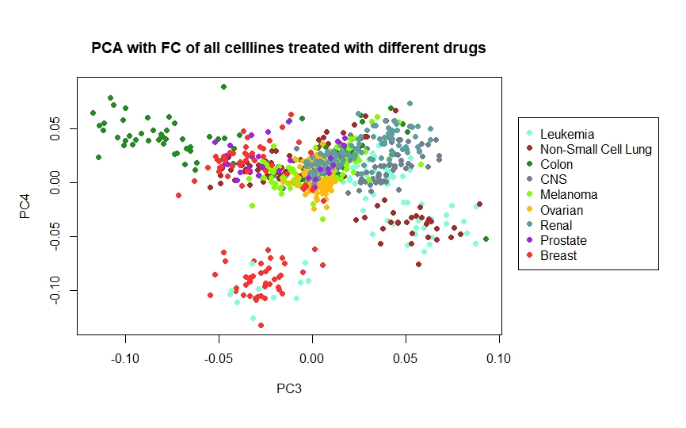
1. Milestone - Broad analysis
PCA

Slide 4
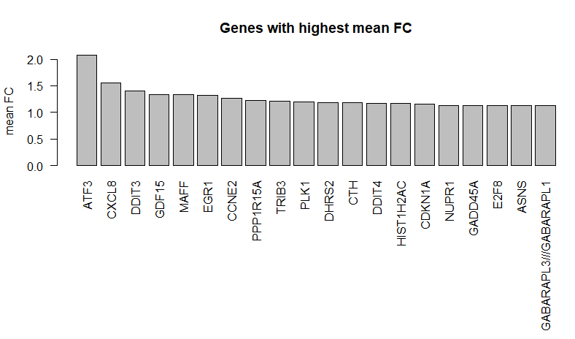
1. Milestone - Broad analysis
Biomarkers
Further ideas:
Color them according to pathway?
Boxplot to show distribution instead of barplot of the mean over all samples

Slide 5
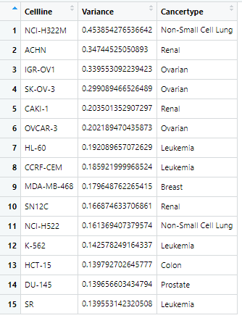
2. Milestone: Most affected celllines
Celllines:
Greatest variance in FC

Slide 6
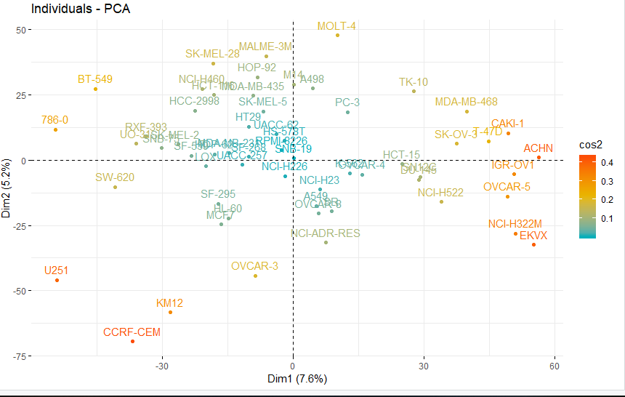
2. Milestone: Most affected celllines
Celllines:
PCA

Slide 7
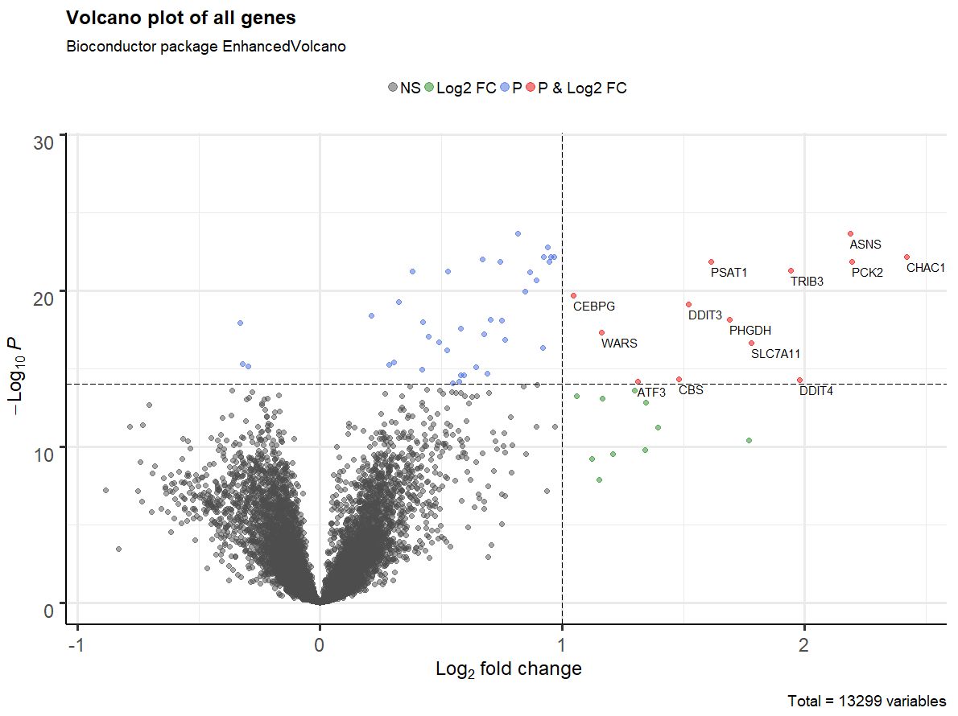
2. Milestone: Most affected genes
Biomarker:
Volcano Plot

Slide 8
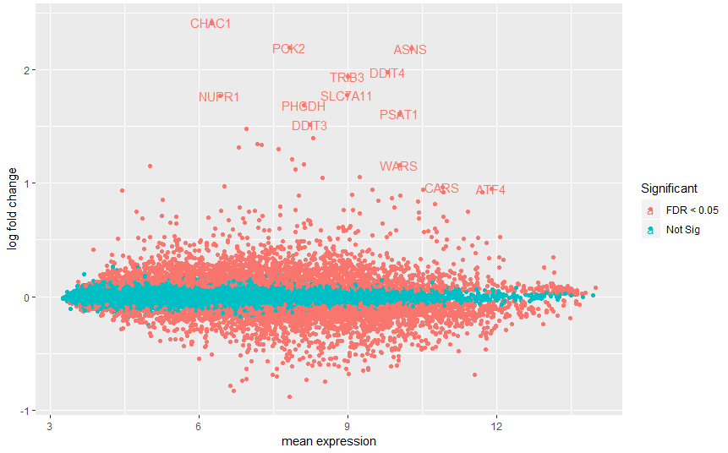
2. Milestone: Most affected genes
Biomarker:
MA Plot

Slide 9
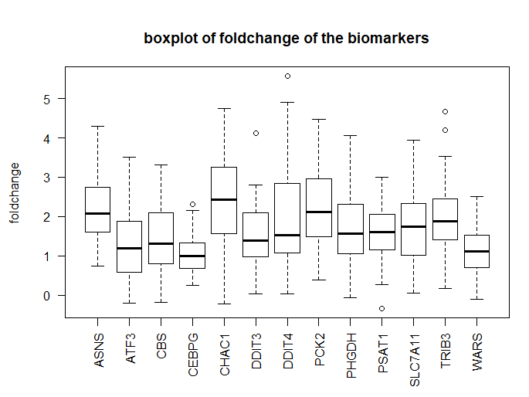
2. Milestone: Most affected genes
Biomarker:

Slide 10
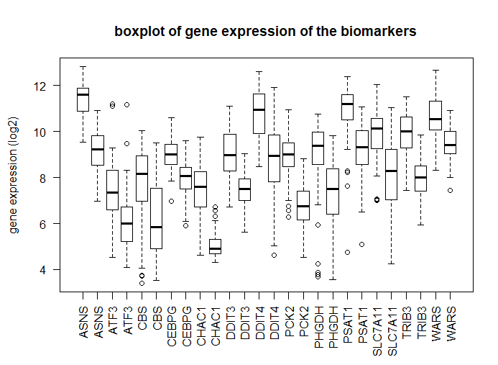
2. Milestone: Most affected genes
Biomarker:
Next steps:
Name genes with treated and untreated
Color genes according to pathway
Single gene response plot

Slide 11
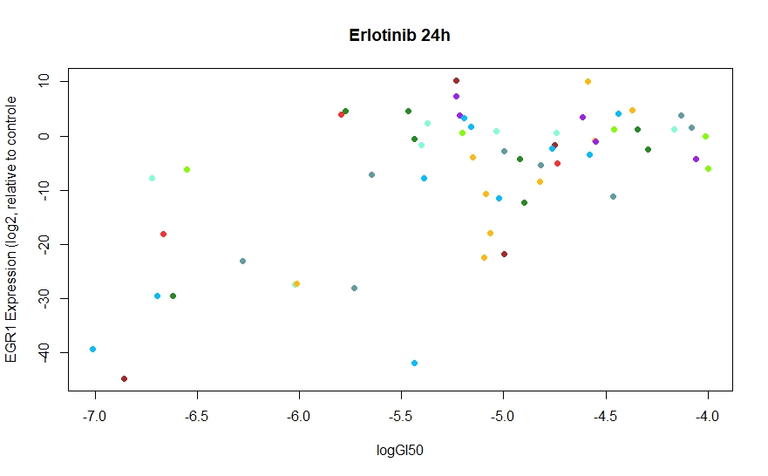
3. Milestone

Slide 12
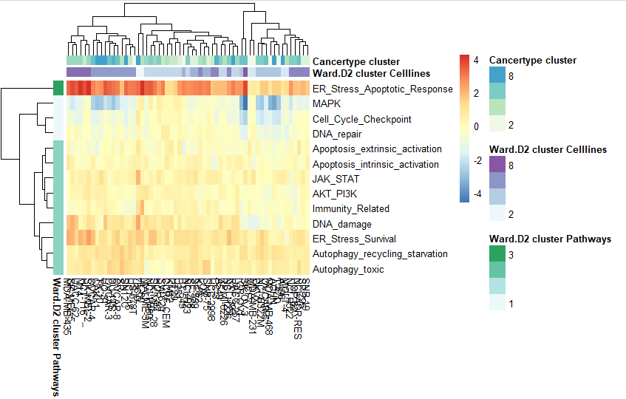
4. Milestone: Affected pathways
Heatmap:
Pathways according to supplementary material of NCI60 TPW
Next steps:
Change coloring (maybe by quantiles)
How many clusters? → elbow method?

Slide 13
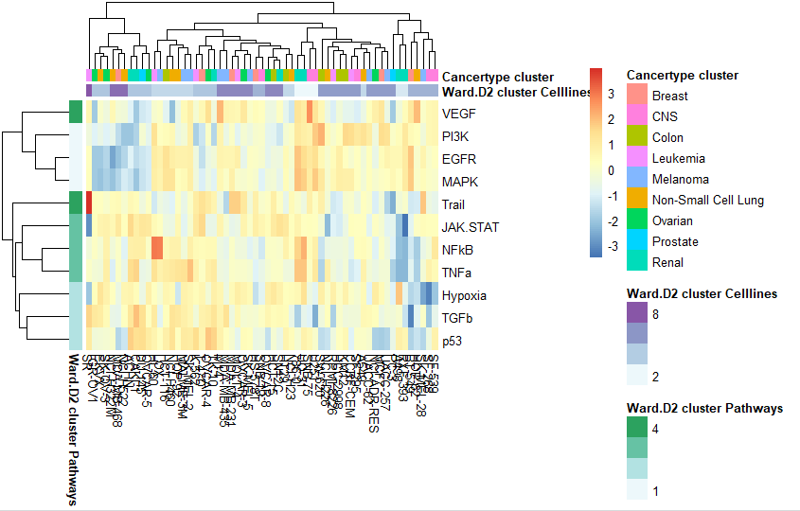
4. Milestone: Affected pathways
Heatmap:
Pathways according to Progeny
Next steps:
Change coloring (maybe by quantiles)
How many clusters? → elbow method?
Compare results from both methods
Compare with function of biomarkers

