Slide 1
Field | Fill in (1 to 2 sentences max)
Use case | This RAG app helps high school students explore STEM scholarships and colleges using a curated local corpus
Corpus | The scholarships include local 86 different programs , while the colleges.
Ingestion + cleaning | I crawled the web for the college and scholarship programs to obtain the URLs. And then use Tavily+Nebius to further drill down and extract the metadata.
Ingestion + freshness | Quarterly refresh cadence
Chunking + embedding | RecursiveCharacterTextSplitter, with a chunk size of 1600 and chunk overlap of 180, used semantic search + keyword search filtering, embedding model used - Qwen/Qwen3-Embedding-8B. I did a few tests and noticed this setup retrieved correct citations.
Retrieve | I have stored the chunks in a PineCone vector database. This uses a hybrid search and retrieves the top 5 chunks.

Slide 2
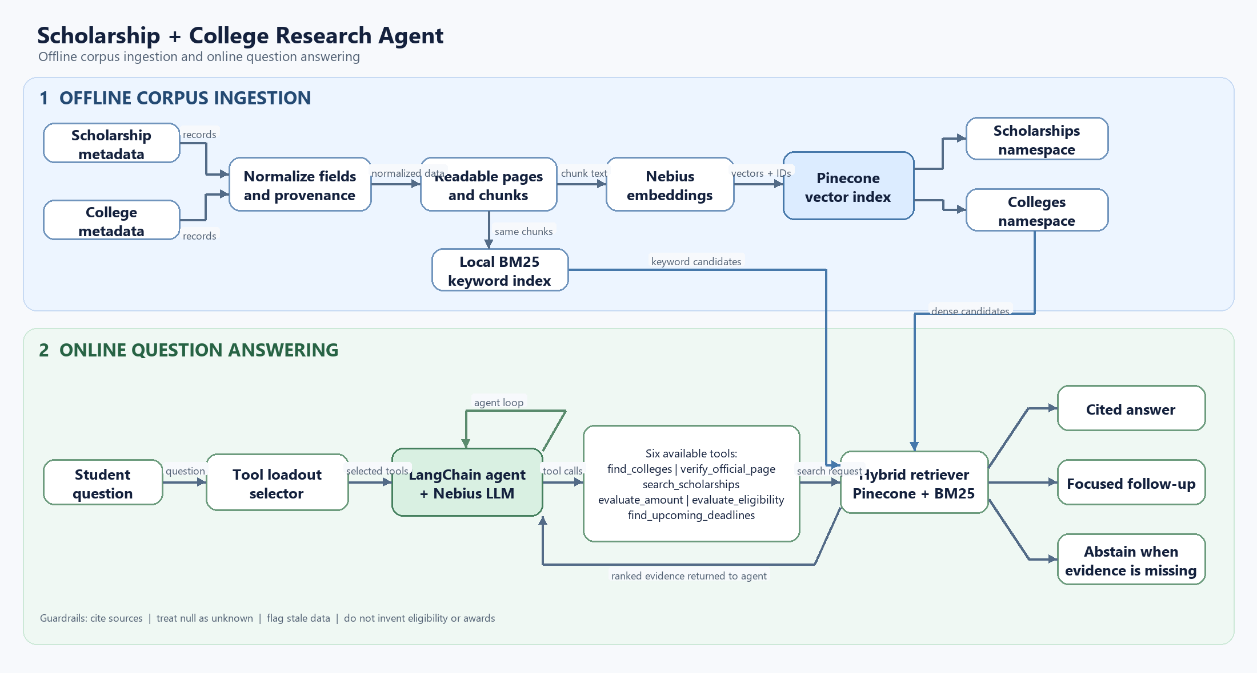
RAG AGENT – SCHOLARSHIPS AND COLLEGE Q&A BOT
This agent helps students explore STEM scholarships and colleges using a curated local corpus.
It retrieves relevant scholarship and college records to answer questions.
Search combines Pinecone semantic search with BM25 keyword search.
Reciprocal Rank Fusion combines the two ranked result lists.
Metadata filters can narrow results by criteria such as state or applicant stage.
The agent can look up colleges and scholarship details, including amounts and deadlines.
It checks eligibility conservatively and identifies information that is missing.
Answers should be grounded in corpus evidence, with sources cited where available.
It avoids inventing facts or treating a scholarship as guaranteed eligibility or funding.
Pinecone ingestion is a separate, explicitly confirmed operation; normal retrieval is read-only.
C:\Users\Rosh\GENAI\WEEK2_PROJECT\college_resources_for_high_schoolers_STEM\scholarship_agent\ streamlit_app.py

Slide 3
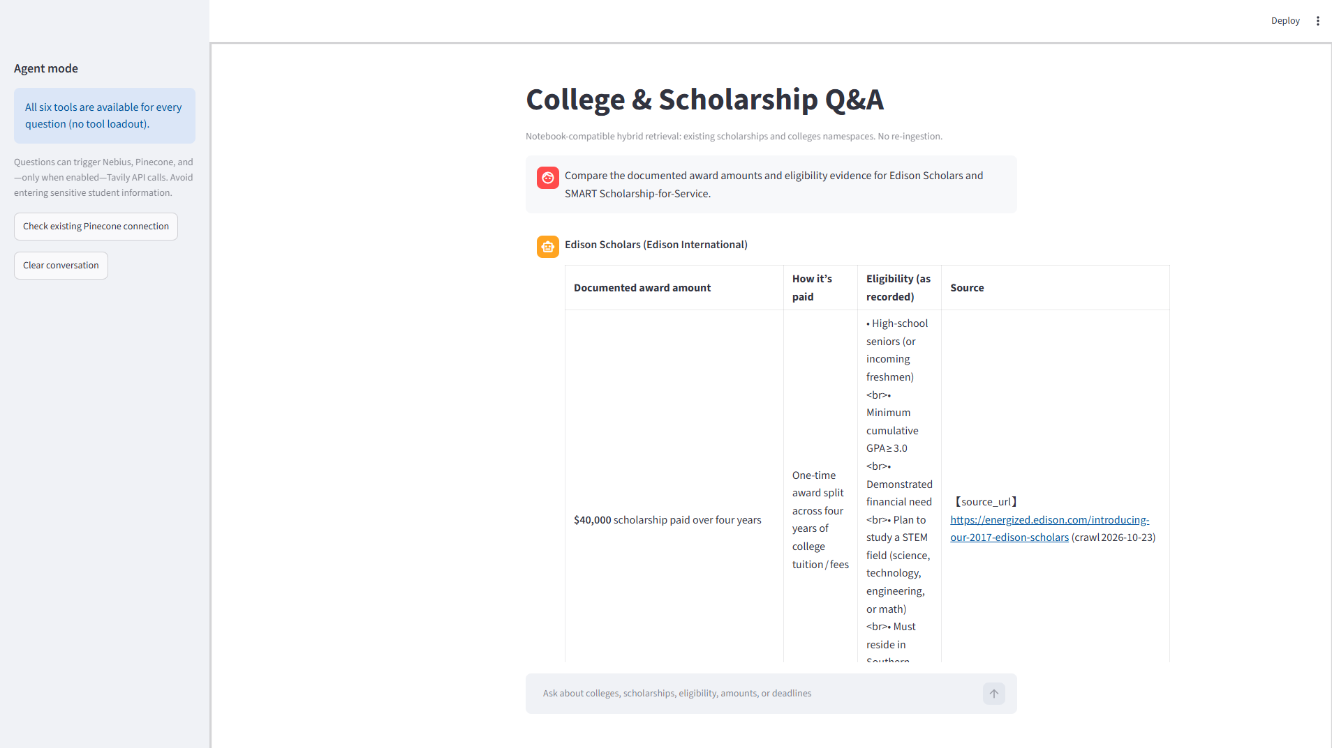
Average Latency | 7 seconds
Average tokens(input+output): | 5.3k
Accuracy | 72%

