Slide 1

Understanding Security Layers
Lesson 1

Slide 2
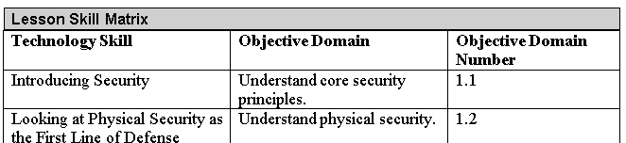
Objectives
Notes:
This should also be a review for the 70-642.

Slide 3
Security
What you are trying to protect
Why does it needs to be protected
What you’re protecting it from

Slide 4
CIA
Confidentiality
Integrity
Availability

Slide 5
Confidentiality
Confidentiality is the characteristic of a resource ensuring access is restricted to only permitted users, applications, or computer systems.
Confidentiality deals with keeping information, networks, and systems secure from unauthorized access.
There are several technologies that support confidentiality in an enterprise security implementation.
  Strong encryption
  Strong authentication
  Stringent access controls

Slide 6
Integrity
Integrity is defined as the consistency, accuracy, and validity of data or information.
One of the goals of a successful information security program is to ensure that data is protected against any unauthorized or accidental changes.

Slide 7
Availability
Availability describes a resource being accessible to a user, application, or computer system when required.
  In other words, availability means that when a user needs to get to information, he or she has the ability to do so.
Typically, threats to availability come in two types: accidental and deliberate.

Slide 8
Risk Management
Risk management is the process of identifying, assessing, and prioritizing threats and risks.
A risk is generally defined as the probability that an event will occur.
A threat, which is defined as an action or occurrence that could result in the breach, outage, or corruption of a system by exploiting known or unknown vulnerabilities.
The goal of any risk management plan is to remove risks when possible and to minimize the consequences of risks that cannot be eliminated.
Risk assessments are used to identify the risks that might impact your particular environment.

Slide 9
Dealing with Risks
After you have prioritized your risks, you are ready to choose from among the four generally accepted responses to these risks. They include:
  Avoidance
  Acceptance
  Mitigation
  Transfer

Slide 10
Principle of Least Privilege
The principle of least privilege is a security discipline that requires that a particular user, system, or application be given no more privilege than necessary to perform its function or job.

Slide 11
Attack Surface
An attack surface consists of the set of methods and avenues an attacker can use to enter a system and potentially cause damage.
The larger the attack surface of a particular environment, the greater the risk of a successful attack.

Slide 12
Social Engineering
Social engineering is a method used to gain access to data, systems, or networks, primarily through misrepresentation.
This technique typically relies on the trusting nature of the person being attacked.

Slide 13
Security and Cost
Security costs money.
You should also strive to make the security measures as seamless as possible to authorized users who are accessing the confidential information or resource.
If security becomes a heavy burden, users will often look for methods to circumvent the measures you have established.
Training goes a long way in protecting your confidential information and resources because it shows users what warning signs to watch for.

Slide 14
Physical Security
Physical security is the first line of defense.
There are a number of factors to consider when designing, implementing, or reviewing physical security measures taken to protect assets, systems, networks, and information.
These include understanding site security and computer security; securing removable devices and drives; access control; mobile device security; disabling the Log On Locally capability; and identifying and removing keyloggers.

Slide 15
Access Control
Access control is the process of restricting access to a resource to only permitted users, applications, or computer systems.

Slide 16
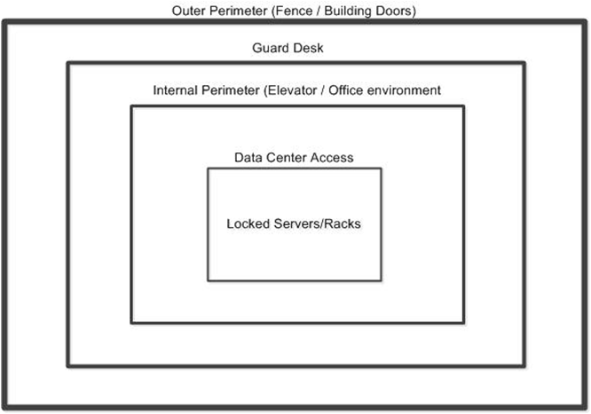
Defense in Depth
Defense in depth means using multiple layers of security to defend your assets.
That way, even if an attacker breaches one layer of your defense, you have additional layers to keep that person out of the critical areas of your environment.

Slide 17
Goals in Physical Security
There are several other goals to keep in mind when designing a physical security plan:
  Authentication: Site security must address the need to identify and authenticate the people who are permitted access to an area.
  Access control: Once a person’s identity has been proven and authenticated, site security must determine what areas that person has access to.
  Auditing: Site security must also provide the ability to audit activities within the facility. This can be done by reviewing camera footage, badge reader logs, visitor registration logs, or other mechanisms.

Slide 18
Physical Premises
For the purposes of this lesson, we will break the physical premises into three logical areas:
  External perimeter
  Internal perimeter
  Secure areas

Slide 19
External Perimeter Security
The external security perimeter is the first line of defense surrounding your office.
Common security measures you may encounter with respect to an organization’s external perimeter include the following:
  Security cameras
  Parking lot lights
  Perimeter fence
  Gate with guard
  Gate with access badge reader
  Guard patrols

Slide 20
Internal Security Perimeter
The internal security perimeter starts with the building walls and exterior doors and includes any internal security measures, with the exception of secure areas within the building.
Some of the features you may use to secure an internal perimeter include the following:
  Locks (on exterior doors, internal doors, office doors, desks, filing cabinets, etc.)
  Security cameras
  Badge readers (on doors and elevators)
  Guard desks and patrols
  Smoke detectors
  Turnstiles and mantraps

Slide 21
Secure Areas
Areas that not only to restrict external attackers, but also to limit internal employee access.
Secure area security technologies include the following:
  Badge readers and Keypads
  Biometric technologies (e.g., fingerprint scanners, retinal scanners, voice recognition systems, etc.)
  Security doors
  X-ray scanners and Metal detectors
  Cameras
  Intrusion detection systems (light beam, infrared, microwave, and/or ultrasonic)

Slide 22
Computer Security
Computer security consists of the processes, procedures, policies, and technologies used to protect computer systems.
  Servers
  Desktop Computers
  Mobile Computers

Slide 23
Mobile Devices
Mobile devices are one of the largest challenges facing many security professionals today.
Mobile devices such as laptops, PDAs, and smartphones are used to process information, send and receive mail, store enormous amounts of data, surf the Internet, and interact remotely with internal networks and systems.
  Docking stations
  Laptop security cables
  Laptop safes
  Theft recovery software
  Laptop alarms:

Slide 24
Removable Devices
A removable device or drive is a storage device that is designed to be taken out of a computer without turning the computer off.
Include memory cards, flash drives, floppy disks, CDs, and DVDs
Removable devices typically connect to a computer through a drive, through external communications ports like USB or Firewire, or, in the case of memory cards, through built-in or USB-based readers.

Slide 25

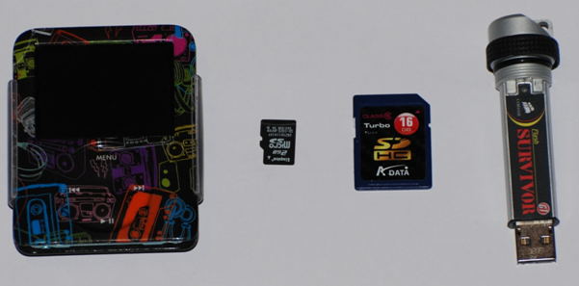
Removable Devices

Slide 26
Removable Devices
There are three basic types of security issues associated with removable storage:
  Loss
  Theft
  Espionage

Slide 27
Keylogger
A keylogger is a physical or logical device used to capture keystrokes.
An attacker will either place a device between the keyboard and the computer or install a software program to record each keystroke taken, and then he or she can use software to replay the data and capture critical information like user IDs and passwords, credit card numbers, Social Security numbers, or even confidential emails or other data.

Slide 28
Summary
Before you can start securing your environment, you need to have a fundamental understanding of the standard concepts of security.
CIA, short for confidentiality, integrity, and availability, represents the core goals of an information security program.
Confidentiality deals with keeping information, networks, and systems secure from unauthorized access.
One of the goals of a successful information security program is to ensure integrity, or that information is protected against any unauthorized or accidental changes.

Slide 29
Summary
Availability is defined as the characteristic of a resource being accessible to a user, application, or computer system when required.
Threat and risk management is the process of identifying, assessing, and prioritizing threats and risks.
A risk is generally defined as the probability that an event will occur.
Once you have prioritized your risks, there are four generally accepted responses to these risks: avoidance, acceptance, mitigation, and transfer.

Slide 30
Summary
The principle of least privilege is a security discipline that requires that a user, system, or application be given no more privilege than necessary to perform its function or job.
An attack surface consists of the set of methods and avenues an attacker can use to enter a system and potentially cause damage. The larger the attack surface of an environment, the greater the risk of a successful attack.
The key to thwarting a social engineering attack is employee awareness. If your employees know what to look out for, an attacker will find little success.

Slide 31
Summary
Physical security uses a defense in depth or layered security approach that controls who can physically access an organization’s resources.
Physical premises can be divided into three logical areas: the external perimeter, the internal perimeter, and secure areas.
Computer security consists of the processes, procedures, policies, and technologies used to protect computer systems.

Slide 32
Summary
Mobile devices and mobile storage devices are among the biggest challenges facing many security professionals today because of their size and portability.
A keylogger is a physical or logical device used to capture keystrokes.

