Slide 1

Understanding Security Policies
Lesson 3

Slide 2
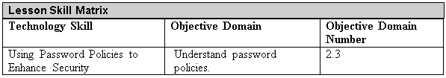
Objectives
Notes:
This should also be a review for the 70-642.

Slide 3
Password
Much of today’s data protection is based on the password.
One basic component of your information security program is ensuring that all employees select and use strong passwords.
The strength of a password can be determined by looking at the password’s length, complexity, and randomness.

Slide 4
Password Complexity
Password complexity involves the characters used to make up a password.
A complex password uses characters from at least three of the following categories:
  English uppercase characters (A through Z)
  English lowercase characters (a through z)
  Numeric characters (0 through 9)
  Nonalphanumeric characters (!, @, #, $, %, ^, &, etc.)

Slide 5
Password Length
The length of a password is a key component of its strength.
Password length is the number of characters used in a password.

Slide 6
Time Between Password Changes
Time between password changes can be defined by two settings:
  Minimum Password Age
  Maximum Password Age

Slide 7
Password History
Password history is the setting that determines the number of unique passwords that must be used before a password can be re-used.
This setting prevents users from recycling the same passwords through a system.

Slide 8
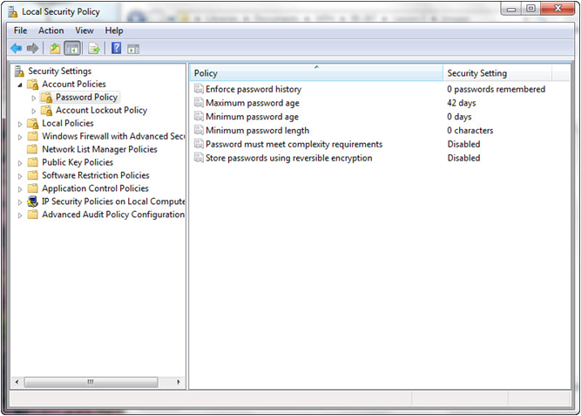
Password Policy

Slide 9
Account Lockout
Account lockout refers to the number of incorrect logon attempts permitted before a system locks an account.
Microsoft provides three separate settings with respect to account lockout:
  Account lockout duration
  Account lockout threshold
  Reset account lockout counter after

Slide 10
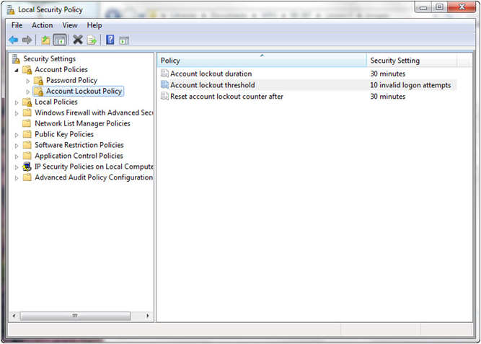
Account Lockout Policy

Slide 11
Common Attack Methods
Passwords have long been recognized as one of the weak links in many security programs.
  First, you are completely reliant on users in the selection of passwords.
  Second, even strong passwords are vulnerable to attack through a variety of different mechanisms.

Slide 12
Dictionary and Brute Force Attacks
A dictionary attack uses a dictionary containing an extensive list of potential passwords that the attacker then tries in conjunction with a user ID in an attempt to guess the appropriate password.
Another, more crude type of attack—called a brute force attack—doesn’t rely on lists of passwords, but rather tries all possible combinations of permitted character types.

Slide 13
Physical Attacks
Anytime your computer can be physically accessed by an attacker, that computer is at risk.
Physical attacks on your computer can completely bypass almost all security mechanisms, such as by capturing the passwords and other critical data directly from the keyboard when a software or hardware keylogger is used.
In fact, if your encryption key passes through a keylogger, you might find that even your encrypted data is jeopardized.

Slide 14
Sniffers
Sniffers are specially designed software (and in some cases hardware) applications that capture network packets as they traverse a network, displaying them for the attacker.
Sniffers are valid forms of test equipment, used to identify network and application issues, but the technology has been rapidly co-opted by attackers as an easy way to grab logon credentials.

Slide 15
Summary
The strength of a password can be determined by looking at the password’s length, complexity, and randomness.
A complex password uses characters from at least three of the following categories: uppercase, lowercase, numeric characters, and nonalphanumeric characters.
Account lockout refers to the number of incorrect logon attempts permitted before a system will lock an account.

Slide 16
Summary
The Minimum Password Age setting controls how many days users must wait before they can reset their password.
The Maximum Password Age setting controls the maximum period of time that can elapse before users are forced to reset their password.
A Group Policy Object (GPO) is a set of rules that allow an administrator granular control over the configuration of objects in Active Directory (AD), including user accounts, operating systems, applications, and other AD objects.

Slide 17
Summary
Passwords have long been recognized as one of the weak links in many security programs.
During a dictionary attack, the attacker tries an extensive list of potential passwords in conjunction with a user ID to try to guess the appropriate password.
Brute force attacks try all possible combinations of permitted character types in an attempt to determine a user’s password.

Slide 18
Summary
Physical attacks on a computer can completely bypass almost all security mechanisms, such as by capturing passwords and other critical data directly from a keyboard when a software or hardware keylogger is used.
In a password crack attack, attackers get access to an encrypted password file from a workstation or server. Once they have access to this file, attackers start running password cracking tools against it.

Slide 19
Summary
Physical attacks on a computer can completely bypass almost all security mechanisms, such as by capturing passwords and other critical data directly from a keyboard when a software or hardware keylogger is used.
In a password crack attack, attackers get access to an encrypted password file from a workstation or server. Once they have access to this file, attackers start running password cracking tools against it.

