Slide 1

Understanding Network Security
Lesson 4

Slide 2
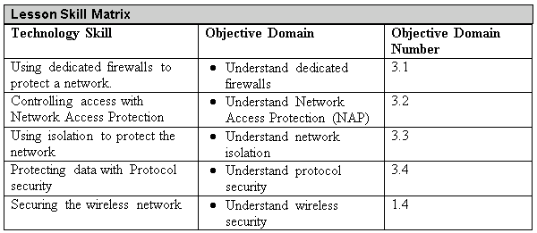
Objectives
Notes:
This should also be a review for the 70-642.

Slide 3
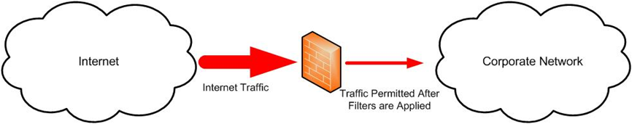
Firewall
Firewalls remain the foundation of network security technologies.
A firewall is a system that is designed to protect a computer or a computer network from network-based attacks.
A firewall does this by filtering the data packets traversing the network.
Notes:
A typical perimeter firewall is implemented with two (or more) network connections:
A connection to the network being protected
A connection to an external network

Slide 4
OSI Model
The OSI model is a conceptual model, created by the International Organization for Standardization (ISO) in 1978 and revised in 1984, to describe a network architecture that allows data to be passed between computer systems.
While never fully utilized as model for a protocol, the OSI model is the standard for discussing how networking works.

Slide 5
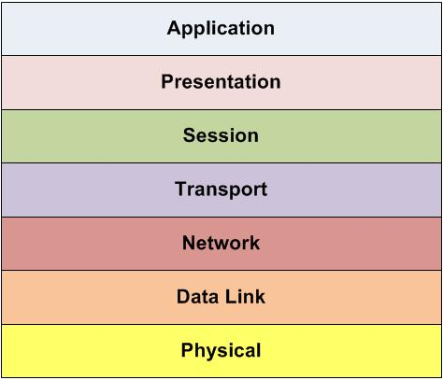
OSI Model

Slide 6
OSI Model
Physical Layer (Layer 1) - Define the physical characteristics of the network, including Media, hardware and topology
Data-Link Layer (Layer 2) - Connects the data layer to the physical layer so that the data can be transmitted across the network. The data link layer handles error detection, error correction and hardware addressing.
  The data link layer is broken into two sub-layers, the Media Access Control (MAC) sub-layer and the Logical Link Control (LLC) sub-layer.
Notes:
MAC layer: The MAC Address is defined at this layer. The MAC address is the physical or hardware address burned into each NIC (for example, 96-4C-E5-48-78-C7). The MAC sublayer also controls access to the underlying network media.
LLC: The LLC layer is the layer responsible for the error and flow control mechanisms of the data link layer. The LLC layer is specified in the IEEE 802.2 standard.

Slide 7
OSI Model
Network Layer (Layer 3) - Primarily responsible for routing.
Transport Layer (Layer 4) - Provides the mechanisms for carrying data across the network. It uses three main mechanisms: segmentation, service addressing and error checking.

Slide 8
OSI Model
Session Layer (Layer 5) - Responsible for data synchronization between the applications on the two devices. The session layer establishes, maintains, and breaks sessions between devices.
Presentation Layer (Layer 6) - The presentation layer converts application layer data into a format that permits the data to be transmitted across the network.

Slide 9
OSI Model
Application Layer (Layer 7) - Takes data from the user and passes the data to the lower layers of the OSI model for transport. Responses are passed up through the layers and are displayed back to the user.

Slide 10
Packet Filtering
Packet filtering firewall is considered the first generation firewall
A packet filtering firewall inspects the data packets as they attempt to traverse the firewall, and based on the rules that have been defined on the firewall, the firewall allows or denies each packet.
Routers have the ability to do some rudimentary packet filtering, such as permitting all outbound traffic while denying all inbound traffic, or blocking specific protocols from passing through the router, like telnet or ftp.

Slide 11
Packet Filtering
When you are configuring a packet filtering firewall rule, you will generally use one (or more) of the following TCP/IP attributes:
  Source IP addresses
  Destination IP addresses
  IP protocol (telnet, ftp, http, https, etc.)
  Source TCP and UDP ports (for example, the http protocol runs on TCP port 80.)
  Destination TCP and UDP ports
  The inbound firewall network interface
  The outbound firewall network interface

Slide 12
Circuit-Level Firewalls
Circuit-level firewalls are typically considered a second generation firewall technology.
They work in a very similar fashion as packet-filtering firewalls, but they operate at the transport and session layers of the OSI model.
Instead of analyzing each individual packet, a circuit-level firewall monitors TCP/IP sessions, by monitoring the TCP handshaking between packets to validate the session.
Traffic is filtered based on specified session rules and may be restricted to authorized computers only.

Slide 13
Application-Level Firewall
Application-level firewalls (also known as proxy servers) work by performing a deep inspection of application data as it traverses the firewall.
Rules are set based by analyzing client requests and application responses, then enforcing correct application behavior.
Application-level firewalls can block malicious activity, log user activity, provide content filtering and even protect against spam and viruses.

Slide 14
Stateful Firewall
Stateful multi-level firewalls are designed to provide the best features of both packet filtering and application-level firewalls.
Stateful inspection also determines whether or not a packet is part of an existing session and that information can be used to determine whether to permit or deny a packet.

Slide 15
Host versus Network Firewalls
There are two basic types of software firewall:
  Host firewall: A software firewall is a firewall application installed on a host, used to protect the host from network-based attacks.
    Host firewalls are also known as personal firewalls.
  Network firewall: The other type of software firewall is a firewall application installed on a server used to protect network segments from other network segments.

Slide 16
Network Access Protection
Network Access Protection (NAP) is solution that allows administrators a more powerful way to control access to network resources.
These controls are based on a client computer’s identity and whether the computer complies with the configured network governance policies.
These components require health state validation and if the computer is not compliant, they enforce limited network access using the Network Policy Server (NPS) which is a component in Windows Server 2008.

Slide 17
Network Access Protection
NAP has three distinct components:
  Health State Validation: In order to validate the health state of a computer, the administrator defines health requirement policies. Then when the computer tries to connect to the network, system health agents (SHAs) and system health validators (SHVs) validate the computer’s configuration against the health requirement policy.

Slide 18
Network Access Protection
  Health Policy Compliance: Administrators can enforce compliance with health requirement policies by configuring NAP to automatically update noncompliant computers with missing software updates or configuration changes.
  Limited Access Mode: The final component that NAP provides to protect the network is Limited Access Mode. This mode permits administrators to protect their networks by limiting the access of noncompliant computers.

Slide 19
Network Access Protection
The NPS also allows the Windows Server 2008 host to act as the health policy server, enforcing limited access in the following ways:
  IPsec Enforcement
  802.1x Enforcement
  VPN Enforcement
  DHCP Enforcement

Slide 20
Virtual LANs (VLANS)
Virtual LANs (VLANs) were developed as an alternate solution to deploying multiple routers.
VLANs are logical network segments used to create separate broadcast domains, but still allow the devices on the VLANs to communicate at Layer 2, without requiring a router.
VLANs are created by switches, and traffic between VLANs is switched, not routed, which creates a much faster network connection, as there is no need for a routing protocol to be involved.
Even though the hosts are logically separated, the traffic between the hosts is switched directly as if the hosts were on the same LAN segment.

Slide 21
Virtual LANs (VLANS)
VLANs provide a number of benefits over a routed network, including:
  Higher performance on medium or large LANs due to reduced broadcast traffic
  Organizing devices on the network for easier management.
  Providing additional security because devices can be put on their own VLAN.

Slide 22
Routing
Routing takes one step up the OSI model from the VLAN – and takes place at Layer 3.
Routing is the process of forwarding a packet based on the packet’s destination address.
At each step in the route a packet takes across the network a decision has to be made about where the packet is to be forwarded.
To make these decisions, the IP layer consults a routing table stored in the memory of the routing device.

Slide 23
Routing Protocols
Routing protocols are based either on a distance vector or link state algorithm.
Path selection involves apply a routing metric to multiple routes, in order to select the best route.
Some of the metrics used are bandwidth, network delay, hop count, path cost, load, reliability, and communication costs.
The hop count is the number of routers traversed by a packet between its source and destination.

Slide 24
IDS and IPS
Two other security technologies available to secure networks are intrusion detection systems (IDS) and intrusion prevention systems (IPS).
An IDS is a solution designed to detect unauthorized user activities, attacks, and network compromises.
An intrusion prevention system (IPS) is very similar to an IDS, except that in addition to detecting and alerting, an IPS can also take action to prevent to breach from occurring.

Slide 25
Honeypots
A honeypot is a trap for hackers. A honey pot is designed to distract hackers from real targets, detect new vulnerabilities and exploits, and learn about the identity of attackers.
A honey net is just a collection of honeypots used to present an attacker an even more realistic attack environment.
A padded cell is a system that waits for an IDS to detect an attacker and then transfers the attacker to a special host where they cannot do any damage to the production environment.

Slide 26
DMZ
DMZ In computer networking, a DMZ (short for demilitarized zone) is a firewall configuration used to secure hosts on a network segment.
In most DMZs, the hosts on the DMZ are connected behind a firewall which is connected to a public network like the Internet.
Another common configuration is to have the firewall connected to an extranet, with connections to customers, vendors or business partners. DMZ’s are designed to provide access to systems without jeopardizing the internal network.

Slide 27
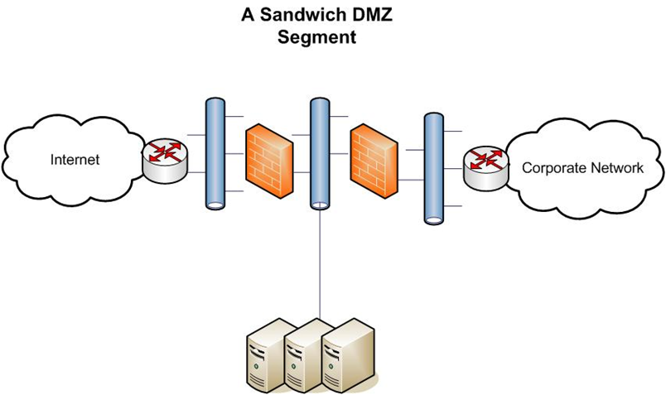
Sandwich DMZ Segment

Slide 28

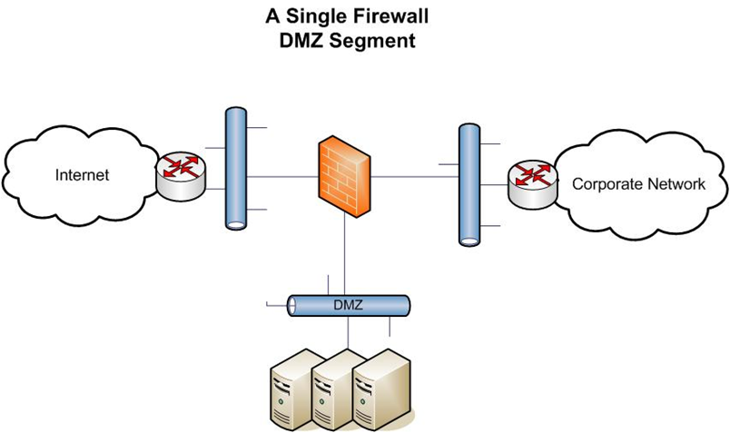
Single Firewall DMZ Segment

Slide 29
Network Address Translation (NAT)
Network Address Translation (NAT) is a technique used to modify the network address information of a host while traffic is traversing a router or firewall.
This technique is used to hide the network information of a private network while allowing traffic to be transferred across a public network like the Internet.
NAT was the resulting workaround solution for preserving the number of IP addresses used on the Internet.

Slide 30
Network Address Translation (NAT)
Static NAT – Static NAT maps an unregistered IP address on the private network to a registered IP address on the public network, using a one-to-one basis. conjunction with DMZ or extranet networks.
Dynamic NAT – Dynamic NAT maps an unregistered IP address on the private network to a registered IP address that is selected by the routing device providing the NAT service from a pool of registered IP addresses.

Slide 31
VPN
VPN (Virtual Private Network) is a technology that uses encrypted tunnels to create secure connections across public networks like the Internet.
VPNs are commonly used by remote employees for access to the internal network, to create secure network to network connections for branch offices or business partner connections, or even to create secure host to host connections for additional security and isolation on an internal network.
VPNs utilize encryption and authentication to provide confidentiality, integrity, and privacy protection for data.

Slide 32
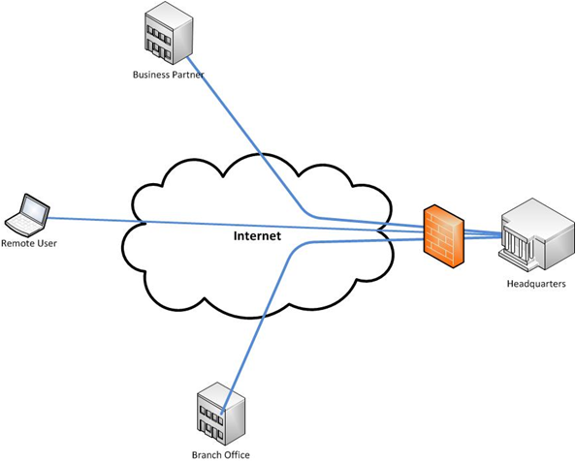
VPN

Slide 33
IPsec
Internet Protocol Security (IPsec) is a standards-based protocol suite designed specifically for securing Internet Protocol (IP) communications.
  It is also a component of IPv6, the next generation of the IP protocol. IPsec authenticates and encrypts each IP packet in an IP data stream.
IPsec has protocols that can be used to establish mutual authentication and cryptographic keys negotiation during a session. IPsec operates at the Network Layer of the OSI model.

Slide 34
SSL
One of the key VPN protocols used today is SSL / TLS, which is the main alternative to IPsec for implementing a VPN solution.
While this protocol is widely used to secure websites, it has since been formalized in the IETF standard known as Transport Layer Security (TLS).
The SSL/TLS protocol provides a method for secure client/server communications across a network and prevents eavesdropping and tampering with data in transit. SSL/TLS also provides endpoint authentication and communications confidentiality through the use of encryption.

Slide 35
Secure Shell (SSH)
The Secure Shell (SSH) Protocol is a protocol for secure remote login and other secure network services over the network.
SSH can be used for a number of applications across multiple platforms including UNIX, Microsoft Windows, Apple Mac and Linux.

Slide 36
Tunneling
Tunneling is defined as the encapsulation of one network protocol within another.
Tunneling can be used to route an unsupported protocol across a network, or to securely route traffic across an insecure network.
VPN’s uses a form of tunneling when data is encapsulated in the IPsec protocol.
Examples include PPTP and L2TP with IPsec.

Slide 37
DNSSEC
DNS Security Extensions (DNSSEC) adds security provisions to DNS so that computers can verify that they have been directed to proper servers.
DNSSEC provides authentication and integrity checking on DNS lookups ensuring that outgoing Internet traffic is always sent to the correct server.
This removes the issues of forged DNS data, because there is no way to forge the appropriate authentication.
This not only addresses the issue of website redirection, but also addresses some challenges associated with spam and the use of faked mail domains.

Slide 38
Spoofing
The word spoof can be defined as a hoax. Protocol spoofing is the misuse of a network protocol to perpetrate a hoax on a host or a network device.
Some common forms of protocol spoofing include:
  ARP Spoofing
  DNS Spoofing
  IP Address Spoofing

Slide 39
Network Sniffing
Network sniffing is a type of network analysis that is a very useful tool for network administrators responsible for maintaining networks and identifying network issues.
It involves connecting a device to the network with the appropriate software to allow access to the details of the packets traversing the network.
Notes:
Wireshark is a commonly used open source network sniffing tool.

Slide 40
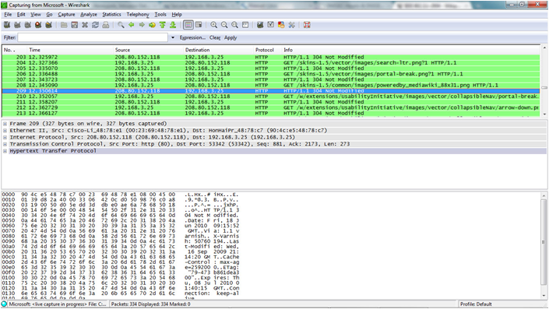
Network Sniffing

Slide 41
Common Attack Methods
Denial-of-Service/Distributed Denial of Service (DoS/DDoS) Attacks
IP Spoofing to Bypass Network Security
Man in the Middle Attacks
Back Door Attack
DNS Poisoning
Replay Attack
Weak Encryption Keys
Social Engineering

Slide 42
Common Attack Methods
Password Cracking
Dictionary Attack
Brute Force Attack
Software Vulnerability Attack
Buffer Overflow Attack
Remote Code Execution Attack
SQL Injection Attack
Cross Site Scripting Attack

Slide 43
Wireless LAN (WLAN)
A Wireless LAN (WLAN) allows users to connect to a network while allowing them to remain mobile.
The most basic component of the wireless network is the SSID (Service Set IDentifier), which is defined in the IEEE 802.11 standard as a name for the WLAN.

Slide 44
Wired Equivalency Privacy (WEP)
The very first security capability available to WLAN users was WEP (Wired Equivalency Privacy).
WEP rapidly fell out of favor when a flaw with the encryption mechanism was found.
The flaw in WEP makes it relatively easy for an attacker to crack the encryption and access the wireless network, so it is generally only used if no other solution is available (WEP is better than nothing) or the WLAN is being used with older devices, or devices like PDAs or handheld games that require the use of WEP.

Slide 45
WPA/WPA2
WPA (Wi-Fi Protected Access) was designed as the interim successor to WEP.
  WPA included a new security protocol, Temporal Key Integrity Protocol (TKIP)
WPA2 (Wi-Fi Protected Access version 2) is the standards-based version of WPA, except WPA2 implements all of the IEEE 802.11i standards.

Slide 46
WLAN and MAC addresses
You can use MAC addresses to control what systems are able to connect to a WLAN through the use of MAC filters.
By turning MAC filtering on, you can limit network access to only permitted systems by entering the MAC address information into the MAC filters.
The table of permitted MAC addresses is maintained by the wireless access points.

Slide 47
Summary
A firewall is a system that is designed to protect a computer or a computer network from network-based attacks.
Network Access Protection (NAP) allows administrators a more powerful way to control access to network resources.
Virtual LANs (VLANs) were developed as an alternate solution to deploying multiple routers.

Slide 48
Summary
Intrusion detection systems (IDS) is a solution designed to detect unauthorized user activities, attacks, and network compromises.
An intrusion prevention system (IPS) is very similar to an IDS, except that in addition to detecting and alerting, an IPS can also take action to prevent to breach from occurring.
Honeypots, honey nets and padded cells are complementary technologies to IDS/IPS deployments. A honeypot is a trap for hackers.

Slide 49
Summary
A DMZ is a firewall configuration used to secure hosts on a network segment.
In most DMZs, the hosts on the DMZ are connected behind a firewall which is connected to a public network like the Internet.
Network Address Translation (NAT) is a technique used to modify the network address information of a host while traffic is traversing a router or firewall.

