Slide 1
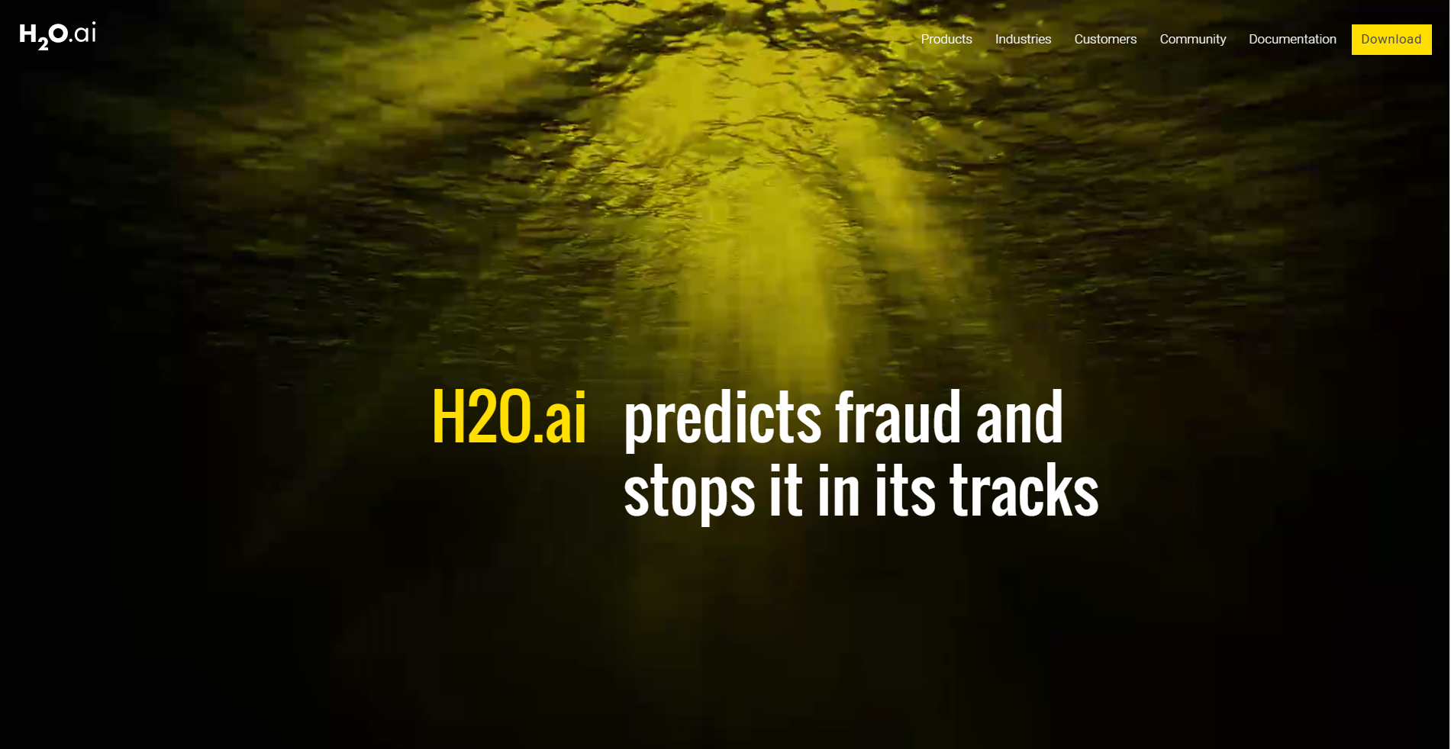
Introduction to h2o
To Bring Beautiful Business Transformation Through AI and Visual Intelligence
Presentation By~
Nikita Anand
Hina Gandhi
Shivam Goel

Slide 2
Presentation outline

Slide 3

What is h2o
H2O is an open source, in-memory, distributed, fast, and scalable machine learning and predictive analytics platform that allows you to build machine learning models on big data and provides easy productionalization of those models in an enterprise environment.
The speed, quality, ease-of-use, and model-deployment for
the various cutting edge Supervised and Unsupervised
algorithms like Deep Learning, Tree Ensembles, and GLRM
make H2O a highly sought after API for big data science.

Slide 4
System Requirements for H2o
Operating Systems:
Windows 7 or later
OS X 10.9 or later
Ubuntu 12.04
RHEL/CentOS 6 or later
Languages:
Scala, R, and Python are not required to use H2O unless you want to use H2O in those environments, but Java is always required. To build H2O or run H2O tests, the 64-bit JDK is required.
Scala 2.10 or later
R version 3 or later
Python 2.7.x or 3.5.x
Browser: An internet browser is required to use H2O’s web UI, Flow.
Hadoop: Hadoop is not required to run H2O unless you want to deploy H2O on a Hadoop cluster.
Spark: Version 1.4 or later. Spark is only required if you want to run Sparkling Water.

Slide 5




H2o products
STEAM
Notes:
Labels

Slide 6
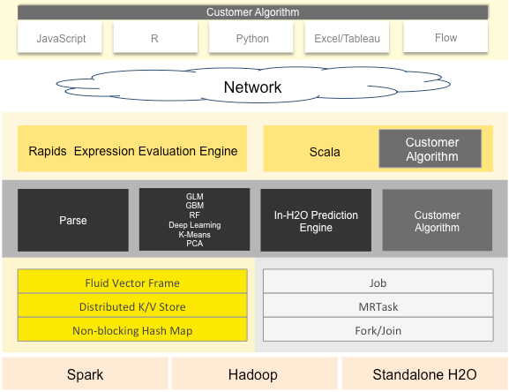
H2o Architecture

Slide 7
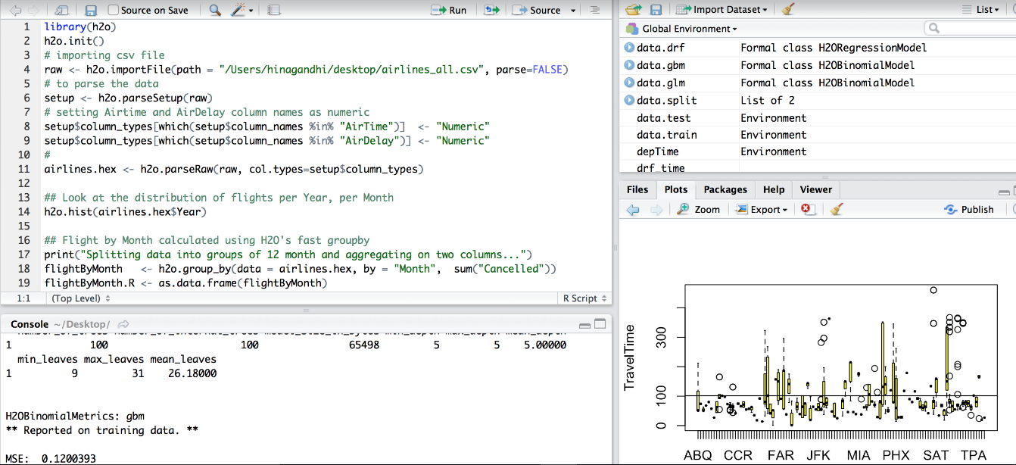
How different rest api clients communicate with h2o
H2O in R
R scripts can use the H2O R package [‘library(h2o)’]

Slide 8
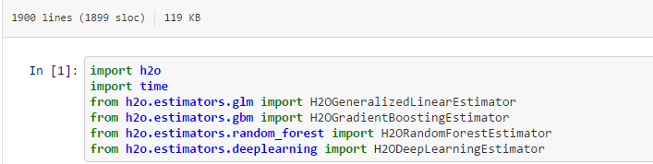
How different rest api clients communicate with h2o
H2O in Python

Slide 9
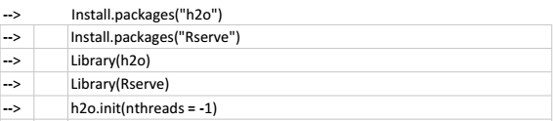
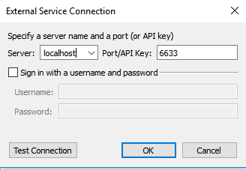
How different rest api clients communicate with h2o
H2O in Tableau
Users can pull results from H2O for visualization in Tableau.

Slide 10
H2o Web ui flow
H2O Flow allows you to use H2O interactively to import files, build models, and iteratively improve them. Based on your models, you can make predictions and add rich text to create vignettes of your work - all within Flow’s browser-based environment.

Slide 11
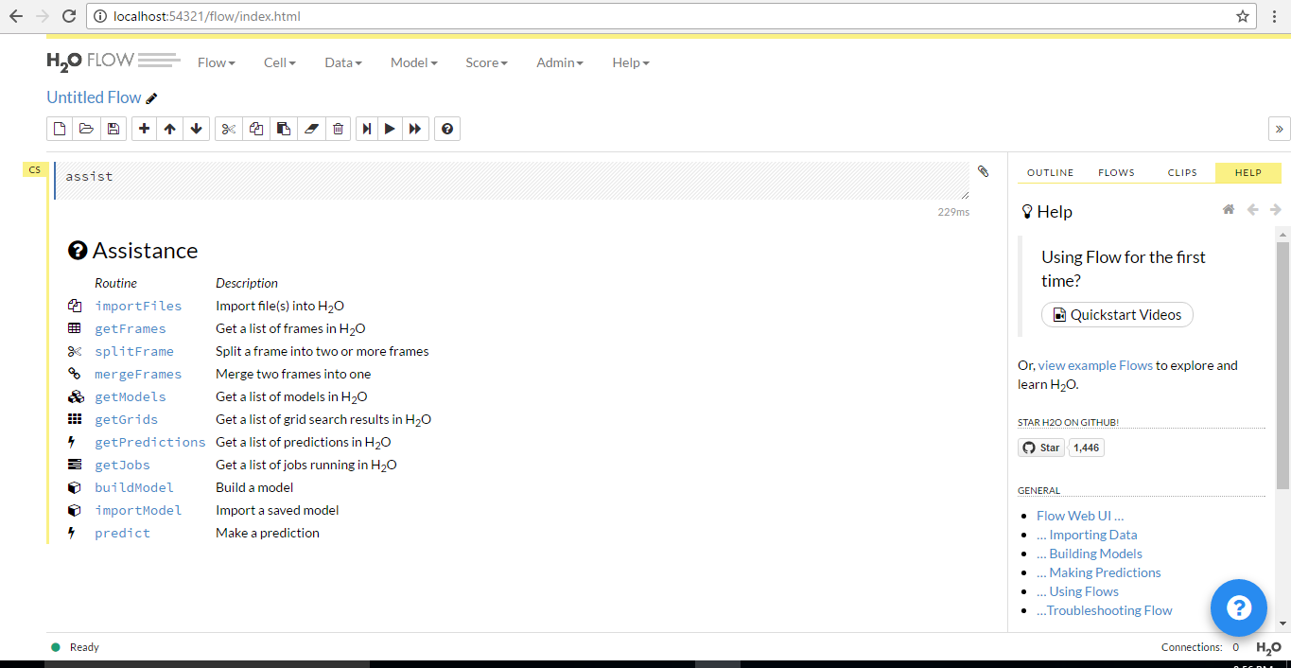
H2o web ui flow
First Look

Slide 12
H2o web ui flow
Installation Guide for H2O Web Flow
Step 1: Install H2O from this link
Step 2: From your command prompt/terminal, get into the location where your h2o folder is downloaded and look for h2o jar file. Then run the following command
java -jar h2o.jar

Slide 13
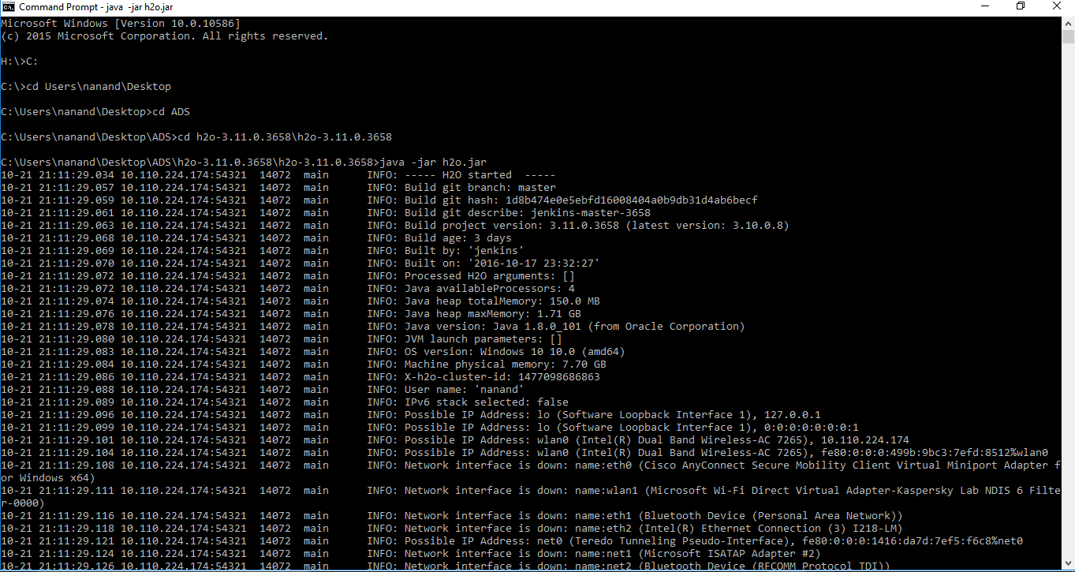
H2o web ui flow

Slide 14
H2o web ui flow
Step 3: Open your browser with localhost:54321

Slide 15
H2o web ui flow
Demo:
Link to dataset: airlines_all.05p.csv
Link to demo PDF:

Slide 16
Predictive Modeling Landscape:
General purpose algorithms
(not to scale)
Random
Forest
(randomForest)
Gradient
Boosted
Machines
(gbm)
Neural
Networks
(nnet)
Support
Vector
Machines
(kernlab)
Complexity
Regularized
Linear
Models
(glmnet)
Splines
(earth)
Naïve Bayes
(klaR)
Generalized
Linear Models (glm)
Classification
And Regression
Trees (rpart)
Linear Models
(lm)
Nearest Neighbor
(kNN)
Linear Models
Decision Trees
Others

Slide 17
Where do you keep your contacts?
(click one)
An Excel workbook
Outlook Contacts
Another email program (like Gmail)
I need to create a contact list
Notes:
Slide for email

Slide 18
What’s your label program? (Click one)
Word
Publisher
Notes:
Labels: Excel

