Slide 1
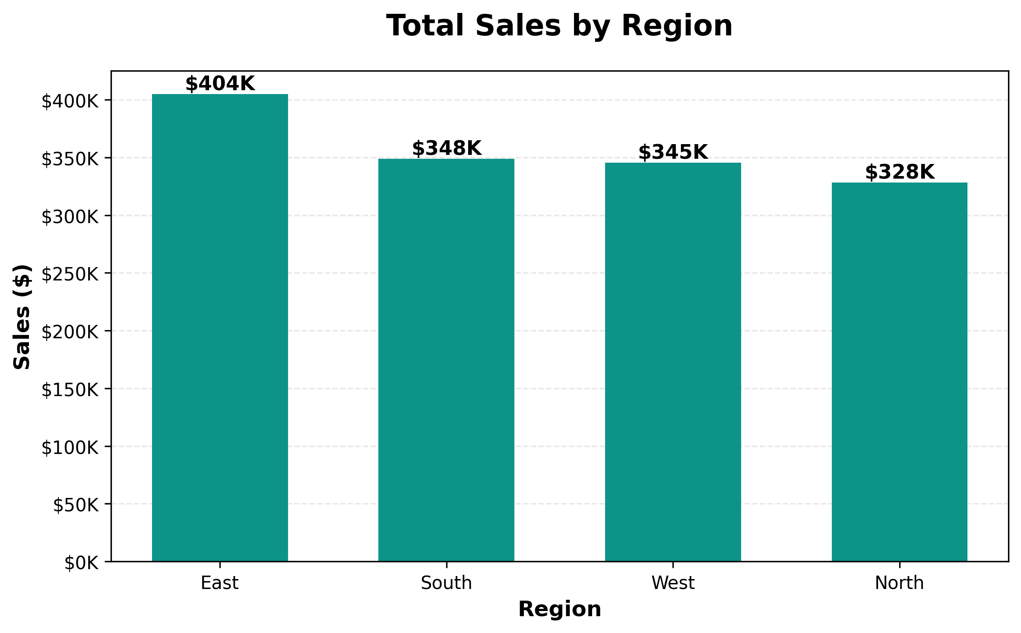
Executive Summary
Overall Performance Metrics
Metric | Value
Total Sales | $1,427,598
Total Profit | $356,077
Profit Margin | 24.9%
Units Sold | 15,863
Key Insights:
Total revenue reached $1,427K with an overall profit margin of 24.9%
Year showed decline of 24.2% from Q1 to Q4
East region leads with highest sales performance
Product A is the top-performing product line

Slide 2
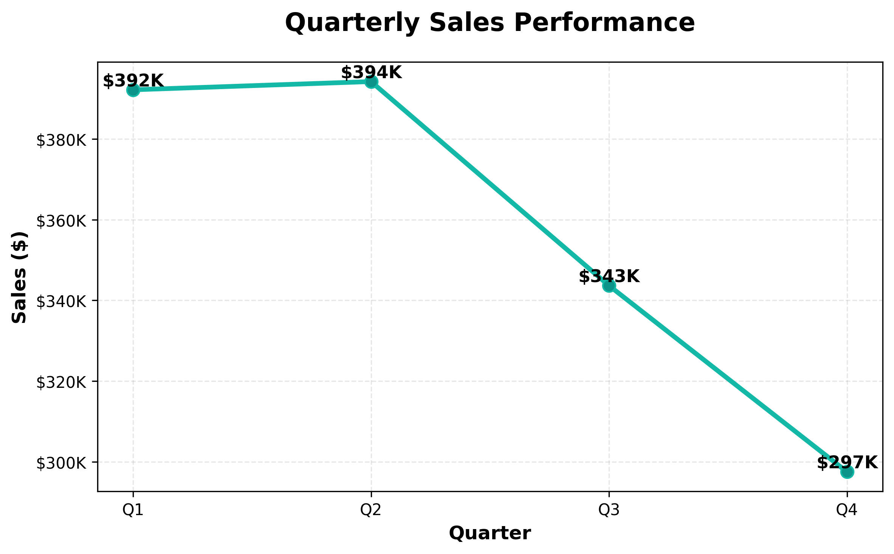
Regional Performance Deep Dive
Comparative Analysis Across Regions
Region | Sales | Profit | Margin % | Units
East | $404,755 | $102,954 | 25.4% | 4,376
South | $348,883 | $89,493 | 25.7% | 3,845
West | $345,622 | $85,239 | 24.7% | 4,096
North | $328,338 | $78,391 | 23.9% | 3,546
Analysis:
East region dominates with $404K in total sales
Performance gap between top and bottom regions is 23.3%, indicating uneven market penetration
All regions show positive profitability, but efficiency varies significantly
Regional strategies should be customized based on local market dynamics

Slide 3
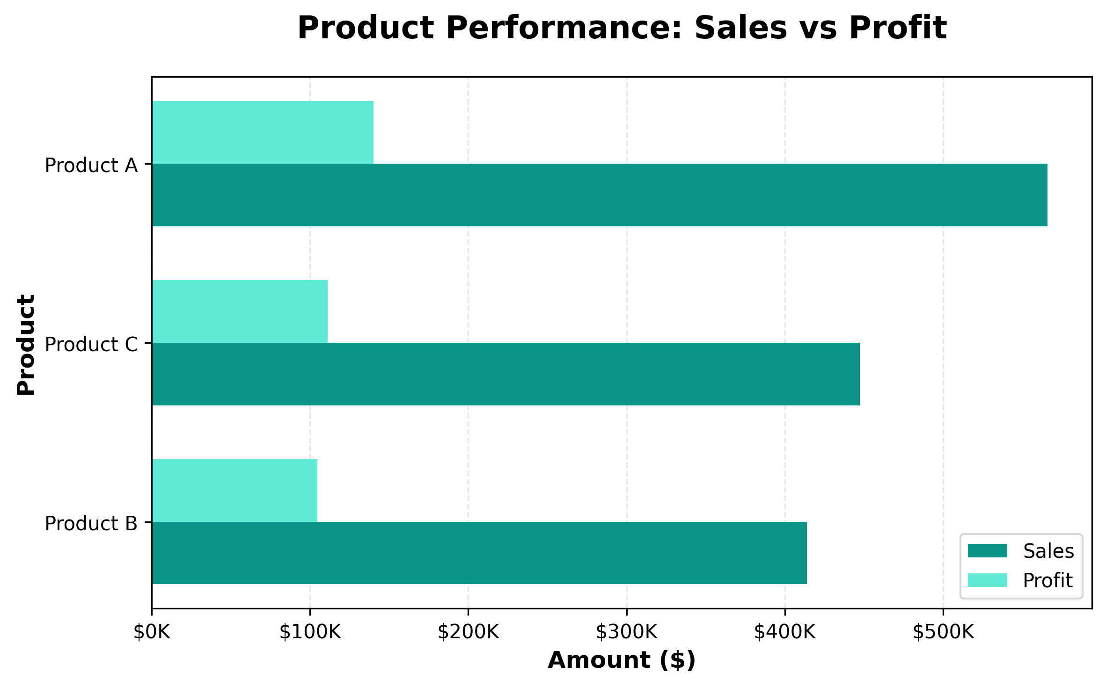
Product Portfolio Performance
Sales and Profitability by Product Line
Product Metrics
Product | Sales | Profit | Margin % | Units
Product A | $565,937 | $140,239 | 24.8% | 5,731
Product C | $447,518 | $111,221 | 24.9% | 5,925
Product B | $414,143 | $104,617 | 25.3% | 4,207
Key Findings:
Product A leads product portfolio with highest sales volume
Top product maintains strong profit margin of 24.8%
Product mix shows balanced performance across all three lines
Cross-selling opportunities exist between complementary products

Slide 4
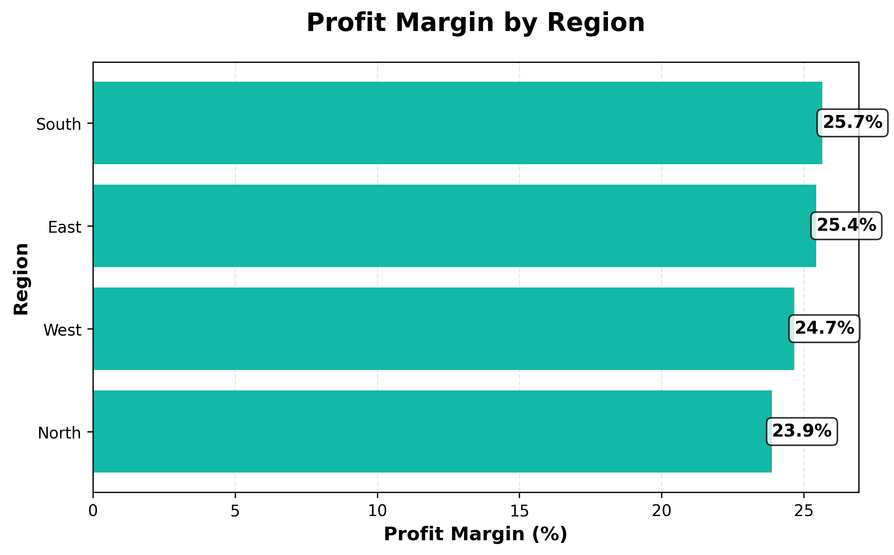
Strategic Recommendations
Action Plan for Next Quarter
Quarterly Trends
Quarter | Sales | Growth %
Q1 | $392,214 | Baseline
Q2 | $394,252 | 0.5%
Q3 | $343,659 | -12.8%
Q4 | $297,473 | -13.4%
STRATEGIC ACTION PLAN
EXPAND: Increase investment in East region to capitalize on market leadership
OPTIMIZE: Focus on improving operational efficiency in underperforming regions
LEVERAGE: Scale Product A production to meet growing demand
INNOVATE: Develop targeted marketing campaigns for Q1 to maintain momentum
MONITOR: Implement quarterly performance reviews to track progress against targets

