Slide 1

Custom Object Detection

Slide 2
Plan
Develop
Deploy
Machine Learning Model
Streamlit Web App
App in Cloud
Train

Slide 3


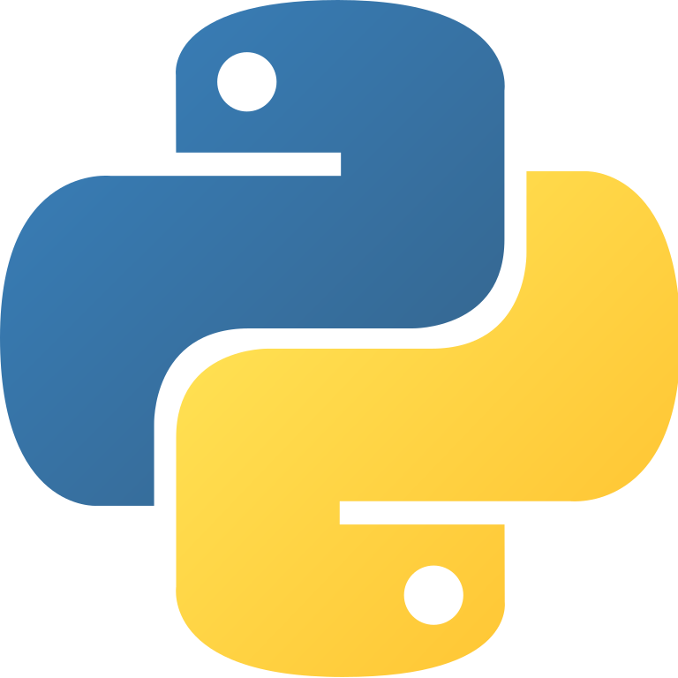
Develop web app with Python
Complete Hands on
Course start from foundation to professional level

Slide 4
Course Structure
Foundations
Streamlit API
Layouts and Widgets
Data Visualizations
Data Science Project
Deploy in Cloud

Slide 5
Let’s begin the course

