Slide 1
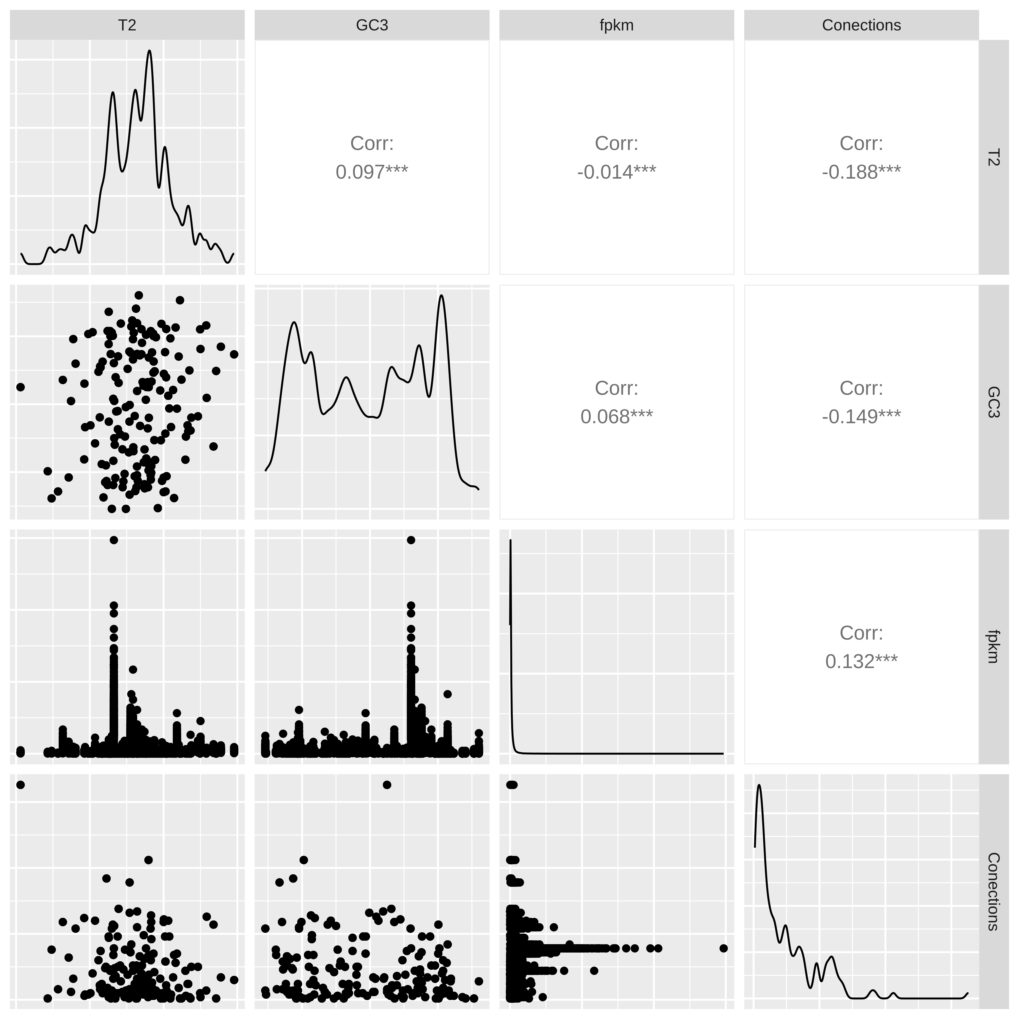
Cerrelation matrix among variables:
T2, connections, CG3, gene expression

Slide 2
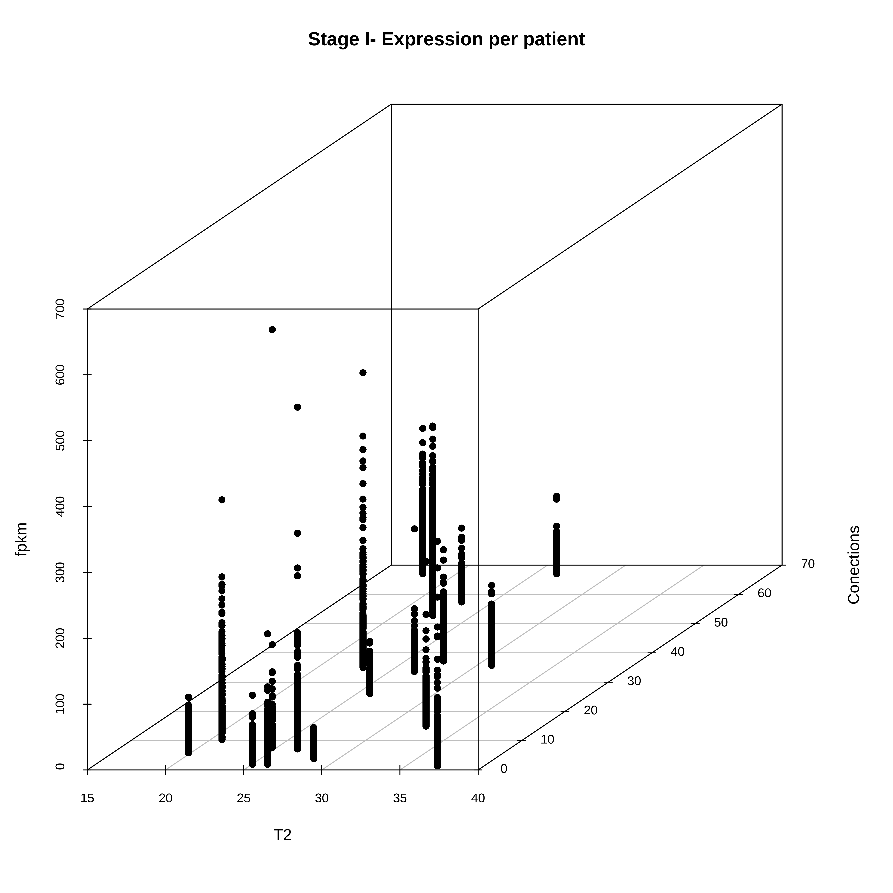
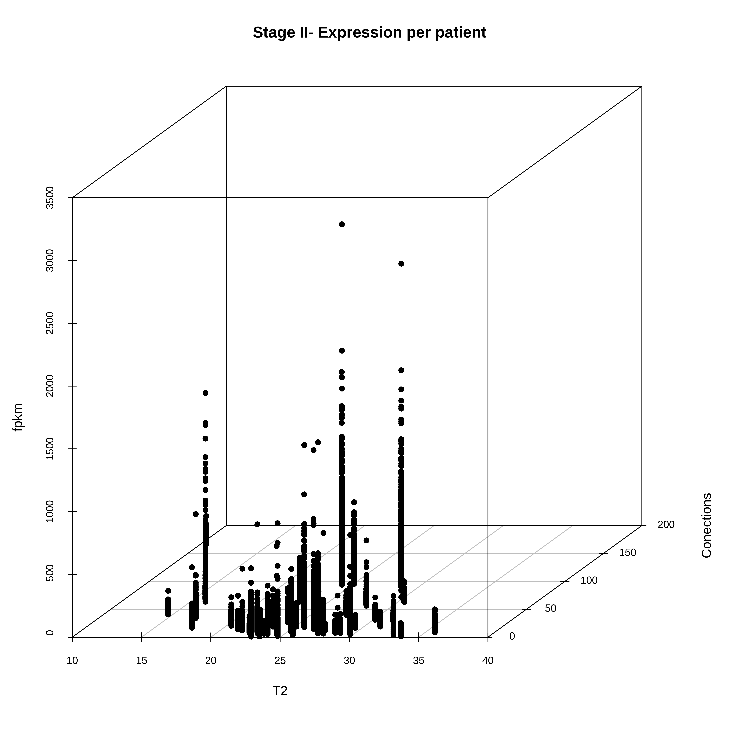
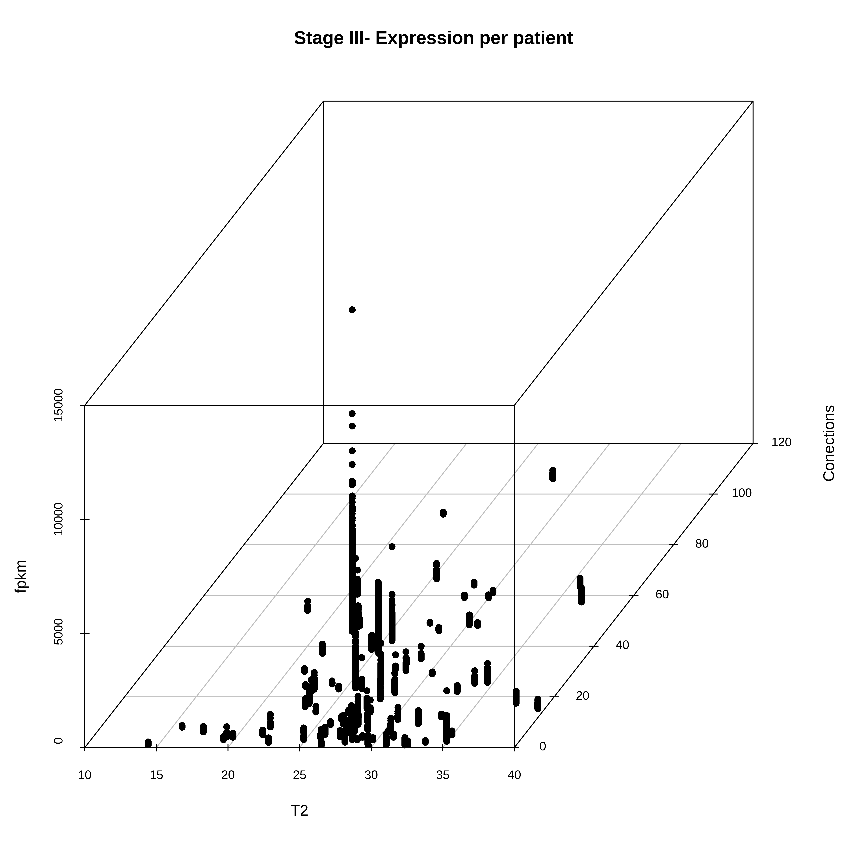
3D scatter plot
x=T2, y=connections, z=gene expression

Slide 3
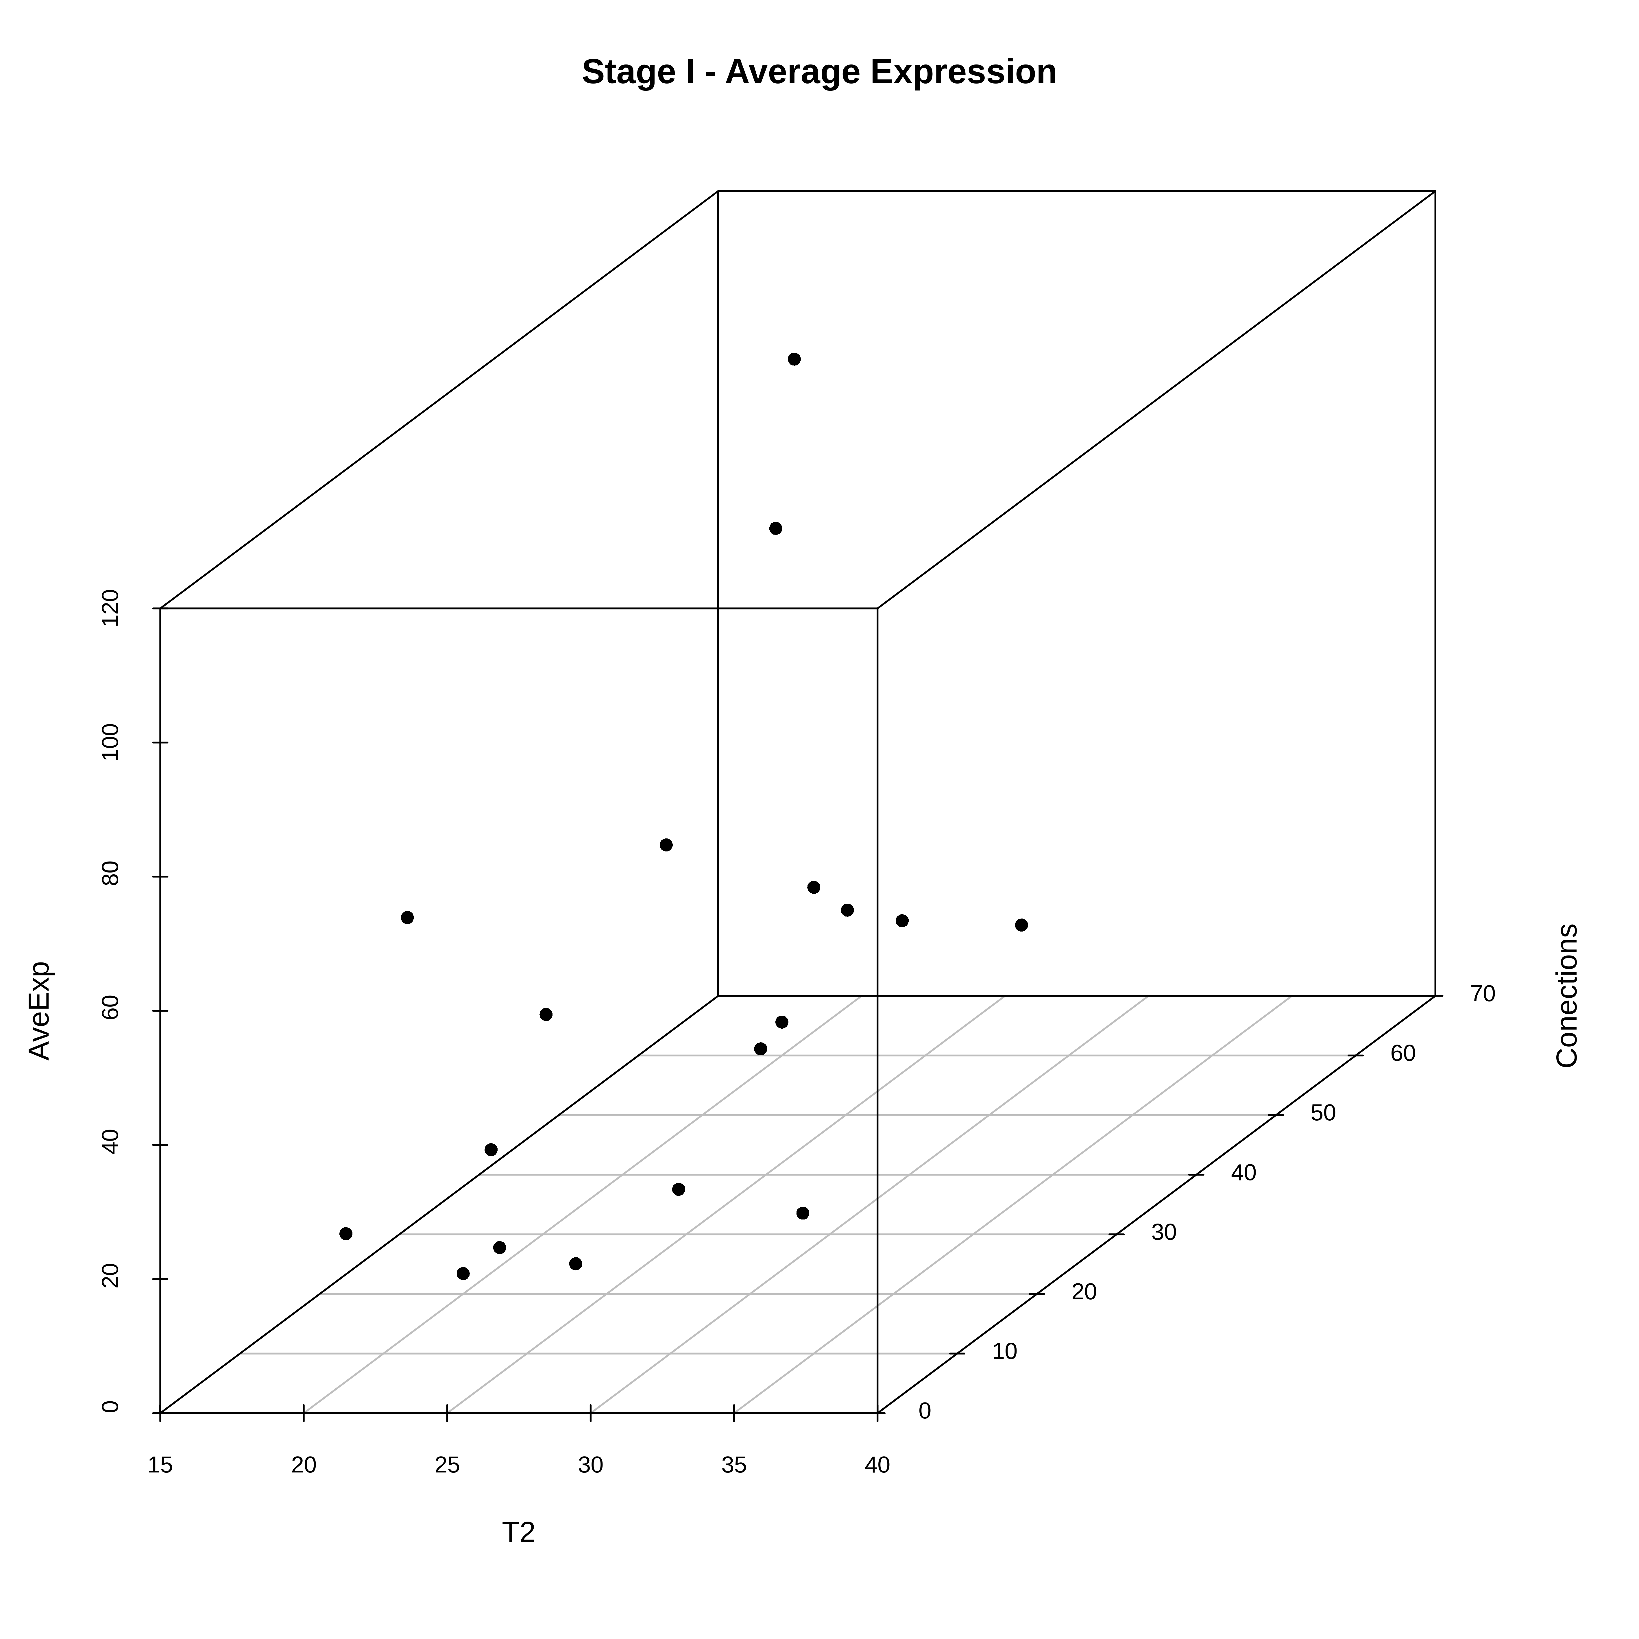
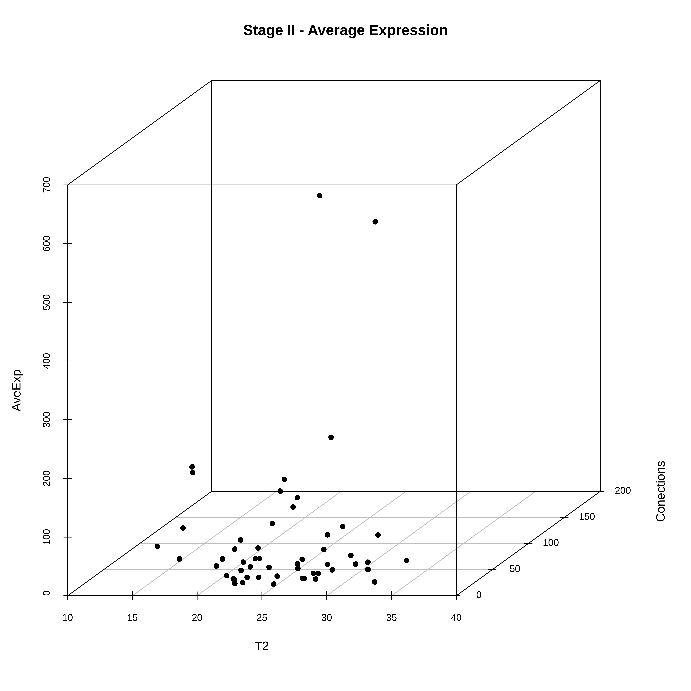
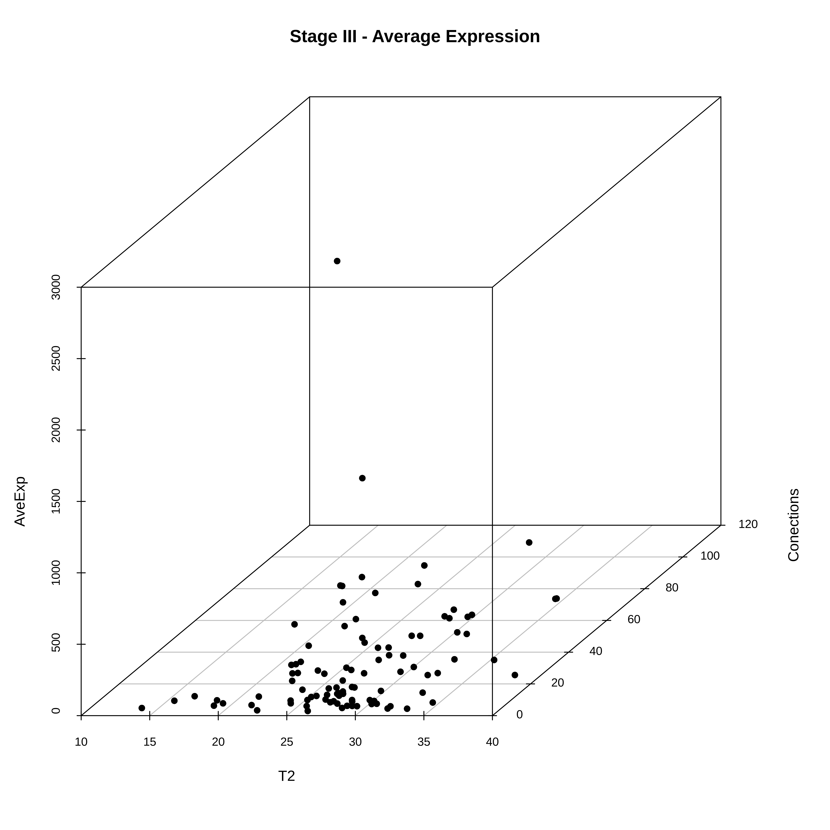
3D scatter plot
x=T2, y=connections, z=average gene expression (all samples)

Slide 4
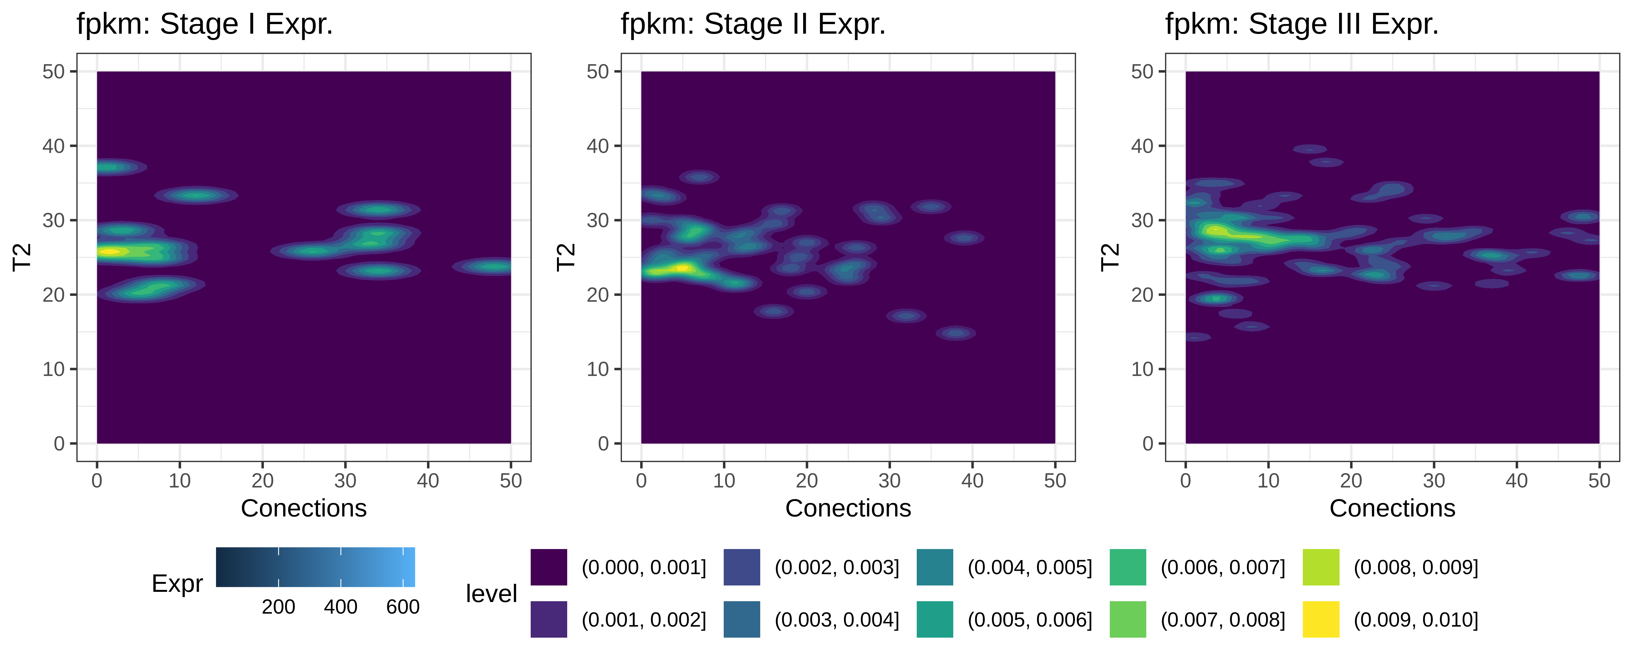
Countour plot
x=T2, y=connections, z=gene expression

Slide 5
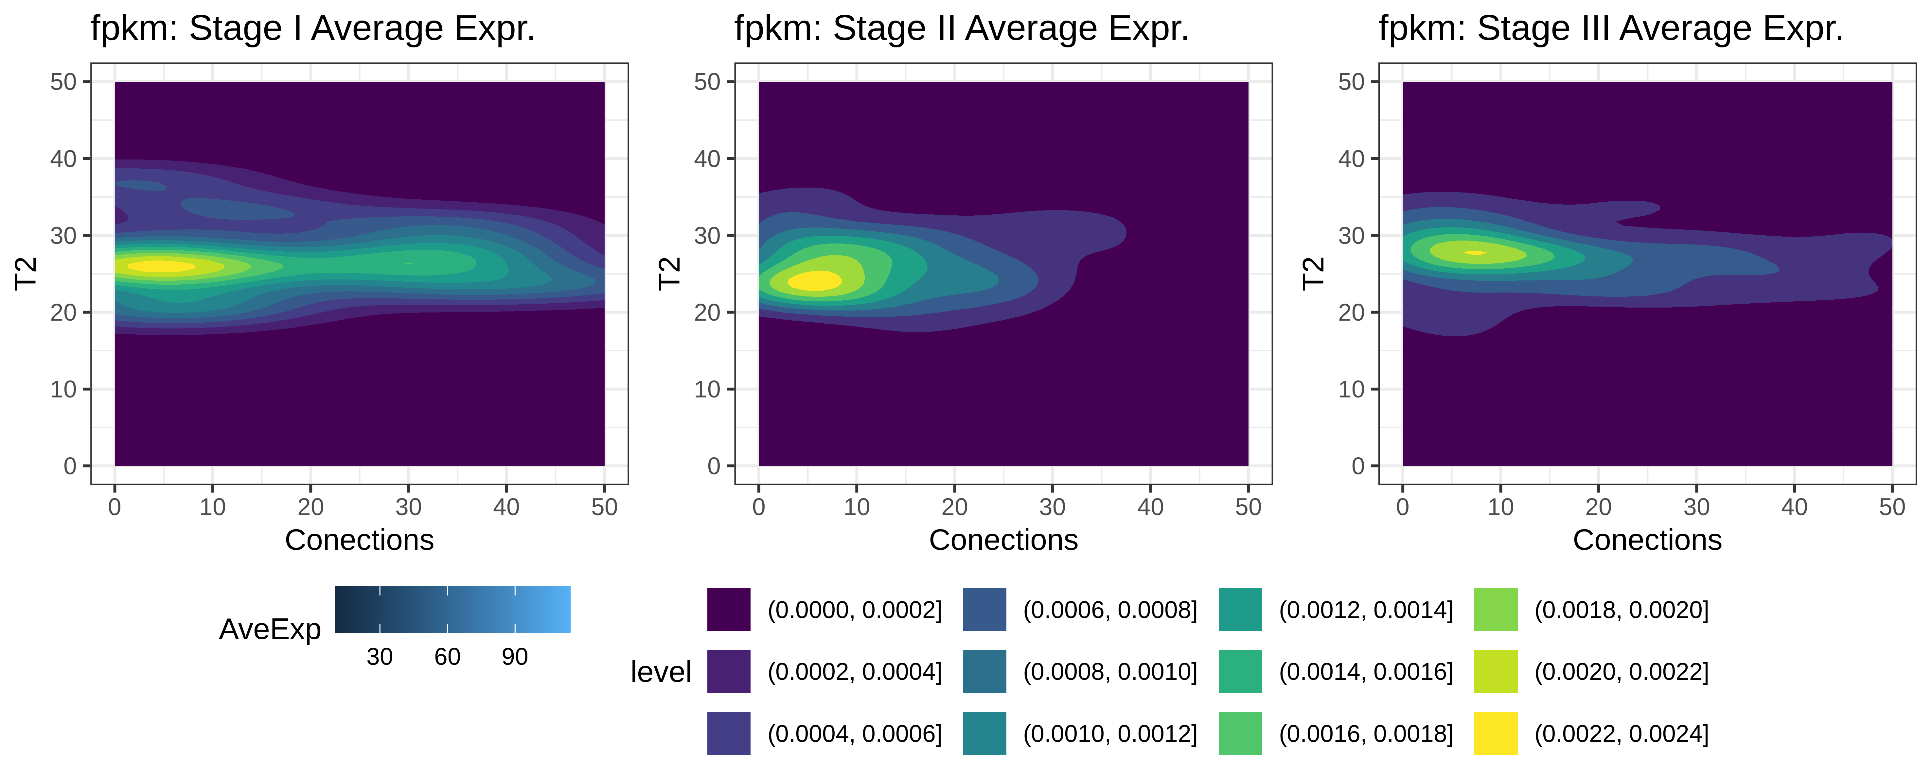
Countour plot
x=T2, y=connections, z=average gene expression

Slide 6
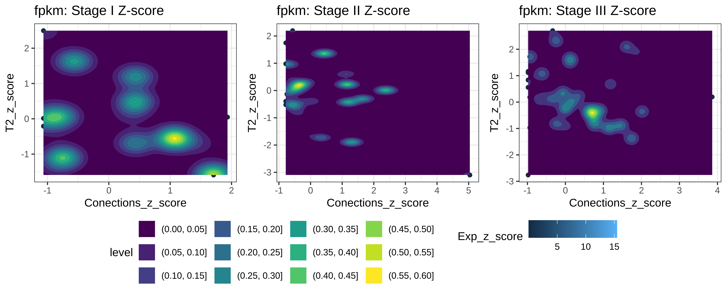
Countour plot
x=z-score T2, y=z-score connections, z=z-score average gene expression

