Slide 1


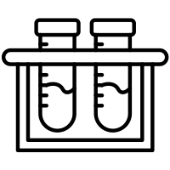

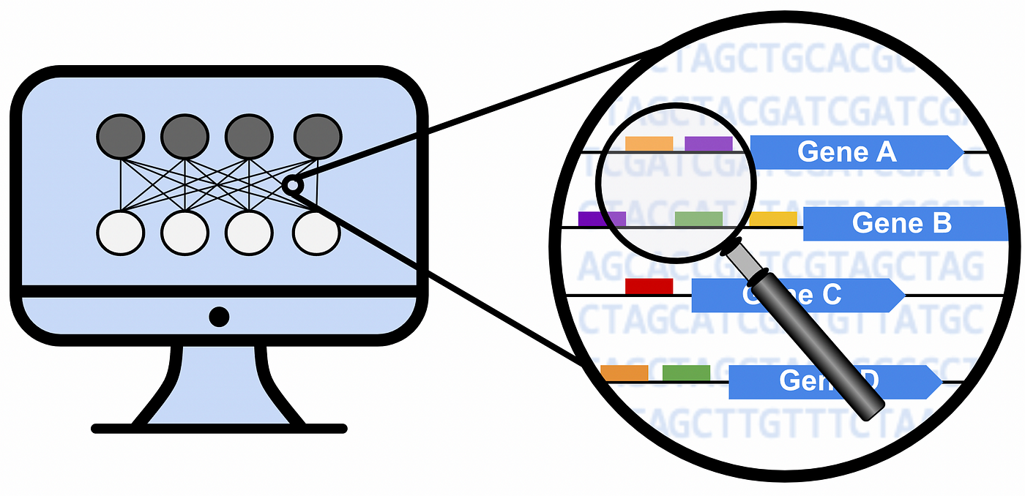
Lung cancer
CreateMetadataFromGDCFiles.R
- Squamous Cell Carcinoma
- 3 stages
Expression dataset
LoadExpressionData.R
RPKM_Normalization.R
- 15208 genes
- 486 samples
- 45 samples paired/control
Paired samples tumor/control positive per stage
CreateMetadataPairedSamplesRPKM.R
CalculateUregulatedfPairedSamplesRPKM.R
log2folchange=log2[Expr(tumor in Stage i)]-log2[Expr(normal in Stage i)]
log2folchange >=0.58
- Stage I : 5422 genes (sub-select 1000x gene sets size n=50)
- Stage II : 5641 genes
- Stage III: 4913 genes
All tumor samples differential pe stage
log2folchange=log2[Expr(Stage i)-Expr(Stages ii and iii)]
log2folchange >=1.58
- Stage I : 51 genes
- Stage II : 46 genes
- Stage III: 112 genes
CreateDEGenesPerStageMeansFromPairedUp.R
CalculateShannonEntropyMeansOfDiffRPKM.R
Entropy analysis
- entropy per stage:
- Stage I : 4.774
- Stage II : 4.082
- Stage III : 5.704

Slide 2

Lung cancer
CreateMetadataFromGDCFiles.R
- Squamous Cell Carcinoma
- 3 stages
Expression dataset
LoadExpressionData.R
RPKM_Normalization_V2.R
- 15208 genes
- 486 samples
- 45 samples paired/control
Filters
all samples
Filters.R
- Mean[Expr(tumor)] >10 RPKM
- fc=Mean[Expr(tumor)]/Mean[Expr(normal)]
- threshold log2fc>= 1.58
- 2725 genes after filters
Only tumor samples
gene per stage
log2folchange=log2[Expr(Stage i)-Expr(Stages ii and iii)]
Log2folchange >=1.58
- Stage I : 347 genes
- Stage II : 301 genes
- Stage III: 744 genes
CreateDEGenesPerStageMeansFromPairedV2.R
CalculateShannonEntropy.R
Entropy analysis
- entropy per stage:
- Stage I : 8.244, p.value=1.000
- Stage II : 9.226, p.value=0.360
- Stage III : 9.373, p.value=0.012
Paired samples tumor/control validation stages~entropy
PairedSamplesEntropyStagesValidation.R
- Stage I : ???
- Stage II : ???
- Stage III: ???

Slide 3
log2folchange=log2[Expr(Stage i)-Expr(Stages ii and iii)]
Log2folchange >=1.58
GeneX_StageI=StageI(Patient1,Patient2,Patient3)
GeneX_StageII and III=(Patient4,Patient5,Patient6)
GeneX_StageI-GeneX_StageII_and_III
- Stage I : 376 genes
- Stage II : 307 genes
- Stage III: 774 genes

Slide 4
