Slide 1




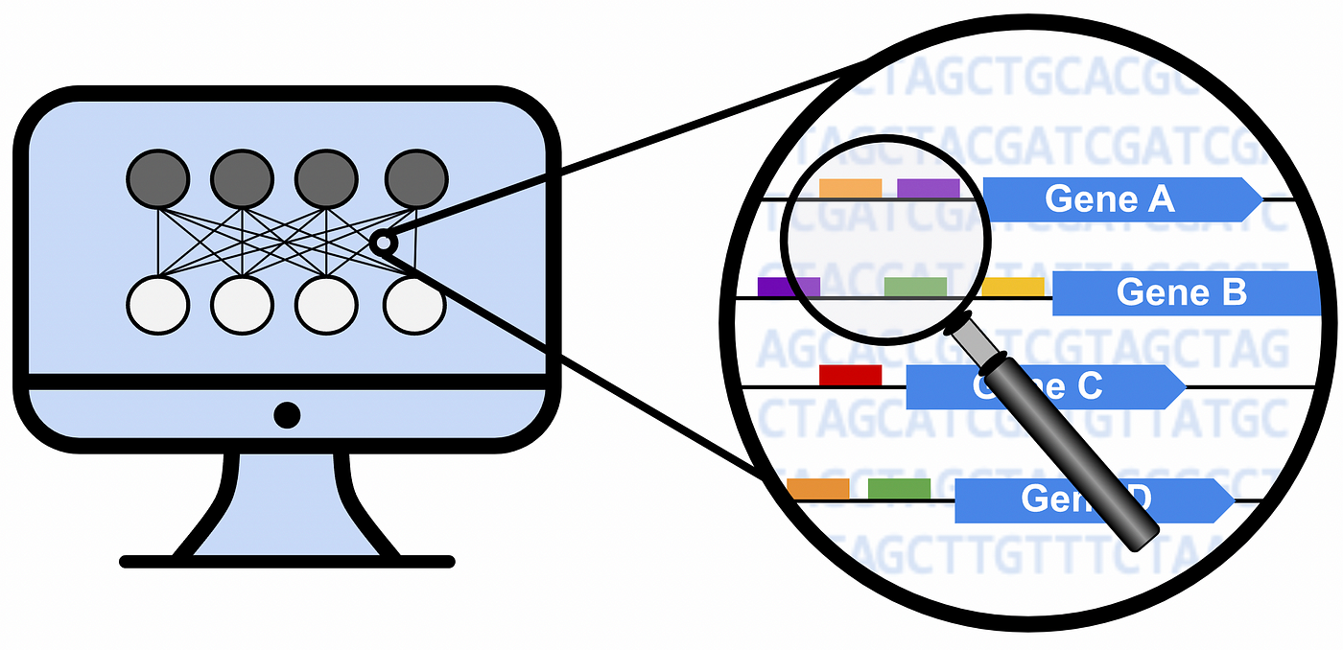
Lung cancer
CreateMetadataFromGDCFiles.R
- Squamous Cell Carcinoma
- 3 stages
Expression dataset
LoadExpressionData.R
RPKM_Normalization.R
- 15208 genes
- 486 samples
- 45 samples paired/control
Paired samples tumor/control positive per stage
CreateMetadataPairedSamplesRPKM.R
CalculateUregulatedfPairedSamplesRPKM.R
log2folchange=log2[Expr(tumor in Stage i)]-log2[Expr(normal in Stage i)]
log2folchange >=0.58
- Stage I : 5422 genes
- Stage II : 5641 genes
- Stage III: 4913 genes
All tumor samples differential pe stage
log2folchange=log2[Expr(Stage i)-Expr(Stages ii and iii)]
log2folchange >=1.58
- Stage I : 51 genes
- Stage II : 46 genes
- Stage III: 112 genes
CreateDEGenesPerStageMeansFromPairedUp.R
CalculateShannonEntropyMeansOfDiffRPKM.R
Entropy analysis
- entropy per stage:
- Stage I : 4.774
- Stage II : 4.082
- Stage III : 5.704

Slide 2
Lung cancer
CreateMetadataFromGDCFiles.R
- Squamous Cell Carcinoma
- 3 stages
Expression dataset
LoadExpressionData.R
RPKM_Normalization.R
- 15208 genes
- 486 samples
- 45 samples paired/control
All tumor samples genes per stage
log2folchange=log2[Expr(Stage i)-Expr(Stages ii and iii)]
log2folchange >=1.58
- Stage I : XX genes
- Stage II : XX genes
- Stage III: XX genes
CreateDEGenesPerStageMeansFromPairedUp.R
CalculateShannonEntropyMeansOfDiffRPKM.R
Entropy analysis
- entropy per stage:
- Stage I : YY
- Stage II : YY
- Stage III : YY
Paired samples tumor/control validation entropy~stage
CreateMetadataPairedSamplesRPKM.R
CalculateUregulatedfPairedSamplesRPKM.R
- Precision
- Recall
- Accuracy

