Slide 1





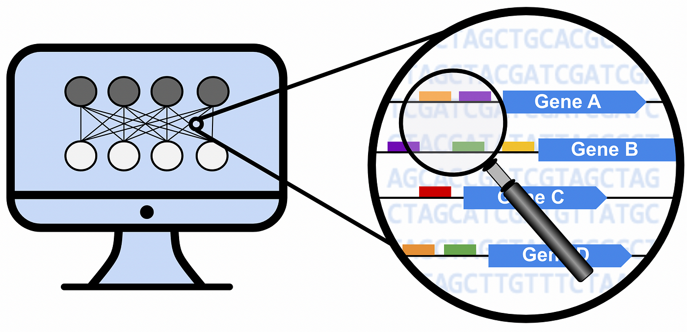
Pipeline 1
Lung cancer
CreateMetadataFromGDCFiles.R
- Squamous Cell Carcinoma
- 3 stages
Expression dataset
LoadExpressionData.R
RPKM_Normalization.R
- 15208 genes
- 486 samples
- 45 samples paired/control
Paired samples tumor/control
CreateMetadataPairedSamplesRPKM.R
- folchange=Expr(tumor)/Expr(normal)
- threshold log2folchange >=0.58
- 3527 genes
Differential analysis
CreateMetadataPairedSamplesDiffRPKM.R
folchange=Mean Expr(Stage i)-Mean Expr(Stage ii and II)
threshold log2folchange >=0.58
- Stage I : 11 genes
- Stage II : 12 genes
- Stage III: 35 genes
Entropy analysis
- entropy per stage
- gene expression per stage
- order of magnitude per stage
- PPI connectivity per stage

Slide 2
Pipeline 2
Lung cancer
CreateMetadataFromGDCFiles.R
- Squamous Cell Carcinoma
- 3 stages
Expression dataset
LoadExpressionData.R
RPKM_Normalization.R
- 15208 genes
- 486 samples
- 45 samples paired/control
Paired samples tumor/control
CreateMetadataPairedSamplesDiffRPKM.R
- folchange=Expr(tumor)-Expr(normal)
- threshold log2folchange >=0.58
- 3527 genes
Differential analysis
CreateDEGenesPerStageMeansOfDiffRPKM.R
folchange=Mean(Expr stage i)-Mean(Expr stages ii and iii)
threshold folchange >=3
- Stage I : 69 genes
- Stage II : 141 genes
- Stage III: 390 genes
Entropy analysis
- entropy per stage
- gene expression per stage
- order of magnitude per stage
- PPI connectivity per stage

Slide 3

Paired samples tumor/control
Diff. of means
Mean of diff.
- folchange=Avg. Expr(tumor)/Avg. Expr(normal)
- log2folchange >=0.58
- 2779 genes
- folchange=RPKM Expr(tumor)-RPKM Expr(normal)
- Avg(log2folchange) >=3.0
- Stage I : 663 genes
- Stage II : 718 genes
- Stage III : 701 genes

