Slide 1
Lung cancer progression and staging with trancriptome bioformatics and entropy analysis
Felipe LEAL VALENTIM
Nicolas CARELS
Carlyle RIBEIRO LIMA
CNPq - Conselho Nacional de Desenvolvimento Científico e Tecnológico
Fiocruz - Fundação Oswaldo Cruz

Slide 2
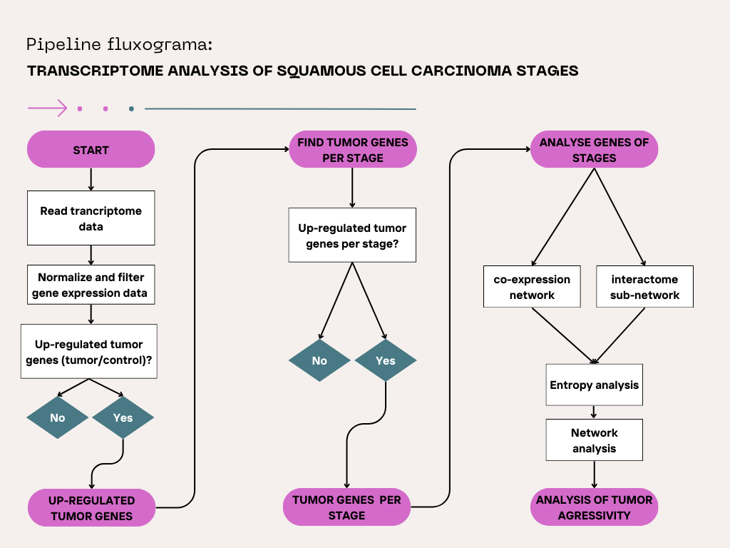

Slide 3
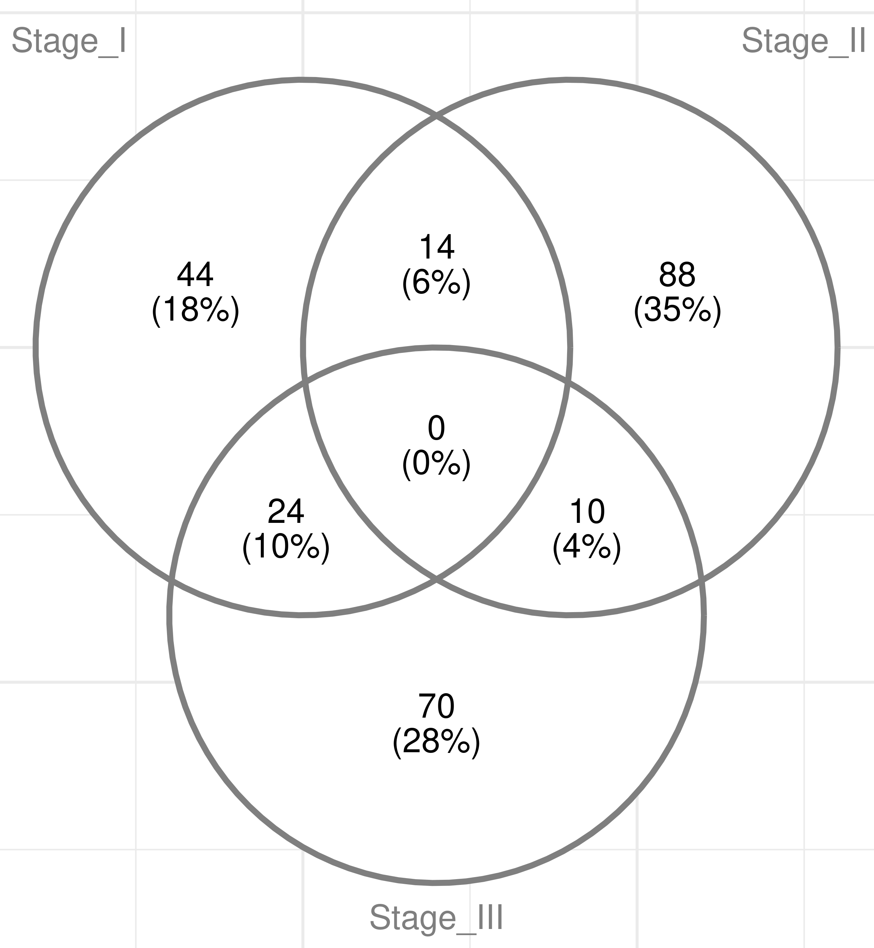

Slide 4
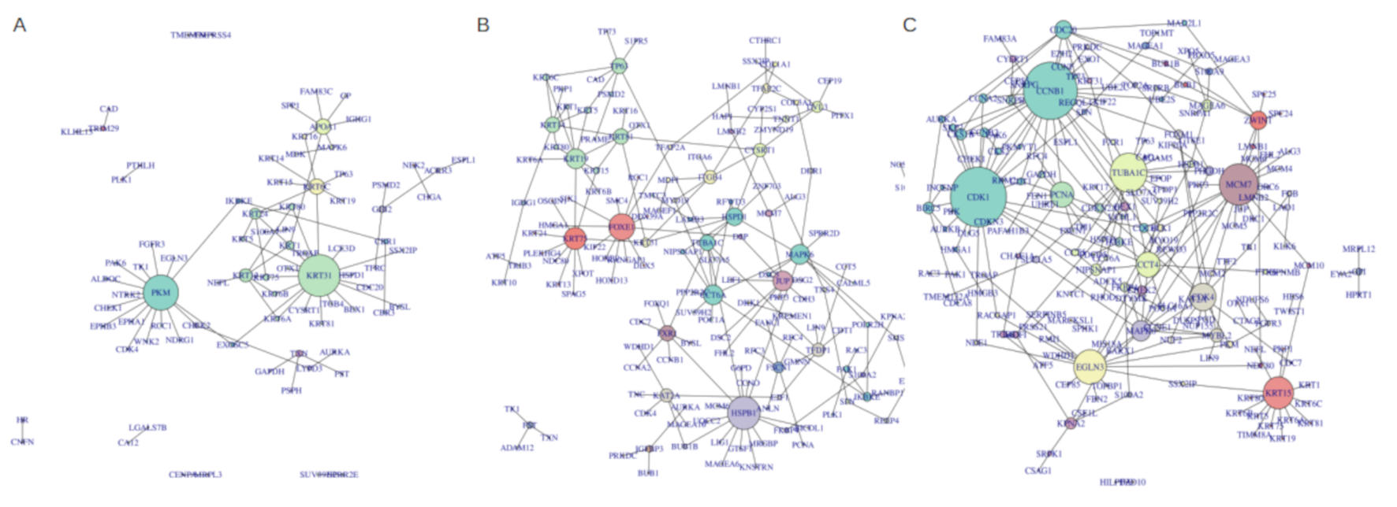

Slide 5
Thresholds |  |  |  | Number of tumor genes per stage (all/exclusive per stage) |  |  | co-expression netwoRk, after filtering (Nº of vertex/Nº of edges/Entropy) |  |  | sub-interactome network, extrapolated (Nº of vertex/Nº of edges/Entropy)
RPKM | LFC tumor | LFC per stage | Nº of tumor genes | Stage I | Stage II | Stage III | Stage I | Stage II | Stage III | Stage I | Stage II | Stage III
3 | ≥1 | ≥1 | 1894 | 159/104 | 246/190 | 344/263 | 78/123/1.8509 | 142/289/2.1892 | 197/416/2.7483 | 360/434/1.8228 | 566/846/2.3299 | 747/1381/2.7499
5 | ≥1 | ≥1 | 1537 | 154/99 | 243/187 | 338/257 | 74/114/1.774 | 140/287/2.2088 | 192/401/2.74 | 317/376/1.7928 | 486/726/2.3635 | 642/1199/2.7873
10 | ≥1 | ≥1 | 1022 | 140/87 | 225/171 | 313/236 | 65/90/1.45 | 130/253/2.076 | 177/376/2.7919 | 231/256/1.7223 | 362/527/2.3367 | 462/824/2.7546
3 | ≥1.58 | ≥1 | 883 | 109/67 | 159/123 | 161/113 | 50/76/1.9375 | 92/190/2.2714 | 84/141/1.9329 | 101/108/1.6237 | 195/229/1.9478 | 233/336/2.2566
5 | ≥1.58 | ≥1 | 695 | 105/63 | 156/120 | 155/107 | 47/73/2.0019 | 90/188/2.304 | 80/130/1.9456 | 84/89/1.5565 | 157/182/1.986 | 186/273/2.3503
10 | ≥1.58 | ≥1 | 452 | 92/52 | 145/110 | 134/89 | 39/54/1.4745 | 82/164/2.1161 | 66/93/1.5724 | 57/52/1.3245 | 118/133/1.9119 | 129/175/2.2628
3 | ≥1.58 | ≥1.58 | 883 | 95/56 | 115/91 | 121/86 | 42/64/1.8642 | 68/113/1.9086 | 64/103/1.8398 | 87/89/1.5051 | 160/187/1.9229 | 195/255/2.0967
5 | ≥1.58 | ≥1.58 | 695 | 92/53 | 115/91 | 117/82 | 39/56/1.6946 | 68/113/1.9086 | 61/100/1.8995 | 72/73/1.4283 | 131/151/1.9352 | 160/213/2.1903
10 | ≥1.58 | ≥1.58 | 452 | 82/44 | 115/91 | 104/70 | 33/44/1.4186 | 67/112/1.9261 | 52/82/1.7948 | 44/42/1.3668 | 106/116/1.8114 | 110/139/2.1201

Slide 7


Slide 8
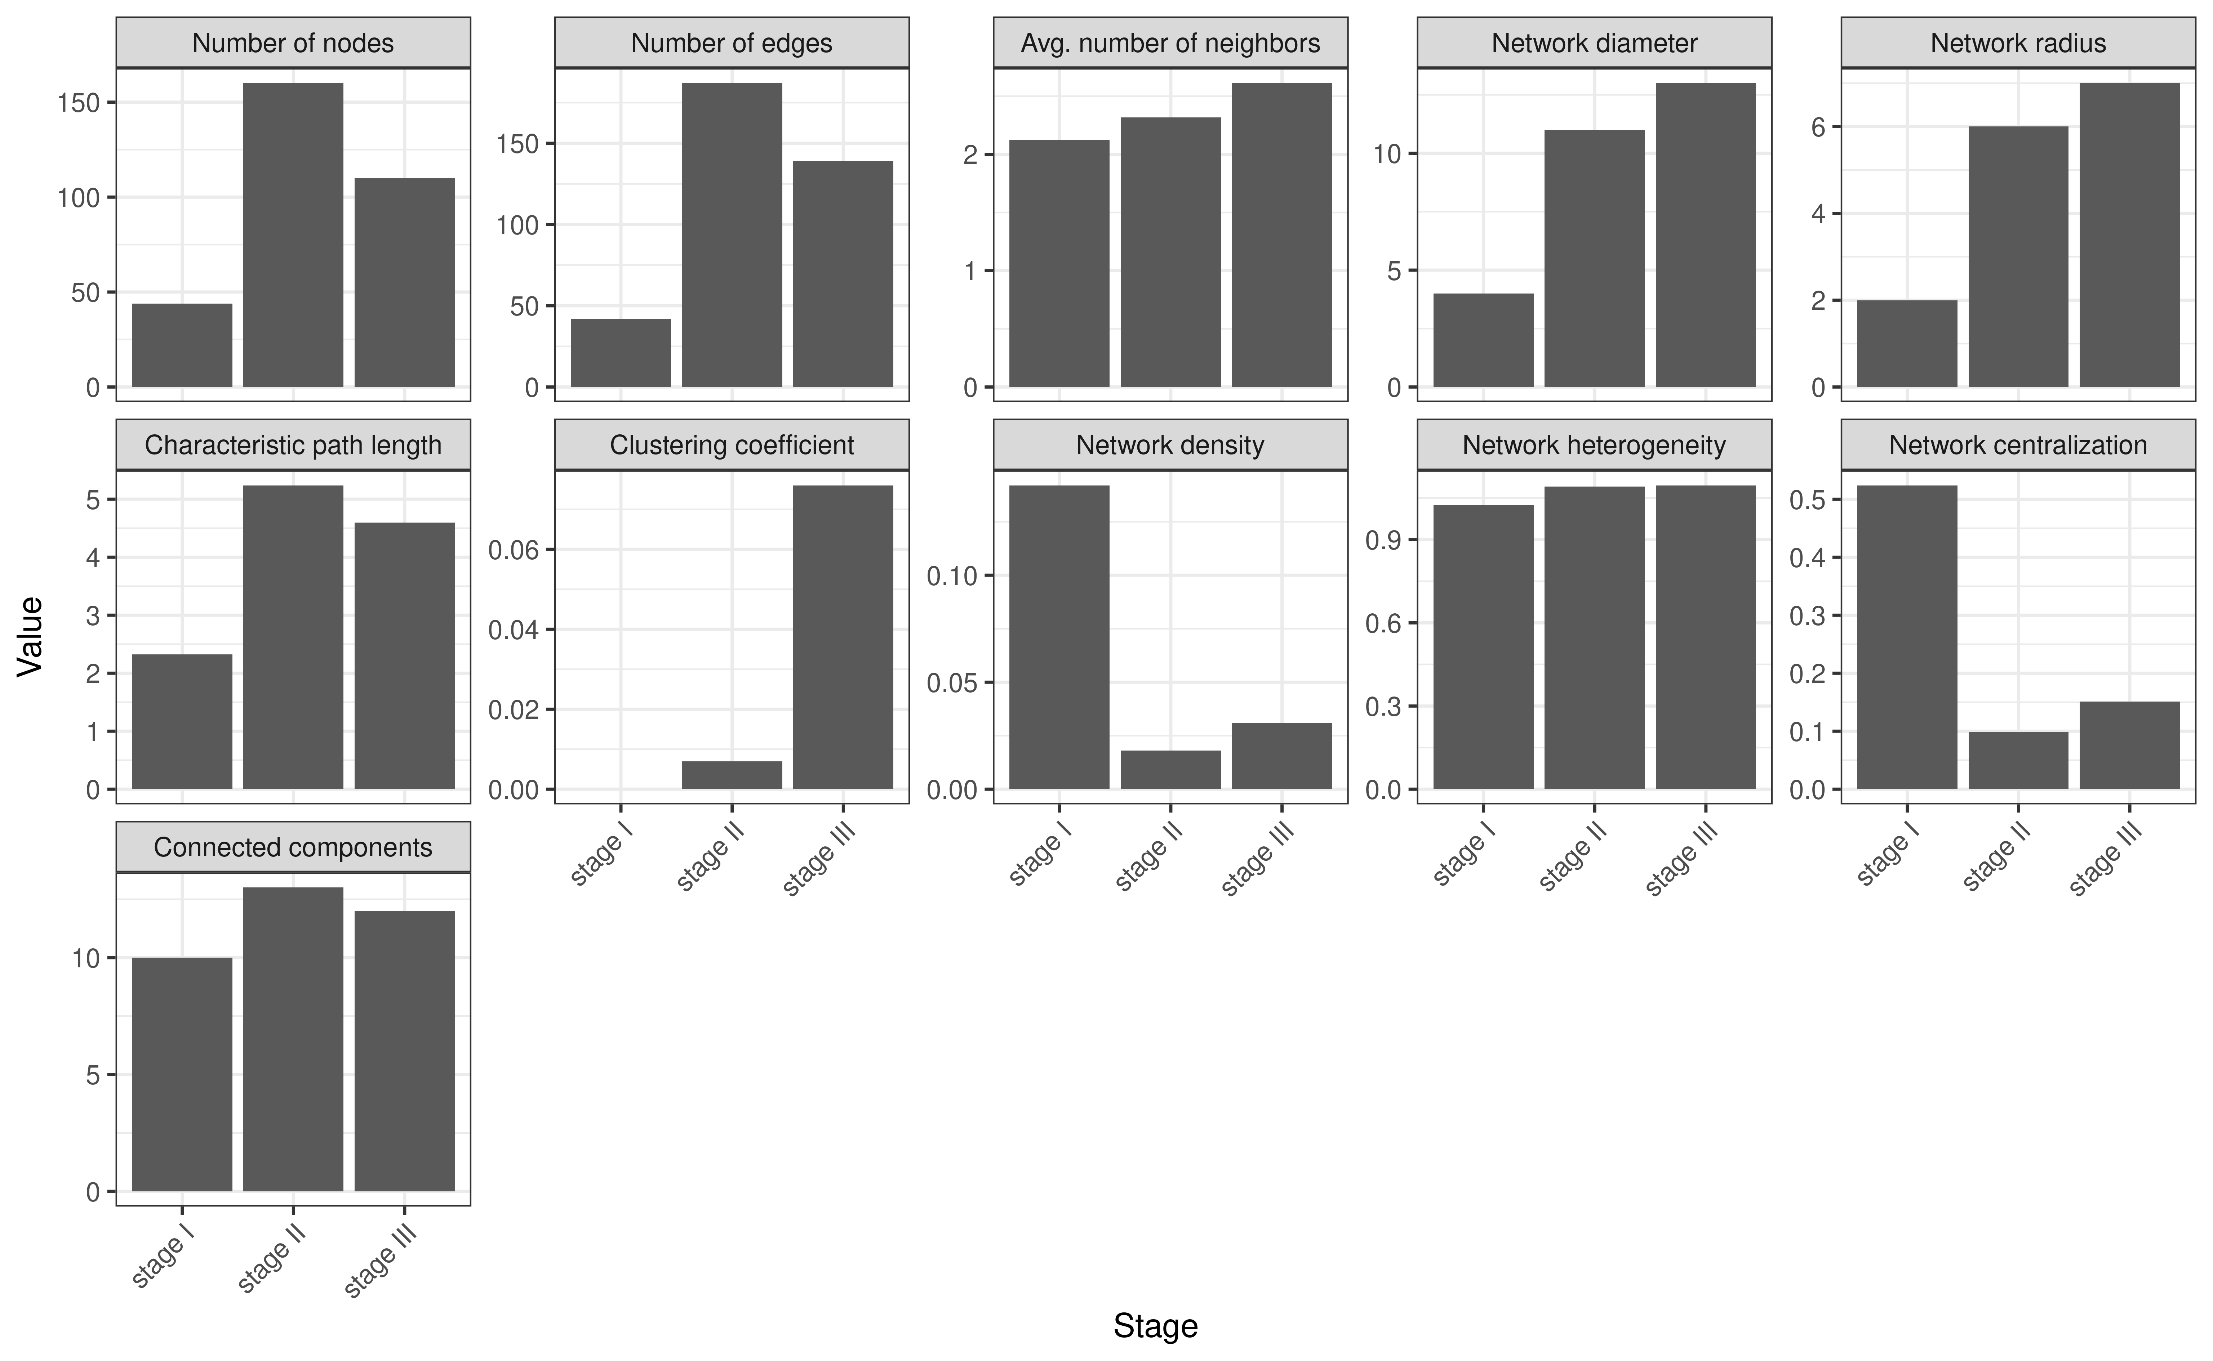

Slide 9
Próximo passos
* Bipartite-network

