Slide 1





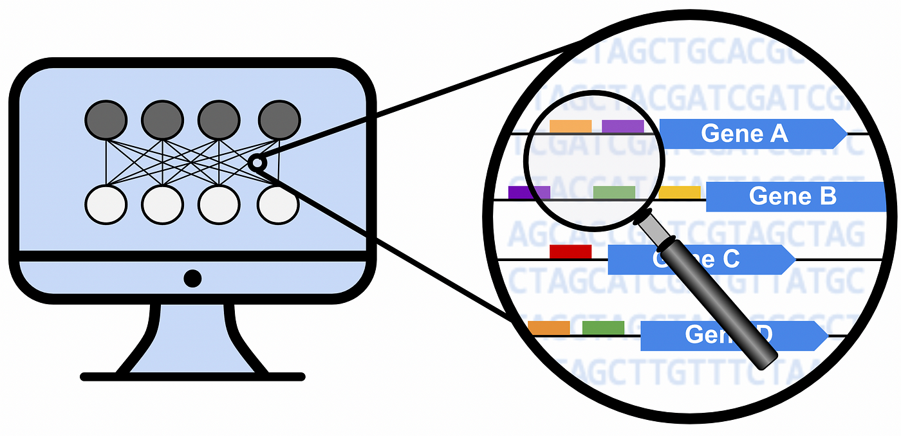
Lung cancer
- Squamous Cell Carcinoma
- 3 stages
Expression dataset
- 15208 genes
- 486 samples
- 45 samples paired/control
Paired samples tumor/control
- log2fc=Expr(genes_in_tumor)/Expr(genes_in_normal)
- threshold log2fc >=0.58
- 2779 genes
Differential analysis
- Samples of stage I vs. Samples of stages II and III
- Samples of stage II vs. Samples of stages I and III
- Samples of stage III vs. Samples of stages I and II
DESeq2
Manually
DESeq2 log2folchange >= 0.58
- Stage I vs. Stages II and III : 13 genes
- Stage II vs. Stages I and III : 7 genes
- Stage III vs. Stages I and II : 71 genes
log2(mean stage i/mean stages ii and III)>=0.58
- Stage I vs. Stages II and III : 201 genes
- Stage II vs. Stages I and III : 81 genes
- Stage III vs. Stages I and II : 215 genes
Entropy analysis
- entropy per stage
- gene expression per stage
- order of magnitude per stage
- PPI connectivity per stage

