Slide 1
Centre for Applied Data Ethics
Dan Towler
UK Statistics Authority

Slide 2

“promoting and safeguarding the production and publication of official statistics that serve the public good”
Informing the public about social and economic matters
Assisting in the development and evaluation of public policy
Regulating quality and publicly challenging the misuse of statistics
Statistics and Registration Service Act 2007 (SRSA)

Slide 3
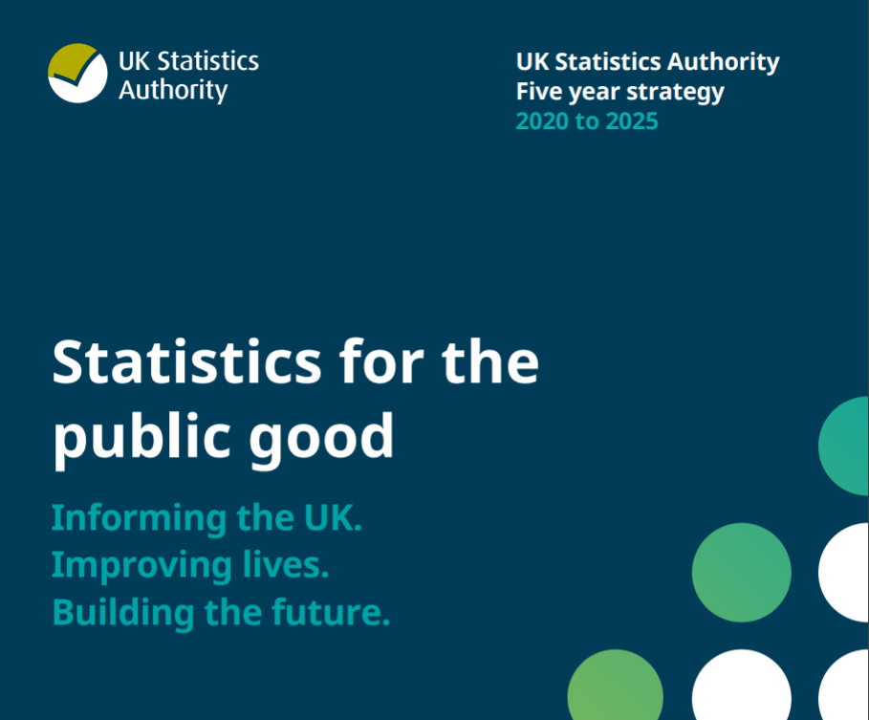
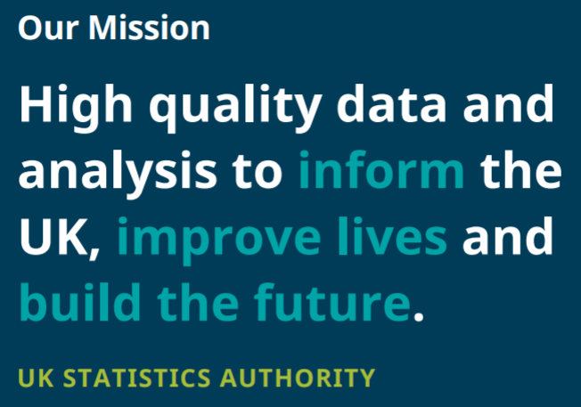
UK Statistics Authority Strategy

Slide 4
Our ambition
To be recognised leaders in the practical application of data ethics for statistics and research.
UK STATISTICS AUTHORITY

Slide 5


Why is ethics important?
Reduce potential harm to all individuals involved in research.
Key factor in maintaining public acceptability around the collection and use of public information.
Enables researchers to efficiently access and harness data that supports the production of statistics for the public good.
Providing solutions to ethical issues helps to enable data to be used in radical, ambitious, inclusive and sustainable ways.
It is a legal requirement for access to data under the DEA research powers.

Slide 6
Ethical principles
The use of data has clear benefits for users and
serves the public good.
Public Good
Confidentiality, data security
The data subject’s identity (whether person or organisation) is protected, information is kept confidential and secure, and the issue of consent is considered appropriately.
Methods and Quality
The risks and limits of new technologies are considered and
there is sufficient human oversight so that methods employed
are consistent with recognised standards of integrity and quality.
Legal Compliance
Data used and methods employed are consistent with legal requirements such as Data Protection Legislation, the Human Rights Act 1998, the Statistics and Registration Service Act 2007, public equalities duty and the common law duty of confidence.
Public views & engagement
The views of the public are considered in light of the data used and the perceived benefits of the research.
Transparency
The access, use and sharing of data is transparent, and is communicated clearly and accessibly to the public.

Slide 7
Why are the principles important?
Public Good
If our use of data is not in the public good, then we are failing in our statutory duty.
Confidentiality & Data Security
If we are not able to guarantee appropriate confidentiality and security of data, our ability to collect and store sensitive data in the future may be impaired.
Methods & Quality
If the methods that we use are not sufficiently robust, or limitations clearly explained and understood, we risk loss of confidence in the data that influences policy decisions.

Slide 8
Why are the principles important?
Legal Compliance
If we do not comply with legal requirements we risk legal action.
Public Views & Engagement
If the public are not supportive of the way in which we use data, we risk substantial reputational damage, democratic challenge and reluctance from the public to share their data.
Transparency
If data subjects are unaware how their data is being used they will not be empowered to exercise their legal rights in relation to that data and the techniques being deployed, or to challenge how their data is used.

Slide 9




Data ethics support
Continue to develop the self-assessment tool and guidance and provide independent expert ethical advice through NSDEC.
New online ethics training for the research and statistical community across Government, academia and the commercial sector.
A new ethics user support service for the research and statistics community to provide ethics advice at the research design phase.
Publish new guidance on cross cutting ethical issues in research and statistics.

Slide 10
Applying ethical principles
Ethics Self-Assessment Tool
National Statistician’s Data Ethics Advisory Committee

Slide 11
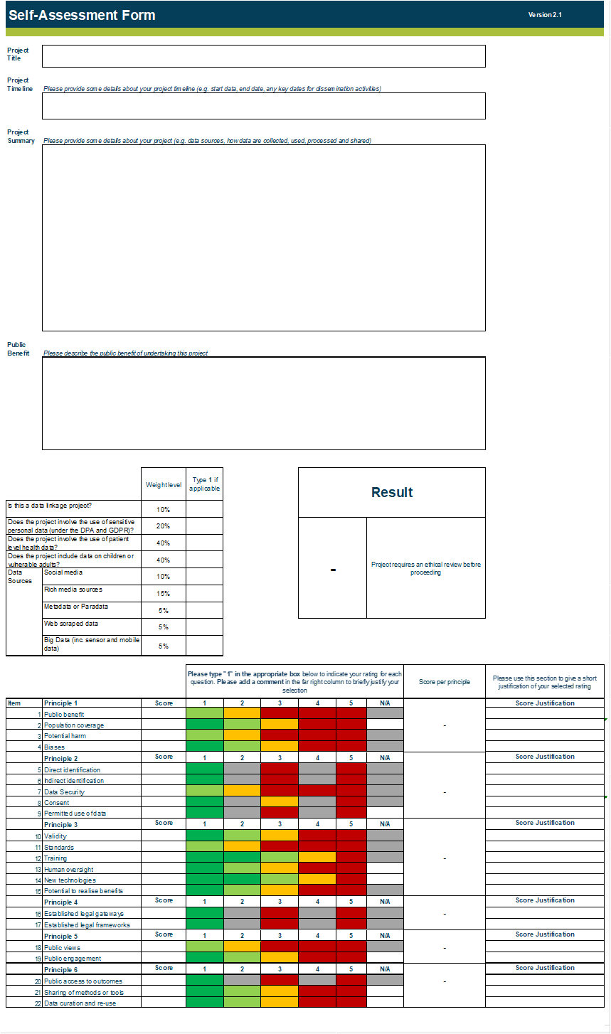
Self-Assessment Tool
The self-assessment tool consists of 3 main sections for a researcher to complete:
Basic information
Weightings
Item scoring scales

Slide 12
Ethics Self-Assessment Tool
Over 470 users of the ethics framework.
Nearly half of projects considered focus on a protected characteristic.
Over half of projects considered are linking data or are using linked data.
Three-day average turnaround time in 2021.

Slide 13





National Statistician’s Data Ethics Advisory Committee
Project | Organisation
Assessing the algorithmic feasibility of COVID-19 specific vocal biomarker detection | JBC
Investigating vulnerabilities linked to serious youth violence using linked data | DfE & MoJ
COVID-19 Infection Survey | ONS & multiple partners
EU Settled Status Scheme (EUSS) Data Linkage Project | Welsh Gov & ADR Wales
Health and Work Support Pilot and Fair Start Scotland evaluation data linkage project | Scottish Gov
Management and Expectations Survey (MES) feedback and trial | ONS, ESRC, ESCoE & Be the Business
Local Government
Other Central Government Departments
Academia
Who?
ONS
Devolved
Administrations
Commercial Sector

Slide 14
CADE - Data Ethics Guidance
Use of geospatial data
Public good
Use of third party data
Machine learning

Slide 15
Key outputs to date
Machine learning ethics guidance
Launch of Centre & Centre strategy
Leading UNECE ML2021 ethics workstream
Roundtable and accompanying discussion note
Ethics considerations in use of data from third-parties
Launch of independent Advisory Committee
Public good ethics guidance
February 18th 2021
November
Publication of Landscape Review
Launch of Geospatial ethics guidance
Public views and engagement guidance
User review of self-assessment
International collaboration & engagement programme
International survey and initial theme meeting

Slide 16
Contact us: Data.ethics@statistics.gov.uk
Or visit our website: https://uksa.statisticsauthority.gov.uk/data-ethics/
Suggest a guidance topic: https://uksa.statisticsauthority.gov.uk/what-we-do/data-ethics/centre-for-applied-data-ethics/guidance-and-support/ethics-guidance-documents/

Slide 17
Thanks for listening.

