Slide 1

Synthetic data generation I. Kaloskampis, L. Benedikt, C. Joshi, D. Pugh, A. Noyvirt, S. Hill, L. Nolan
30 August 2018

Slide 2
Project overview
Problems with using real data
Data sensitivity, availability, missing data
Solution: Use synthetic data
Impact
Easier, faster and safer for ONS to share sensitive data
Linked to several ONS DSC projects (Trade, Housing, etc.)
Data sharing/privacy for medical, defence apps etc.
Online tool for synthetic data generation in the future

Slide 3
Roadmap
Model | Dataset | Application | Testing for… | Result
GAN | LSOA Atlas, OCS Adult Census, Cancer Cells, Credit card fraud | Synthesis | Data quality
CGAN
WGAN
WCGAN
SMOTE

Slide 4
Progress – Processing Pipeline
Generative Adversarial Networks (GAN)
(Variational) Auto-encoder
Auto-regressive models
Conventional generators (SMOTE etc.)
System parameters determination
Synthetic data generation
Data Quality
Model type, architecture, parameters
Privacy
Notes:
Security environment, access to confidential data, permissions etc.

Slide 5
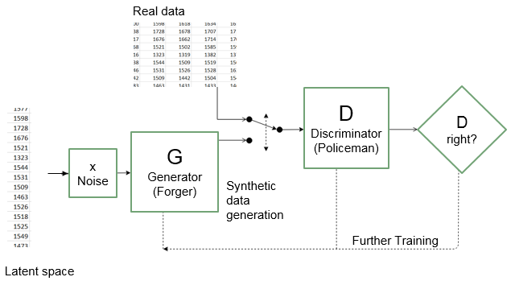
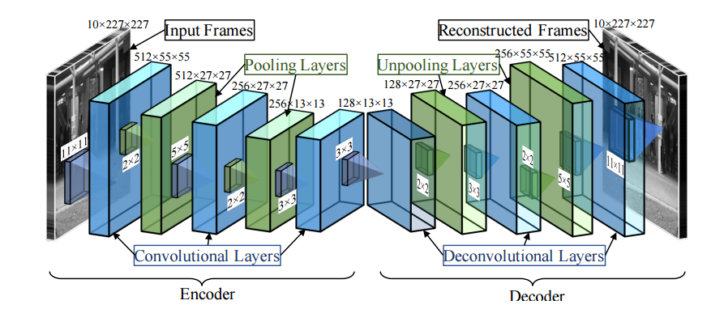
Deep learning models
Generative adversarial network (Goodfellow et al., 2014)
Autoencoder (Liou et al., 2008)
Notes:
Security environment, access to confidential data, permissions etc.

Slide 6
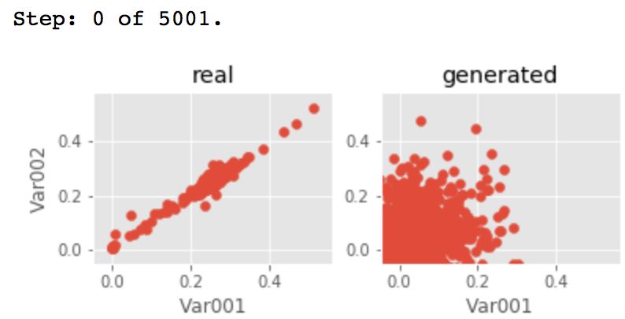
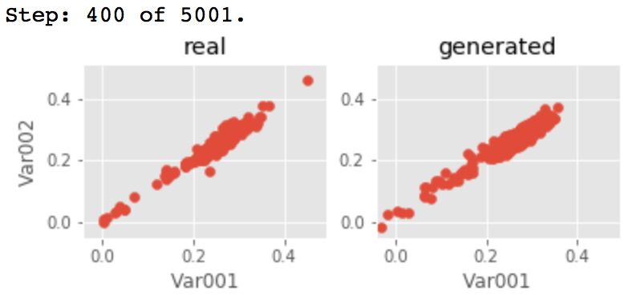
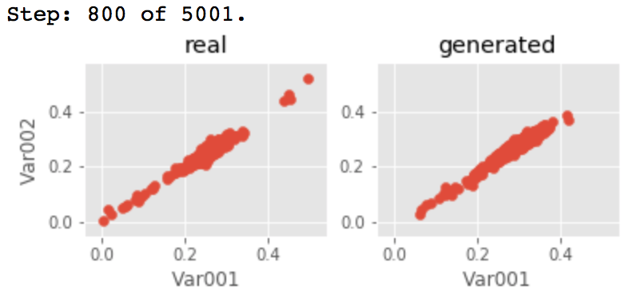
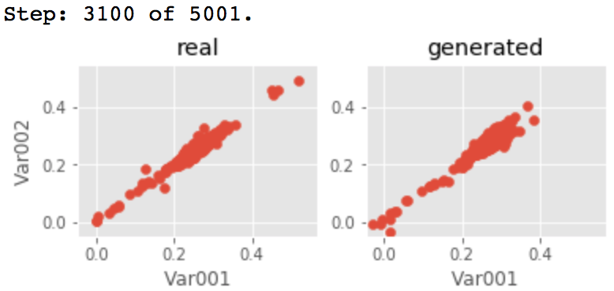
Progress – Results on LSOA Atlas post-2011
Notes:
Security environment, access to confidential data, permissions etc.

Slide 7
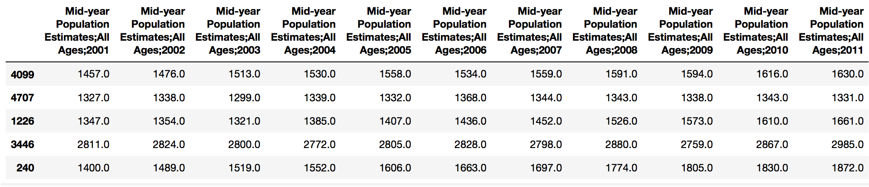
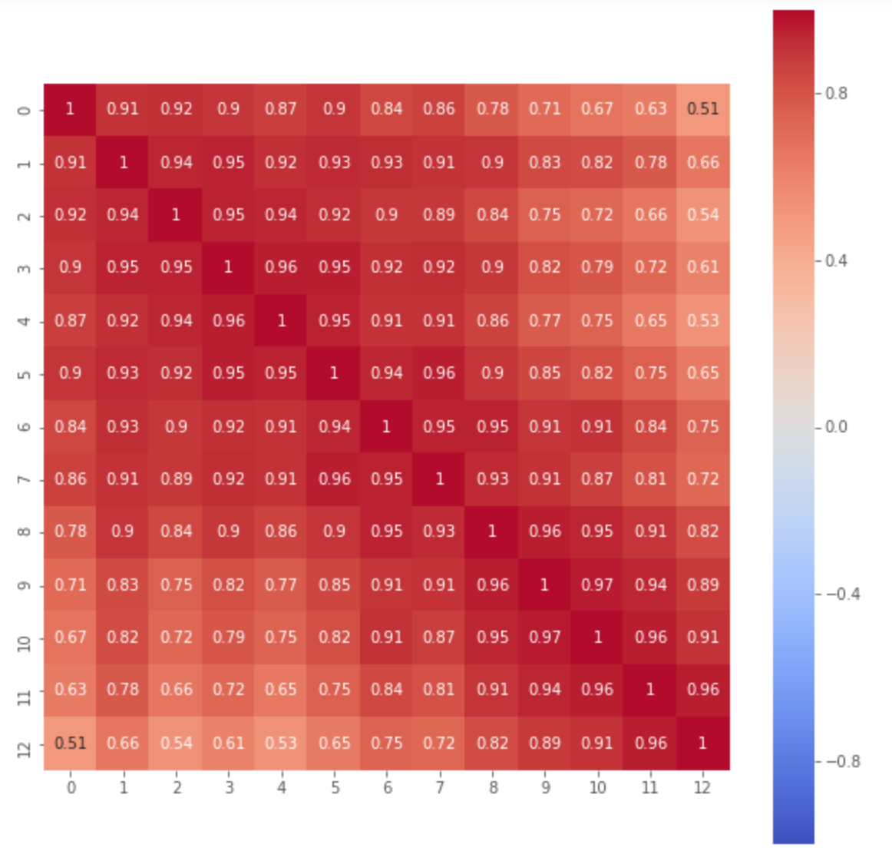
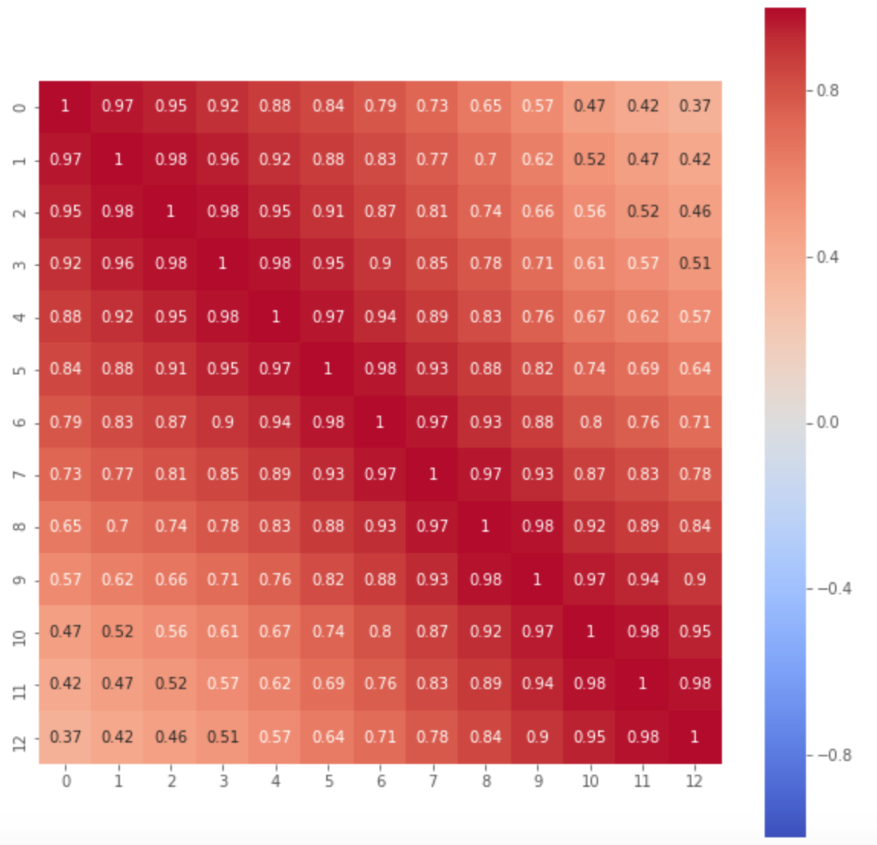
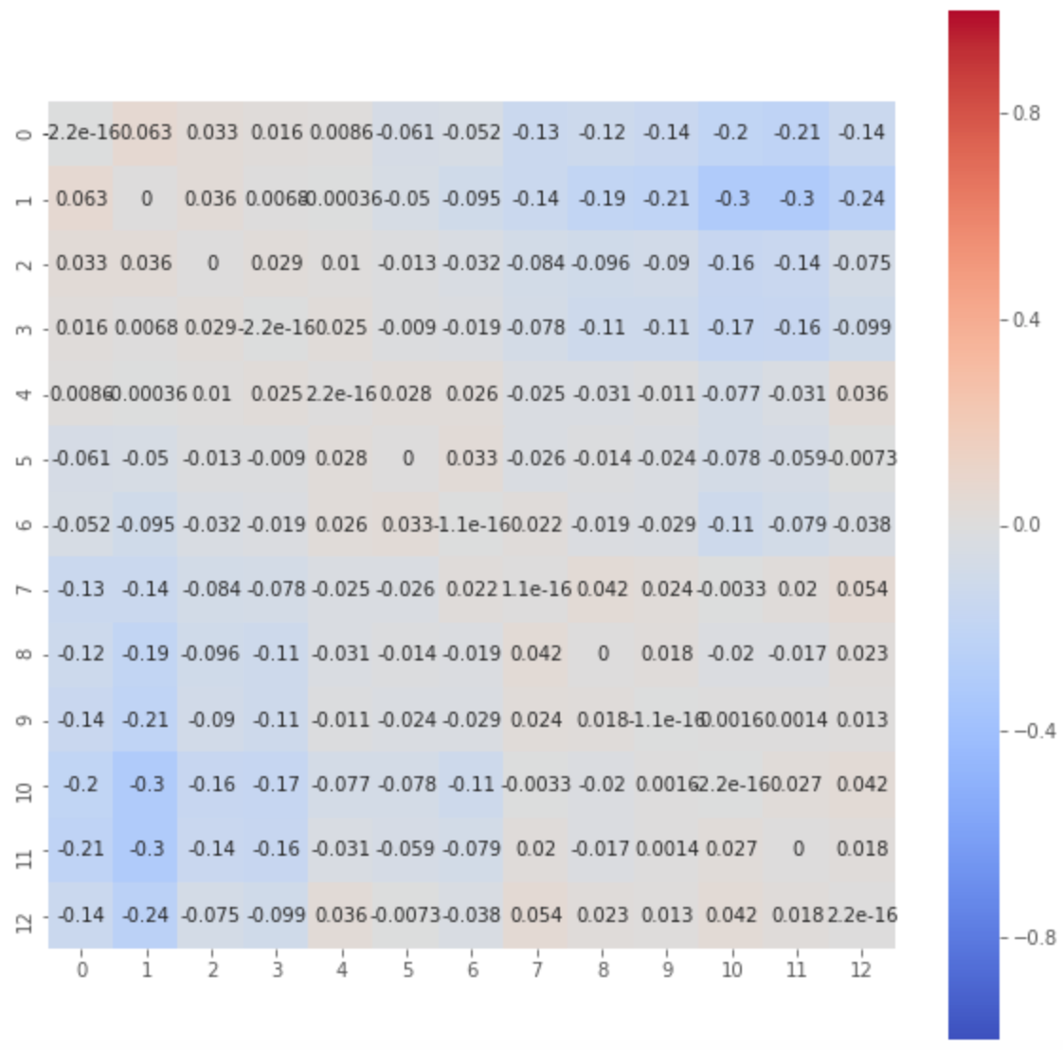
Progress – Results on LSOA Atlas post-2011
Pearson heatmap - Real
Pearson heatmap - Synth
Difference
Notes:
Security environment, access to confidential data, permissions etc.

Slide 8
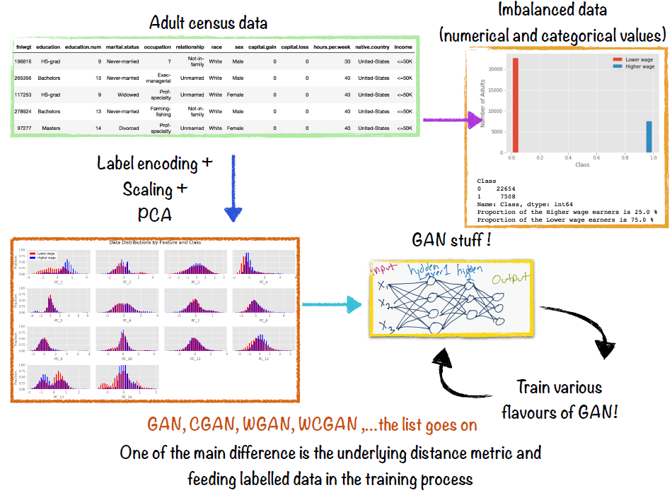
Progress – GAN Variations
Notes:
Security environment, access to confidential data, permissions etc.

Slide 9
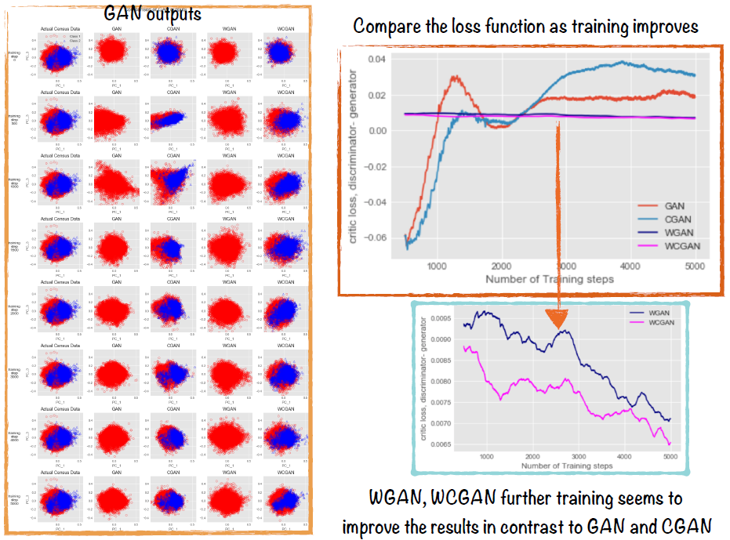
Progress – GAN Variations
Notes:
Security environment, access to confidential data, permissions etc.

Slide 10
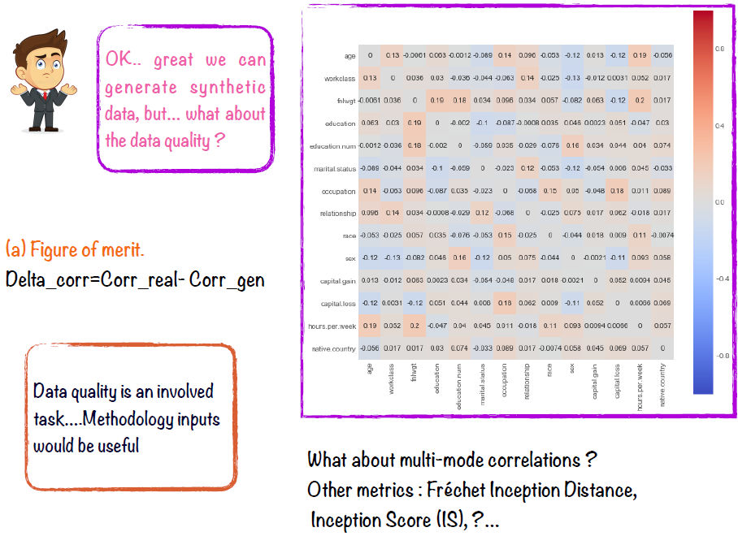
Progress – GAN Variations
Notes:
Security environment, access to confidential data, permissions etc.

Slide 11
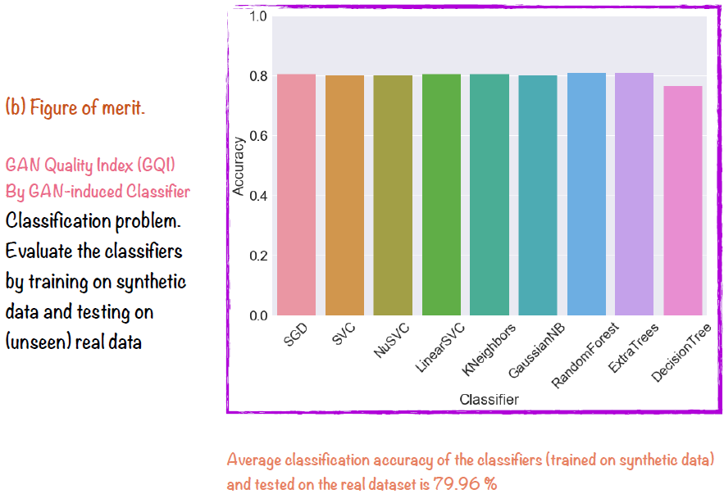
Progress – GAN Variations
Notes:
Security environment, access to confidential data, permissions etc.

Slide 12
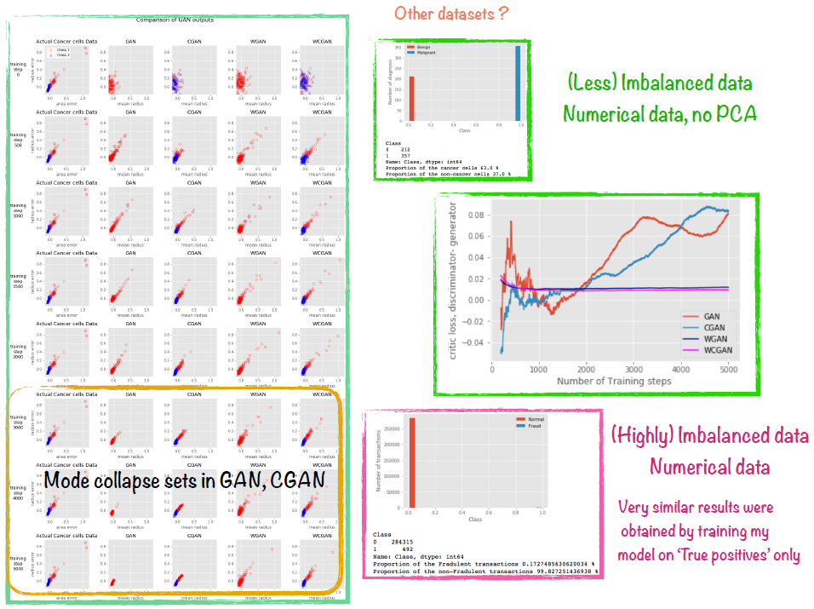
Progress – GAN Variations
Notes:
Security environment, access to confidential data, permissions etc.

Slide 13
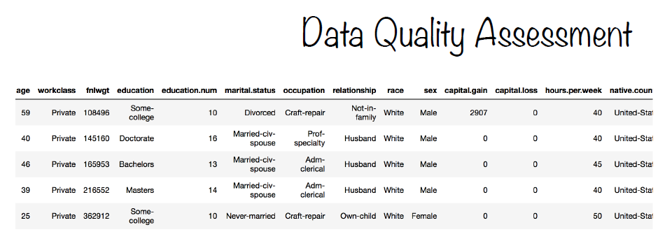
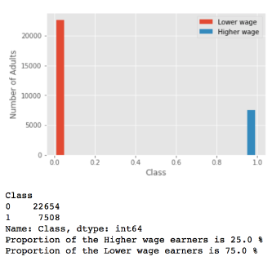
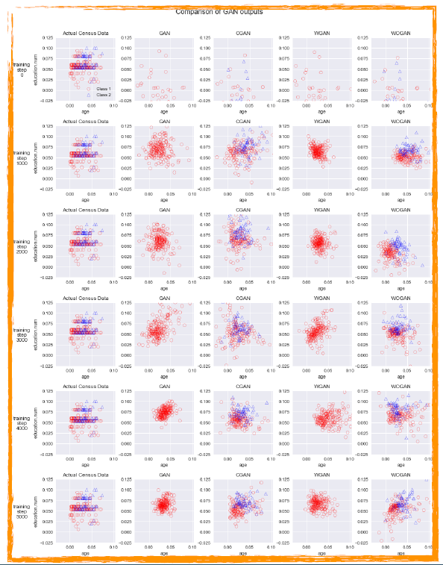
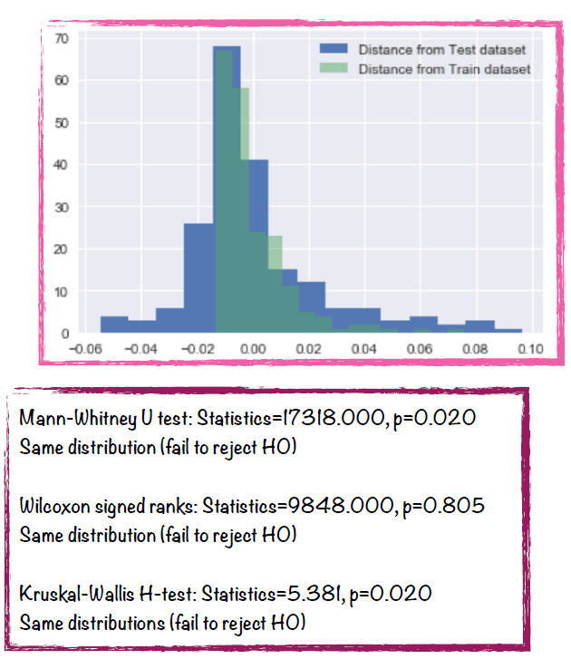
Progress – GAN Variations
Notes:
Security environment, access to confidential data, permissions etc.

Slide 14
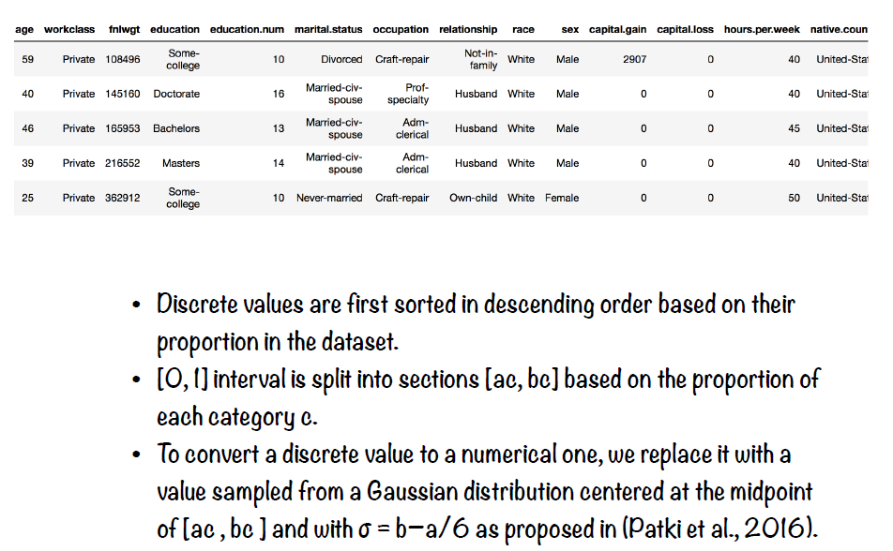
Categorical Variables
Notes:
Security environment, access to confidential data, permissions etc.

Slide 15



Well established techniques exist to generate synthetic data
$$x_{i}$$
Synthetic minority over sampling technique (SMOTE)
is an established method for balancing datasets for machine learning
$$x_{new}$$
$$x_{zi}$$
SMOTE and its many variants sythesise new instances between real points using a k nearest neighbour approach

Slide 16
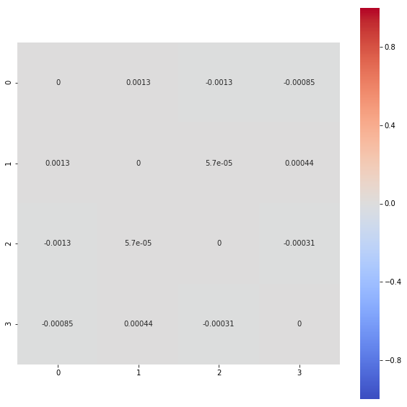
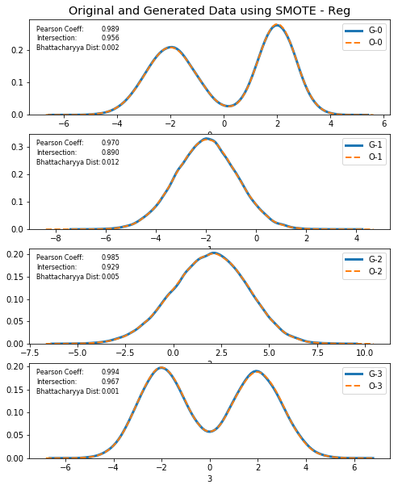
SMOTE can be used to synthetically generate numerical data
Correlation diff between original and
generated data
4 different variants of SMOTE
-regular, B1, B2 & ADASYN
3 different datasets
-generated data
-ICS adult census
-LSOA Atlas census
quality assessed
-correlation
-intersection
-Bhattacharyya distance
SMOTE can accurately synthesise data distributions

Slide 17
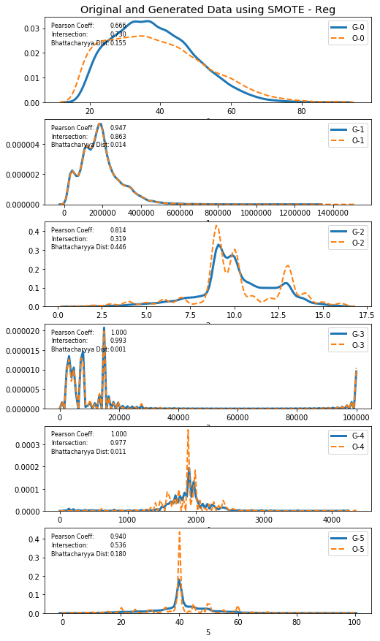
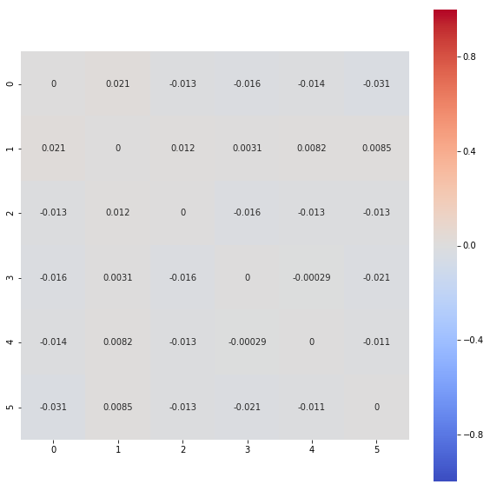
SMOTE can also be used to synthesis more complex datasets
Correlation diff between original and generated data – ICS adult census numerical data
Modelling of numerical data from the ICS adult census
The nature of SMOTE leads to some generalisation and smoothing of the data; can be affected by outliers => quality measures decrease
Need to carefully consider how SMOTE can be applied to categorical data

Slide 18
Results – OCS Adult Census
Model | Dataset | Application | Testing for… | Result
GAN | OCS Adult Census (numerical variables) | Synthesis | Data Quality – Pearson Correlation absolute mean difference between real & synthetic correlation matrices | 0.085802
WGAN |  |  |  | 0.064000
SMOTE |  |  |  | 0.011192
SMOTE B1 |  |  |  | 0.011192
SMOTE B2 |  |  |  | 0.009105
ADASYN |  |  |  | 0.012401
Autoencoder |  |  |  | 0.008293
Variational Autoencoder |  |  |  | 0.211314

Slide 19
Application to real-world problem I
Stakeholder: ONS Stats support team (Pete Stokes, Adil Deedat)
What? Labour Force Survey (LFS) – Synthetic data
Currently doing:
Uploading LFS dataset to DAP
Investigating categorical data problem

Slide 20
Application to real-world problem II
Stakeholder: ONS national Accounts, Trade ITIS (International Trade in Services)
What? Imputation, back-casting
Currently doing:
investigate hardware DAP (plan A), Campus VM (plan B, need GPU)
data pattern analyses
To do: requirements, scoping, planning (need domain expertise)
Need go/no-go decision

Slide 21
Next steps
Further evaluation of algorithms and techniques
Standardise quality assessment
Privacy evaluation (with Cardiff University)
Model optimization (with University of Bath, MSc project)
Categorical data
Report write-up (blog & technical)
Notes:
Security environment, access to confidential data, permissions etc.

Slide 22
Challenges
Access to Customers: data, domain expertise
Understanding the quality/privacy trade off
Hardware
DAP
Computer with GPUs
Is deep learning the way forward?
Notes:
Managing expectations
Security environment, access to confidential data, permissions etc.

