Slide 1

Synthetic data generation I. Kaloskampis, L. Benedikt, C. Joshi
22 May 2018

Slide 2
Project overview
Problems with using real world data
Data sensitivity
Data availability
Missing data
Data labelling for supervised learning algorithms
Solution: Use synthetic data

Slide 3
Research question
Can we use Machine Learning techniques to generate synthetic micro data? Data imputation?
Stakeholder: ONS Methodology

Slide 4
Impact
Make it easier and faster for ONS to share data with the research communities
A safer way to share sensitive data
Can generalise to similar problems of data sharing and privacy protection in other domains (medical, defence)
Linked to several current ONS Data Science problems (Trade, Housing, etc.)
Set up an online tool for synthetic data generation in the future
Notes:
The ‘so what’ question – what is the value – which should include: value to society / policy imperative, campus learning, collaborator / mentor learning, learning about new data sources, re-use, range of stakeholders etc.

Slide 5
Methodology
What are the techniques we will investigate?
Generative Adversarial Networks (GAN)
Variational Auto-encoder
Auto-regressive models
Others?
Notes:
The ‘so what’ question – what is the value – which should include: value to society / policy imperative, campus learning, collaborator / mentor learning, learning about new data sources, re-use, range of stakeholders etc.

Slide 6
Concerns
What data do we use for proof of concept?
Publicly available datasets (e.g. Police data)
Transfer learning
How to make our methods/models work for different data
Hardware restrictions
Big data problem, deep networks require high performance computers for efficient processing
Notes:
The ‘so what’ question – what is the value – which should include: value to society / policy imperative, campus learning, collaborator / mentor learning, learning about new data sources, re-use, range of stakeholders etc.

Slide 7
Deliverables
What will you deliver? | How will you know it’s done? | Target date for completion
Literature review methods and data | Written up | End May 2018
Proof of concept basic GAN on small datasets (police data) | Model implemented and running | End May 2018
Proof of concept Variational Auto-encoder on small datasets | Model implemented and running
Proof of concept other models on small datasets | Model implemented and running
Comparison performances on larger datasets (LFS, Census) | Simulations completed and results written-up
Final report and codes | Conclusions written-up and codes released on Github
Notes:
To include: comms e.g. project profile, blog(s), etc.; capability building e.g. collaborator(s) will be able to use and adapt code; article, code, dataset & tool publication etc. as appropriate
Make sure all outputs (tangible & otherwise are included

Slide 8
Stakeholders
Who? | How are they involved? | How are you communicating?
ONS Methodology | Collaboration, testing, QA-ing | TBD (weekly Show&Tell)
ONS Business Areas | Users of the tool | TBD (not before proof of concept ready)
Other government Departments | Users of the tool | TBD (not before proof of concept ready)
Notes:
This should list all of the stakeholders with an interest in the project – include (& specify) ONS teams
How are they involved could be: collaborating, mentoring, customer, share results, notify of publication etc
How are you communicating could be e.g. monthly / weekly meetings, invited to presentation at end of project, email notifying of output etc., invite to show & tell etc or tbd

Slide 9
Last week’s backlog
Task | Owner | Complete? | Blocker
Notes:
This slide is the weekly progress update
Tasks in this slide should be the same as those in the previous week’s ‘next week’s backlog’
additions can be made, but any of last week’s list not completed should describe the blocker / reason in the appropriate column
Tasks should be at a detailed level, and describe the outcome for example, ‘do analysis’ is insufficient, ‘decide best method for A so we can do B’, or ‘do K-means clustering to understand X in order to do Y’ is OK
Owner is the team member who is leading – there should only be one owner per task
Keep a note of blockers as they happen

Slide 10
Synthetic data demo
Problem: Mimic normally distributed samples starting from a uniform distribution
Synthetic data generator: Generative adversarial network
Implementation: Pytorch
Notes:
Here is where any demos, charts, screen shots, images etc. which show the week’s progress should go
Items should be selected to demonstrate successful task completion – screen shots of work are useful
They do not have to be on the slide, but if they are e.g. demos, videos etc. please provide the links here
You can use more than 1 slide, but please be mindful of the strict time limit, and that this is not a place for detailed QA or technical discussion, and make sure any artefacts here tell your story

Slide 11
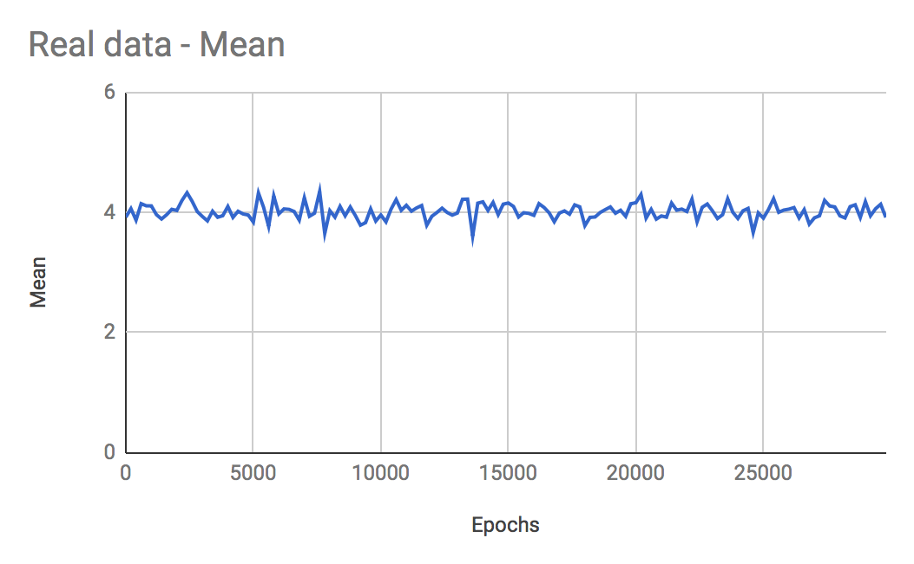
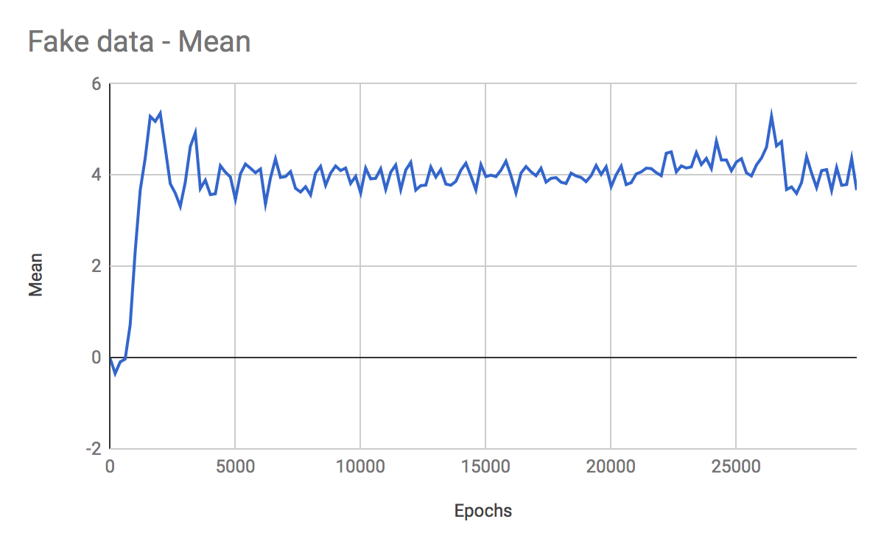
Normal distribution - Mean
Notes:
Here is where any demos, charts, screen shots, images etc. which show the week’s progress should go
Items should be selected to demonstrate successful task completion – screen shots of work are useful
They do not have to be on the slide, but if they are e.g. demos, videos etc. please provide the links here
You can use more than 1 slide, but please be mindful of the strict time limit, and that this is not a place for detailed QA or technical discussion, and make sure any artefacts here tell your story

Slide 12
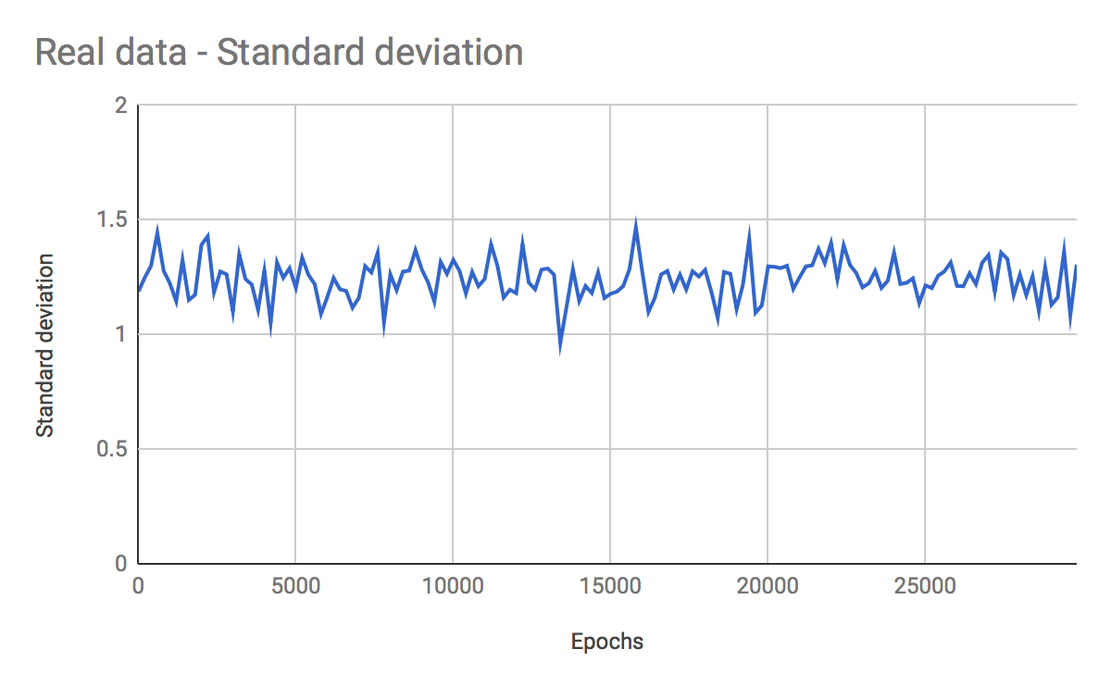
Normal distribution - Standard deviation
Notes:
Here is where any demos, charts, screen shots, images etc. which show the week’s progress should go
Items should be selected to demonstrate successful task completion – screen shots of work are useful
They do not have to be on the slide, but if they are e.g. demos, videos etc. please provide the links here
You can use more than 1 slide, but please be mindful of the strict time limit, and that this is not a place for detailed QA or technical discussion, and make sure any artefacts here tell your story

Slide 13
Next week’s backlog
Task | Owner
Notes:
This slide is the list of tasks for the next week
Tasks should be at a detailed level, and describe the outcome for example, ‘do analysis’ is insufficient, ‘decide best method for A so we can do B’, or ‘do K-means clustering to understand X in order to do Y’ is OK
Owner is the team member who is leading – there should only be one owner per task

Slide 14
Delivery progress
What will you deliver? | % of total completed as of last week | % of total completed as of this week | Target date for completion | Date completed
Notes:
Deliveries – the same as for slide 6
Target date – same as for slide 6
% completed – this is the (rough estimate!) of the amount completed for each deliverable. Best guess is fine
The two columns compare the progress towards completion for each deliverable in the current week with the last week

Slide 15
Project review objectives
Transparency
ensure senior managers, stakeholders, team members and colleagues have a clear, up-to-date view of each project’s progress, successes and challenges
understand blockers
ensure work loads are balanced
ensure pace of delivery
Inspection
provide independent validation of the project approach and direction
Adaption
prioritisation of backlogs (and projects)
agree amendments to backlog
make timely stop / go decisions
ensure timely and appropriate internal and external comms
Notes:
Backlog = list of project tasks
‘agree amendments’ – this doesn’t mean that amendments can’t be made outside the review meeting (and such amendments should be clear & explained in the meeting), rather that further amendments may surface during the meeting

Slide 16
Project review meeting rules
Times slots will be adhered to - there will be no scope for over-running
Please come prepared
Slides should be completed and agreed with team members in advance
Please remember that these meetings are for project review, not detailed QA or technical discussion – please focus on task progress, successes, blockers etc.
Blockers should include activities outside the project as well as project blockers, e.g. other commitments, leave, mentoring etc.
Project comms, stakeholder meetings, data acquisition etc should all be included as tasks
Demos are welcome!
The first 6 slides are unlikely to change much – after the first project review, we will review them only if there are changes
Expect the question ‘what value is this adding’!

