Slide 1

Synthetic data generation I. Kaloskampis, C. Joshi, D. Pugh, A. Noyvirt, L. Benedikt, S. Hill, L., Nolan
05 November 2018

Slide 2
Project overview
Problems with using real data
Data sensitivity, availability, missing data
Solution: Use synthetic data
Impact
Easier, faster and safer for ONS to share sensitive data
Linked to several ONS DSC projects (Trade, Housing, etc.)
Data sharing/privacy for medical, defence apps etc.
Online tool for synthetic data generation in the future

Slide 3
Progress – Processing Pipeline
Generative Adversarial Networks (GAN)
(Variational) Auto-encoder
Auto-regressive models
Conventional generators (SMOTE etc.)
System parameters determination
Synthetic data generation
Data Quality
Model type, architecture, parameters
Privacy
Notes:
Security environment, access to confidential data, permissions etc.

Slide 4
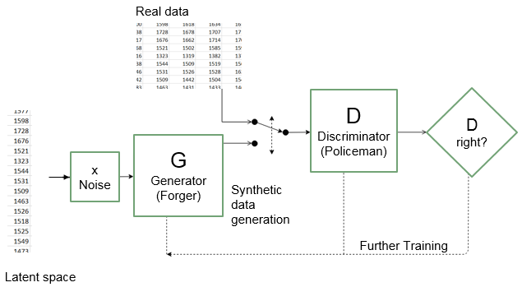
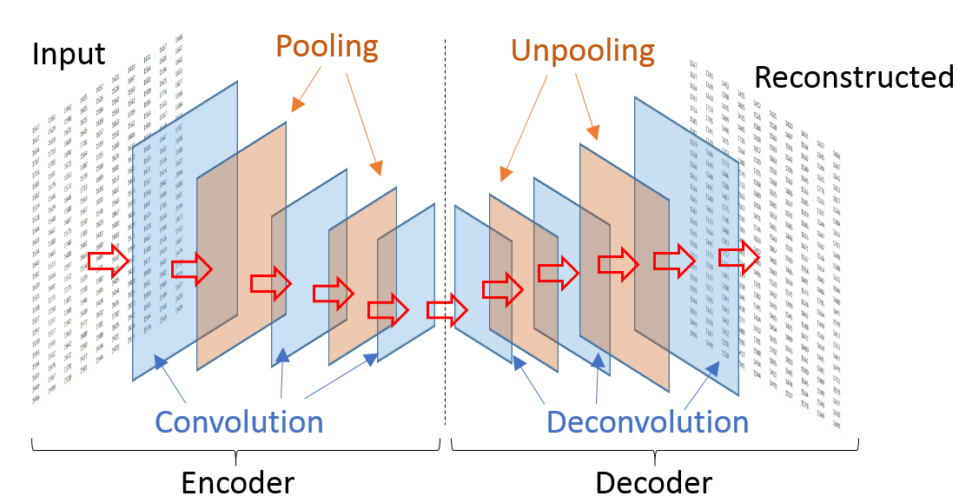
Deep learning models
Generative adversarial network (Goodfellow et al., 2014)
Autoencoder (Liou et al., 2008)
Notes:
Security environment, access to confidential data, permissions etc.

Slide 5
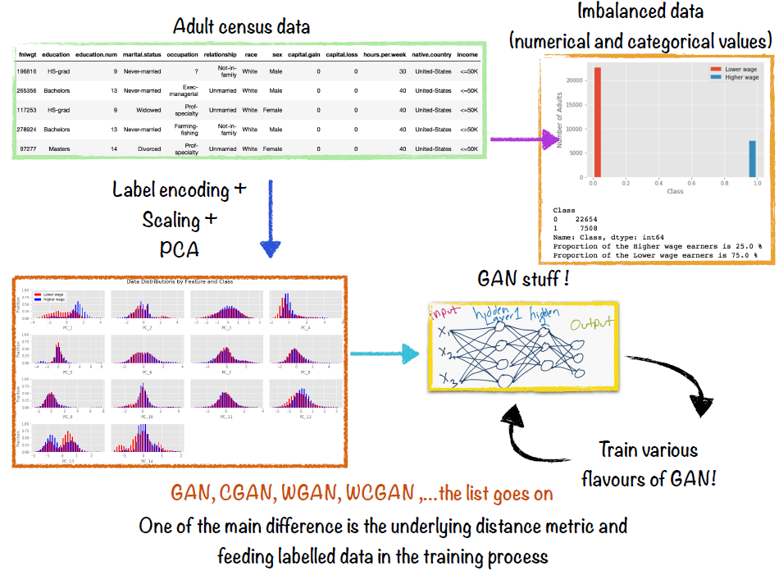
GAN Variations
Notes:
Security environment, access to confidential data, permissions etc.

Slide 6
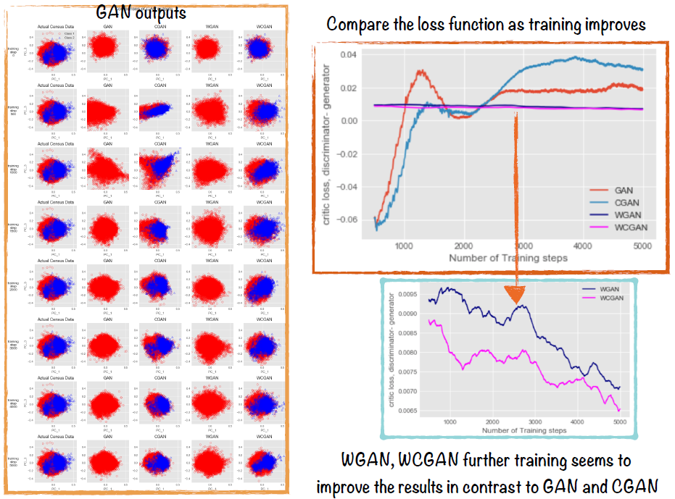
GAN Variations
Notes:
Security environment, access to confidential data, permissions etc.

Slide 7
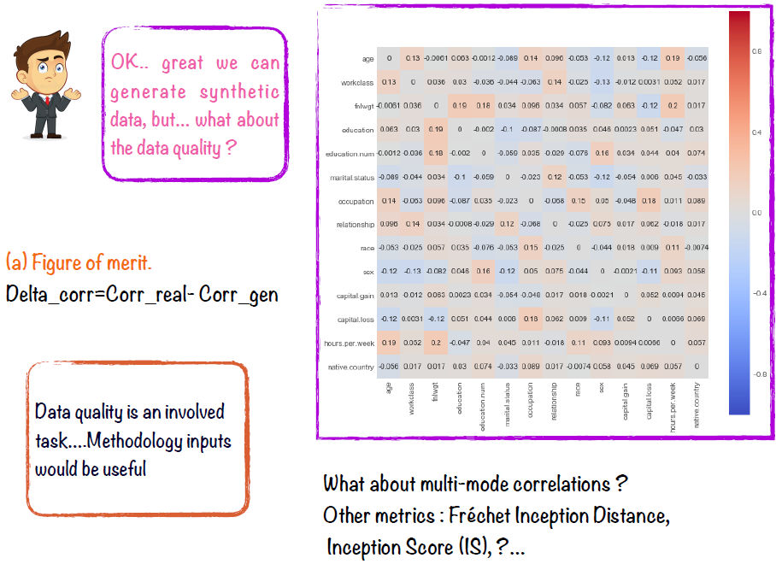
GAN Variations
Notes:
Security environment, access to confidential data, permissions etc.

Slide 8
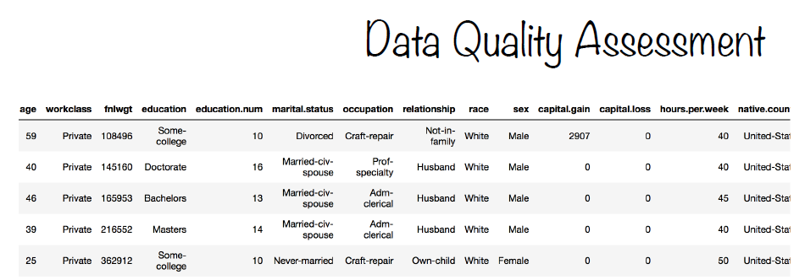
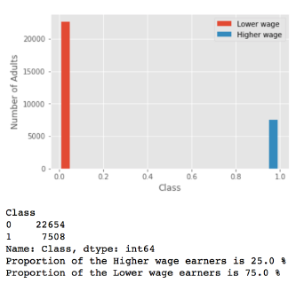
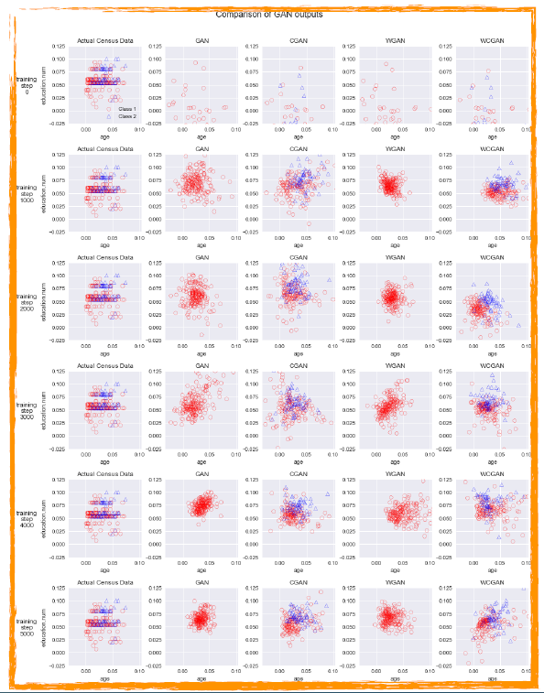
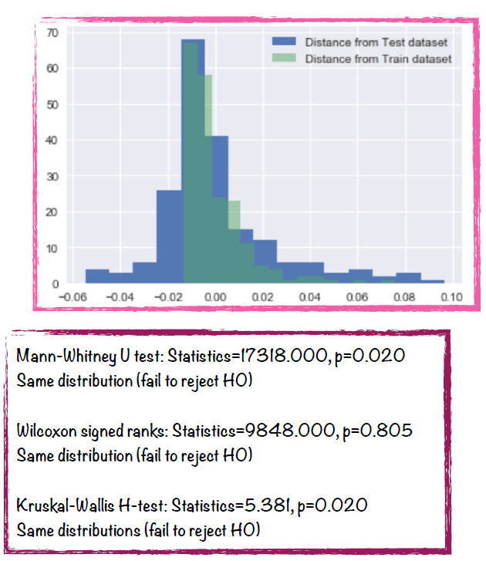
Progress – GAN Variations
Notes:
Security environment, access to confidential data, permissions etc.

Slide 9
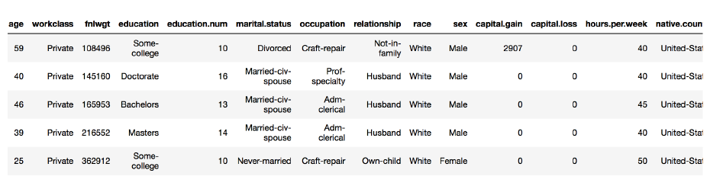
Dataset – US Adult Census
Notes:
Security environment, access to confidential data, permissions etc.

Slide 10
Results – US Adult Census

Slide 11
Next steps
Further evaluation of algorithms and techniques
Standardise quality assessment
Privacy evaluation (with Cardiff University)
Model optimization (with University of Bath, MSc project)
Categorical data
Collaboration with BEIS - National Energy Efficiency Data-framework
Notes:
Security environment, access to confidential data, permissions etc.

