Slide 1
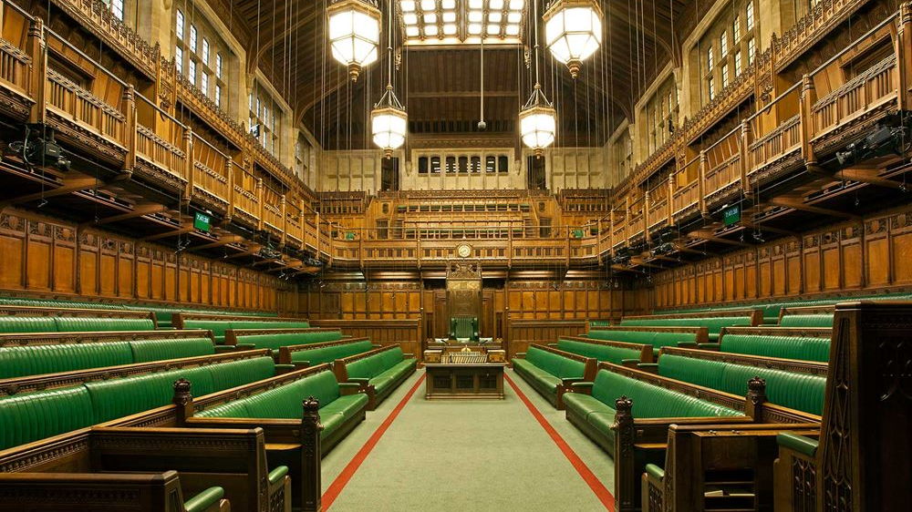
Identifying mentions of ONS in the UK Parliament
Rory Corbett
Senior Corporate Analyst, Corporate MI & Analytics

Slide 2
Initial Objectives
Use data science techniques (NLP) to extract information from Hansard
Identify mentions of ONS/UKSA/OSR in the House of Commons
Group mentions by topic & sentiment
Provide information to Parliamentary team (Millie Tyler) at ONS via interactive dashboard
Notes:
Data Science Accelerator project
Currently developing a prototype -> not ready for production for a while yet

Slide 3
Toggle: Topic/Sentiment
Heading
Filter -- Topic
Filter – Parliament (UK/NI/SCO/WAL)
Filter -- Speaker
Filter -- Week/Year
15
10
11
9
9
7
Count
4
Parliament in recess
04/01/2016
11/01/2016
18/01/2016
25/01/2016
01/02/2016
08/02/2016
15/02/2016
22/02/2016
Context
Topic
id
Speaker
Sentiment
Source (date + location + debate)
Notes:
Sentiment

Slide 4
Toggle: Topic/Sentiment
Heading
Filter -- Topic
Filter – Parliament (UK/NI/SCO/WAL)
Filter -- Speaker
Filter -- Week/Year
15
10
9
11
4
9
7
Count
Environment
Crime
COVID
Parliament in recess
Census
04/01/2016
11/01/2016
18/01/2016
25/01/2016
01/02/2016
08/02/2016
15/02/2016
22/02/2016
Context
Topic
id
Speaker
Sentiment
Source (date + location + debate)
Notes:
Topic

Slide 5
Method
Hansard data
https://parser.theyworkforyou.com/hansard.html
Processing
Data cleaning & preparation in Python
Modelling
ML/rules-based approach using spaCy to produce models to identify sentiment & topic
Dashboard
Provide data to users via interactive dashboard

Slide 6
Longer-term objectives
Productionise dashboard – weekly updates
Include all data from UK Parliament, plus NI Executive, Scottish Parliament & Welsh Senedd
Automatic identification of topics with frequent/infrequent mentions

