Slide 1
First page (copy from T&F slide deck)

Slide 2
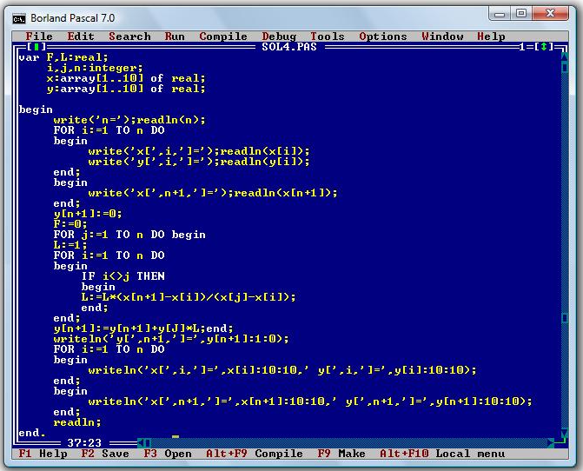
Pascal to Python
2nd page – background: Last time I did any programming was Pascal in school

Slide 3
My project info pt1

Slide 4
My project info pt2

Slide 5
What I leanred:
Git (gitignore + big files)
Debugging & what to search for (problem formulation)
Python - functional programming, spacy
ML - model build & evaluation (rules based turned out better in prototype - monitor going forward)
User engagement early - topic > sentiment

Slide 6
Next steps
Existing project – productionise
Looking at govt policy papers (T&F group)
Interest from other teams for similar work on other datasets
Private sector - board reports/annual reports > do ONS economic stats get mentioned?
OSR -> using hansard data to help with evaluating how stats are used (Michael Hodge). Identifying use of stats in parliament.
Anything with quality of forecasting - still way out at the start and at end of FY find we're fine
Vacancies - creating model that updates with the latest data each month(?)

Slide 7
More technical audience (Graduation event)
rewriting code to be more modular/functional, re-using it
Usage of git

