Slide 1
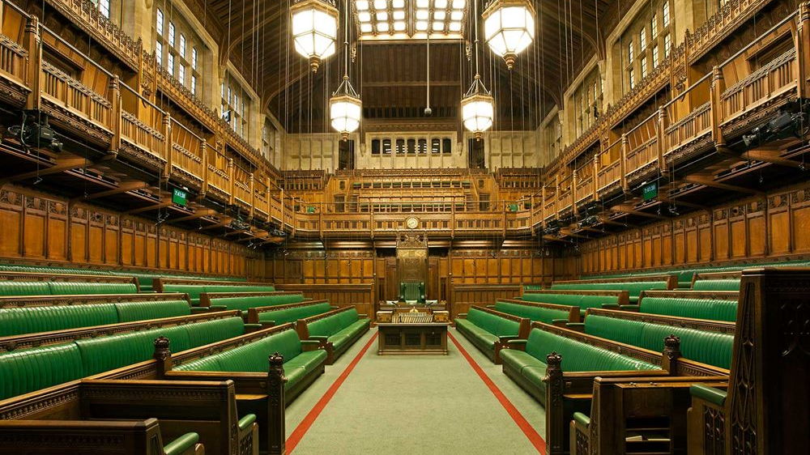
Identifying mentions of ONS in the UK Parliament
Rory Corbett
Senior Corporate Analyst, Corporate MI & Analytics

Slide 2
Initial Objectives
Use data science techniques (NLP) to extract information from Hansard
Identify mentions of ONS/UKSA/OSR in the House of Commons
Group mentions by topic & sentiment
Provide information to Parliamentary team at ONS via interactive dashboard – intended to replace existing paid service

Slide 3
Challenges
Accessing data – overcoming network challenges
Early user engagement – sentiment not very useful
Natural Language Processing – learning & application
Topic classification – designing & evaluating models

Slide 4
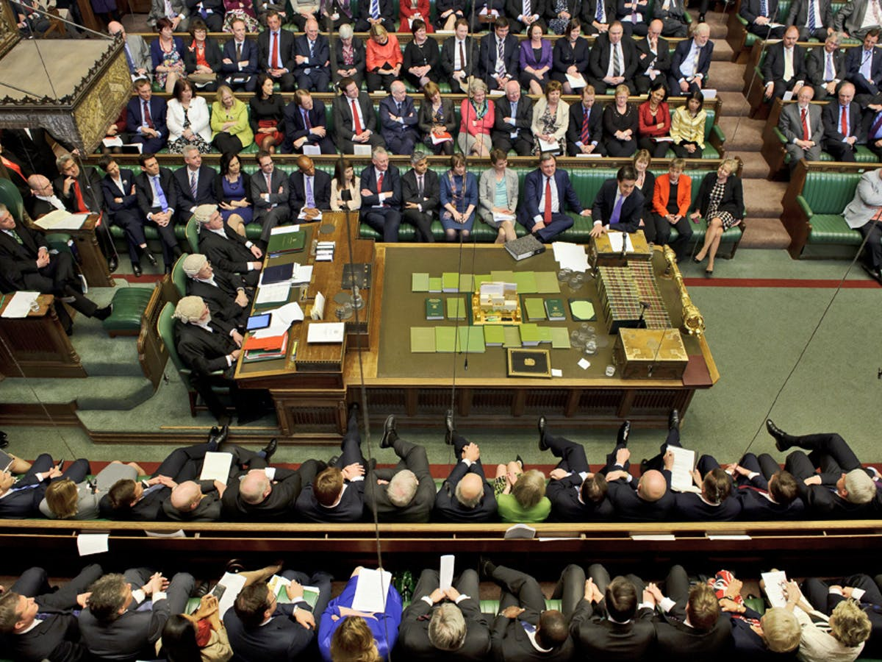

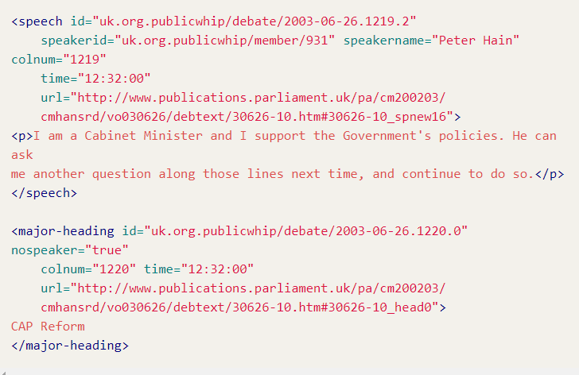
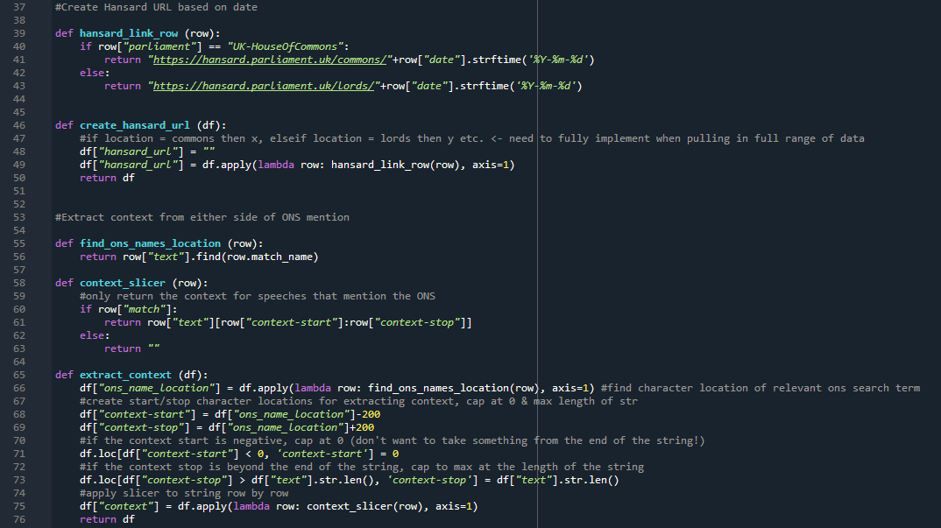
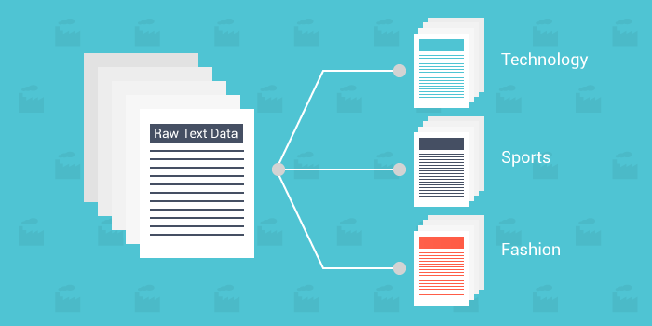

Method
Speech in Parliament
Recorded in Hansard
Speeches converted to XML
Data cleaning/processing
Topic Classification
Dashboard
Notes:
Hansard data
https://parser.theyworkforyou.com/hansard.html
Processing
Data cleaning & preparation in Python
Modelling
ML/rules-based approach using spaCy to produce models to identify topic
Dashboard
Provide data to users via interactive dashboard

Slide 5
Outcome
Show dashboard (5yr summary)
Show graphs
Show BANs (mentions by party, most regular mention-er)
Once fully implemented, saving of c£10k per annum

Slide 6
What I gained – Data science
Data science
Coding
Git
Documentation – reading & writing
NLP
Machine Learning modelling
Evaluating approaches
rules vs ML
False positives, false negatives etc.
- Packages / Languages / Functionality
Pandas, data science functionality
Manipulating DFs
NLP using spacy
Some ML - and when not to use it
Rules based NLP
Automated file downloads & navigating ONS servers / error handling
Notes:
Summarise during talk – learned A LOT. Some key highlights are… (pick out 3?) [prob: documentation / ML exposure / Git]

Slide 7
What I gained – Project management
Project management/user engagement
Wireframing
Identifying user priorities
Trello, sketch out the parts required, user testing, working in the open with users, iterative (or Agile) development, timeline management, identifying prototype scope

Slide 8
What I gained – Contacts
Contacts
ONS (e.g. Mitch in ESG, Michael Hodge in OSR)
Cabinet Office
x-gov data science slack

Slide 9
Next Steps
Productionise dashboard – weekly updates, live data
Include all data from UK Parliament, plus NI Executive, Scottish Parliament & Welsh Senedd
Automatic identification of topics with frequent/infrequent mentions
Looking at govt policy papers (T&F group)
Next steps overall:
What else we could do with DS skills – give examples
X-data gov possibilities for my Hansard work
Other departments may want to copy?
Go to Hansard directly – something they could build in to their site?
Private sector - board reports/annual reports > do ONS economic stats get mentioned?
OSR -> using hansard data to help with evaluating how stats are used (Michael Hodge). Identifying use of stats in parliament.

Slide 10
Applying Data Science techniques to other problems
Interest from other teams for similar work on other datasets
[28/05 16:34] Hanratty, Mathew 1. What are our key stakeholders are talking about? We have been looking at pulling together manual reports on what our key stakeholders are talking about on Twitter (and what's gaining traction), any consultations they have open, any new research released etc. We're expected to track the activity of c.30 organisations and we're struggling to see how we can scale this work. Is there a way we can automate this? There's lots of sources, but it's largely collating stuff in the public domain.
[28/05 16:34] Hanratty, Mathew 2. Contacts. We frequently need to pull together stakeholder lists based on professions/job titles, often within government. LinkedIn is often a great source of information, but a time-consuming task. Is there something we could build to pull together a list of all Permanent Secretaries across government for example?
Anything with quality of forecasting - still way out at the start and at end of FY find we're fine
Vacancies - creating model that updates with the latest data each month(?)

Slide 11
Add some joke about wizards for Rhys!

