Slide 1
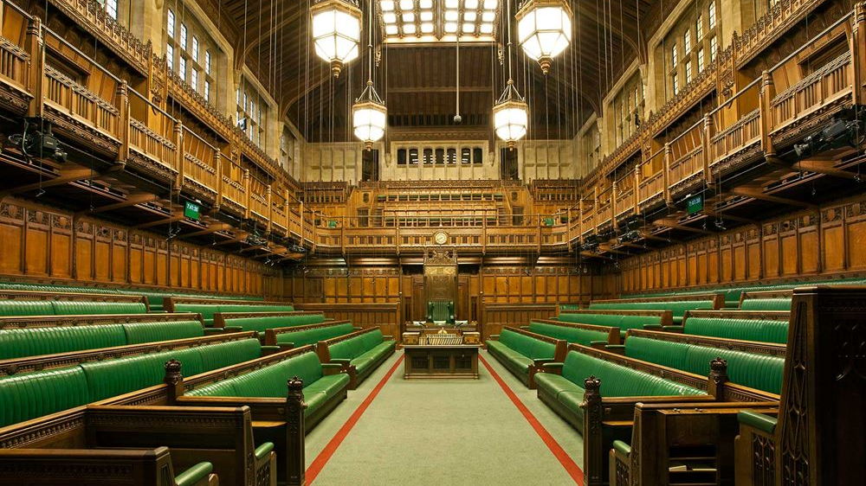
Identifying mentions of ONS in the UK Parliament
Rory Corbett
Senior Corporate Analyst, Corporate MI & Analytics
Notes:
Intro james
3 parts: what I have done, what I learned & what’s next

Slide 2
Initial Objectives
Use data science techniques (NLP) to extract information from Hansard
Identify mentions of ONS/UKSA/OSR in the House of Commons
Group mentions by topic & sentiment
Provide information to Parliamentary team at ONS via interactive dashboard – aiming to replace paid service (c£10k)
Develop my data science skills!

Slide 3
Challenges
Accessing data – overcoming network challenges
Early user engagement – sentiment not very useful
Natural Language Processing – learning & application
Topic classification – designing & evaluating models
Notes:
Need to mention switch to 2015-2019 dataset here! [accessing data issue]

Slide 4
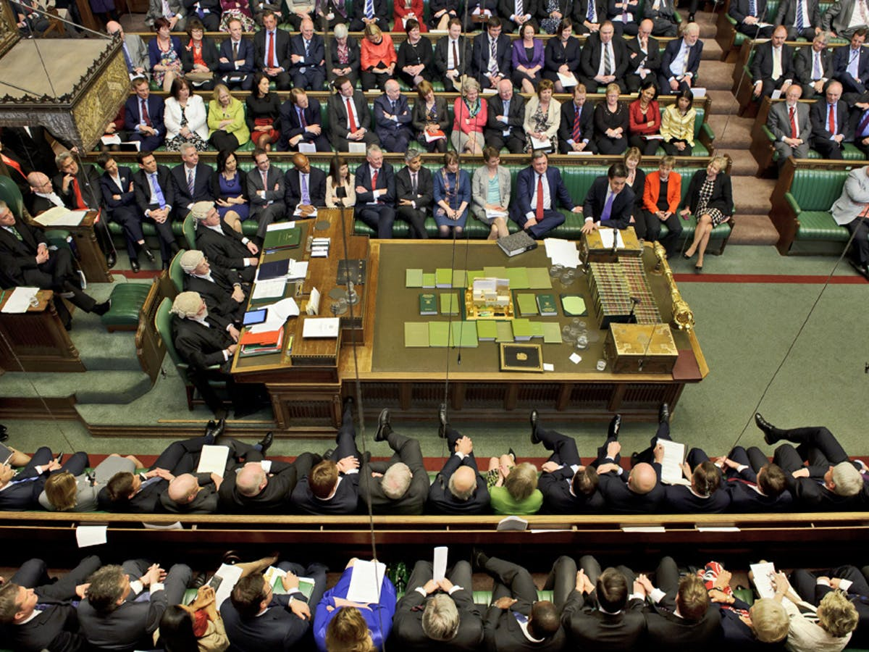

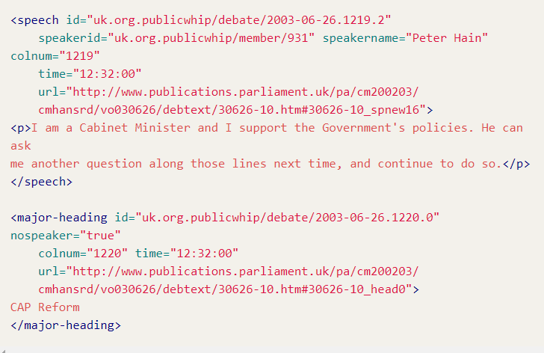
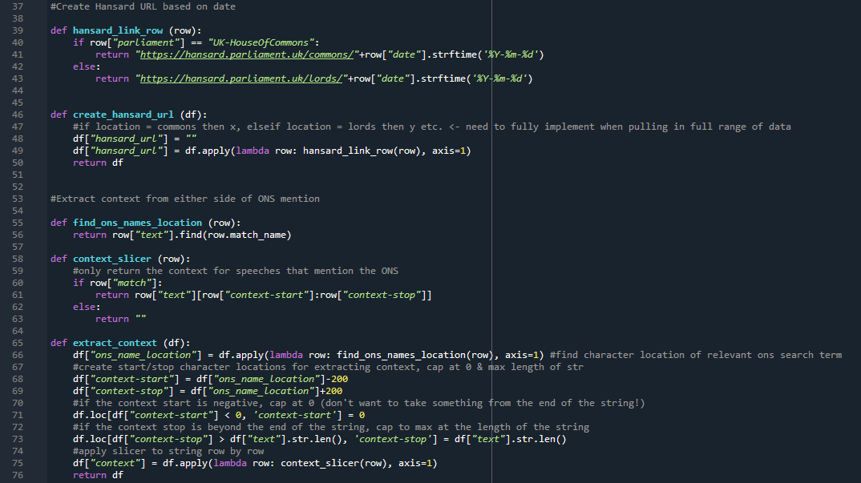


Method
Speech in Parliament
Recorded in Hansard
Speeches converted to XML
Data cleaning/processing
Topic Classification
Dashboard
Notes:
Hansard data
https://parser.theyworkforyou.com/hansard.html
Processing
Data cleaning & preparation in Python
Modelling
ML/rules-based approach using spaCy to produce models to identify topic
Dashboard
Provide data to users via interactive dashboard

Slide 5
Topic Classification
Machine Learning
Rules-based system
Debate titles vs speeches vs both
Evaluation
Further development

Slide 6




Mentions in 2015-2019
UK House of Commons leaderboard
379,963
total speeches
Rt Hon James Brokenshire MP
20
1,008
Speeches mentioned ONS/UKSA/OSR
Sir William Cash MP
12
<0.01%
of speeches mentioned us by name… but use of our statistics likely to be much more frequent
Jack Dromey MP
11
Notes:
- Use of our stats -> link to OSR connection that will cover later

Slide 7
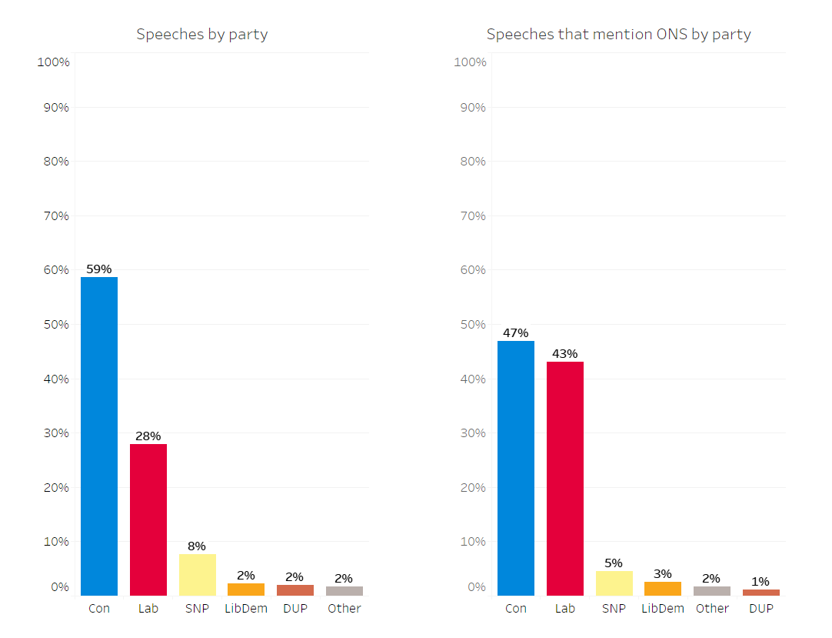
Mentions by party
Conservatives dominated debate in the 2015-2019 period…
…but mentions of ONS were not distributed equally across the parties.
A Labour MP was much more likely to mention us in their speech than an MP from any other party.

Slide 8
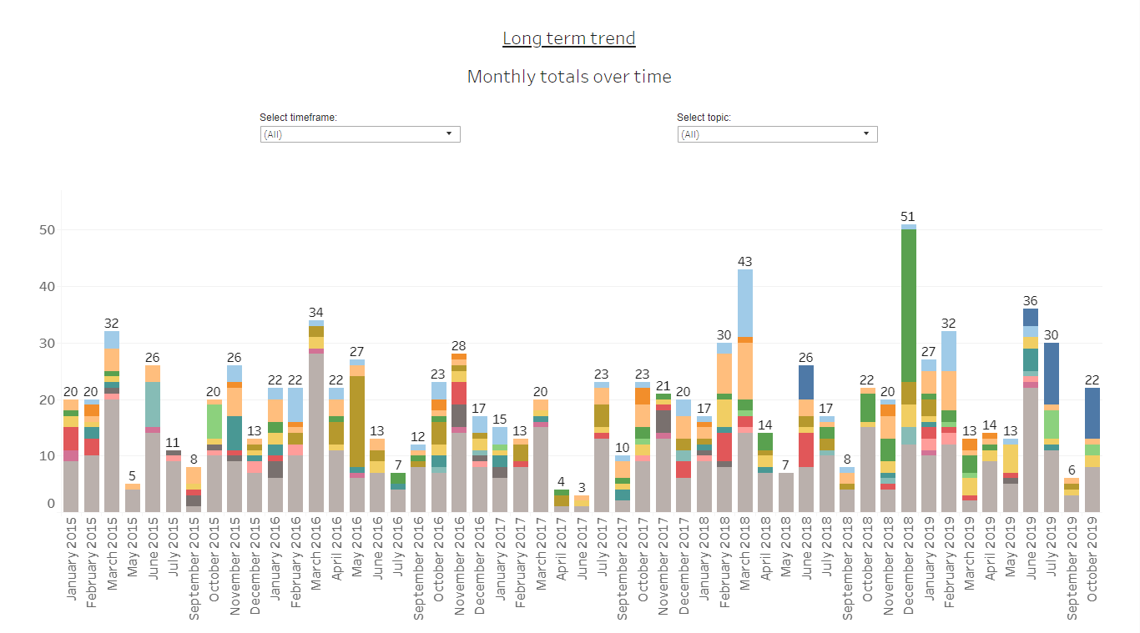
Dashboard
Prototype dashboard
View by topic
View by MP
Long-term trend
Notes:
Dec 2018 – green = ONS decision on student loan statistics
Dark blue = census – first shows up in late 2018, gets more frequent as census approaches
Light blue = crime
Light orange = economy
Both fairly frequent.

Slide 9
What I learned
Data science
Coding, incl. experience with plenty of Python packages
Git
Documentation – reading & writing
Web scraping, automating file downloads & dealing with ONS network
NLP with spaCy
Rules based NLP
Machine Learning modelling
Evaluating approaches
rules vs ML
Recall & Precision (False positives, false negatives etc.)
Notes:
Data science
Summarise during talk – learned A LOT. Some key highlights are… (pick out 3?) [prob: documentation / ML exposure & evaluation / Git]

Slide 10
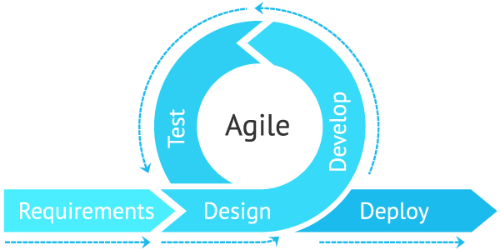
What I learned
Project management
Using GitHub to manage a Data Science project
Further experience with Agile development practices
Asynchronous working
Scoping realistic aims for prototype
Importance of early user engagement
Wireframing product very early on
Identifying user priorities
User testing & working in the open with users
Notes:
Project mgmt.
Contacts:
Key contacts in ONS/OSR (e.g. Mitch & Michael)
X-gov data science Slack
DSA cohort
Cabinet Office (James!)

Slide 11
What next?
Productionise dashboard – weekly updates, live data
Include all data from UK Parliament, then add in NI Executive, Scottish Parliament & Welsh Senedd
Automatic identification of topics with frequent/infrequent mentions
Link up with OSR to look at how we might evaluate how our stats are used in parliament
Expand approach to include govt policy papers
X-gov possibilities
Could be adapted to suit other government departments
Evaluating use of our economic stats in private sector - board reports/annual reports

Slide 12
Applying Data Science techniques to other corporate data problems
Interest from other teams for similar NLP work on other datasets
External Affairs
Monitoring what key stakeholders are talking about – collating information in public domain (e.g. Twitter, public consultations)
Scraping LinkedIn to identify stakeholders across government
Finance team
Improving quality of financial forecasting – ML approach could be useful here
Forecasting vacancies – opportunity for development of model that utilises most recent data

Slide 13
Questions?
Notes:
Say thank you for listening here!

