Slide 1
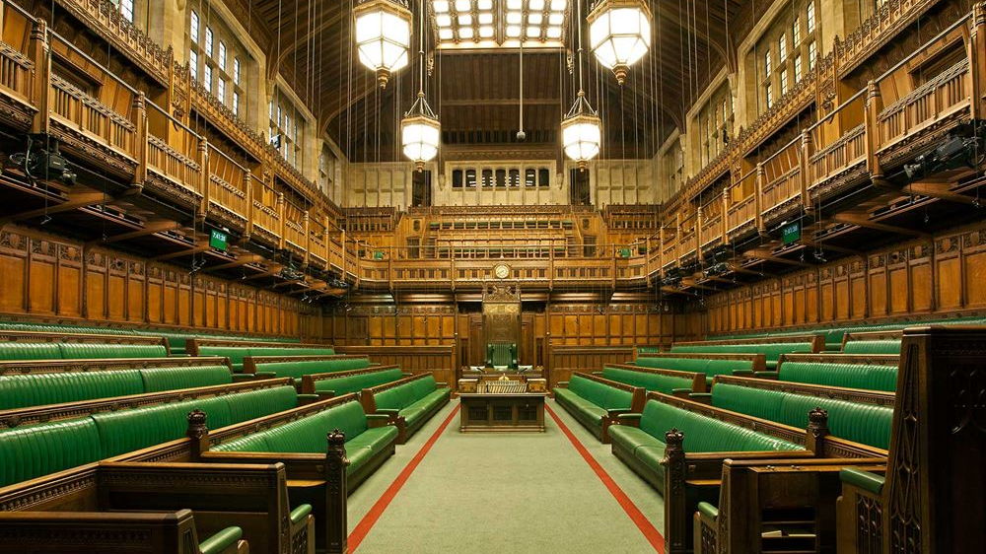
Identifying mentions of ONS in the UK Parliament
Rory Corbett
Senior Corporate Analyst, Corporate MI & Analytics, ONS
Notes:
Intro james
3 parts: what I have done, what I learned & what’s next
background: parliamentary team & strategic need for impact MI

Slide 2
Initial Objectives
Use NLP to extract information from Hansard
Identify mentions of ONS/UKSA/OSR in the House of Commons
Group mentions by topic & sentiment
Provide information to Parliamentary team at ONS via interactive dashboard – aiming to replace paid service
Develop my data science skills!

Slide 3
Challenges
Accessing data – overcoming network difficulties
Early user engagement – sentiment not very useful
Natural Language Processing – learning & application
Topic classification – designing & evaluating models
Notes:
Need to mention switch to 2015-2019 dataset here! [accessing data issue]

Slide 4
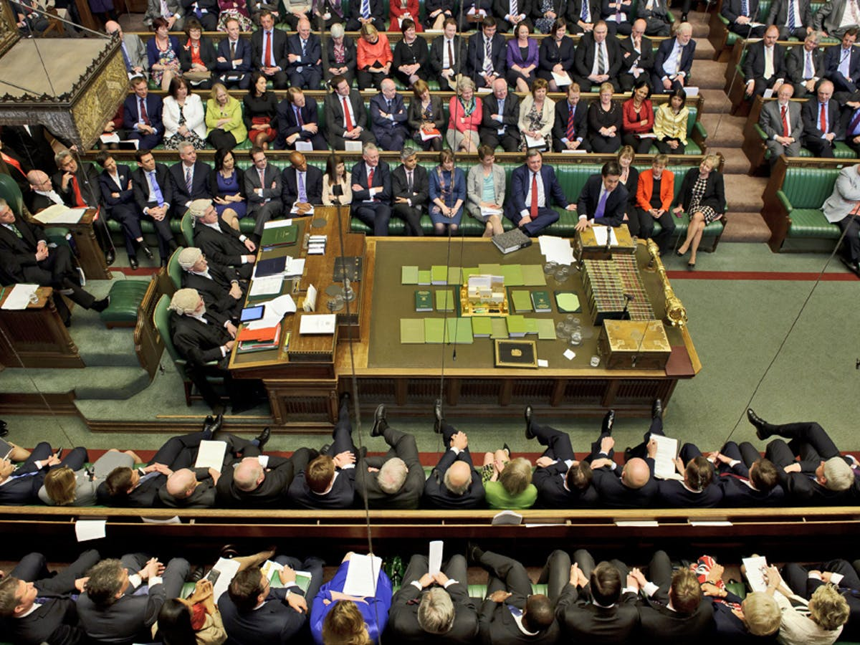

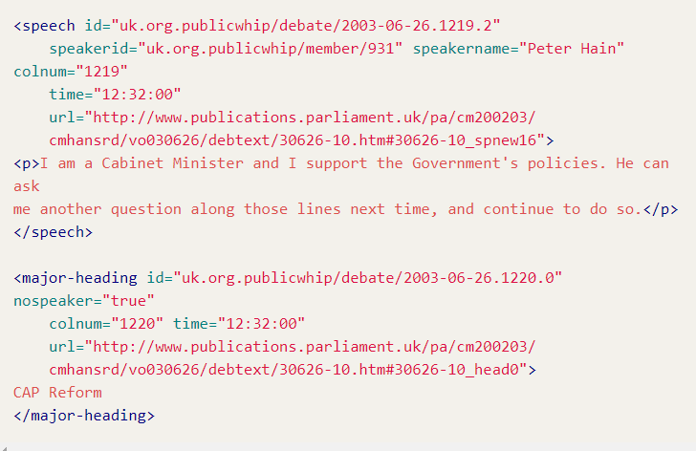
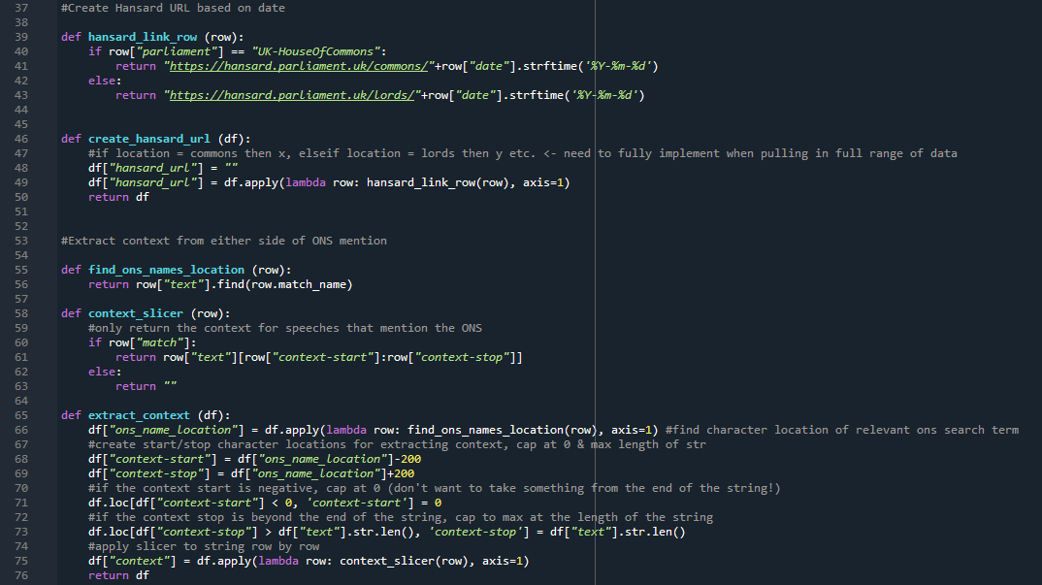


Method
Speech in Parliament
Recorded in Hansard
Speeches converted to XML
Data cleaning/processing
Topic Classification
Dashboard
Notes:
Hansard data
https://parser.theyworkforyou.com/hansard.html
Processing
Data cleaning & preparation in Python
Modelling
ML/rules-based approach using spaCy to produce models to identify topic
Dashboard
Provide data to users via interactive dashboard

Slide 5
Topic Classification
Machine Learning
Rules-based system
Debate titles vs speeches vs both
Evaluation
Further development
Notes:
- Supervised ML model > defined target topics

Slide 6
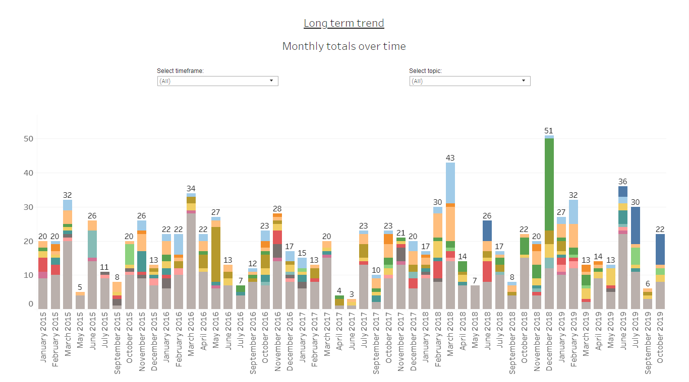
Dashboard
Prototype dashboard
View by topic
View by MP
Long-term trend
Notes:
Dec 2018 – green = ONS decision on student loan statistics
Dark blue = census – first shows up in late 2018, gets more frequent as census approaches
Light blue = crime
Light orange = economy
Both fairly frequent.

Slide 7
What I learned
Data science
Coding, incl. experience with plenty of Python packages, modular code
Debugging + problem formulation
Git
Documentation – reading & writing
Web scraping, automating file downloads & dealing with ONS network
NLP with spaCy
Rules based NLP
Machine Learning modelling
Evaluating approaches
rules vs ML
Recall & Precision (False positives, false negatives etc.)
Notes:
Data science
Summarise during talk – learned A LOT. Some key highlights are… (pick out 3?) [prob: documentation / ML exposure & evaluation / Git]
Link to Daniel’s talk – how to conceptualise issues, James helped a lot with this

Slide 8
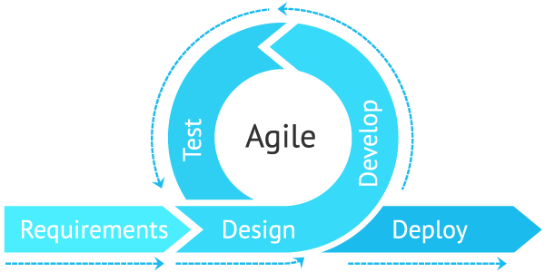
What I learned
Project management
Using GitHub to manage a Data Science project
Further experience with Agile development practices
Asynchronous working
Scoping realistic aims for prototype
Importance of early user engagement
Wireframing product very early on
Identifying user priorities
User testing & working in the open with users
Notes:
Project mgmt.
Contacts:
Key contacts in ONS/OSR (e.g. Mitch & Michael)
X-gov data science Slack
DSA cohort
Cabinet Office (James!)

Slide 9
What next?
Productionise dashboard – weekly updates, live data
Include all data from UK Parliament, then add in NI Executive, Scottish Parliament & Welsh Senedd
Automatic identification of topics with frequent/infrequent mentions
Link up with OSR to look at how we might evaluate how our stats are used in Parliament
Expand approach to include govt policy papers
X-gov possibilities
Could be adapted to suit other government departments

