Slide 1



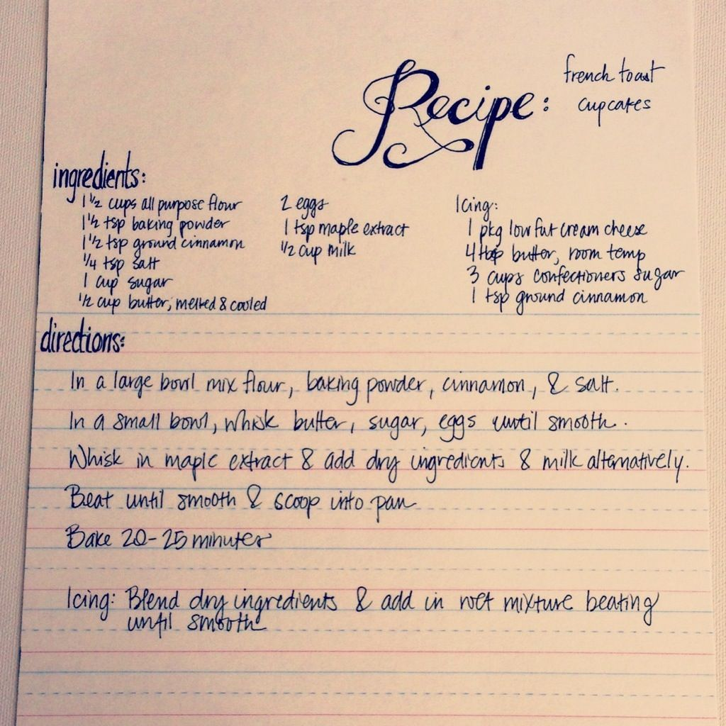
CRAN
library
package
function

Slide 2
CRAN
Comprehensive R Archive Network
- R equivalent of British Library or Library of Congress
Contains all packages
Contains all versions of R
Install package once from CRAN to local library.

Slide 3
library
Where packages from CRAN are locally stored on your computer.
Load packages into your workspace using:
library(package_name)
library(package_name, dependencies = TRUE)

Slide 4
package
function
A package is essentially a book of functions (recipes).
Functions take arguments (ingredients) and are made up of a list of instructions.

Slide 5
CRAN
Install package once →
library
Load from library→
package
Call from package →
function

