Slide 1
DATA STRUCTRES:
ARRAYS

Slide 2
01
An array is a linear data structure that collects elements of the same data type and stores them in contiguous and adjacent memory locations. Arrays work on an index system starting from 0 to (n-1), where n is the size of the array.
For example, int student[30];
Here, student is an array name holds 30 collection of data item, with a single variable name
WHAT IS AN ARRAY?

Slide 3
02
An array is always stored in consecutive memory location.
It can store multiple value of similar type, which can be referred with single name.
The pointer points to the first location of memory block, which is allocated to the array name.
An array can either be an integer, character, or float data type that can be initialised only during the declaration.
The particular element of an array can be modified separately without changing the other elements.
All elements of an array can be distinguishing with the help of index number.
CHARACTERISTICS

Slide 4
03
Let's suppose a class consists of ten students, and the class has to publish their results. If you had declared all ten variables individually, it would be challenging to manipulate and maintain the data.
If more students were to join, it would become more difficult to declare all the variables and keep track of it. To overcome this problem, arrays came into the picture.
WHY DO WE NEED ARRAYS OVER DATA STRUCTURES ?

Slide 5
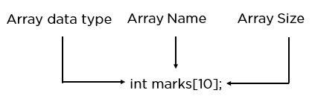
04
Arrays are typically defined with square brackets with the size of the arrays as its argument.
Here is the syntax for arrays:
1D Arrays: int arr[n];
2D Arrays: int arr[m][n];
3D Arrays: int arr[m][n][o];
DECLARING AN ARRAY

Slide 6
05
Method 2:
int n;
scanf(“%d”,&n);
int arr[n];
for(int i=0;i<5;i++)
{
scanf(“%d”,&arr[i]);
}
Method 1:
int a[6] = {2, 3, 5, 7, 11, 13};
INITIALISING AN ARRAY

Slide 7
06
Method 4:
int arr[5];
arr[0]=1;
arr[1]=2;
arr[2]=3;
arr[3]=4;
arr[4]=5;
Method 3:
int arr[]= {2, 3, 5, 7, 11};
INITIALISING AN ARRAY

Slide 8
07
Traversal of an array refers to the process of visiting OR accessing each element of an array one by one. This is a fundamental operation when working with arrays in programming, and there are several common methods to traverse an array, depending on the programming language you are using. In C++, you can traverse an array using various methods, including for loops, while loops, and recursion.
Algorithm:
Initialize a loop variable i to 0.
Iterate through the array using a loop that continues until i is less than the length of the array.
Within the loop, access and operate on the element at index i.
Increment i by 1 in each iteration.
Continue the loop until i is equal to or greater than the length of the array.
TRAVERSING IN ARRAYS

Slide 9
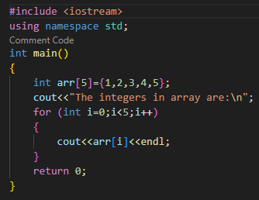
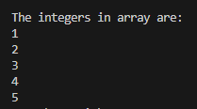
08
OUTPUT:
TRAVERSING IN ARRAYS

Slide 10
09
This operation is performed to insert one or more elements into the array. As per the requirements, an element can be added at the beginning, end, or at any index of the array. Now, let's see the implementation of inserting an element into the array.
ALGORITHM:
Specify the index at which you want to insert the new element (insertIndex) and the value you want to insert (value).
Create a loop that starts from the end of the array and moves towards the beginning until reaching the insertIndex.
In each iteration of the loop:
Shift the element at the current index one position to the right (i.e., move it to the next index).
Once the loop reaches the insertIndex, assign the value to the element at that index
INSERTION IN ARRAYS

Slide 11
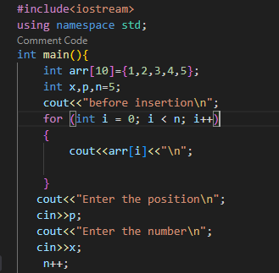
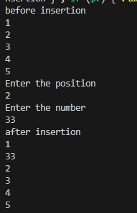
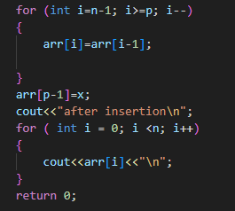
10
OUTPUT:
INSERTION IN ARRAYS

Slide 12
11
As the name implies, this operation removes an element from the array and then reorganizes all of the array elements.
To delete elements from an array in C++, you typically have two common scenarios: deleting an element at a specific position (index) and deleting elements that match a certain value.
ALGORITHM:
Specify the index of the element you want to delete (deleteIndex).
Create a loop that starts from deleteIndex and moves towards the end of the array.
In each iteration of the loop:
Replace the element at the current index with the element at the next index (shift elements to the left).
Decrement the length of the array to effectively "remove" the last element, which is now a duplicate of the second-to-last element.
DELETION IN ARRAYS

Slide 13
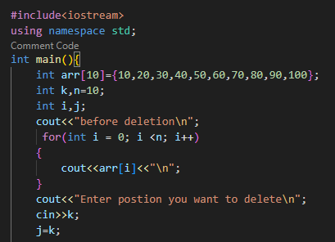
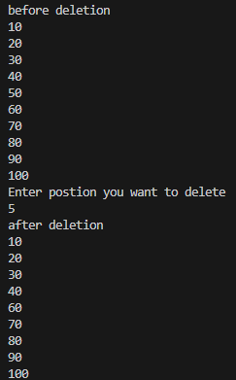
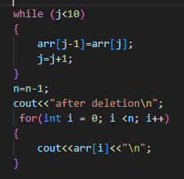
12
OUTPUT:
DELETION IN ARRAYS

Slide 14
13
Searching an array means to find a particular element in the array. The search can be used to return the position of the element or check if it exists in the array.Searching in data-structure refers to the process of finding a desired element in set of items. The desired element is called "target".
ALGORITHM:
Specify the element you want to search for (target).
Create a loop that iterates through the array from the beginning to the end.
In each iteration of the loop:
Check if the current element is equal to the target.
If it is, return the index at which the element was found (currentIndex).
If the loop completes without finding the target, return a value (e.g., -1) to indicate that the element was not found.
SEARCHING IN ARRAYS

Slide 15
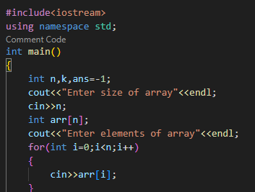
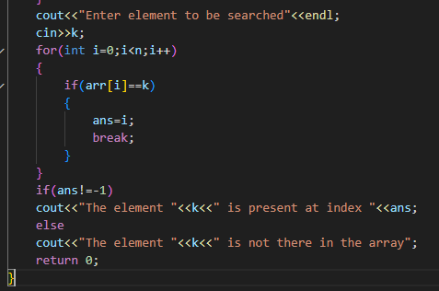
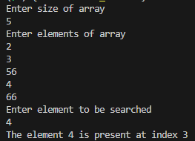
14
OUTPUT:
SEARCHING IN ARRAYS

Slide 16
15
The process of updating (modifying/changing) an existing element of an array at a specified index with another element is called updating an array or update operation in array.
ALGORITHM:
Specify the index of the element you want to update (updateIndex) and the new value you want to replace it with (newValue).
Check if the updateIndex is within the valid bounds of the array (i.e., greater than or equal to 0 and less than the length of the array).
If the updateIndex is valid:
Assign the newValue to the element at index updateIndex.
UPDATION IN ARRAYS

Slide 17
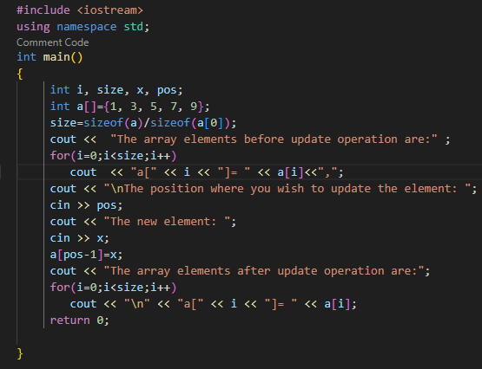
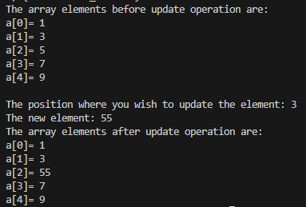
16
OUTPUT:
UPDATION IN ARRAYS

Slide 18
17
Arrays are fundamental data structures in computer programming and have a wide range of applications across various fields. Here are some common applications of arrays:
1. Data Storage: Arrays are used to store collections of data of the same type. For example, you might use an array to store a list of integers, characters, or strings.
2. Lists and Sequences: Arrays can be used to implement dynamic lists or sequences, where elements can be added or removed as needed. This is often done using dynamic arrays or ArrayLists in languages like C++ and Java.
3. Matrices and Grids: Arrays can represent multi-dimensional data structures like matrices or grids. This is particularly useful in mathematics, computer graphics, and scientific computing.
APPLICATIONS OF ARRAYS

Slide 19
18
4. Searching and Sorting: Arrays are commonly used for implementing search and sorting algorithms. For example, linear search and binary search work with arrays to find specific elements efficiently
5. Dynamic Memory Allocation: Arrays are used as the underlying data structure for dynamic memory allocation in languages like C and C++. They allow you to allocate memory for a collection of elements at runtime.
6. Games and Graphics: Arrays are crucial in computer graphics and game development. They are used to represent objects, vertices, textures, and more.
APPLICATIONS OF ARRAYS

Slide 20
19
A 2D array, short for two-dimensional array, is a fundamental data structure that organizes elements into a grid-like fashion with rows and columns. It can be thought of as an array of arrays, where each element in the outer array points to another array, creating a matrix-like structure. 2D arrays are widely used in programming to represent data that has a natural two-dimensional structure, such as matrices, tables, and images. They provide a convenient way to store and manipulate grid-based data, making them an essential concept in computer science and software development.
2D ARRAYS

Slide 21
20
A 2D array is like a grid with rows and columns. We use nested loops to systematically initialize each element in the 2D array.You can set initial values for elements based on your application's requirements, whether it's filling the array with zeros, specific values, or computed values.
ALGORITHM:
Decide on the dimensions of the 2D array, i.e., the number of rows and columns (numRows and numCols).
Create a nested loop structure to iterate through each row and column of the 2D array:
The outer loop (with variable i) iterates through rows, from 0 to numRows (exclusive).
The inner loop (with variable j) iterates through columns, from 0 to numCols (exclusive).
INITIALIZING 2D ARRAYS

Slide 22
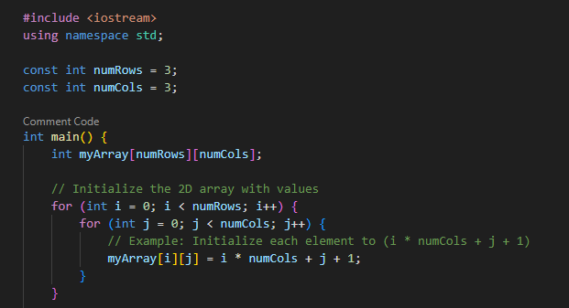
21
Within the nested loop, assign initial values to the elements based on your requirements.
Increment the j loop variable (column) in each iteration of the inner loop.
After finishing the inner loop (column initialization), increment the i loop variable (row) and reset j to 0 to move to the next row.
Continue the nested loop until i reaches numRows, indicating that you've initialized the entire 2D array.
INITIALIZING 2D ARRAYS

Slide 23
22
Traversing a 2D array involves systematically iterating through its rows and columns to access and process each element, enabling operations like printing, searching, or manipulation. It typically requires nested loops for row and column traversal.
ALGORITHM:
Initialize two loop variables, i for rows and j for columns, to 0.
Start a nested loop that iterates through the 2D array:
The outer loop (with variable i) iterates through rows, from 0 to the number of rows (exclusive).
The inner loop (with variable j) iterates through columns, from 0 to the number of columns (exclusive).
TRAVERSAL IN 2D ARRAYS

Slide 24
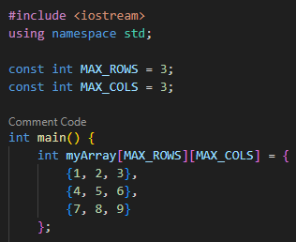
23
Within the nested loop, access and operate on the element at row i and column j.
Increment the j loop variable (column) in each iteration of the inner loop.
After finishing the inner loop (column traversal), increment the i loop variable (row) and reset j to 0 to move to the next row.
Continue the nested loop until i reaches the number of rows, indicating that you've traversed the entire 2D array.
TRAVERSAL IN 2D ARRAYS

Slide 25
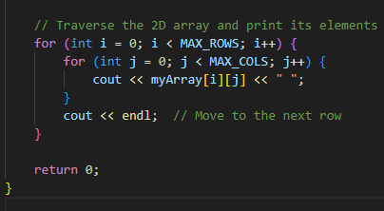

24
OUTPUT:
TRAVERSAL IN 2D ARRAY

Slide 26
25
To insert an element into a 2D array, you need to specify the row and column where you want to insert the element.
You can shift the existing elements to make room for the new element.
ALGORITHM:
insert_element function takes the 2D array arr, row and column indices (row, col), and the value to be inserted.
It checks if the specified position is valid within the array bounds.
If the position is valid, it inserts the value into the specified location using the insert method of the row.
If the position is invalid, it returns False.
INSERTION IN 2D ARRAY

Slide 27
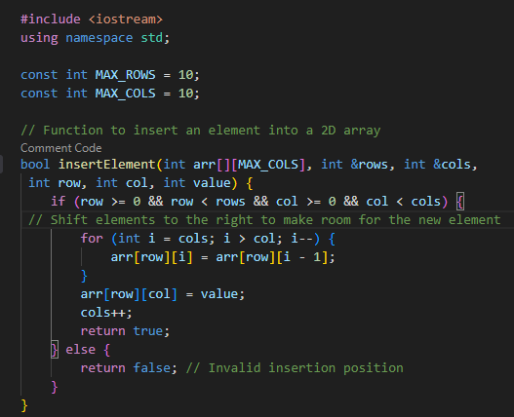
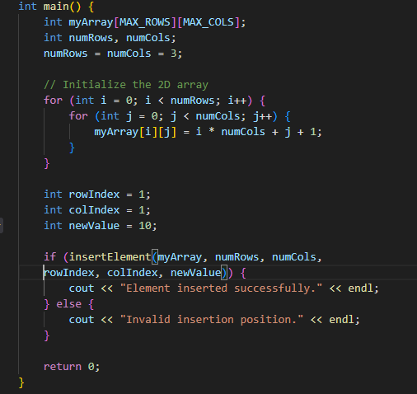
26
INSERTION IN 2D ARRAY

Slide 28
27
Deletion in a 2D array involves removing an element from a specified position.
After deletion, you may need to shift the remaining elements to fill the gap.
ALGORITHM:
We define a function deleteElement that takes the 2D array, the number of rows and columns, the row and column of the value to delete.
It checks if the specified position is valid and then shifts elements to the left to fill the gap created by the deletion.
Finally, it decrements the number of columns.
DELETION IN 2D ARRAY

Slide 29
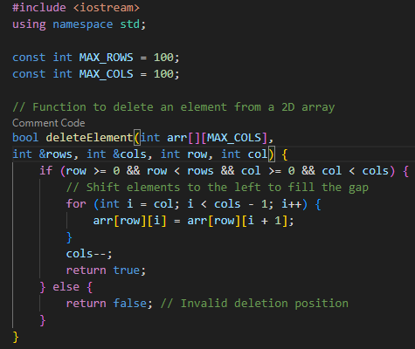
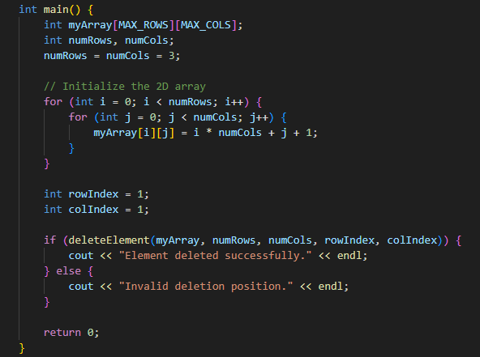
28
DELETION IN 2D ARRAY

Slide 30
29
Searching in a 2D array involves finding whether a particular element exists in the array.
You typically need to iterate through the array and compare each element with the target value.
ALGORITHM:
We define a function searchElement that takes the 2D array, the number of rows and columns, and the target value to search for.
It iterates through the array, comparing each element with the target.
If it finds the target, it returns a pair containing the row and column indices.
If the target is not found, it returns a pair with (-1, -1).
SEARCHING IN 2D ARRAY

Slide 31
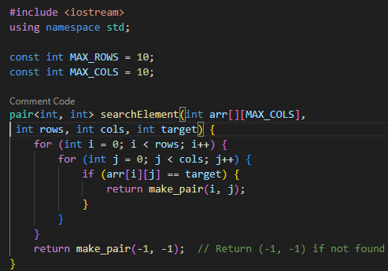
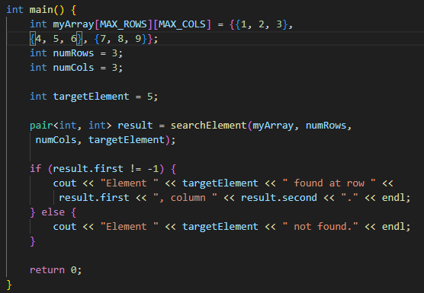
30
SEARCHING IN 2D ARRAY

Slide 32
31
Image Processing: Representing and manipulating images as grids of pixels.
Graphics and Games: Creating game sprites, tiles, and maps.
Data Tables: Storing and analyzing data in tables/spreadsheets.
Grids and Maps: Representing geographical information.
Puzzle Solvers: Solving puzzles like Sudoku.
Board Games: Representing game boards (chess, tic-tac-toe).
Matrices in Math: Solving linear equations and transformations.
Computer Vision: Analyzing and processing image data.
Terrain Modeling: Creating 3D terrain models.
Heatmaps: Visualizing data density or intensity.
Cellular Automata: Simulating dynamic systems.
Sparse Matrices: Efficiently storing sparse data.
APPLICATIONS OF ARRAYS

Slide 33

thank you!

