Slide 1
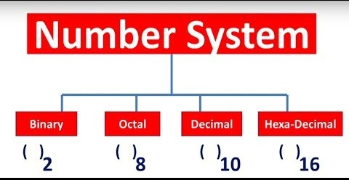
Conversion Number System

Slide 2
Decimal Number System
Decimal number system is a base 10 number system having 10 digits from 0 to 9. This means that any numerical quantity can be represented using these 10 digits. Decimal number system is also a positional value system.
Example– 734, 971 and 207. The value of 7 in all three numbers is different−
In 734, value of 7 is 7 hundreds or 700 or 7 × 100 or 7 × 10²
In 971, value of 7 is 7 tens or 70 or 7 × 10 or 7 × 10¹
In 207, value 0f 7 is 7 units or 7 or 7 × 1 or 7 × 10⁰

Slide 3

Decimal Number System
734
10 is the Base Number.
0, 1 and 2 are the Exponents.
Hundreds | Tens | ones
7 | 3 | 4
10^2 | 10^1 | 10^0

Slide 4
Binary Number System
The easiest way to vary instructions through electric signals is two-state system – on and off. On is represented as 1 and off as 0, though 0 is not actually no signal but signal at a lower voltage. The number system having just these two digits – 0 and 1 – is called binary number system.

Slide 5

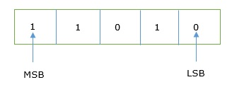
Binary Number System
Each binary digit is also called a bit.
The rightmost digit is called least significant bit (LSB) and leftmost digit is called most significant bit (MSB).

Slide 6
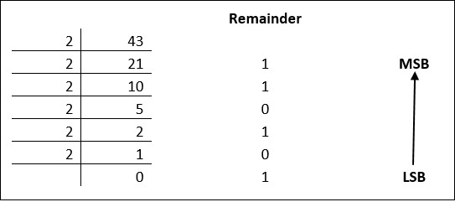
Conversion of Decimal to Binary Numbers
The remainders are to be read from bottom to top to obtain the binary equivalent.
43₁₀ = 101011₂

Slide 7
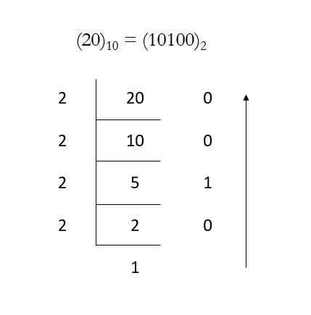
Conversion of Decimal to Binary Numbers

Slide 8
Conversion of Negative Decimal to Binary Numbers
-10
Binary 10 0 0 0 0 1 0 1 0
1’s Complement 1 1 1 1 0 1 0 1 (change 1 to 0 and 0 to 1)
2’s Complement 1 1 1 1 0 1 0 1 (add 1 to 1’s complement) + 1
1 1 1 1 0 1 1 0

