Slide 1

(Open Computer Vision)

Slide 2
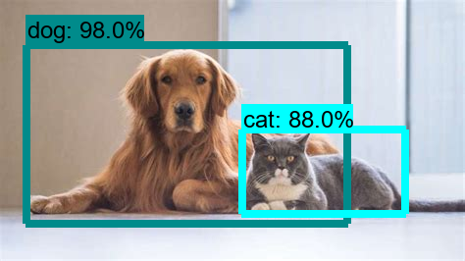

Slide 3
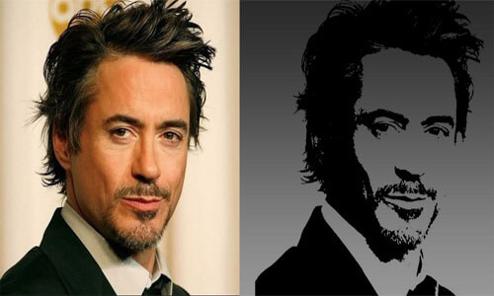

Slide 4
