Slide 1
R/Shiny Tax Project
Simple tax planning and analysis
Author: Long nguyen

Slide 2
About me
Currently enrolled in Master of Software Development online program at Boston University (expected graduation Sep 2019).
Corporate Tax Auditor for the Wisconsin Department of Revenue for almost 5 years.
Professional licenses: CMA, CPA, and CFA (level 1).
My website: https://adatascientist-cpa.com/about/

Slide 3
Agenda
Introduction about Shiny
Go over UI and Server codes
Introduction about Shiny modules
Introduction about app deployment options
App components
Demonstration

Slide 4
Introduction about Shiny
Shiny is an R package that allowed user to build interactive web apps.
There are two main parts of a Shiny app:
User Interface (UI)
Server
A single page web app can be built with both UI and server code in a single file ‘app.R’
Website: https://shiny.rstudio.com/
Install package (‘shiny’), runExample

Slide 5
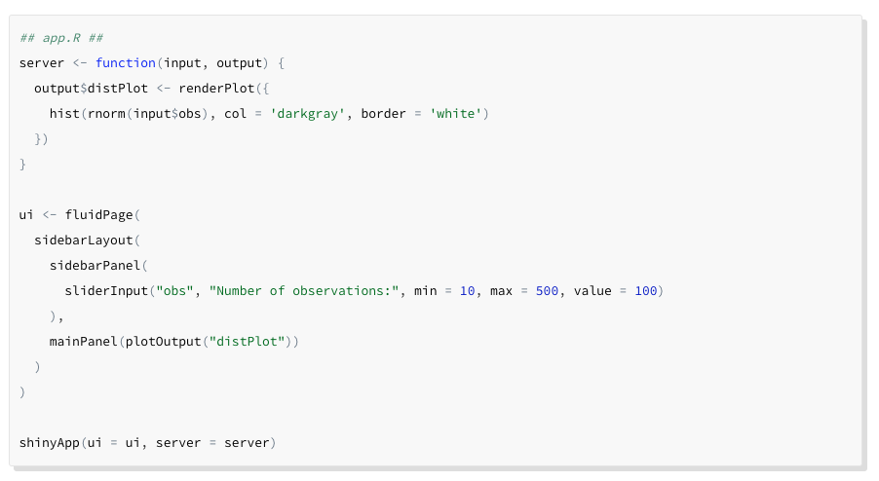
Introduction about Shiny

Slide 6
UI Codes
Include 3 main components:
UI Layout: Examples are: mainPanel, navListPanel, tabPanel, etc.
UI Inputs: Interactive element such as textInput, numericInput, sliderInput
UI Outputs: Display output of your application. Examples are: tableOutput, plotOutput.
List of UI components: https://shiny.rstudio.com/reference/shiny/1.2.0/
Watch out for comma when working with UI components

Slide 7
Server Codes
Use ‘input$UI_Input_Name’ to access to UI Input value.
UI input values can be accessed only from:
Reactive expression
Reactive observe
Rendering function
Use ‘output$UI_Output_Name’ to access to UI Output.

Slide 8
Modules
Often use to build larger Shiny application.
Shiny module is written similar to Shiny app with both UI & Server codes.
Shiny module cannot be run directly.
Include module in the main app by calling: ‘source(“moduleName.R”)’ and include a callModule() in the server codes.
Reference: https://shiny.rstudio.com/articles/modules.html

Slide 9
App Deployment
Several options:
Shinyapps.io – really simple process.
https://www.shinyapps.io/
Shiny Server Open Source
Shiny Server
Deploy app using AWS(Free):
https://www.charlesbordet.com/en/shiny-aws-2/
https://deanattali.com/2015/05/09/setup-rstudio-shiny-server-digital-ocean/

Slide 10
App Components
app.R: Main component
Modules:
Instructions.R
filingStatus.R
income.R
Deductions.R
Credits.R
Functions:
incomeTaxCalculation.R – This is the main function that used to calculate income tax.
deductionCalculation.R – help main function calculates all deductions.
creditCalculation.R – help main function calculates credits
Data:
TaxRates.xls – Contains data used to compute taxes, credits, and deductions.

Slide 11
App Demonstration
Shinyapps.io: https://longnguyen.shinyapps.io/R_TaxProject/
AWS link: R_TaxProject
Source code: https://github.com/datasciencecpa/R_TaxProject

Slide 12
Resources & References
Shiny Tutorials: https://shiny.rstudio.com/tutorial/
R-Shiny Cheat sheet: https://shiny.rstudio.com/images/shiny-cheatsheet.pdf

Slide 13
Questions
R/Shiny Question: Free
Tax Question: CPA Fee (JK)
Contact me at:
nguyenhlongvn@gmail.com
https://adatascientist-cpa.com/
https://www.linkedin.com/in/longnguyen87/

