Slide 1
Tax Analysis 2018
Tax Calculation with R/Shiny
Author: Long Nguyen

Slide 2
Disclaimers
Amounts of taxes and credits showed on here can be different than amounts calculated on your tax return.
The app does not support income from self-employment (schedule C, 1099), rental income, royalty income, pensions and annuities, income flow-through from partnership, S-Corp, trust, Schedule F income, income from Social Security Benefits in order to make the app small and efficiency.
Some assumptions were made in order to calculate your taxes and credits. Your return can be different than what is showed on here because of that.

Slide 3
Introduction: Purposes
Create a tool that allows people to calculate their 2018 federal income taxes.
Compare tax liability under the 2017 tax laws.
Perform tax planning by adjusting some predefined variables.
Calculate estimated tax liability to adjust withholding correctly under the new tax laws.

Slide 4
Filing Status Tab
Report your filing status.
Report number of dependents
Your age (Spouse age if applicable), and ages of your dependents

Slide 5
Income Tab
Report W-2 income and Medicare Wages income
If you have more than 1 W-2, you can combine all W-2 income before enter it in, or you can enter additional W-2 income in the additional input box.
Dividends Income
Taxable Refunds (I assumed that the entire amount will be taxable)
Alimony income.

Slide 6
Income Tab – Continue
Net short-term, long-term capital loss as showed on Schedule D.
IRA Distribution income – check the box if you meet the requirements for exception of the 10% additional tax.
Unemployment income.
Report tax withheld from W-2 wages, Medicare tax, and others.

Slide 7
Deductions Tab
Where you report above-the-line deductions.
Educator expenses
HSA deductions: Report both HSA contributions that you made, and/or HSA contribution through employer reported on your W-2.
Currently, if you contributed over the maximum amount allowed, I assumed that the over-contribution amount will be withdraw on time and no penalty will be assessed. The app will calculate the maximum amount allowed based on your HAS plan, and your age.

Slide 8
Deductions Tab - Continue
IRA deductions.
Check if you/your spouse was covered by a retirement plan at work or through self-employment. If you were covered, some or all deduction may not be allowed. The app will figure out the correct IRA deductions allowed based on your income and situation.
Your contribution to IRA will be used to calculate saver’s credit if you are eligible.
Student loan interest

Slide 9
Deductions Tab: Itemized Deductions
Report your 2018 expenses to calculate amount of itemized deduction on your return.
Even though you may not claim itemized deduction on your 2018 return because of the new laws, enter your expenses here would help if you plan to compare the result under the 2017 tax laws.
The $10,000 cap of SALT taxes were included in the 2018 result.

Slide 10
Credits – Child and Dependent Care
Child and Dependent Care:
I assumed that you may meet all the requirements to claim the credit.
If you were a full-time student or disabled, entered the number of months you/your spouse were a student or disabled.
TIPS: You and your spouse must have earned income (Wages + Alimony in this app) to claim the credit. The number of months you were a student or disabled will add some incomes to your earned income. If one spouse did not have any income, and not a student/disabled, you won’t qualify for the credit.

Slide 11
Education Credits – AOC and LL
The app covers American Opportunity Credit and Lifetime Learning Credit.
The default conditions is that you/spouse/ or your dependents were qualified for AOC credit.
If you have expenses for more than 2 students. Combined them into two groups: One group to report AOC expenses. The other to report LL expenses.
Maximum of LL expenses is $10,000 per return for all eligible students

Slide 12
Credits – Saver’s Credit
Enter amount of contribution to retirement reported on your W-2 here.
Combine all retirement contribution from all of your W-2s and report it on the correct column.
Saver’s credit will be phased out when your income reached certain level. See the link on the app for detail.

Slide 13
Results Tab
Your Tax Summary
Graph
Detail Credits – it will display credits that you’re eligible in 2018.
Tax Planning
Compare with 2017
Other details summary: Income Summary and Above AGI Deduction Summary. This is to supplement for the tax summary table above.

Slide 14
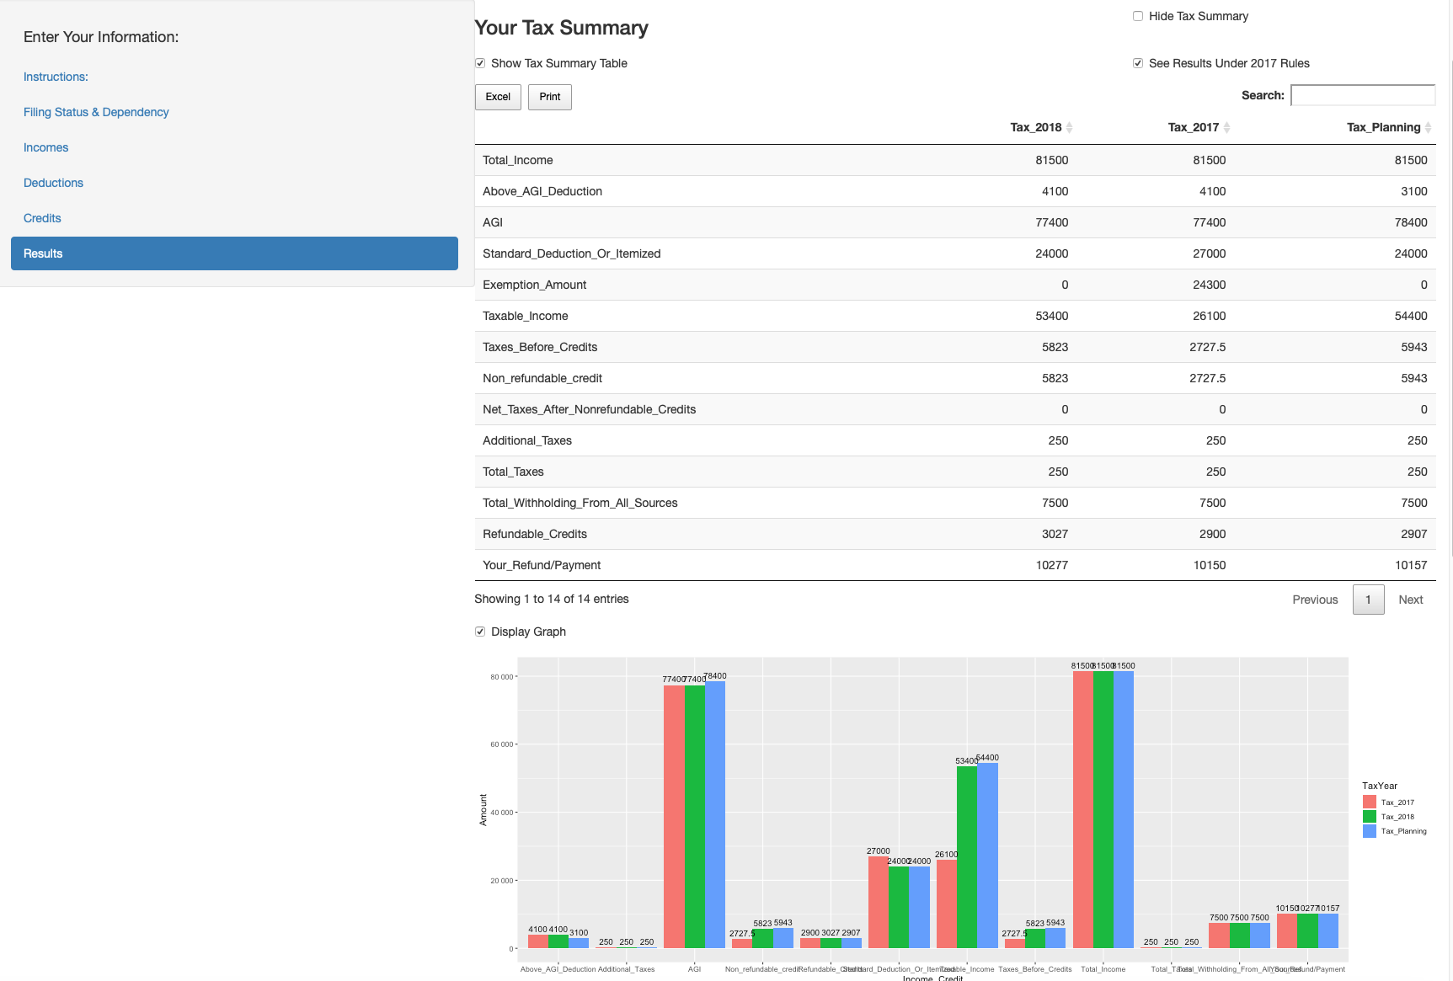

Slide 15
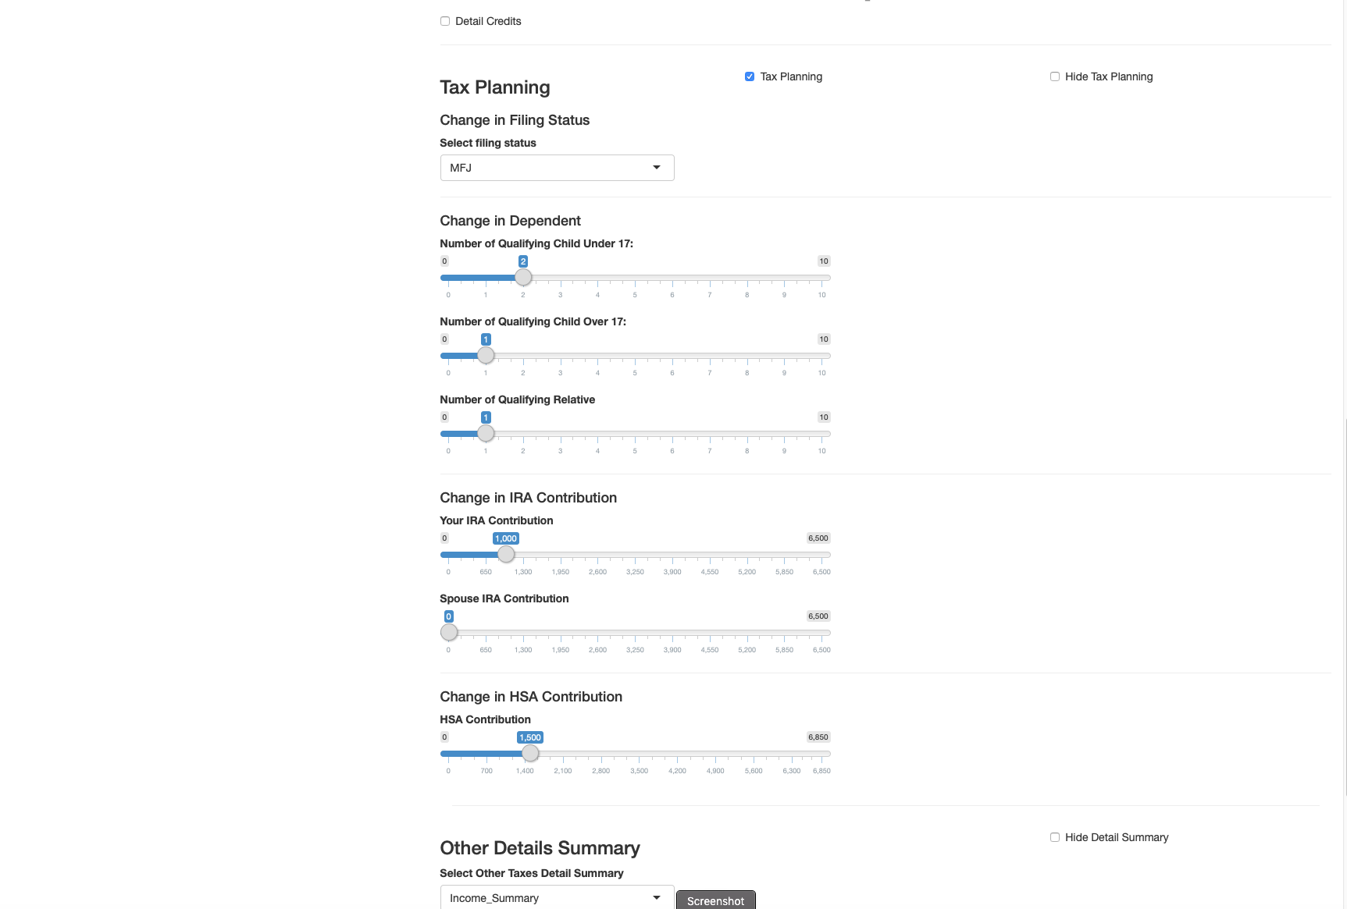

Slide 16
Result Tab - Continue
You can export each data table to Excel, or Print
Future version may include a one button that allows you to download all data into one Excel file.
The Information Summary tab on the navigation bar contains all information that you entered
Check either the Tax Planning box, or the 2017 Tax box would add another column into the Summary table.

Slide 17
Result Tab - Continue
Tax Planning:
Values such as filing status, numbers of dependents, IRA contribution amount, etc are automatically updated based on amounts you entered.
Update maximum HSA contribution based on your HSA plan, ages, and filing status.
Changes variables in this section will reflect on the Summary Table.
Uncheck the Tax Planning box will the column on the Summary Table and reset variable values back to 2018 values.

Slide 18
Tips
You can use the app to figure out the tax you may have to pay in 2019. Simply dividing the Total_Taxes as showed on the Summary table the remaining payments that you may receive from now till the end of the year.
You can use the app for planning to maximize your refund/ or minimize your tax liability. Some credits are based on AGI. By contributing to HSA, or IRA before April 15, you may reduce your tax enough to eligible for some credits.
Child tax credit in 2018 was $2000 per child. It’s still time to plan for this additional tax savings :D

Slide 19
Questions
Please send your questions to: datasciencecpa@gmail.com
Survey: Please take a few minutes of your time to complete a survey below:
https://www.surveymonkey.com/r/FBSYBGN
Video demonstration in Vietnamese: Link

