Slide 1
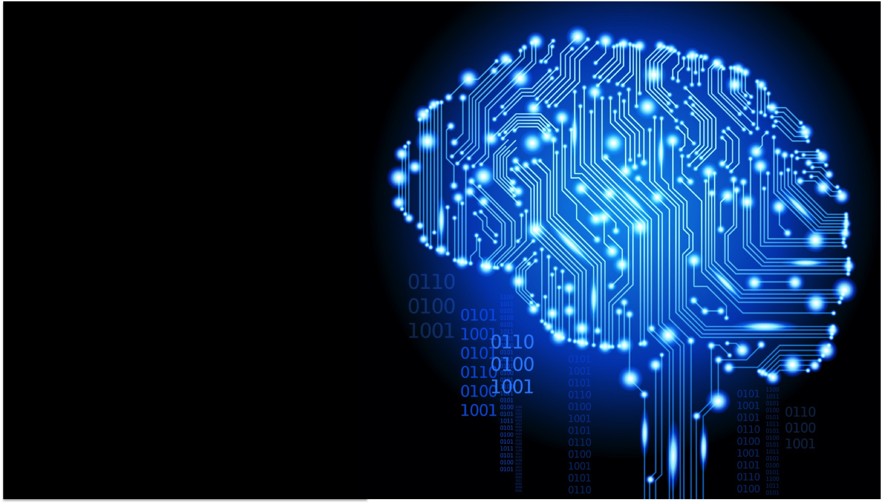
Machine Learning approach to solving real world problems
How to deploy your solution to use.

Slide 2
Agenda
Introduction
What are Application Programming Interfaces (API)?
Crafting a Machine Learning Model
Serialization & Deserialization of an ML model
Turning models to API with Flask
Testing that the API works
Questions and Answer

Slide 3
Introduction
What is machine learning?
A branch of AI that gives computer systems the ability to automatically learn and improve from experience, rather than being explicitly programmed.
In machine learning, computers use massive sets of data and apply algorithms to train on and make predictions.
Notes:
Supervised machine learning algorithms can apply what has been learned in the past to new data using labeled examples to predict future events. Starting from the analysis of a known training dataset, the learning algorithm produces an inferred function to make predictions about the output values. The system is able to provide targets for any new input after sufficient training. The learning algorithm can also compare its output with the correct, intended output and find errors in order to modify the model accordingly.
In contrast, unsupervised machine learning algorithms are used when the information used to train is neither classified nor labeled. Unsupervised learning studies how systems can infer a function to describe a hidden structure from unlabeled data. The system doesn’t figure out the right output, but it explores the data and can draw inferences from datasets to describe hidden structures from unlabeled data.
Semi-supervised machine learning algorithms fall somewhere in between supervised and unsupervised learning, since they use both labeled and unlabeled data for training – typically a small amount of labeled data and a large amount of unlabeled data. The systems that use this method are able to considerably improve learning accuracy. Usually, semi-supervised learning is chosen when the acquired labeled data requires skilled and relevant resources in order to train it / learn from it. Otherwise, acquiringunlabeled data generally doesn’t require additional resources.
Reinforcement machine learning algorithms is a learning method that interacts with its environment by producing actions and discovers errors or rewards. Trial and error search and delayed reward are the most relevant characteristics of reinforcement learning. This method allows machines and software agents to automatically determine the ideal behavior within a specific context in order to maximize its performance. Simple reward feedback is required for the agent to learn which action is best; this is known as the reinforcement signal.

Slide 4
Introduction
Categories of ML Models
Supervised machine learning algorithms can apply what has been learned in the past to new data using labeled examples to predict future events.
Unsupervised learning studies how systems can infer a function to describe a hidden structure from unlabeled data.
Reinforcement machine learning algorithms is a learning method that interacts with its environment by producing actions and discovers errors or rewards.
Notes:
Supervised machine learning algorithms can apply what has been learned in the past to new data using labeled examples to predict future events. Starting from the analysis of a known training dataset, the learning algorithm produces an inferred function to make predictions about the output values. The system is able to provide targets for any new input after sufficient training. The learning algorithm can also compare its output with the correct, intended output and find errors in order to modify the model accordingly.
In contrast, unsupervised machine learning algorithms are used when the information used to train is neither classified nor labeled. Unsupervised learning studies how systems can infer a function to describe a hidden structure from unlabeled data. The system doesn’t figure out the right output, but it explores the data and can draw inferences from datasets to describe hidden structures from unlabeled data.
Semi-supervised machine learning algorithms fall somewhere in between supervised and unsupervised learning, since they use both labeled and unlabeled data for training – typically a small amount of labeled data and a large amount of unlabeled data. The systems that use this method are able to considerably improve learning accuracy. Usually, semi-supervised learning is chosen when the acquired labeled data requires skilled and relevant resources in order to train it / learn from it. Otherwise, acquiringunlabeled data generally doesn’t require additional resources.
Reinforcement machine learning algorithms is a learning method that interacts with its environment by producing actions and discovers errors or rewards. Trial and error search and delayed reward are the most relevant characteristics of reinforcement learning. This method allows machines and software agents to automatically determine the ideal behavior within a specific context in order to maximize its performance. Simple reward feedback is required for the agent to learn which action is best; this is known as the reinforcement signal.

Slide 5
Introduction
What next after building your ML Model?
Most of the times, the real use of our Machine Learning model lies at the heart of a product.
There are two known options to implementing ML models in production:
Rewriting the whole code in the language that the software engineering guys work.
API- Web APIs have made it easy for cross-language applications to work well.
Notes:
There are two known options to implementing ML models in production:
Rewriting the whole code in the language that the software engineering guys work. However, majority of languages like JavaScript, do not have great libraries to perform ML. One would be wise to stay away from it.
API-first approach – Web APIs have made it easy for cross-language applications to work well. If a frontend developer needs to use your ML Model to create a ML powered web application, they would just need to get the URL Endpoint from where the API is being served.

Slide 6
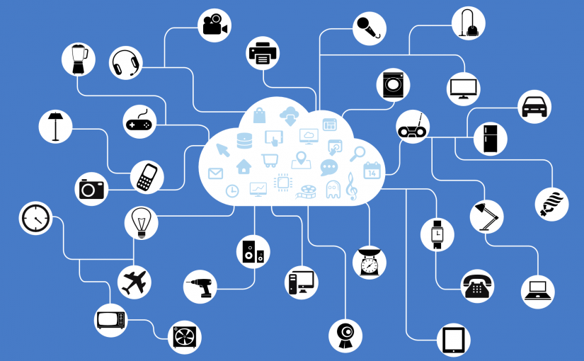
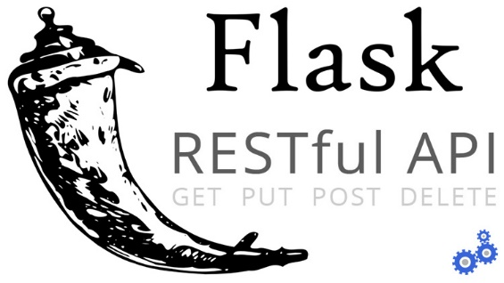
What are Application Programming Interfaces (API)?
In simple words, an API is a (hypothetical) contract between 2 softwares saying if the user software provides input in a pre-defined format, the later with extend its functionality and provide the outcome to the user software.
In this talk, we’ll understand how to create our own Machine Learning API using Flask, a web framework in Python.

Slide 7
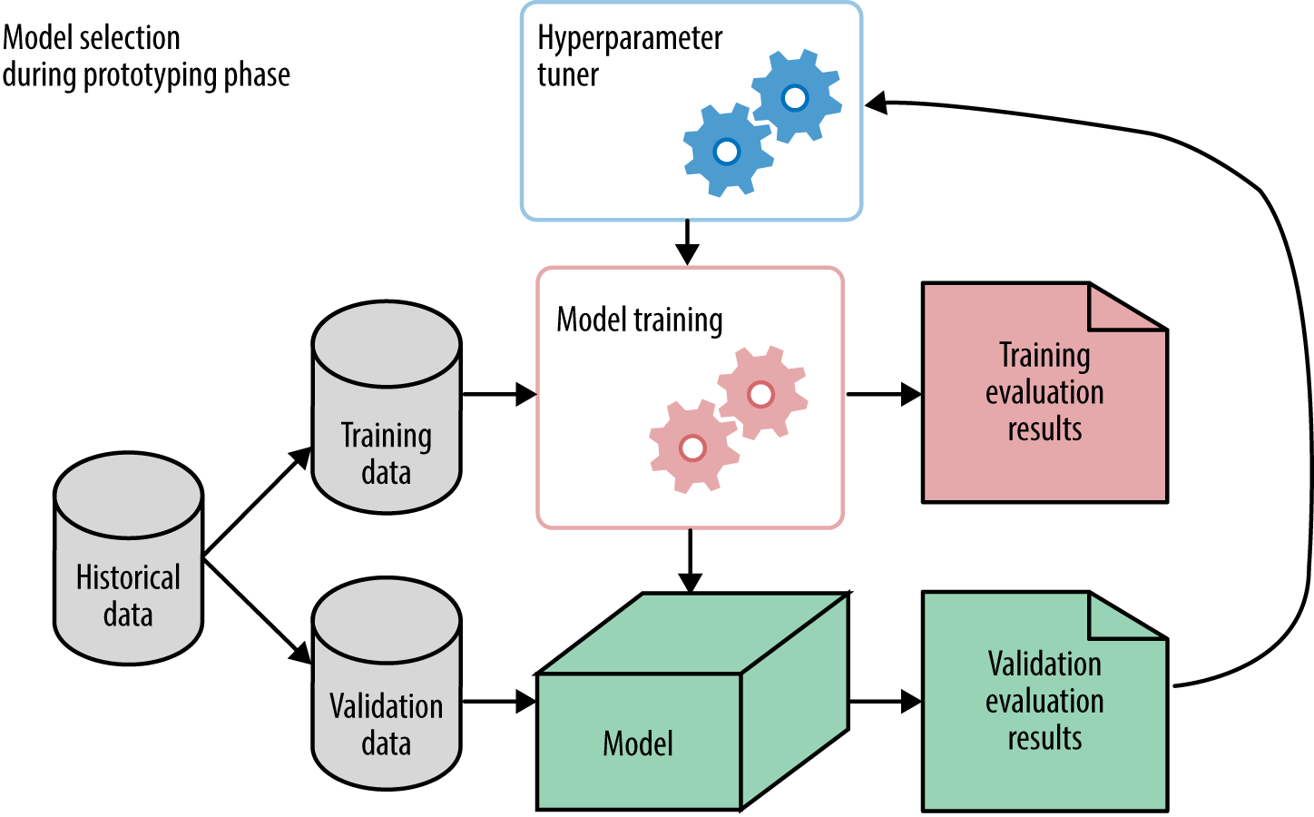

Crafting a Machine Learning Model

Slide 8
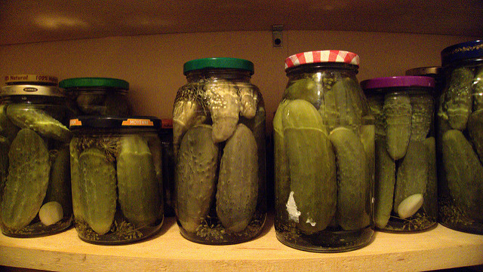
Serialization & Deserialization of an ML model
In Python, pickling is a standard way to store objects and retrieve them as their original state.

Slide 9

Turning models to API with Flask
There are three important parts in constructing our wrapper function, api():
Getting the request data (for which predictions are to be made)
Loading our pickled estimator
jsonify our predictions and send the response back with status code: 200
Notes:
HTTP messages are made of a header and a body. As a standard, majority of the body content sent across are in json format. We’ll be sending (POST url-endpoint/) the incoming data as batch to get predictions.

Slide 10
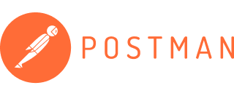
Testing that the API works
We will test our RestAPI using Postman.
Notes:
HTTP messages are made of a header and a body. As a standard, majority of the body content sent across are in json format. We’ll be sending (POST url-endpoint/) the incoming data as batch to get predictions.

Slide 11
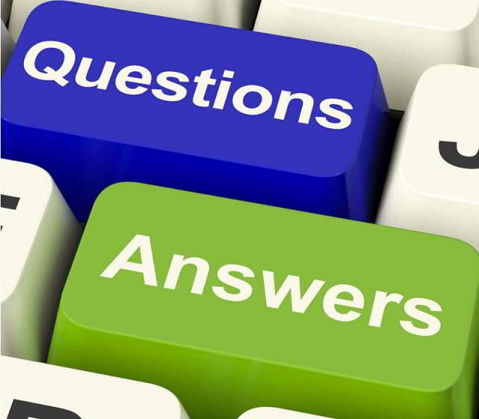
Notes:
HTTP messages are made of a header and a body. As a standard, majority of the body content sent across are in json format. We’ll be sending (POST url-endpoint/) the incoming data as batch to get predictions.

